Slide 1
Overview of the 1% Requirement and Maine's Alternate Assessments based on Alternate Academic Achievement Standards (AA-AAAS)
September 11th, 2023
Jodi Bossio-Smith, Assessment Team
Leora Byras, Special Projects Team

Slide 2
Housekeeping
The session is being recorded. The link to the recording, slides, and Q&A documents will be shared via email to all participants and Directors by the beginning of next week.
We will have time for questions at the end of the session. Please record your questions utilizing the Q&A feature at the bottom of your zoom screen, or you can raise a virtual hand at the end of the presentation.

Slide 3
Learning objectives
Participants will develop an understanding of:
What are the federal and state requirements when it comes to assessment, including assessment of students with the most significant cognitive disabilities?
2. Why does participation matter?
2
Notes:
The goals for today are to:

Slide 4
Learning objectives
Participants will develop an understanding of:
3. Who is eligible for alternate assessments based on alternate academic achievement standards, and what are those standards?
4. What role does this play in IEP development and general supervision and monitoring?
5. What does the timeline look like for AA-AAAS this year in Maine, and what resources are available?
2
Notes:
The goals for today are to:

Slide 5
Objective 1
1. What are the federal and state requirements when it comes to assessment, including assessment of students with the most significant cognitive disabilities?

Slide 6
Objective 1
Two federal laws, the Elementary and Secondary Education Act (ESEA), known as the Every Student Succeeds Act (ESSA, 2015), and the Individuals with Disabilities Education Act (IDEA), require that all students in specified elementary, middle, and high school grade ranges participate in state assessments each year. To ensure that all students are tested and that appropriate assessment accommodations are provided as needed, these laws include assessment participation rate requirements for states to follow (U.S. Department of Education, 2016)

Slide 7
Objective 1
Federal regulations are in place to ensure that all students, including students with disabilities, are included in statewide assessment participation. For students with disabilities, section 300.160 of IDEA calls for states to make certain that all children with disabilities are included in all general state and districtwide assessment programs, including assessments described under section 1111 of ESEA, 20 U.S.C. 6311, with appropriate accommodations and alternate assessments, if necessary, as indicated in their respective individualized education programs (IEPs).

Slide 8
Objective 1
Section 1111(c)(4)(E) of ESEA reinforces testing for all students, stipulating that states must assess at least 95 percent of all students, as well as 95 percent of students in each subgroup, including English learners and children with disabilities, with federally approved statewide academic content assessments to meet federal accountability requirements. States are required to administer assessments: in reading/language arts and mathematics annually in grades 3–8 and once in high school; in science once in each grade span (elementary, middle, and high school); and for annual English language proficiency in grades K–12 for all English learners.

Slide 9
Objective 1
With respect to alternate assessments for students with the most significant cognitive disabilities, measure student performance based on alternate academic achievement standards defined by the State consistent with section 1111(b)(1)(E) of the Act that reflect professional judgment as to the highest possible standards achievable by such students to ensure that a student who meets the alternate academic achievement standards is on track to pursue postsecondary education or competitive integrated employment, consistent with the purposes of the Rehabilitation Act of 1973, as amended by the Workforce Innovation and Opportunity Act, as in effect on July 22, 2014.

Slide 10
Objective 2
2. Why does participation matter?

Slide 11
Objective 2
States are required to coordinate educational services with the requirements of Workforce Innovation & Opportunity Act.
States must demonstrate for the federal assessment peer review that students with disabilities who meet the state's alternate academic achievement standards are on track to:
pursue postsecondary education, or
competitive integrated employment

Slide 12
Objective 2
Competitive, integrated employment: ...full-time or part time work at minimum wage or higher, with wages and benefits similar to those without disabilities performing the same work, and fully integrated with co-workers without disabilities. (34 CFR §§361.5(c)(9)(ii) and 361.5(c) (32)(ii))
Do you know of students who have participated in alternate assessments who are now in competitive, integrated employment or in supported employment? What knowledge and skills, including literacy, math and science content knowledge and skills, do you think helped them achieve this employment?

Slide 13
Objective 2
Participation in state assessments is a matter of educational equity
Full participation in the assessment program is an important means to ensure that the public education system is delivering on the promise of high academic expectations and college and career readiness for each and every student.

Slide 14
Objective 2
Preliminary Data Indicates that in Spring 2023:
Content Area | Participation Rate | Students Eligible | Students Participated
Math | 78.28% | 806 | 631
ELA/literacy | 77.79% | 806 | 626

Slide 15
3. Who is eligible for alternate assessments based on alternate academic achievement standards, and what are those standards?

Slide 16
Objective 3
A child with a Disability is an Individual Who –
•Has reached the age of 3 years;
•Has neither graduated from a secondary school program with a regular HS diploma nor reached nor reached 20 years of age at the start of the school year;
•Has been observed in the learning environment/classroom setting; and
•Has been evaluated according to these rules and has been determined to have a disability which requires the provision of special education and supportive services.
•A child with a disability shall have one or more of the disabilities listed in MUSER VII.2.A-M

Slide 17
Objective 3
IDEA/MUSER Disability Categories
Autism Developmental Delay (3-5) Hearing Impairment Other Health Impairment Specific Learning Disability Deaf-Blindness Developmental Delay (K) Intellectual Disability | Orthopedic Impairment Traumatic Brain Injury Deafness Emotional Disturbance Visual Impairment (including Blindness) Speech/Language Impairment Multiple Disability

Slide 18
Objective 3
In order for an IEP Team to determine a child eligible for Specially Designed Instruction (SDI), the evaluations must show and "ADVERSE EFFECT" on their ability to access FAPE.
Maine requires the use of at least 1 Eligibility Form to document adverse effect:
Determination of Adverse Effect
Specific Learning Disability Eligibility Form
Speech or Language Impairment Eligibility Form

Slide 19
Objective 3
In order to qualify for the Alternate Assessment, the IEP Team must determine that the student exhibits a
"Significant Cognitive Disability".
A student with significant cognitive disability is a student that has been identified with one or more of the existing categories of disability under the IDEA, and displays an intellectual functioning much below the average student, that exists parallel to significant deficits in adaptive behavior. Students with a significant cognitive disability require extensive instruction with goals and objectives connected to Maine’s alternate achievement standards. [AAS]

Slide 20
Objective 3
After the IEP Team determines the child exhibits an adverse effect on their ability to access FAPE, the team must determine which assessment is most appropriate for the student.
Maine requires the use of the:
"Participation Decision Flowchart" to guide that determination.
The decision is then documented in section 6B of the IEP.

Slide 21
Participation Decision Document
Notes:
This document provides a checklist that can be used to prepare evidence to justify a student’s participation in the alternate assessments. Please remember, they may also be areas that justify why a student should not participate in the alternate assessments.

Slide 22
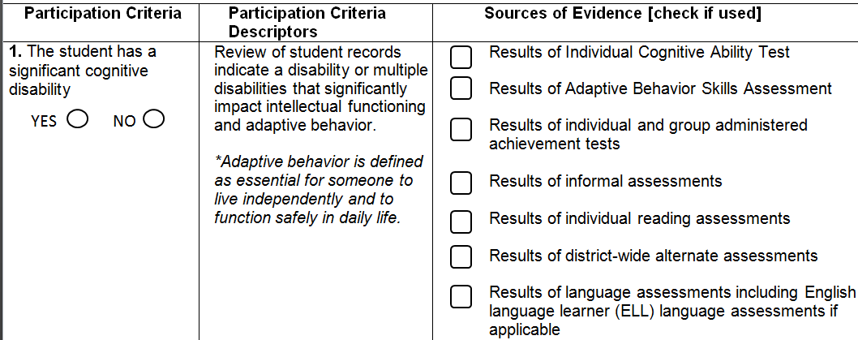
The Student has a Significant Cognitive Disability
Formal and informal informative tests – Achievement tests
Psychological reports – WIAT - WISK
Adaptive Behavior assessments - Vineland
Notes:
Lets take a closer look. This is a great document to use to record individual students’ justification.

Slide 23
Learning is Linked to Rigorous Standards
Artifacts here include;
Work samples
Progress monitoring data
Research-based interventions (RTI)
Present levels of academic and functional performance – goals - objectives
Notes:
Goals and instruction are linked to the enrolled grade level standards. Can this student access instruction which incorporates the Maine Learning Results with accommodations, supports and or other adapted features? Does this student need to have goals and objections written with less depth and breadth, linked to and derived from the Maine Learning Results?

Slide 24
Intensive Direct Individualized Instruction
Artifacts here include;
Work samples
Data
Checklists
Present levels of academic and functional performance – goals - objectives
Notes:
The student needs intensive direct individualized Instruction with substantial support to achieve measurable gains in grade level curriculum.
Another need might be adapted materials and other individualized ways to acquire and maintain growth.
Here are some examples.

Slide 25
Maine Alternate Participation Guidance
Notes:
This slide looks at part of the participation guidance on page 5 of the guidance. These are areas for the IEP team to consider…

Slide 26
3. Who is eligible for alternate assessments based on alternate academic achievement standards, and what are those standards?

Slide 27
Objective 3
Multi-State Alternate Assessment
MSAA
Administered in grades 3-8 and 3rd year of High School
Content areas of math, ELA/literacy, and science (Science is only administered in Grades 5, 8 and 3rd year of HS)
Designed around the state’s alternate academic achievement standards

Slide 28
Objective 3
Alternate academic achievement standards are not “alternate standards” for students with significant cognitive disabilities.
These are derived from state standards (CCSS), significantly reduced in breadth and complexity for this population of students. The AAAS provide an entry point and pathway for the students to continue to work towards grade level content. These also ensure we are holding the promise and responsibility of high academic expectations and college or career readiness.

Slide 29
Objective 3
What does an AAAS look like in comparison to a regular grade level standard?

Slide 30
Objective 3
What does an AAAS look like in comparison to a regular grade level standard?

Slide 31
Objective 3
And what does that AAAS then look like on the MSAA?

Slide 32
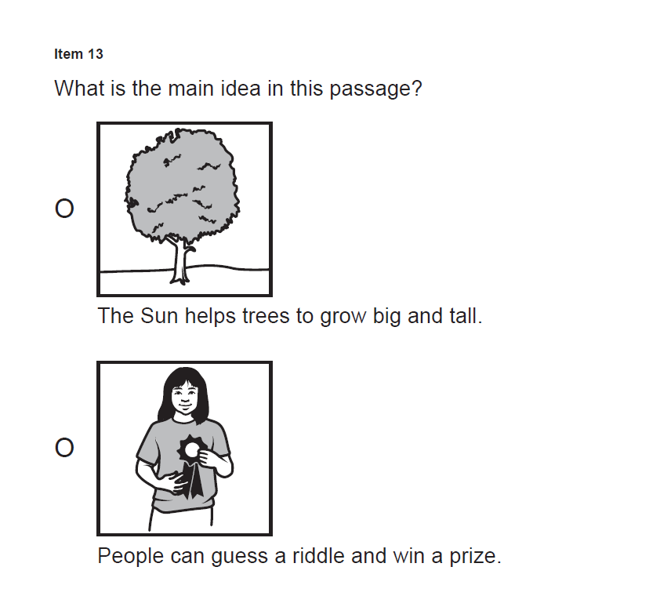
Objective 3

Slide 33
Objective 3
The purpose of state assessments is to provide a measure of what students know and can do in relation to grade-level content.
The instruction informs the assessment design, not the other
way around

Slide 34
Objective 3
MSAA
Maine partners with 10 other entities as part of the MSAA Consortium:
Arizona
Bureau of Indian Education
South Dakota
Montana
Department of Defense Educational Activity (DoDEA)
Guam
American Samoa
Northern Mariana Islands
Vermont
Washington, D.C.

Slide 35
Objective 3
MSAA
Educators from all participating entities in the MSAA Consortium, including Maine, have the opportunity to participate in the ongoing assessment development
Item review committees
Standard Setting
Bias/Sensitivity Reviews
… the expertise of Maine educators serving Maine students with significant cognitive disabilities is an invaluable asset to the MSAA Program

Slide 36
Objective 3
MSAA
A highly accommodated form with accessibility features embedded, including:
Test is read aloud to the student by the Test Administrator
Test is administered in a 1:1 setting
Frequent breaks, repetition of directions, text and response options, all as needed
Resource sheets included as part of the Directions for Test Administration (DTA)
Opportunity to utilize supports that are regularly incorporated into student’s instructional routine

Slide 37
Objective 3
MSAA
Stage adaptive – Students begin with Session 1 and are routed to Session 2 at varying levels of complexity based on Session 1 performance.
Default administration is computer or tablet. Can also be administered as a paper-based or special form, or mixed modality, based upon student need and IEP accommodations.
Math, ELA and Science are administered within the same platform. More in a bit about the timeline for this!

Slide 38
4. What role does this play in IEP development and general supervision and monitoring?

Slide 39
Objective 4
IEP Requirements for Eligible Students

Slide 40
Objective 4
IEP Requirements for Eligible Students

Slide 41
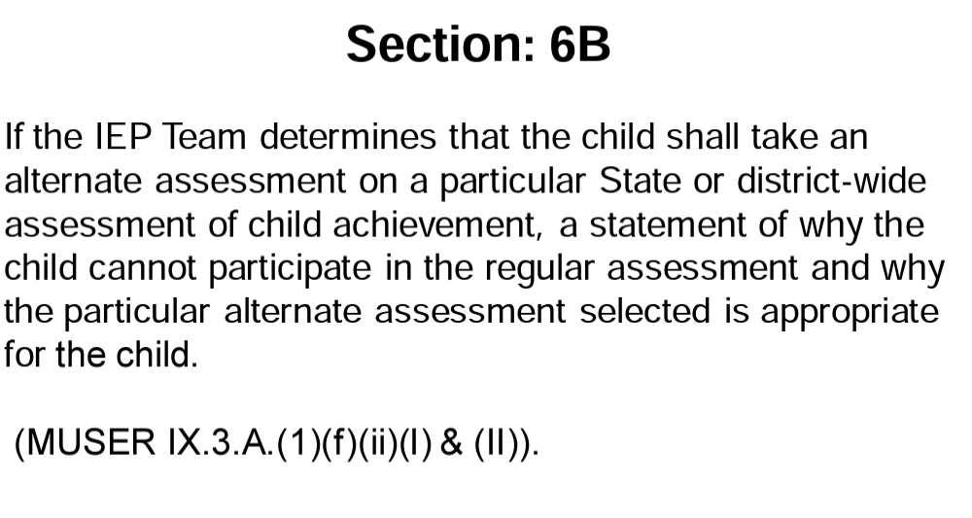
Objective 4
IEP Requirements for Eligible Students

Slide 42
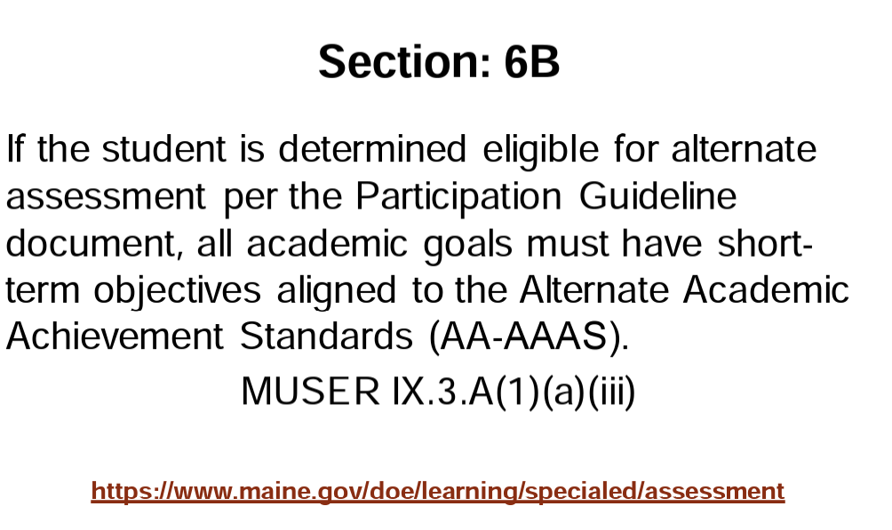
Objective 4
IEP Requirements for Eligible Students

Slide 43
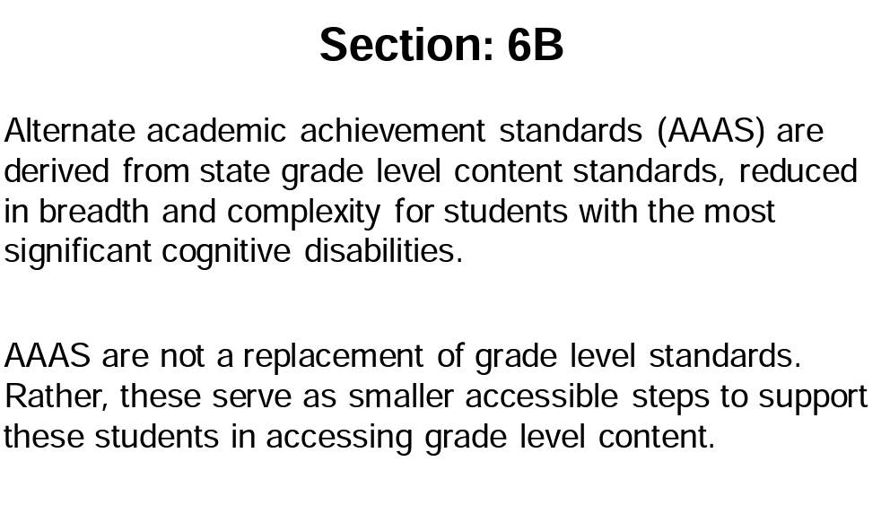
Objective 4
IEP Requirements for Eligible Students

Slide 44
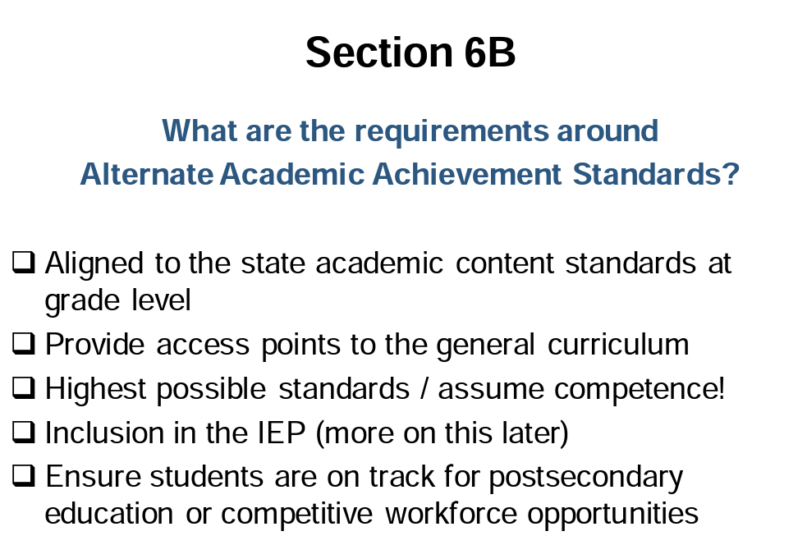
Objective 4
IEP Requirements for Eligible Students

Slide 45
Objective 4

Slide 46
5. What does the timeline look like for AA-AAAS this year in Maine, and what resources are available?

Slide 47
Objective 5
August-September-October: SAUs need to confirm that all students eligible for AA-AAAS participation have the alternate assessment box “checked” via Synergy. This field does not carry over from year to year.

Slide 48
Objective 5 (Timeline Continued)
October 2023
SAUs finalize enrollment including alternate assessment flags
Alternate Academic Achievement Standards virtual training
ME DOE prepares individualized action plans for Maine SAUs

Slide 49
Objective 5
Maine SAUs will receive customized action plan templates including AA-AAS participation data
Action Plans include the following components:
Participation rate and justification of non-assessed students
1% Calculation for Spring 2023
Justification of overage
4. Percentage goal to achieve within one year
Action plan – outline of proposed strategies
Opportunity to request Maine DOE support

Slide 50
Objective 5 (Timeline Continued)
November 2023
SAUs receive customized action plans, Action Planning webinar
MSAA Test Coordinators Training, Test Coordinator Survey
December 2023
SAUs return action plans to Maine DOE

Slide 51
Objective 5 (Timeline Continued)
January 2024
Maine DOE completes initial upload of students to MSAA Platform
MSAA Test Administrator Training
February 2024
MSAA Test Coordinator and Test Administrator trainings
TCs gain access to the MSAA Platform

Slide 52
Objective 5 (Timeline Continued)
March 2024
Maine DOE completes final upload of students to MSAA Platform (to identify any enrollment changes from Jan-March)
MSAA administration window opens March 11th
April 2024
MSAA administration window closes on April 26th

Slide 53
Objective 5 (Timeline Continued)
July 2024
District, school and student results reports become available (Test Coordinators with logins can access) within the MSAA Platform

Slide 54
Any
Questions?
Jodi Bossio-Smith, Director of Assessment
Office of Federal Programs, jodi.bossio-smith@maine.gov
Leora Byras, Educational Specialist
Office of Special Services & Inclusive Education, leora.byras@maine.gov

