Slide 2
Follow
GaDOE Social Studies on Social Media
@GaDOE_SS
GADOE Social Studies
gadoesocialstudies

Slide 3
Agenda
Inquiry & Read Alouds: Where does it fit?
Tips for Integrating Read Alouds 6-12
Specific Examples
A Few of my Favorite Books
Read Alouds in Distance Learning
Where to Find Additional Titles
We Need Your Feedback!

Slide 4
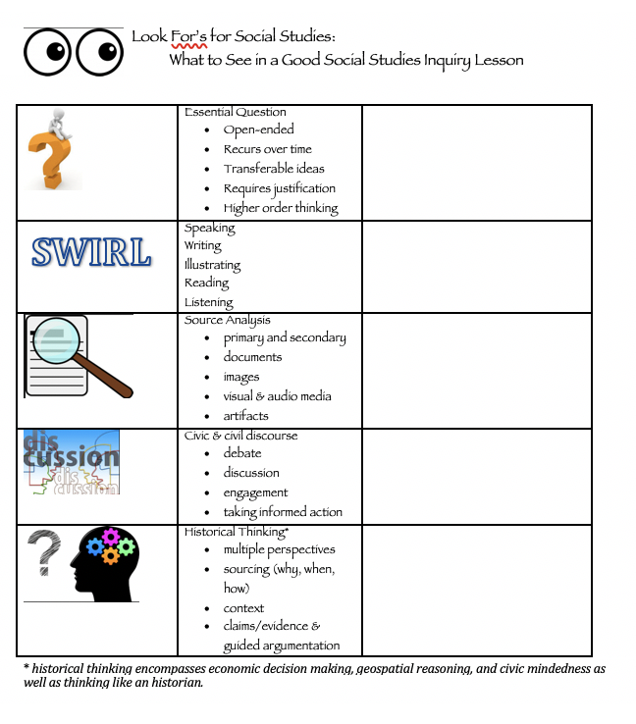
Inquiry & Read Alouds: Where does it fit?

Slide 5
Process for Integration
Why choose this book? What does it offer?
This will determine how I use the book
Connecting Theme/Enduring Understanding
Develop a Good Question (McTighe & Wiggins)
Create the Task

Slide 6
Introducing a Unit
EQ: What is the art of war?
Clarify the Question:
war- conflict, fighting, international-between countries, civil, internal, tensions, propaganda, persuasive techniques, misinformation
Art- expression, illustrations, feelings, emotions, color, shape, music, theatre, how you do something, skill

Slide 7
Activity: 30 Seconds
This is an individual activity. Do not talk for the until instructed to do so.
Select someone to be your timer.
Once everyone has the image: Stare at the painting for 30 seconds without writing.
After time is up: Silently write everything you observed in the image for 60 seconds.
Discuss the image in your small group.
What was the first thing you saw?
What colors do you see? Could they mean something?
What items are in the image?
What time period does it represent?
What did people at your table see that you missed?
What else did you see that relates to the supporting or essential question?
Individually, write your response to the following question: How does this image help answer the essential question? (be sure to justify your response with evidence from the source)

Slide 8
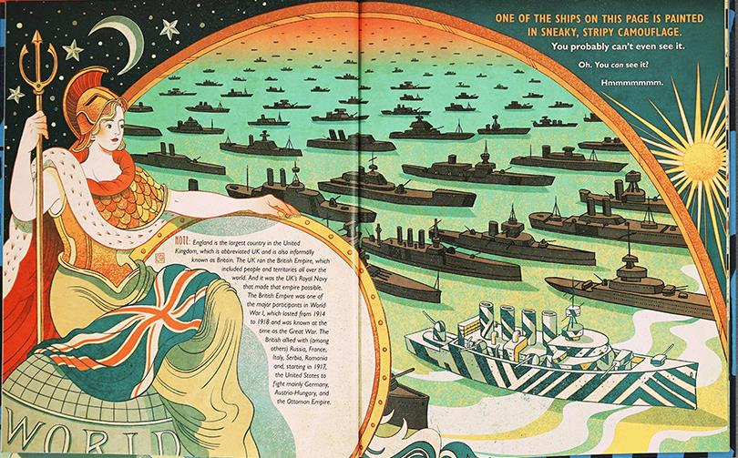
What is the art of war?
Prediction

Slide 9
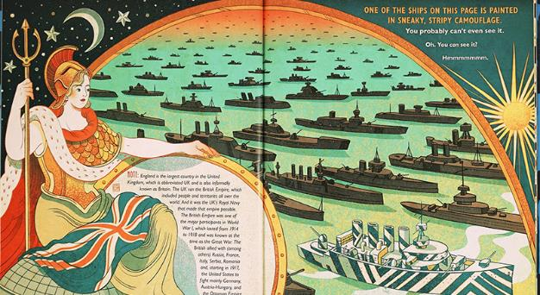
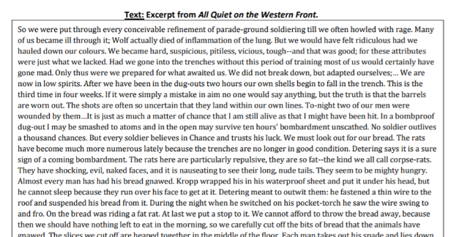
Prediction – visual analysis strategy
Common narrative
Spark Interest
Paired with document set including excerpt from All Quiet on the Western Front

Slide 10
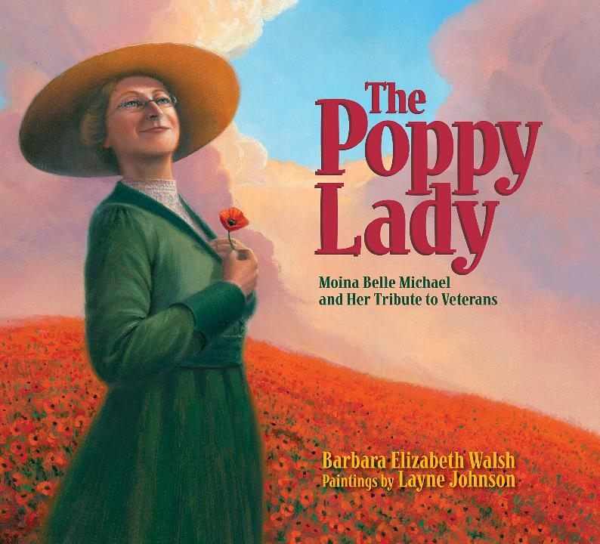
During the Unit
I choose this book because it shows a variety of domestic efforts by women during WWI.
It has a GA connection.
Information about the home front is evident in primary sources.

Slide 11
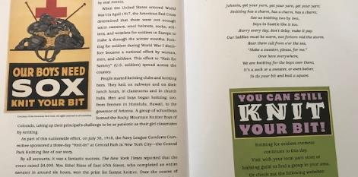
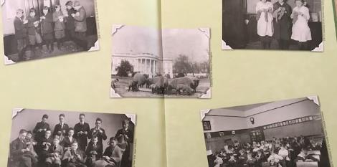
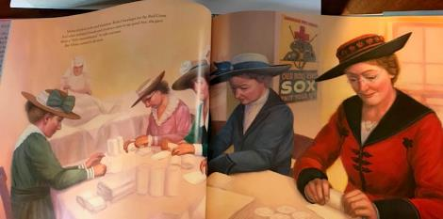
EQ: How does the warfront affect the home front?
Task
Set up a research activity:
College
Red Cross
Knitting for soldiers
Greeting soldiers
Canteen Worker
Help soldiers emotionally
Honoring the dead – Flanders Field
Prompt a writing activity.
Letter to a soldier
Connection to any modern wars, COVID-19

Slide 12
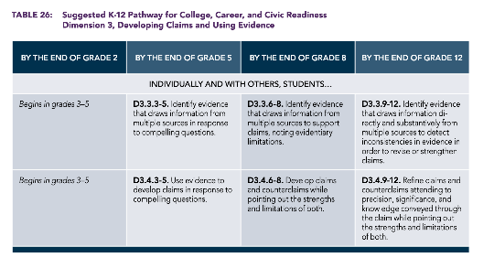
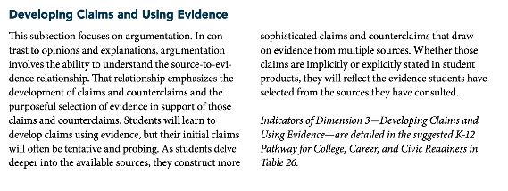
https://www.socialstudies.org/sites/default/files/c3/C3-Framework-for-Social-Studies.pdf – C3 Framework, NCSS, p. 55

Slide 13
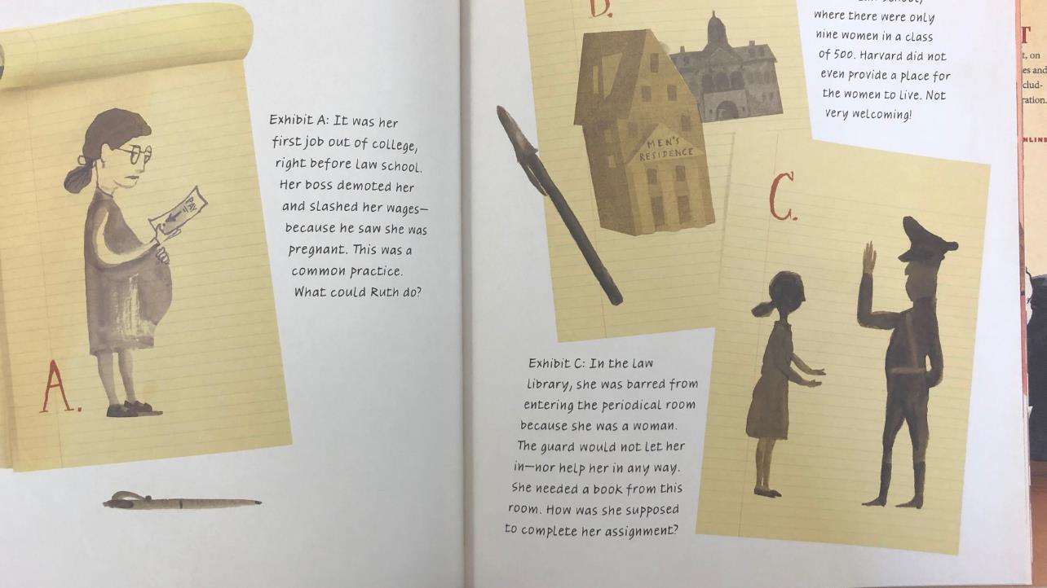
What freedoms are worth fighting for?
Evaluate the argument!
What is the claim/argument?
What evidence is given to support it?

Slide 14
Ideas for Ruth Bader Ginsburg: The Case of R.B.G. vs. Inequality by Jonah Winter (Author), Stacy Innerst (Illustrator)
Argument Analysis | Start off the unit with this book Create the argument-evidence chart After each lesson, have student review new sources to determine if the evidence is corroborated or if a counter argument can be made
Writing/Reading/Illustrating connections | Annotation – focus on unfamiliar words/phrases Write an argument supported with evidence Create a picture book that makes an argument from this unit
Visual Analysis | 30 Seconds – How does the illustrator support the text with the images on these pages?
Chronology and Context | Have students create a timeline of events from the book and correlate them to the context of the unit. While RBG was deciding to become a lawyer, McCarthy was instigating a communist witch hunt in the U.S.

Slide 15
Pairing Titles

Slide 16
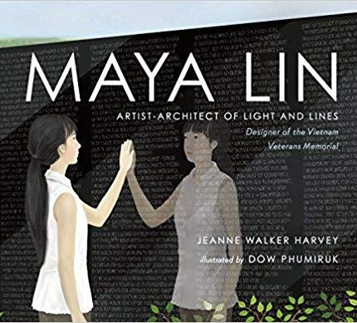
Introducing the book
How do we remember important events or people in our lives?
What do we mean by remember?
What are memorials?
What kinds of memorials do we have in our neighborhood, community, town, state, or country?

Slide 17
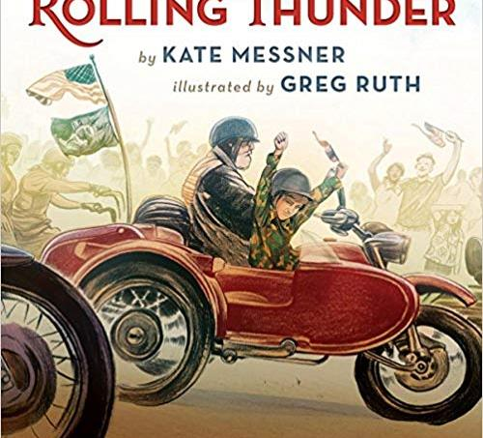
Introducing Rolling Thunder
How do we remember important events or people in our lives?
What is a veteran?
How and why do we remember veterans?
What does it mean to honor someone?
How does this book connect to the book about Maya Lin?

Slide 18
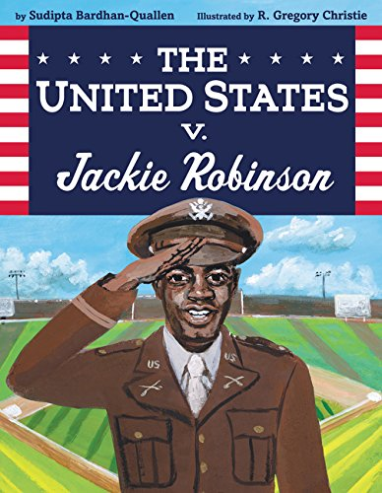
The United States v. Jackie Robinson
Written by: Sudipta Bardhan-Quallen
Illustrated by: R. Gregory Christie
Jackie Robinson broke boundaries as the first African American player in Major League Baseball. But long before Jackie changed the world in a Dodger uniform, he did it in an army uniform. As a soldier during World War II, Jackie experienced segregation every day—separate places for black soldiers to sit, to eat, and to live. When the army outlawed segregation on military posts and buses, things were supposed to change. So when Jackie was ordered by a white bus driver to move to the back of a military bus, he refused. Instead of defending Jackie’s rights, the military police took him to trial. But Jackie would stand up for what was right, even when it was difficult to do.

Slide 19
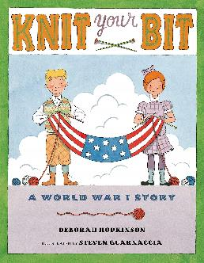
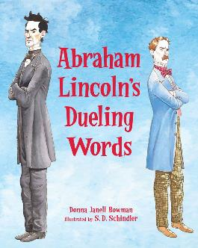
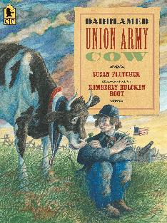
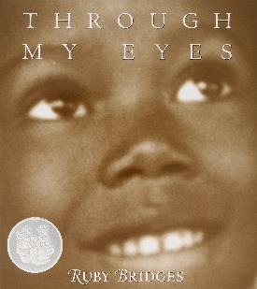
Ways to Use Literature in 6-12
Before Teaching:
Build background knowledge
Create a common narrative
Making Predictions
During Teaching
Selected passages as a primary or secondary source
Making connections
Visualizing learning
Visual Literacy
After Teaching
Evaluating learning
Synthesizing learning

Slide 20
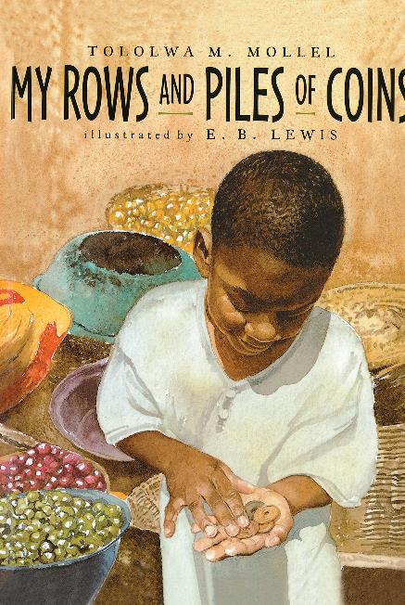
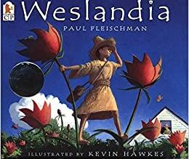
My Favorite Read Alouds for Economics

Slide 21
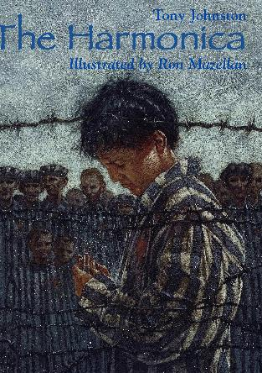
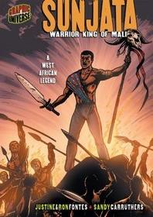
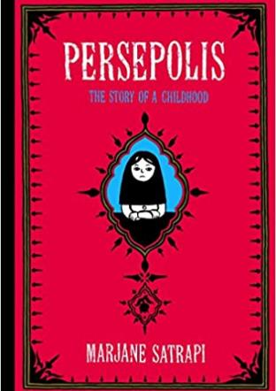
World History

Slide 22
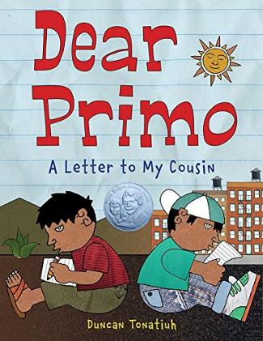
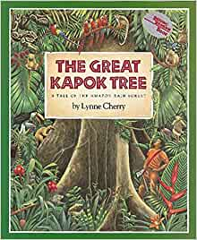
World History/Geography

Slide 23
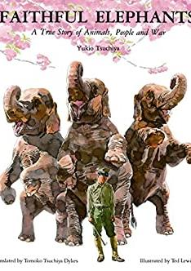
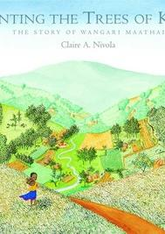
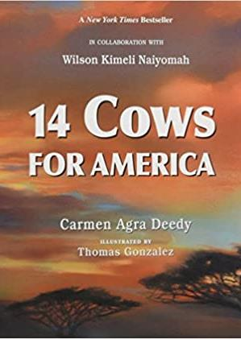
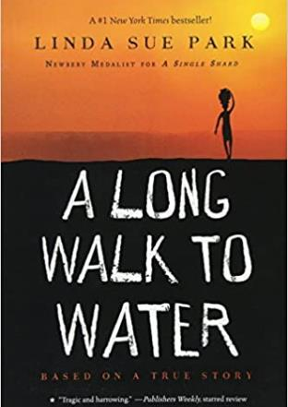
World History/Geography

Slide 24
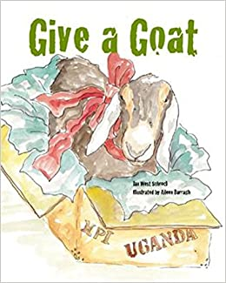
World History/Geography Civic Action

Slide 25
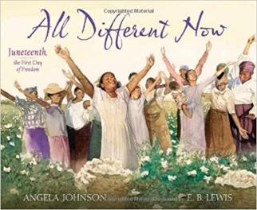
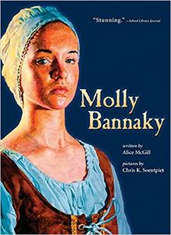
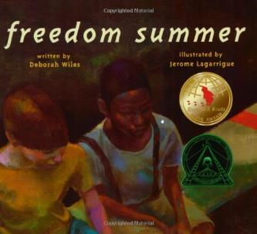
I Love These!

Slide 26
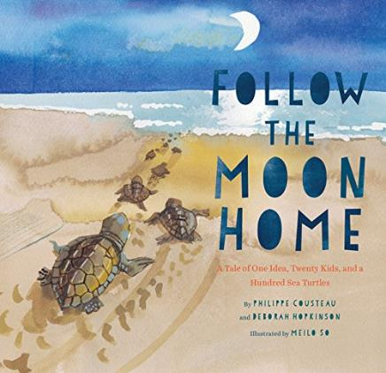
Civic Action

Slide 27
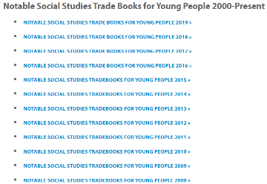
Where to find titles
https://www.gcss.net/site/page/view/childrens-literature
https://www.socialstudies.org/publications/notables
US History

Slide 28
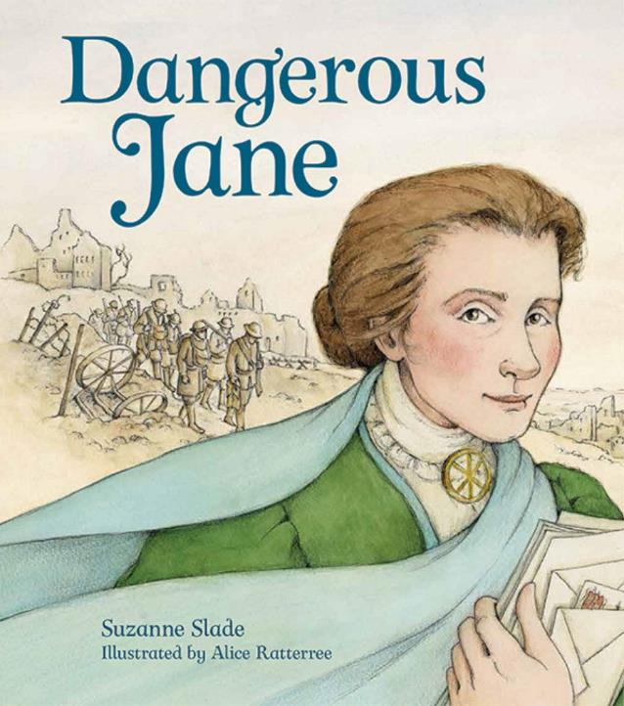
WHY we want to read aloud? Because we can help our students to…
Change attitudes about books and reading and foster a love of reading.
Listen to and comprehend a book on a significantly higher level than if they were reading silently.
Stimulate language development.
Understand characters better, including themselves.
Go beyond stereotypes and become more tolerant of differences in the world.
Become part of a thoughtful classroom community through the deep reflection and discussion a great read-aloud can promote.
Value the role of stories in our lives.
Steven L. Layne, 2015

Slide 29
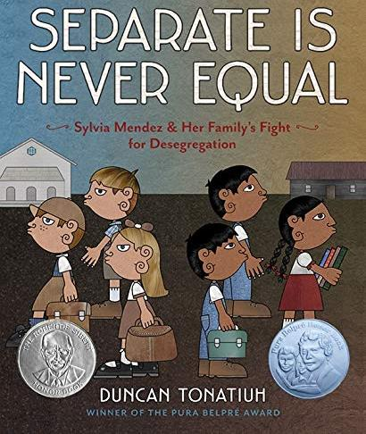
What the Research Says (a small sampling)
Reading aloud improves our students’:
Vocabulary acquisition (Beck and McKeown, 2001, Kindle 2009, McGee and Schickedanz 2007, Routman, 2003, etc.)
Comprehension (Elster 1994, Knoth 1998, Kraemer, MccCabe, and Sinatra 2012; Richardson 2000, etc.)
Engagement (Albright and Ariail 2005, Morrison and Wlodarczyk 2009)
Attitudes (Braun 2010, Krashen 2004, Layne 2009. Trelease 2013)
Understanding of text types (Donovan, Milewicz, and Smolkin 2003)
Ability to become more culturally sensitive (Irvine and Armento 2001, Morgan 2009, Routman 2003, Verden 2012)
Rapport with the teacher and classmates (Atwell 2007, Pardeck 1990, Routman 2003)
Previous research, especially that of Becoming a Nation of Readers, the landmark study of 1985, laid a firm grounding for the high value and return for reading aloud across the curriculum to our students, k-12.
Review good read aloud strategies with Lester Laminack’s Unwrapping the Read-Aloud, Read Alouds Across the Curriculum, and his article, “Read Aloud Often and Well” published by NCTE in 2017. https://secure.ncte.org/library/NCTEFiles/Resources/Journals/VM/0244-may2017/VM0244Read.pdf

Slide 30
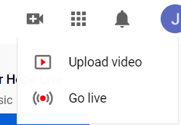
1. Create a Free Account
2. To upload your mp4 click the video camera
3. Select upload video

Slide 31
4. Drag and Drop or Select your mp4

Slide 32
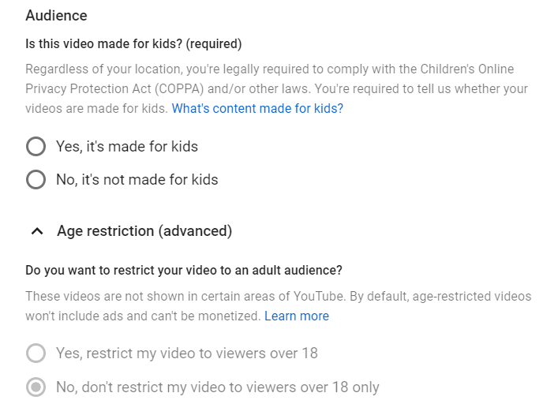
5. Give your video a title and description

Slide 33
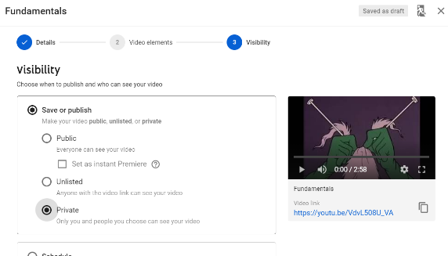
6. Privacy is the Last Page

Slide 34
Remember that you matter

Slide 35
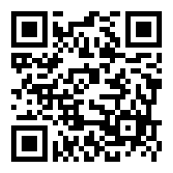
Please take a moment to give some feedback on today’s session.
https://forms.gle/i37at9uYGMznfQcr8
Name of session:
Getting More Bang for Your Book in Social Studies 6-12
Joy Hatcher
jhatcher@doe.k12.ga.us

