Slide 1
Module 8
Feedback, Assessment,
and Grading

Slide 2
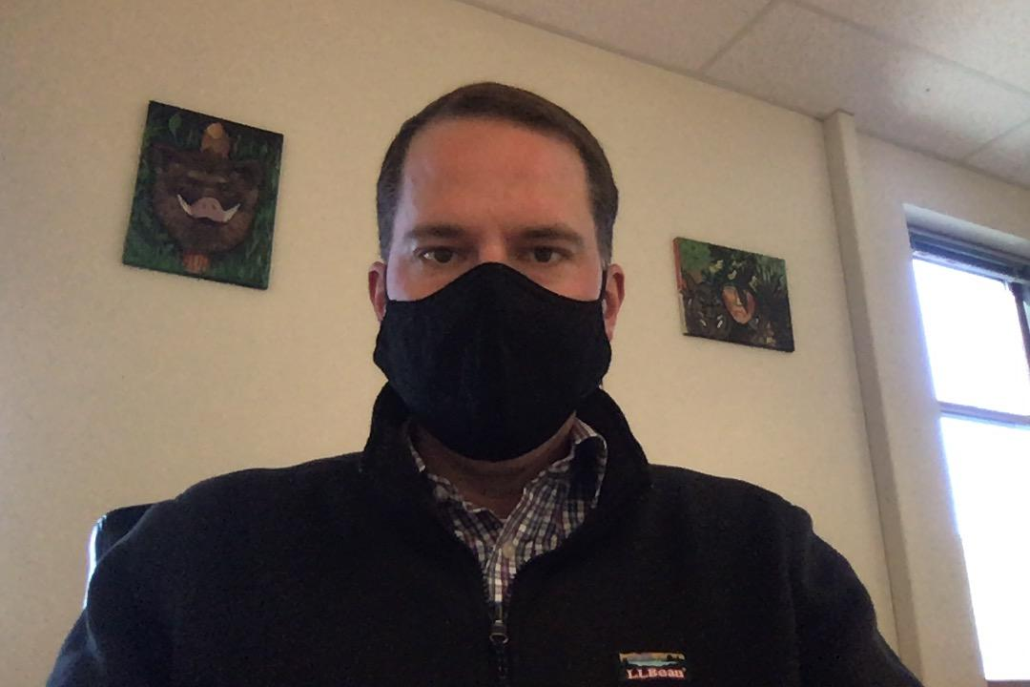
Hello!
Mr. Brandon Terrill
English Teacher
Hall-Dale High School
M.S.Ed. Educational Leadership, UMaine-Farmington
Concentration: Proficiency-Based Education
bterrill@kidsrsu.org

Slide 3
Module 8
Learning Intentions
I am learning about feedback and its applications in distance learning.
I am learning about the relationship between feedback and formative evaluation.
I am learning about unique considerations distance learning poses to summative evaluation.
I am learning about competency-based grading.

Slide 4
Feedback has been described as the most underutilized instructional approach we teachers have at our disposal”
(Fisher & Frey, 150)

Slide 5
.66
The Effect Size of Feedback is likely to have a positive impact on student learning (average=.40).

Slide 6
What makes feedback effective?
High Information Feedback
Information about Processes and Self-Regulation
Corrective Feedback
+
=

Slide 7
Feedback has higher impact on cognitive and motor skills outcomes than on motivational and behavioral outcomes”
(Fisher & Frey, 153).

Slide 8
Useful Feedback Addresses the
3 Major Questions Learners Have...
Where am I going?
Learning Intentions and Success Criteria
How am I going there?
Strategies to close the gap between student performance and success criteria
Where will I go next?
Future actions

Slide 9
20%
In a study, Zumbrunn and her colleagues (2016) found...
of Middle/High School students disregarded feedback on their writing because they didn’t have a good relationship with their teacher.

Slide 10
The Socioemotional Links to Feedback
For feedback to be received…
Relationship between teacher and student needs to be positive
Teacher needs to be seen as credible
Climate of classroom must not shame errors

Slide 11
Feedback...from a Distance
Feedback from student to teacher
How are they experiencing online learning?
Usefulness of materials?
Reflect on self-regulation

Slide 12
Feedback...from a Distance
Voice Notes
Students hear warmth and tone behind feedback
The Read&Write function on Google Docs
Voice Notes are a premium feature!
Free for teachers, not for students

Slide 13
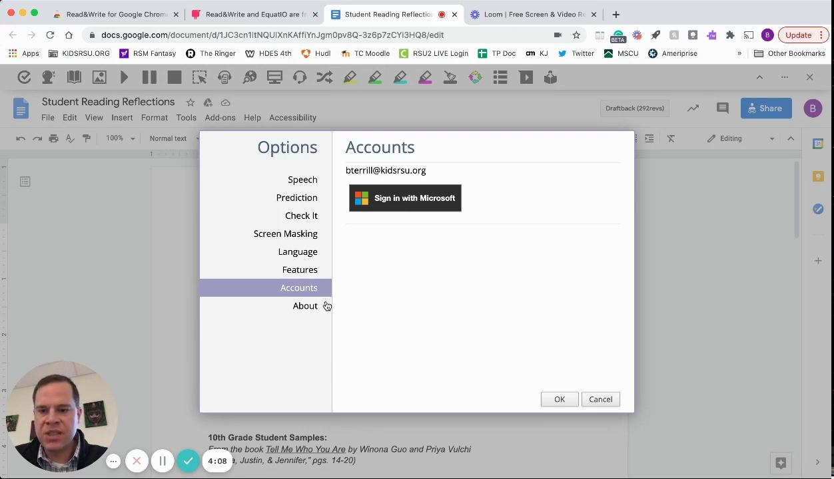
Loom Video: Feedback using Voice Notes in Read&Write for Google Docs

Slide 14
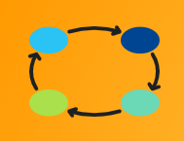
Breakout Group Discussion #1
3 people/8 minutes
How do you balance the need to foster a positive relationship with students with the need to offer useful feedback on assessments?
One “rose” and one “thorn” from your feedback practices in hybrid or remote systems this fall

Slide 15
De-Brief
from
Small Group Session
Link to Padlet

Slide 16
Formative Assessment
Effect Size .34, but only if:
Teacher and student use results to take action on future teaching and learning

Slide 17
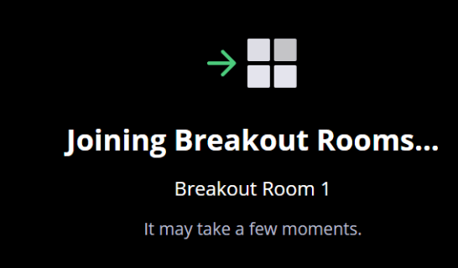
Formative Assessment
from a Distance
Exit Slips to intentionally form Breakout Rooms

Slide 18
Formative Assessment
from a Distance
Polls in Meet/Zoom/Teams

Slide 19
Formative Assessment
from a Distance
Practice Quiz using Google Forms

Slide 20
Using a Poll for immediate feedback
Have you used the following formative assessment features...
Exit Slips
Intentionally-grouped Breakout Rooms
Polls in Meet/Zoom/Teams
Online Practice Quiz
Other
None of the Above

Slide 21
Summative Assessment
in Hybrid/Remote Systems
Testing or Assessment Task Equity
Access
Testing for content or other factors?
Academic Honesty, Plagiarism
Assessment Formats and Platforms

Slide 22
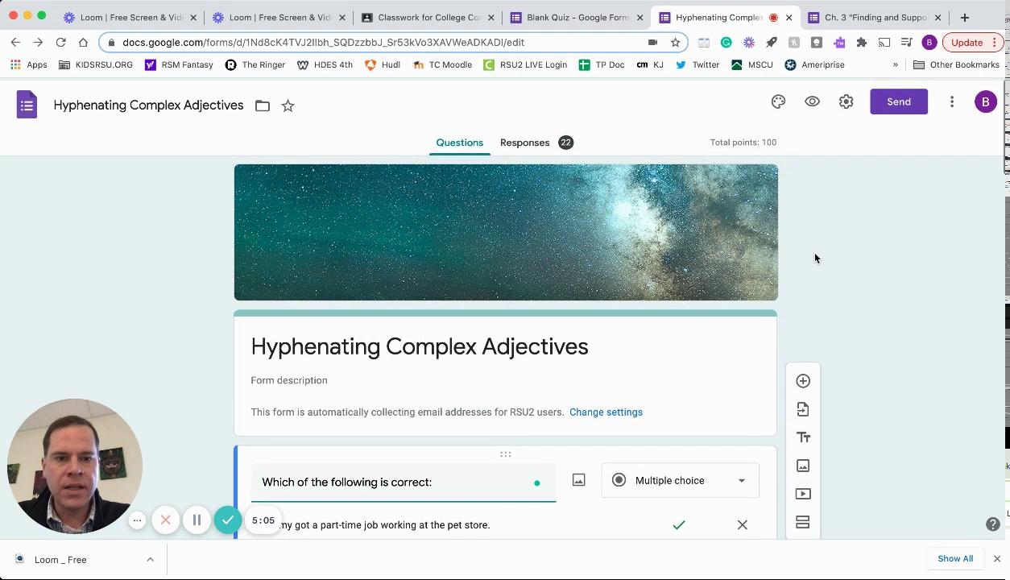
Loom Video: Google Form Quiz Function

Slide 23
Competency-Based Grading: What Goes Into a Grade?

Slide 24
Competency-Based or Proficiency-Based Grading...
Does…
Focus on mastery of content and eliminates grading of practice work and non academic behaviors.
Students receive grades on summative assessments only
Allow retakes of alternate version of summative assessments after re-learning
Add a separate “Citizenship” or “Work Habits” Grade

Slide 25
Competency-Based or Proficiency-Based Grading...
Does Not…
Give points towards course grade for formative assessments and homework
Average together performance on multiple tasks
Allow students to fail any summative assessment and pass the course
Always use the same grading number scale (0 to 100 or 1-4)

Slide 26
Using a Poll
Does your school...
Combine all tasks into one overall course grade
Separate content grade from Work Habits/Citizenship Grade and put on report card/transcript
Separate content grade from Work Habits/Citizenship Grade without putting on report card/transcript
Other

Slide 27
Proficiency-Based Grading Features and Barriers
Features
Minimize the variables of hybrid/remote systems by separating out content skills/knowledge from issues of equity beyond students’ control:
Internet access
Home learning environment
Sibling responsibilities
Parent/Guardian support
Allows teachers more flexibility to adjust assessment formats and platforms to match students’ remote learning needs

Slide 28
Proficiency-Based Grading Features and Barriers
Barriers
Giving “teeth” to the Work Habits/Citizenship grade
Put on transcript?
Number grade or qualitative comment?
Tie to extracurricular eligibility
Trigger interventions, academic support sessions, makeup classes
1-4 vs. 0-100
“Optional” homework, no firm deadlines, numerous test retakes = lower motivation?

Slide 29
Breakout Group Discussion #2
3 people/8 minutes
How can you provide students with a work habits/citizenship grade that “has teeth” in the context of your classroom?
What is the value of retakes? How can we provide retakes that are different but equally rigorous?

Slide 30
De-Brief
from
Small Group Session
Link to Padlet

Slide 31
How can we make sure our grading practices in our hybrid systems are equitable, fair, and motivating?

Slide 32
Thanks!
Any questions?
You can find me at:
bterrill@kidsrsu.org

Slide 33
Feedback and certificate
Complete the feedback here https://forms.office.com/Pages/ResponsePage.aspx?id=q6g_QX0gYkubzeoajy-GTmWot5HVlCZMuDf_wKSJo1hURTJYTzQxVjEzQ1hBR1hYWURJSUo4OUxCMC4u
When you get the “thank you” message, copy the url, paste into your browser, then download the certificate.

Slide 34
Next session
Tuesday,
December 15,
3:30 - 5:00
Kristen Shaw
Georgia Valley

