Slide 1
Multi-State State Alternate Assessment: Understanding and Utilizing Score Reports
Jodi Bossio-Smith
State Coordinator, Alternate and English Language Proficiency Assessments
Office of Federal Programs, Maine DOE

Slide 2
Agenda
Brief overview – purposes of alternate assessment
Overview of MSAA reports available at the SAU/school/student level, and the information that can be interpreted from each report
Additional resources for families
Appropriate uses of the data

Slide 3
Brief overview – Alternate Assessments

Slide 4
Federal Requirements Around State Assessment and AA-AAAS
States are required under federal law to assess students in ELA and mathematics in grades 3-8 and one year of high school. States are required to assess in science in grades 5, 8 and one year of high school. There are three opportunities to participate in these state assessments:

Slide 5
Three Opportunities to Participate
A general assessment without accommodations
A general assessment with accommodations as outlined in the student’s IEP
An alternate assessment based on alternate academic achievement standards (AA-AAAS)

Slide 6
Why We Assess
The main purpose of state assessments is to provide data around what the students know and can do in relation to grade level content. This data can be examined at the district, school and student levels.
All students must have access to grade level content and academically rigorous coursework, including students with the most significant cognitive disabilities.

Slide 7
Grade Level Content and Rigorous Academics for All Students
For students with the most significant cognitive disabilities, that grade level content has been supplemented by the alternate academic achievement standards. The alternate academic achievement standards are aligned to (derived from) grade level standards and are smaller, more accessible steps, reduced in breadth and complexity, to support this population of students in learning and mastery of grade level content.

Slide 8
Alternate Academic Achievement Standards
In Maine, the alternate academic achievement standards are:
Core Content Connectors in ELA
Core Content Connectors in Mathematics
Extended Performance Expectations in Science

Slide 9
Alternate Assessments Based on Alternate Academic Achievement Standards
Maine’s alternate assessments are the Multi-State Alternate Assessment (MSAA) in both ELA and math, and the MSAA Science in Science.
These alternate assessments are designed around the alternate academic achievement standards, to ensure that students with the most significant cognitive disabilities are also instructed and assessed in grade level content.

Slide 10
MSAA Reports

Slide 11
MSAA Reports – District Summary Report

Slide 12
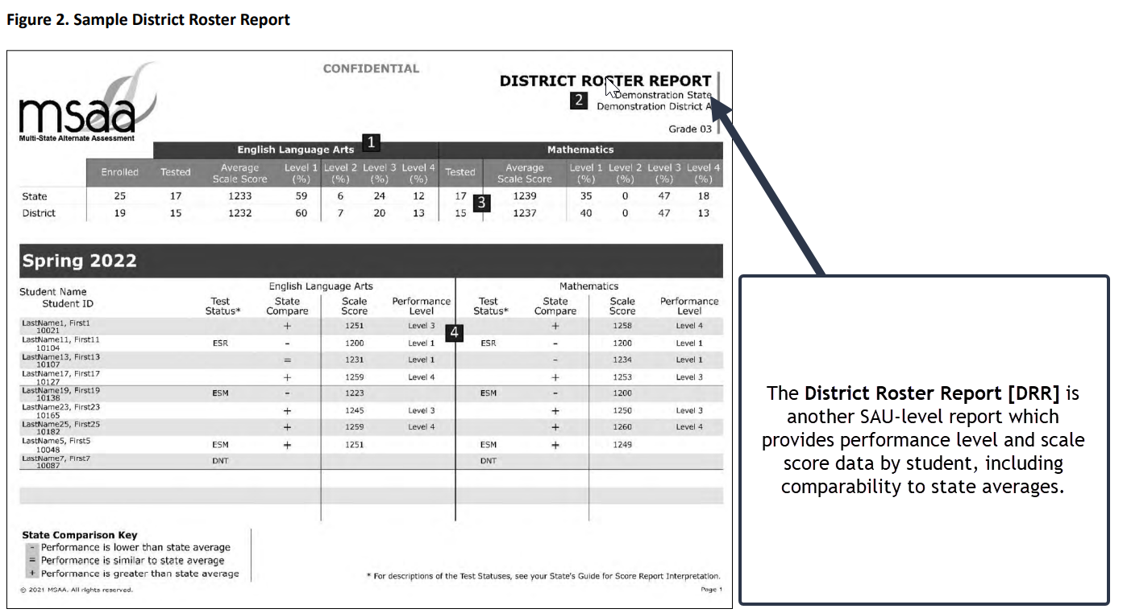
MSAA Reports – District Roster Report

Slide 13
MSAA Reports – School Summary Report

Slide 14
SAU/School Level Reports and Score Interpretation
Applications of SAU and school level summative assessment data:
Identification and allocation of necessary supports and resources at the state, SAU and school levels
Planning for services and determining professional development needs
Evaluating, designing and revising curricula

Slide 15
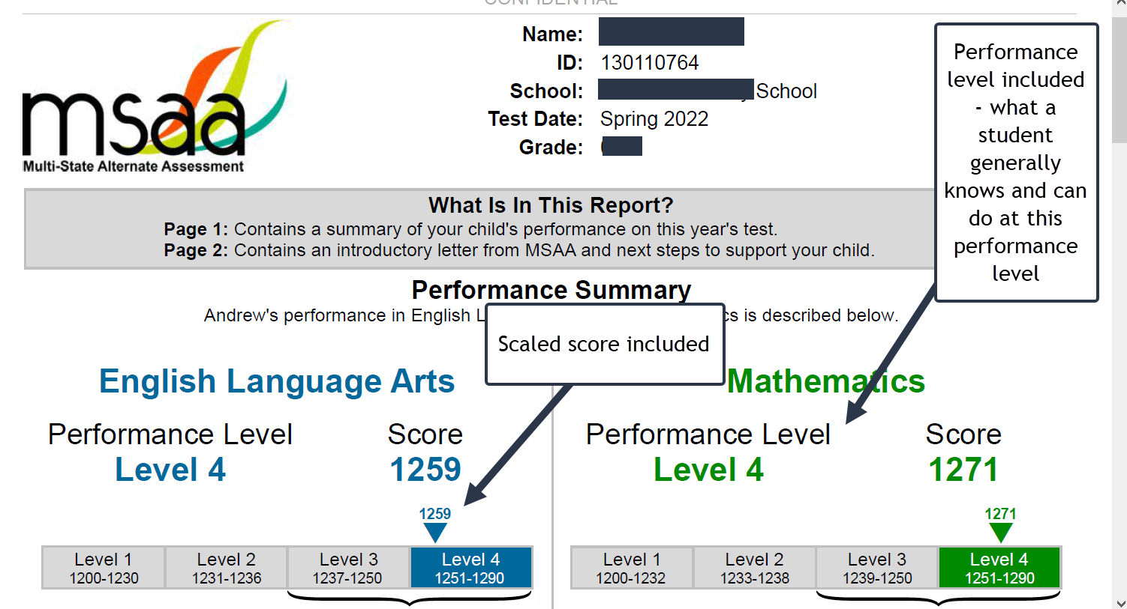
Student Score Reports

Slide 16
Student Score Reports

Slide 17
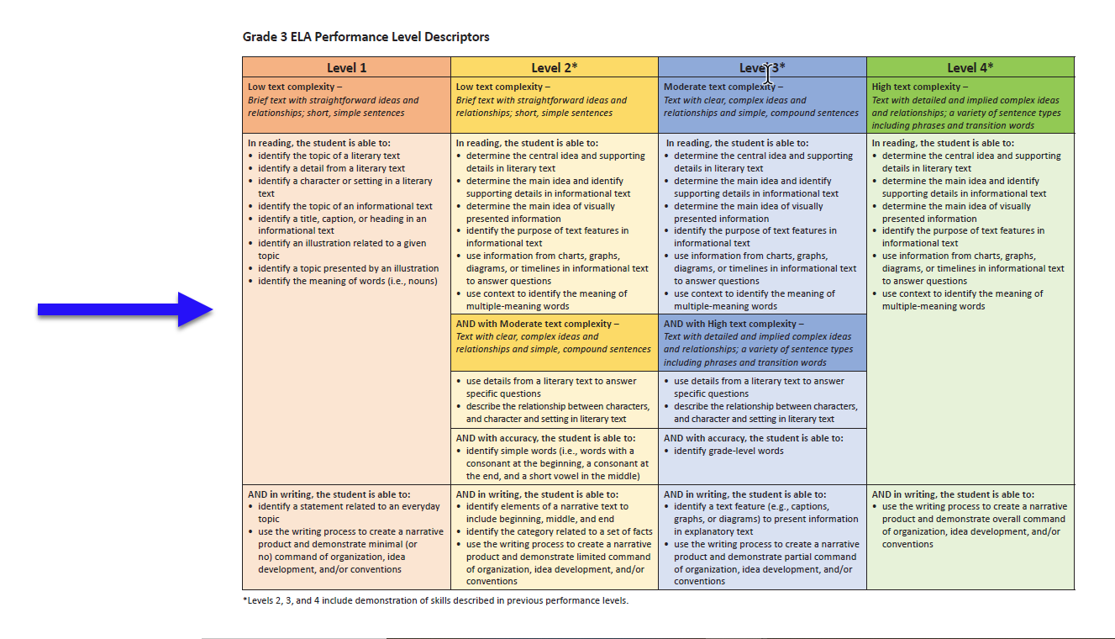
Where are the Performance Levels?

Slide 18
Student Score Reports

Slide 19
Student Score Reports

Slide 20
SAU/School Level Reports and Score Interpretation
Applications of student level score reports:
Provides information around what the student knew and could do; “snapshot in time”
Performance level data can be used in conjunction with multiple other data sources, including formative and interim measures, to guide IEP conversations, academic goal setting, and development of objectives
This data can be shared with families to support conversations around how the student is doing in relation to grade level content, and what comes next
Performance level descriptors and next steps can be shared with students, to empower them to take ownership over their own data and understand the value of state assessment

Slide 21
SAU/School Level Reports and Score Interpretation
In a Balanced Assessment System, state assessments constitute a small portion and are designed to be used for specific purposes:

Slide 22
Questions & Answers
Jodi Bossio-Smith
State Coordinator for Alternate and English Language Proficiency Assessments
Jodi.bossio-smith@maine.gov

