Slide 1
Local Entitlement Application – FY21
Dr. Roberta Lucas
Maine Department of Education
May 21, 2020

Slide 2
FY21 Application Timeline Funds Availability 07/01/2020-09/30/2022
05/21/20
Estimated Allocations Loaded.
FY 21 Application opens, projects are fully developed and allowable, budget amounts can be estimated and adjusted later.
06/15/2020
Applications due for substantial approval.
Must be completed in order to commit funds for July 1, 2020. Applications will be reopened in July for budget revisions based on grant award notice.
09/30/2020
Full Application due or substantial status will be forfeited.
Drawdown billing will be temp suspended until application is completed.

Slide 3
FY20 Year End Reporting Timeline
09/30/2021
All funds must be committed by 09/30/2021.
10/30/21
Actual Expenditures from 07/01/2020-06/30/2021 are recorded in the Year End Report. Narratives for Outcomes and Performance Indicators are written
10/30/22
Expenditures from Carryover project funds are recorded. Funds for those carryover projects need to be committed by 09/30/2022 and invoiced through the Grant Reimbursement system by 10/30/2022.
Overages greater that 10% of the total grant require authorization from DOE.
Carryover projects are created or continued with remaining funds.

Slide 4
FY19 Final Exit Report
Actual Expenditures from 07/01/2019-09/30/2020 are recorded in the Final Exit Report. Narratives for Outcomes and Performance Indicators are written.
If you expended all funds in year 1 of the grant, you will not have a final Exit Report to complete.
Final Exit Reports can be completed anytime after all funds have been expended.
All funds must be committed by 09/30/2020.
9/30/20
10/30/20
NOTE

Slide 5
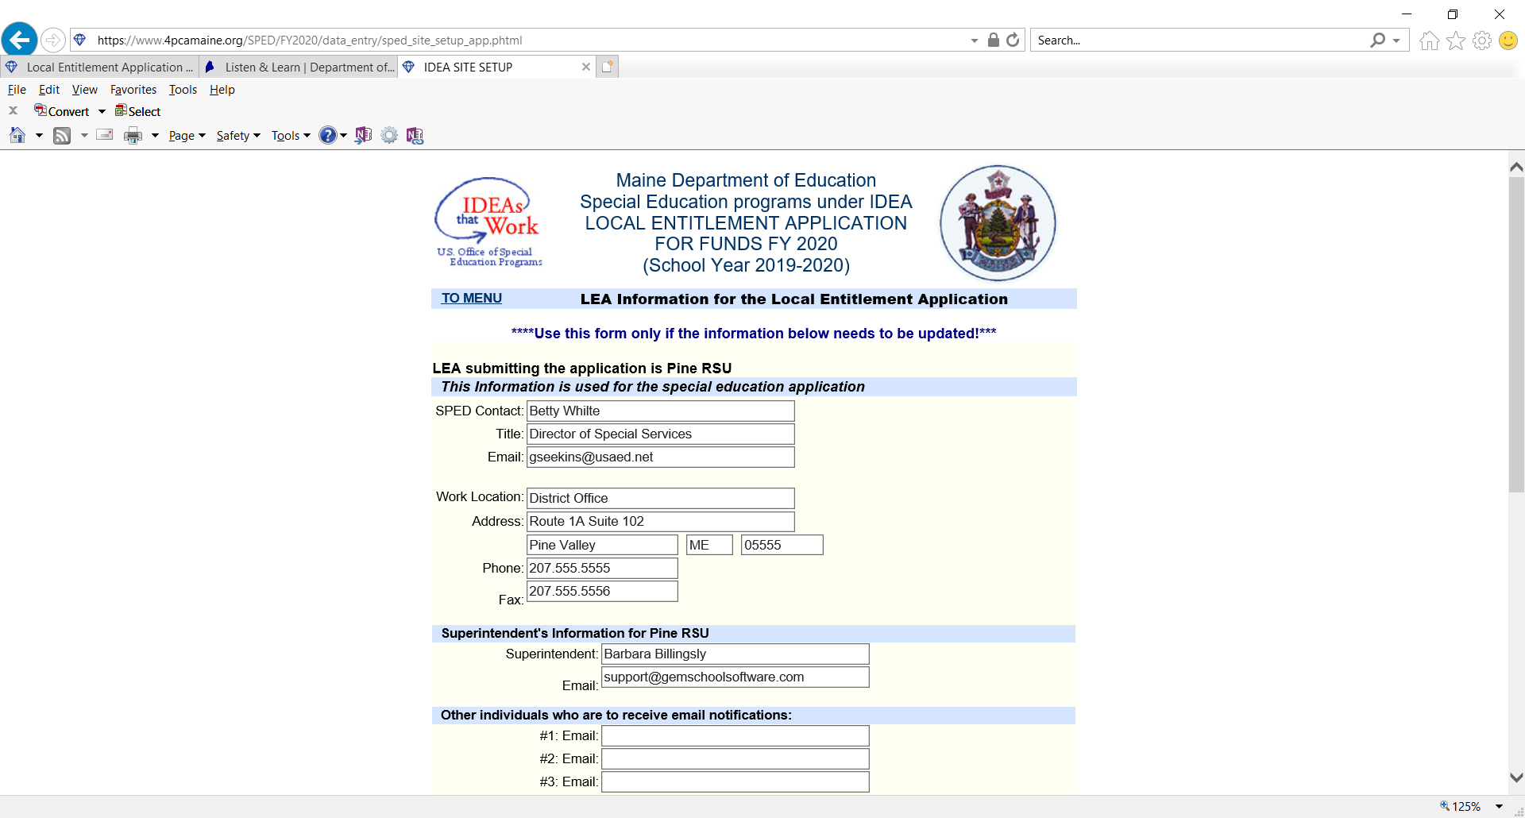
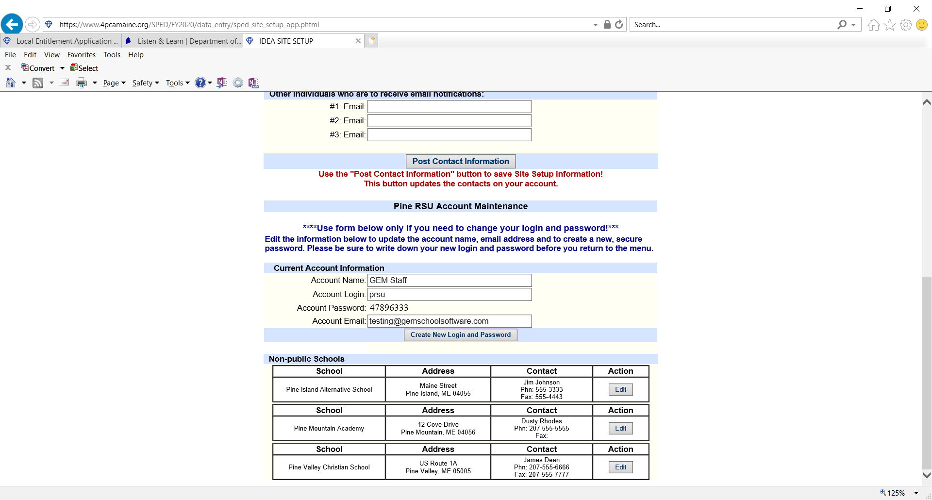
Site Setup
All information pertaining to LEA and contacts should be checked and updated. Non- Public Schools information should be updated from Site Setup page.

Slide 6
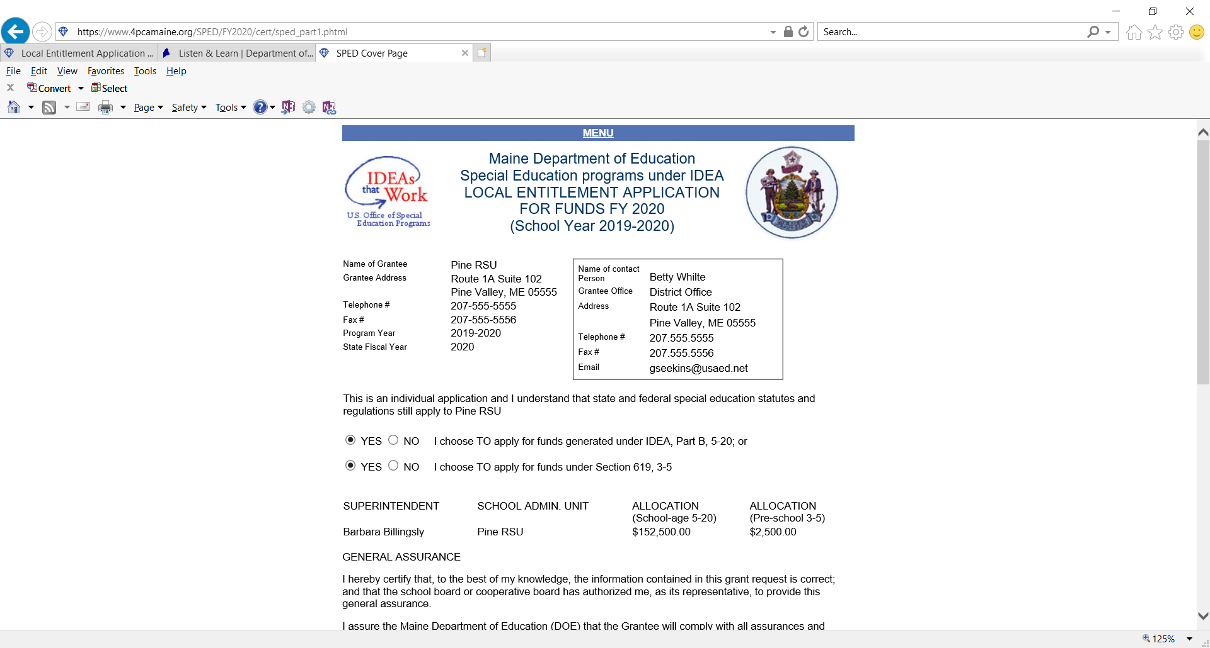
Application Cover Sheet
Choose yes or no to accept funds for Part B 5-20 and for 3-5. If you choose not to accept 3-5 funds, the application will not include projects for those funds.
***Always remember to POST UPDATE***

Slide 7
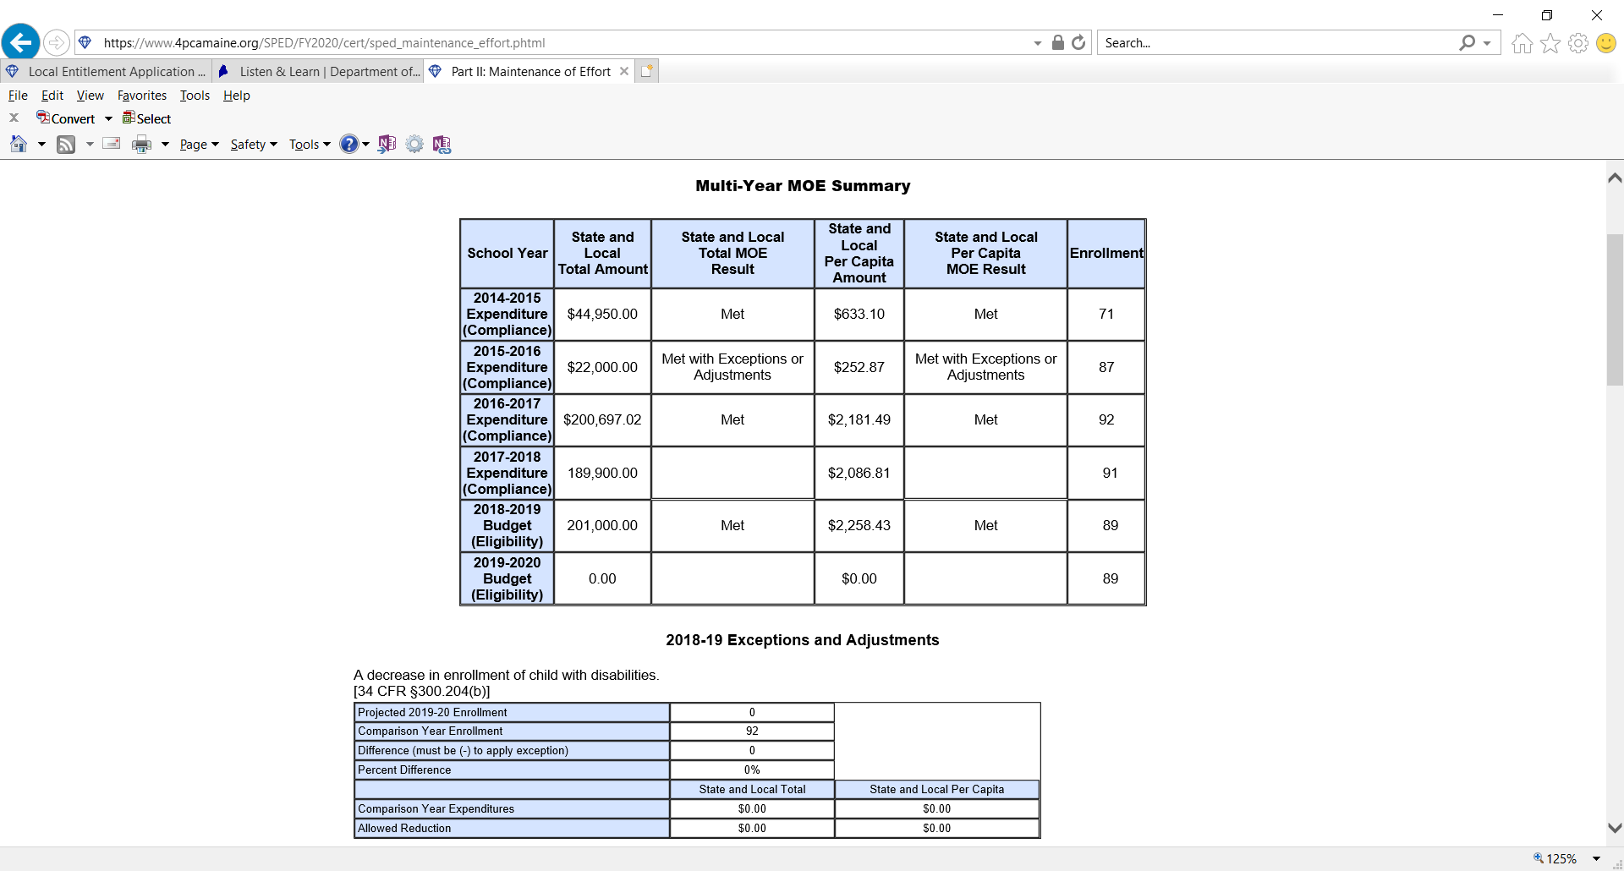
Maintenance of Effort ~ Application
Where does the FY20 MOE Budget information come from?
Standard Article 2 (Special Education)
Standard Article 8 (Transportation & Buses) Function Code 2750 only
Estimated Child Count

Slide 8
EXCEPTIONS TO MAINTENANCE OF EFFORT
What happens if MOE “does not meet”?
The voluntary departure, by retirement or otherwise, or departure for just cause, of special education or related services personnel.
A decrease in the enrollment of children with disabilities.
The termination of the obligation of the agency, consistent with this part, to provide a program of special education to a particular child with a disability that is an exceptionally costly program , as determined by the SEA, because the child 1. has left the jurisdiction of the agency; 2. has reached the age at which the obligation of the agency to provide FAPE to the child has terminated; or 3. no longer needs the program of special education.
The termination of costly expenditures for long-term purchases, such as the acquisition of equipment or the construction of school facilities.
Call Barbara McGowen 624-6645 Barbara.a.mcgowen@maine.gov

Slide 9
Proportionate Share for Parentally Placed Students
Enter TOTAL number of eligible children with disabilities (same # in MOE)
Enter number of parentally place eligible students in private schools (do not include home schooled)
The worksheet will calculate the total amount of the project based on your inputs.
Most Frequent Errors
Parentally placed
Direct services based on ISP (not evaluations)
Parentally placed count
Failure to carry over PP $ for 24 months- funds cannot be reallocated until the last 3 months of the grant life.
Failure to consult
**Sending funds directly to private schools**

Slide 10
Frequent Errors

Slide 11
Frequent Errors

Slide 12
Frequent Errors

Slide 13
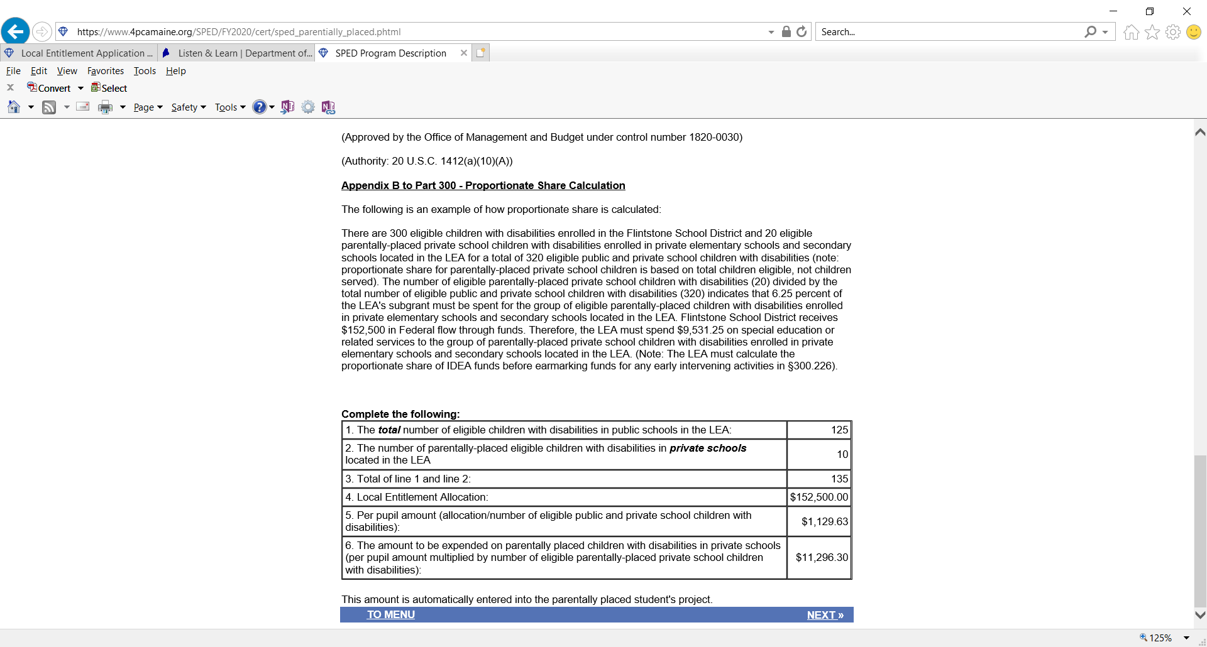
Proportionate Share for Parentally Placed Students- continued
Parentally placed project funds must be available for two years
Is structured as a carryover project
At end of 2nd year remaining funds can be used for any other allowable LE activity. A note should be made in the Parentally Place description in the Year-end report.

Slide 14
Proportionate Share for Parentally Placed Students- continued
Project must include:
A determination statement in project how these decisions are made – ex:
based on need of child
staff availability
YE report
confirm when explaining expenditure

Slide 15
Project Choice Options
Function Codes
1000 Instruction
1000 Extended School Year Programs
1000 Out of District Placements
2110 Social Work Services
2130 Nursing Services
2140 Psychological Services
2150 Speech Pathology/ Audiology
2160 Occupational Therapy
2170 Physical Therapy Services
2180 Visually Impaired/ Vision Services
2198 Parentally Placed Students
2199 Coordinated Early Intervening Services
2330 Special Area Administrative Expenses
2700 Within District Transportation
2750 Out of District Transportation

Slide 16
Project updates
If “new” project – please indicate
Technology project- must include language that the purchase is outside of the district technology purchase.
Multiple projects with in one project
Equipment- identify the specific equipment
Stipend – not allowable

Slide 17
Program Activities
1. Purpose of Activity: (must be allowable under IDEA)
To provide related services as required by the IEPs of students with disabilities
2. Project Description: describe the activities/strategies to be undertaken to accomplish the purpose.
The school district will contract with licensed occupational therapists to provide evaluations, consultations, and direct therapy services
3. Outcomes/Performance Indicators: describe how you will know that the project was successful and the purpose met. (A well-written outcome is realistic, clear, specific and measurable.)
100 % of all students needing evaluations will be assessed in a timely manner that complies with timelines in MUSER. 100% of students requiring OT will receive the service as required by the students’ IEPs.

Slide 18
MOST FREQUENT ERRORS (**)
Purpose
“To provide speech therapy services to students with disabilities who require it as either specially designed instruction or as a related service”
Project Description
RSU 100 will contract with a local agency to obtain speech-language therapy services for 20 hours per week.
Name exactly what you are going to do – e.g. “provide support” isn’t as clear as “employ an ed tech to provide support”
Be careful of “related services” as it relates to MUSER rules. No therapeutic swim, horseback riding, music therapy, etc
Don’t be too wordy.
Spending money on non–allowable costs
Equipment incorrectly assigned

Slide 19
Preschool funds
SAU may reject funds, but are supposed to be able to prove they are providing FAPE (in development). Note: this also applies to school age funds
“to provide special education and related services in accordance with Part B of the Act... to children with disabilities aged three through five years . . .”
Age limitations – 3,4, and 5 year olds in kindergarten**

Slide 20
Preschool Funds
Preschool Funds:
Supplies
Expenses CDS will cover are not allowable

Slide 21
Preschool funds
Regular education vs special education
E.g. whiteboards **
Time and effort reporting using split funding sources **
Kindergarten aides**

Slide 22
Year End Report Training
Dates to be announced
For Business & Finance Office staff
Excess Cost
Carryover projects
Expenditure reporting

Slide 23
Review Application
https://www.4pcamaine.org/

Slide 24
Questions?
Contact:
Roberta Lucas: 624-6621 Roberta.lucas@maine.gov
Barbara McGowen: 624-6645
Barbara.a.mcgowen@maine.gov
Colene O’Neill: 624-6713
Colene.oneill@maine.gov
Thank you for all you do in the service of children!

