Slide 1
community
Notes:
How does this picture show the meaning of the word community?
Prompt children to describe how the people are working together.

Slide 2
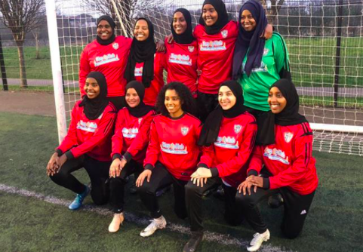
community
https://www.aljazeera.com/indepth/features/british-somali-player-started-club-women-colour-200228154054176.html
Notes:
How does this picture show the meaning of the word community?

Slide 3
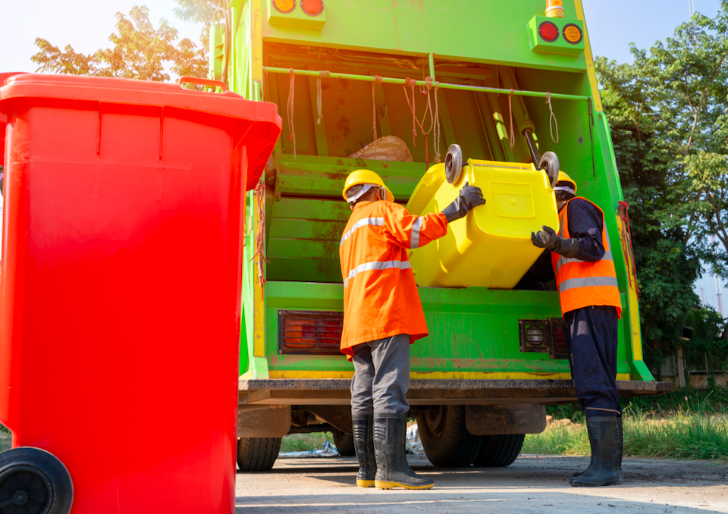
community
Notes:
How does this picture show the meaning of the word community?

Slide 4
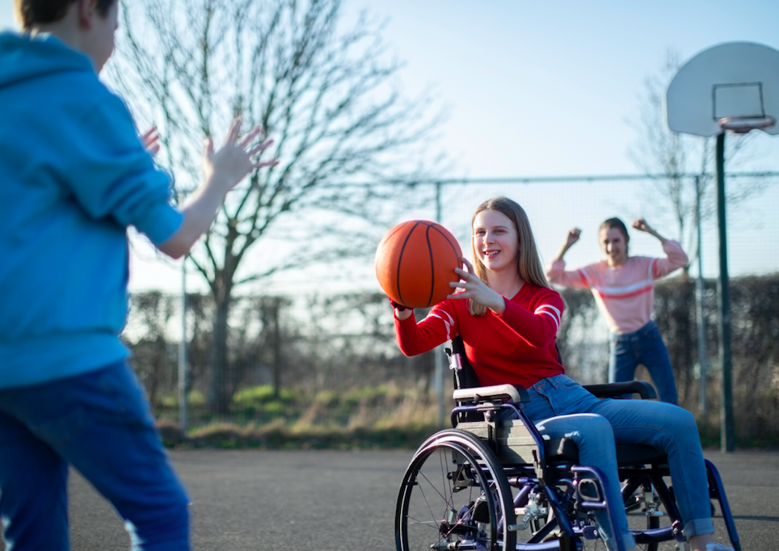
community
Notes:
How does this picture show the meaning of the word community?

Slide 5
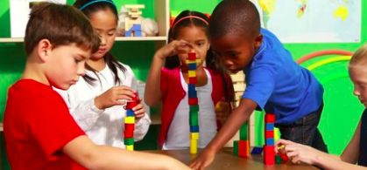
community
Notes:
How does this picture show the meaning of the word community?

