Slide 1
Increasing Students’ Motivation to Learn a World Language
April Perkins
World Languages & ESOL/Bilingual Programs Specialist
9.22.21

Slide 2
Welcome!
Introductions
The session is being recorded and will be posted to the Maine DOE YouTube channel.
Avoid sharing students’ Personally Identifiable Information (PII).
We will use this Jamboard to record notes from partner discussions.
Logistics:
Please keep your camera on if you can.
Please stay muted unless you are speaking.
Feel free to interject with questions/comments, or you can use the “raise hand” feature if you prefer.

Slide 3
Temperature Check
From 0-100% motivated, enter into the chat an estimate of your students’ average level of motivation this school year.
Notes:
How does that average compare to past school years? If motivation is low, what do you believe are the causes? We will engage in an exploration of the topic of motivation, ending in a discussion of motivation during a pandemic.
How does it compare to your level of motivation as a teacher?
Like many teachers, you might be observing that students’ motivation is lowered by the stress we are all living under in the midst of the pandemic. In fact, our own motivation as educators may also have taken a hit.

Slide 4
Framing Success
With your partner(s)(5 minutes):
Think about one or two of your most successful students,* past or present.
What factors do you think contribute to their success?
What motivates their language learning?
What themes emerged from your conversation? Record 1-2 on the Jamboard (page 1).
*Reminder not to share PII
Notes:
What is the group’s collective definition of success?

Slide 5
CAL: Student Voices
At the NCSSFL 2020 annual meeting, a panel of six teacher-selected, outstanding students was convened to discuss their language learning experiences.
Responses on motivation:
Students are motivated by connection more than by career opportunities.
They cited a desire to engage with target-language-speaking peers both in person and virtually, as well as family members, teachers, and people met while traveling.
They noted an appreciation for difference and wanting to explore it.
The enthusiasm of the teacher is contagious.

Slide 6
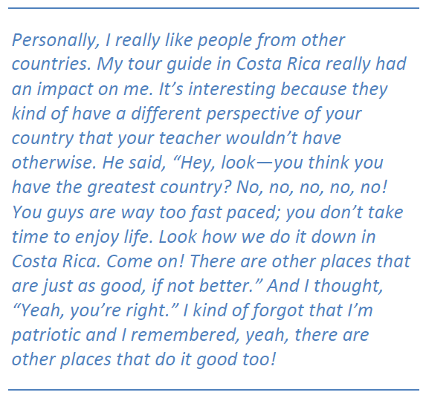
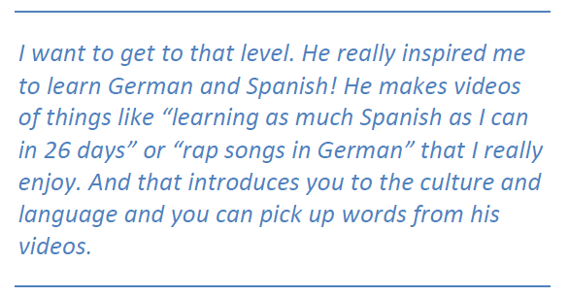
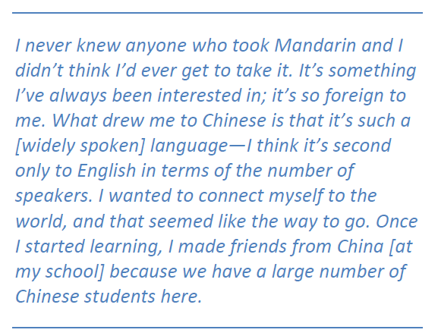
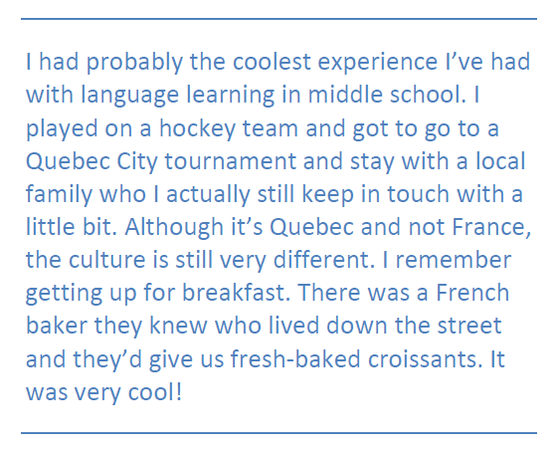
CAL: Student Voices
How are these similar to or different from what your students might say?
Notes:
How are these similar or different from what your students might say?
These four student quotes involve opportunities to interact in person with speakers of the target language. Not all students have this opportunity, but there are ways to create these kinds of experiences for students in your classroom. For students learning classical languages, motivation may stem from other applications of target language.

Slide 7
TELL* Project: Engaging and Motivating Language Learners
While you watch: On the Jamboard (page 2), record 3-4 key words that summarize the video’s message about what motivates students.
*Teacher Effectiveness for Language Learning

Slide 8
Robert Gardner’s Socio-Educational Model
Lai, H-S.T. (2013). The Motivation of Learners of English as a Foreign Language
Revisited. International Education Studies, Vol. 6, No. 10.
Notes:
This model frames motivation and ability as the two primary factors contributing to language learning. Motivation is dissected into three types.
Is there anything here you question? Anything you would add, omit, or represent differently?
Integrativeness has been misunderstood as the learner’s desire to be a member of the target language speaking culture. It is really intended as the learner’s desire to know and understand it, as well as to successfully interact with its members.

Slide 9
Dörnyei’s L2* Motivational Self System
“The vision of who students would like to become as L2 users seems to be one of the most reliable predictors of long-term long-term learning behavior.”
– Dr. Zoltán Dörnyei
The Ideal L2 Self is our future vision ourselves as L2 users.
*L2 = second language
Notes:
Do you do visioning work with students already? If so, how?

Slide 10
Helping Students Envision Their Ideal L2 Selves
With your partner(s), list on the Jamboard (page 3)1-2 specific ways a teacher can integrate each of the following into instruction (10 minutes):
Activities to get to know your students and their interests
Show students examples of success
Let them experience success in target language
Show them the real-world applicability of language skills
Notes:
Success as defined by students

Slide 11
Motivational Strategies Questionnaire (Cheng & Dörnyei, 2007)
Make a Copy of the Adapted Version
Highlight your copy using the following color coding. Identify at least two strategies in each of the three categories (5 minutes).
What strategies do you already employ regularly and successfully?
What strategies would you like to learn more about?
What strategies will you try for the first time?
Notes:
Are there other strategies NOT listed that you regularly use?

Slide 12
Leveraging Standards
Notes:
Research and anecdotal evidence tell us that integrativeness is a top motivating factor for students. We can leverage this by providing opportunities for cultural engagement and community connections, as emphasized in the ACTFL World-Readiness Standards for Learning Languages in the Cultures and Communities goal areas.
All of the World-Readiness Standards have a relationship to students’ motivation. Knowing what we know about integrativeness and its relationship to motivation, these two goal areas are particularly promising.

Slide 13
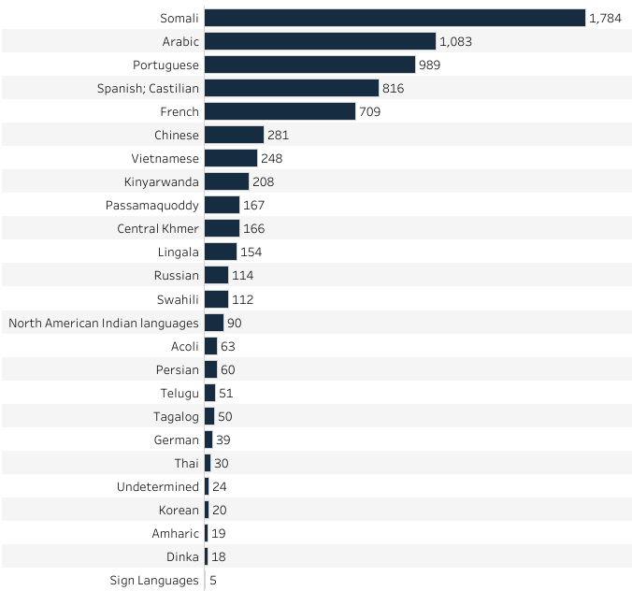
Maine Cultural/Community Connections
Reported Home Languages
Immigrant/Cultural Community Organizations
Arabic
New England Arab American Organization (NEAAO)
Chinese
Chinese American Friendship Association-ME
Bangor Chinese School
French
Burundi Community Association-ME
Congolese Community of Maine*
Franco American Center
Gedron Franco Center
Rwandese Community Association of Maine
Spanish
CHISPA Centro Hispano de Maine
Mano en Mano
Presente! Maine
*Member of Maine Immigrant Rights Coalition
Notes:
Research and anecdotal evidence tell us that integrativeness is a top motivating factor for students. We can leverage this by providing opportunities for community connections, as emphasized in the ACTFL World-Readiness Standards for Learning Languages in the Communities goal area.

Slide 14
International Opportunities
Chinese Guest Teacher and Trainee Program
Programme Jules Verne
Teachers of Critical Languages Program
Visiting Teachers from Spain
Fulbright Classroom Teacher Exchange Program
Spanish Language and Cultural Assistants
Nantes School Partnership Program
Consulate of Spain Scholarship
Goethe-Institut Exchange Programs

Slide 15
Motivation in the Midst of a Pandemic
Language learning as:
Therapy
Escape
A space for optimism
Notes:
A language classroom is an ideal place to help students process their thoughts and feelings around the pandemic. As language teachers, we can center our instruction on what is most valuable and most relevant to students at a given point in time. Providing a space to reflect on the situation we are in, especially through the comfortable distancing a second language offers, can be a true form of therapy. Language learning gives students a much-needed opportunity to fantasize and dream about their futures, and to practice optimism about things that may seem out of reach right now, like travel and unimpeded human connection.

Slide 16
Motivation in the Midst of a Pandemic
Suggested Reading:
Guardian: Learning a language helps me talk back to the voice of depression
Move this World: SEL and Language Acquisition: Introduction to Affective Filter Theory
Language Network: How Learning a New Language Can Benefit Your Health
Badger Herald: Exploring a closed world: Language learning during the pandemic

Slide 17
Research
Gardner, R. C., & Lambert, W. E. (1972). Attitudes and motivation in second language learning. Rowley, MA: Newbury House.
Masgoret & Gardner (2003). Attitudes Motivation, and Second Language Learning: A Meta-Analysis of Studies Conducted by Gardner and Associates, Language Learning. 167-21
Dörnyei, Z. (2005). Psychology of the language learner: Individual differences in second language acquisition. Mahwah, NJ: Lawrence Erlbaum.
Dörnyei, Z. (2009). Motivation, language identity and the L2 self. Bristol, UK: Multilingual Matters.

Slide 18
Contact Hour Certificate Request Form
In order to receive your certificate, please complete this form by 9.27.21.
Notes:
https://forms.office.com/Pages/ResponsePage.aspx?id=q6g_QX0gYkubzeoajy-GTrgYxcYZ8OtAsEUkw8o3VCdUOEsyOE9ERDFZVkRYSDI0MldRTkM2MDkxQi4u

