Slide 1
How a House Is Built
By Gail Gibbons
Sequencing Sheets
Read Aloud Unit 3, Week 5 Day 5
Notes:
How a House Is Built sequencing sheets

Slide 2
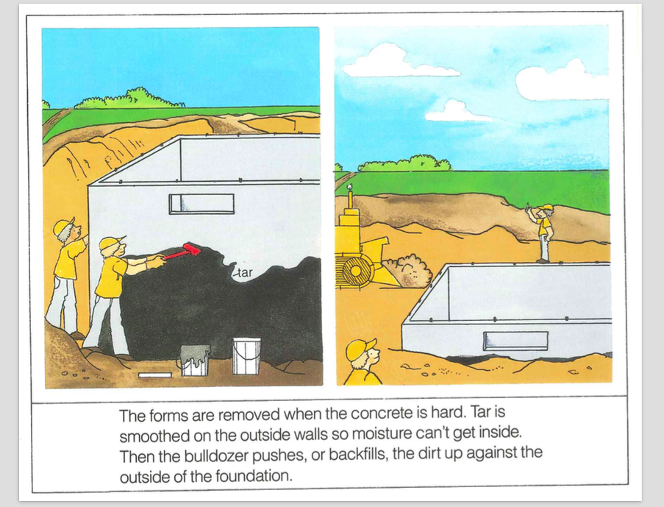

Slide 3
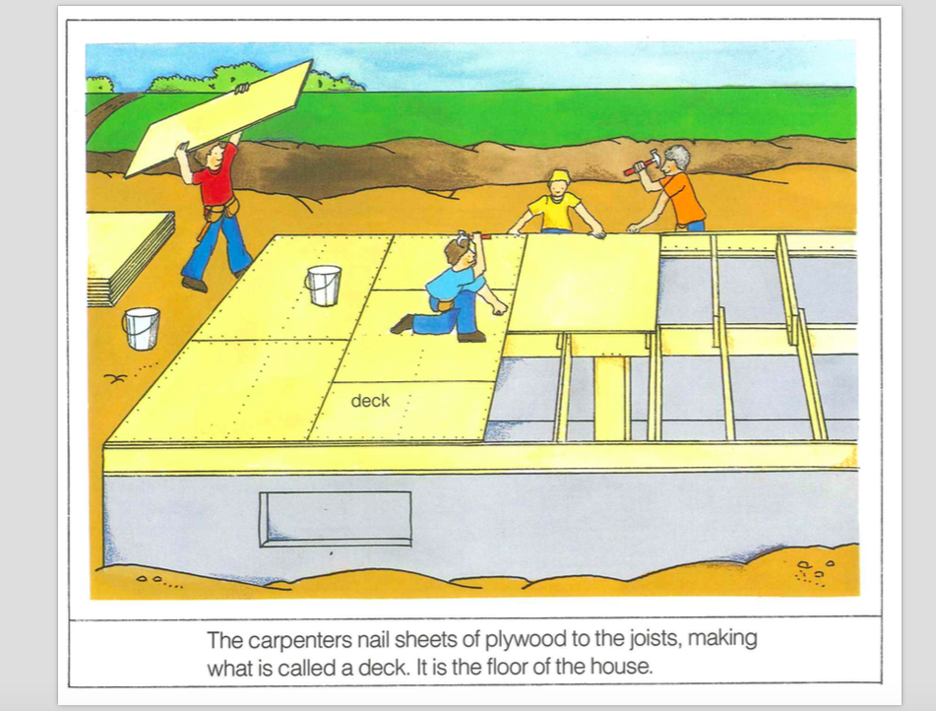

Slide 4
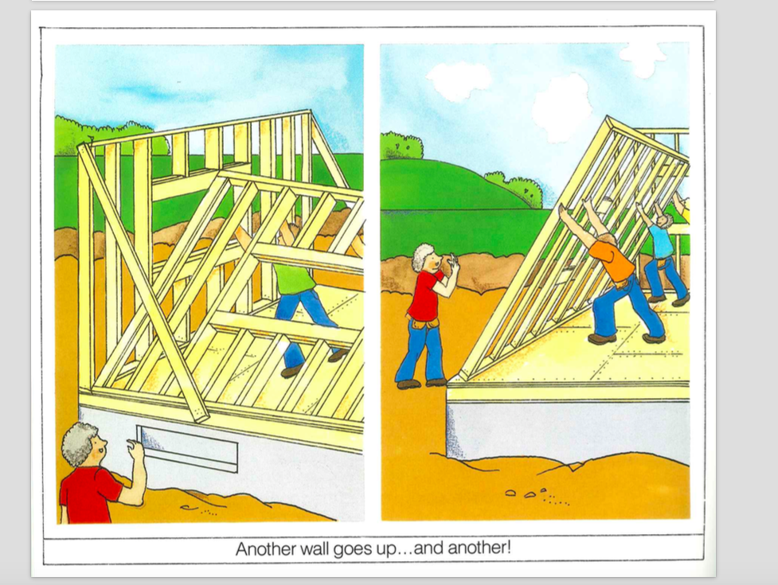

Slide 6
