Slide 1
Straw, Wood, and Bricks!
Read Aloud Unit 3, Week 1, Day 3

Slide 2
For thousands of years, communities around the world have used straw, wood, and bricks to build their homes.Let’s see how people today use these three building materials. Each material comes from different natural resources, and each has different properties.
Builders in the past and builders today think carefully about why they will use certain materials for their structures, and how they will get the materials.

Slide 3
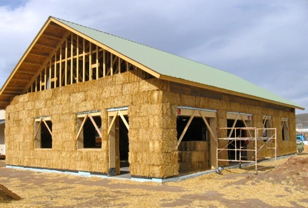
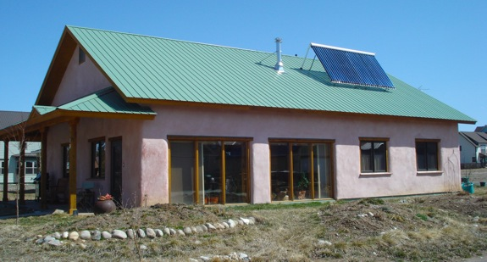
Notes:
Lesson invites observations and questions.
https://greenpassivesolar.com/2011/05/passive-solar-straw-bale-house/

Slide 4
These homes are made from bales of straw. The straw bales insulate the house, which means they keep the home warm in the winter and cool in the summer. After the straw bales are added, it is covered with plaster to create a very strong and sturdy structure. These homes are on a big farm in the state of Colorado where straw can be grown.
Notes:
https://greenpassivesolar.com/2011/05/passive-solar-straw-bale-house/

Slide 5
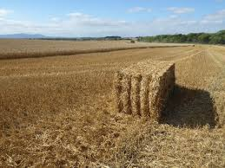
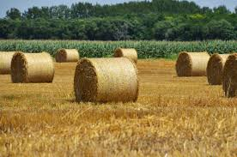
Notes:
Lesson invites observations and questions.

Slide 6
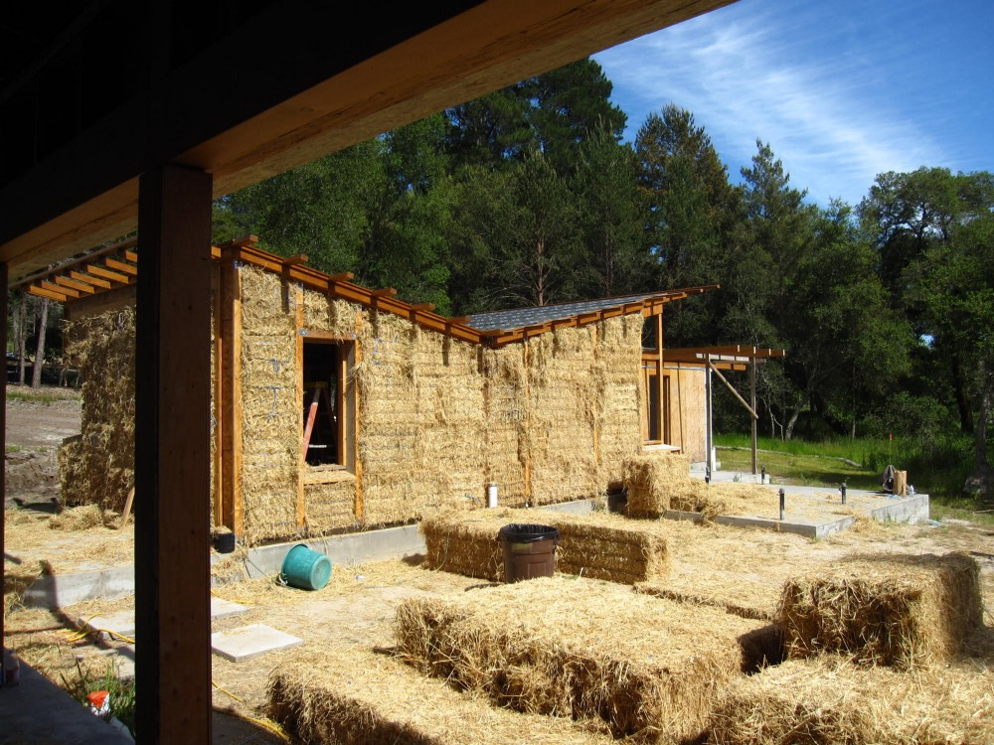
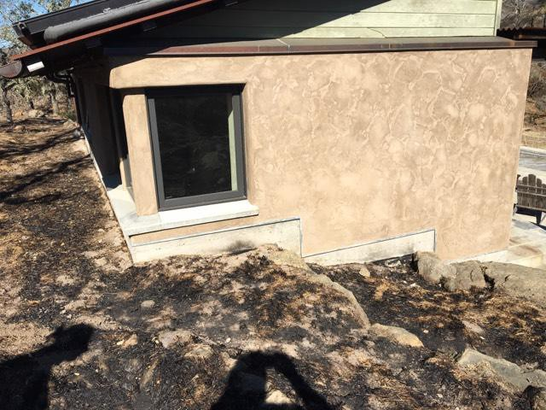
These pictures are from homes in Northern California, in a place that has recently had many wildfires. Just like in the pictures from Colorado, plaster covers straw bale walls. Some people want to build their homes this way because the structures survive wildfires better than homes that have wood and plaster walls.
Notes:
https://onezero.medium.com/people-are-future-proofing-their-homes-with-straw-e25b470f5474

Slide 7
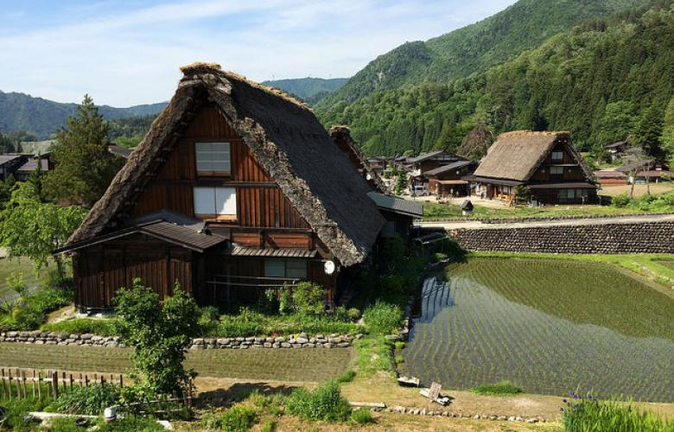
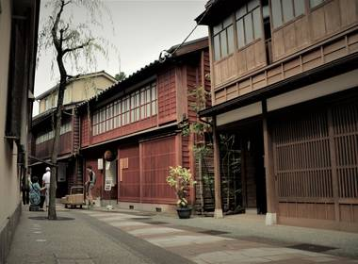
Notes:
Lesson invites observations and questions.
https://www.rethinktokyo.com/2017/12/12/6-elements-japanese-traditional-architecture/1513026009
https://www.japan-experience.com/to-know/understanding-japan/the-machiya

Slide 8
Today, homes and buildings in the country of Japan are made of many materials. Historically, homes in the rural farm lands and the cities were made of wood. Japan is very humid, and wood was a good material for keeping homes dry and free of mold. Japanese homes traditionally also used bamboo, a type of plant that grows in Japan.
Notes:
https://www.rethinktokyo.com/2017/12/12/6-elements-japanese-traditional-architecture/1513026009
https://www.japan-experience.com/to-know/understanding-japan/the-machiya

Slide 9
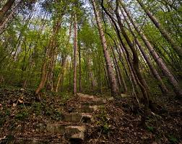
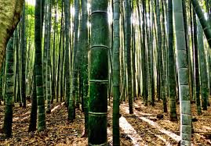
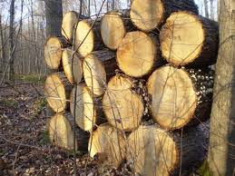
Notes:
Lesson invites observations and questions.

Slide 10
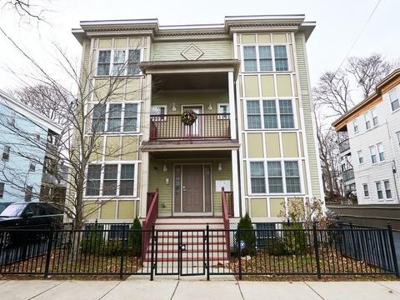
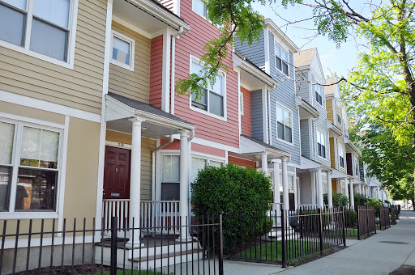
Notes:
Lesson invites observations and questions.
http://www.madison-park.org/what-we-do/real-estate-development/housing-portfolio/

Slide 11
Wood has been used to build structures for thousands of years. Many homes in Boston are made of wood. Hundreds of years ago, people cut trees here in Massachusetts to build homes out of wood. Now, most of the timber is brought here from other places.
Notes:
http://www.madison-park.org/what-we-do/real-estate-development/housing-portfolio/

Slide 12
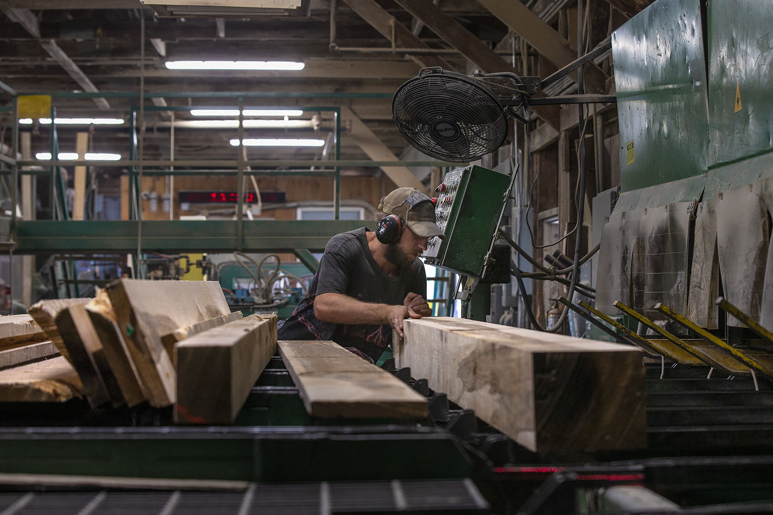
Notes:
https://www.wbur.org/bostonomix/2019/09/24/hardwood-china-tariffs-lumber-sawmills

Slide 13
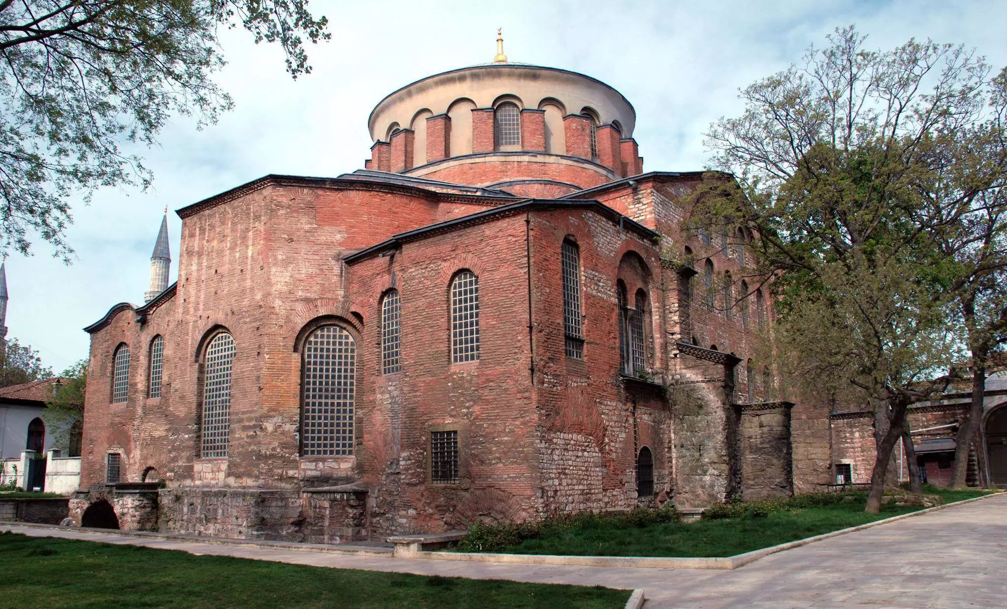
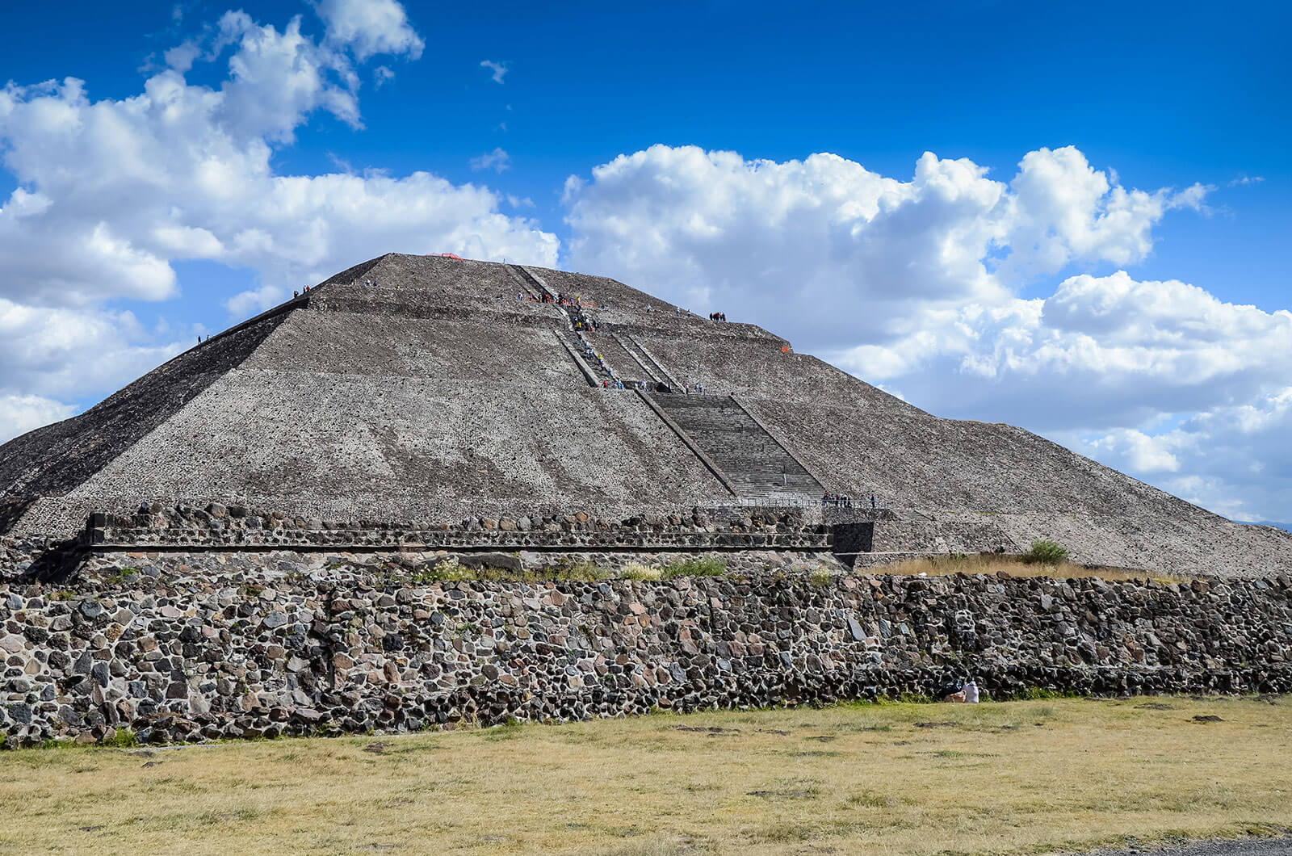
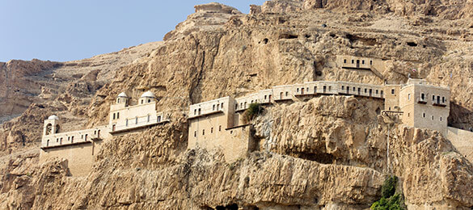
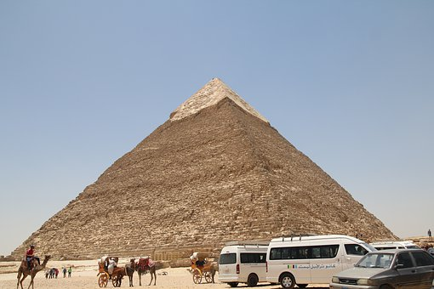
Notes:
Lesson invites observations and questions.
https://www.britannica.com/topic/Topkapi-Palace-Museum
https://brickarchitecture.com/about-brick/why-brick/the-history-of-bricks-brickmaking#:~:text=Bricks%20date%20back%20to%207000,around%20the%20city%20of%20Jericho.

Slide 14
For thousands of years, people around the world have made buildings from bricks. Historians think that people first started using bricks made from mud and stones in the country of Turkey.
Bricks were first used in places with warm climates. In Egypt, people made bricks from a mix of clay and straw to build pyramids. The Aztecs used adobe bricks to build pyramids in Central America.
Notes:
https://brickarchitecture.com/about-brick/why-brick/the-history-of-bricks-brickmaking#:~:text=Bricks%20date%20back%20to%207000,around%20the%20city%20of%20Jericho.

Slide 15
Teotihuacan, Mexico
Aztec pyramid of the sun
Topaki Palace Museum Istanbul, Turkey
Egypt
Jericho, Palestine
Notes:
Lesson invites observations and questions.

Slide 16
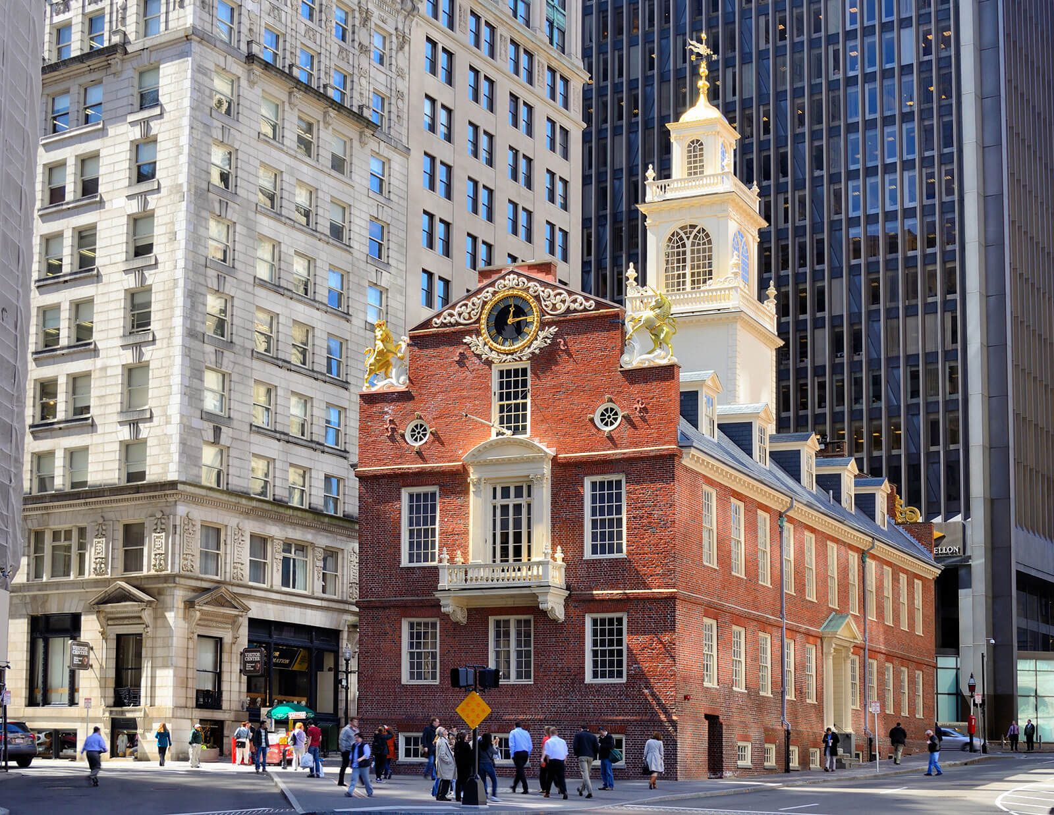
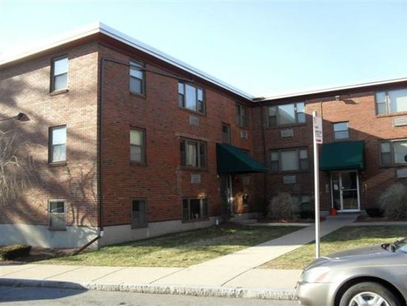
Notes:
https://www.trulia.com/n/ma/boston/east-boston/83565/
https://www.zillow.com/homedetails/4885-Washington-St-APT-2B-West-Roxbury-MA-02132/2102505251_zpid/

Slide 17
Many homes and buildings in Boston are made of bricks. Bricks were used hundreds of years ago in Boston because they helped keep homes warm in the winter and cool in the summer. They also kept buildings strong in harsh winters with falling snow, and they could withstand fires.
Old State House, Boston
Apartment Building,
West Roxbury, Boston
Notes:
https://www.trulia.com/n/ma/boston/east-boston/83565/
https://www.zillow.com/homedetails/4885-Washington-St-APT-2B-West-Roxbury-MA-02132/2102505251_zpid/

Slide 18
