Slide 1
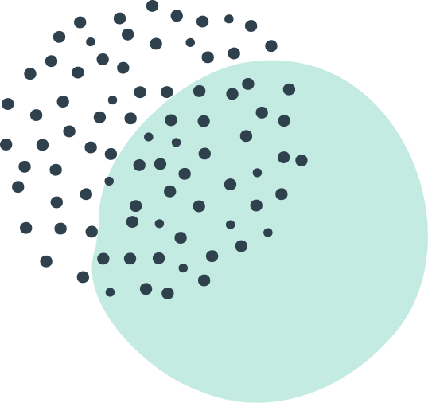
MAINE DOE BOOK STUDY
SESSION
GRADING FOR EQUITY
By Joe Feldman

Slide 2
Today's Webinar
CHAPTER PREVIEW & DISCUSSION–MORE OF IT!
Chapter 3:
How Traditional Grading Stifles Risk-Taking and
Supports the"Commodity of Grades"
Grading for Equity
by Joe Feldman

Slide 3
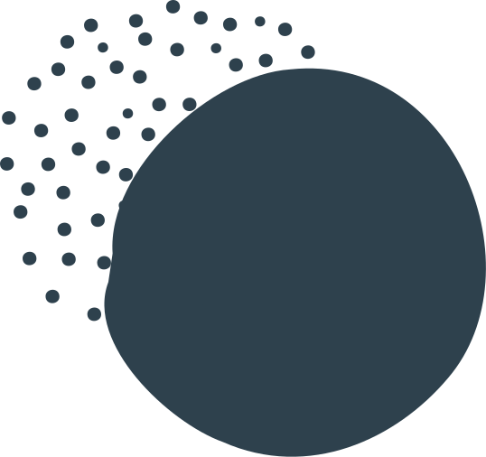
Guiding question:
What's best for students?
GRADING FOR EQUITY
BOOK STUDY

Slide 4
BREAKOUT DISCUSSION GROUP
SECTION
1
PREVIEW
BREAKOUT DISCUSSION GROUP
LEARNING STRUCTURE
SECTION
2
PREVIEW
BREAKOUT DISCUSSION GROUP
WHOLE GROUP REPORT OUT

Slide 5
AUTHENTIC ENGAGEMENT AGREEMENTS
Short Presentations
Mute
Video off
Longer breakout
group discussions
Share the air
Chat box
TQEs
Discussion prompts

Slide 6
Break out Groups
Factors for Success
Facilitator
Timekeeper
Engagement

Slide 7
Discussion Question
Reflect on your reading of chapters 1 & 2
What changed, challenged, or confirmed
your thinking?
Groups of 4, 10 minutes to discuss, at least 2 minutes each!

Slide 8
PART 2 | THE CASE FOR CHANGE
INTRODUCTION
TO THE CASE FOR CHANGE

Slide 9
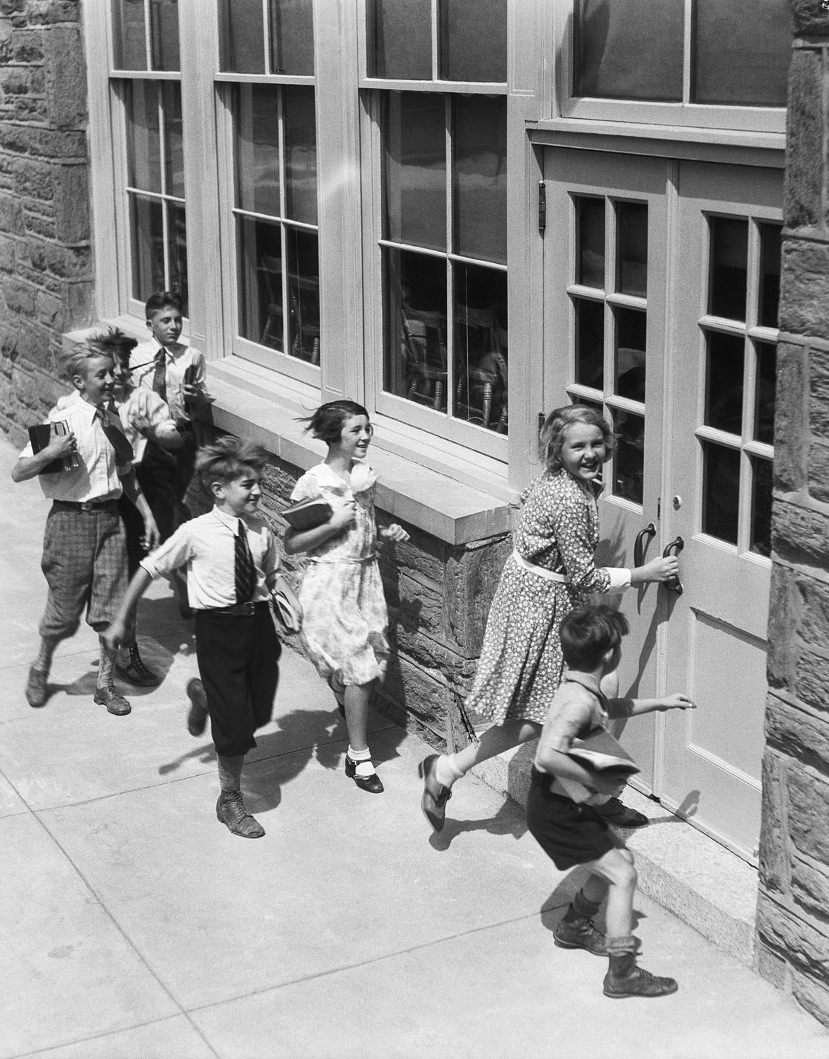
20th Century Beliefs
Student achievement occurred on a curve
Students were motivated through
extrinsic rewards & consequences
Key purpose of schools
was to sort students

Slide 10
21st Century Beliefs
All students are capable of meeting academic standards
Extrinsic motivation may work for rote behaviors but intrinsic motivation works better for higher-order thinking
Schools should not sort students

Slide 11
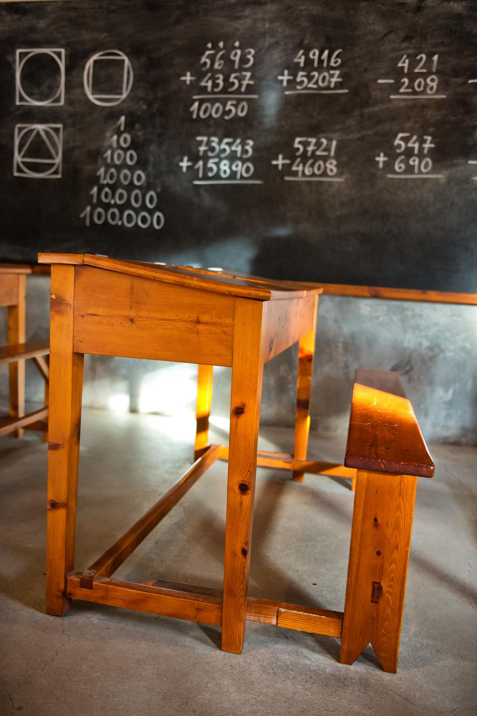
Yet–
WE STILL USE
GRADING SYSTEMS OF THE EARLY 20TH CENTURY
Part 2 | The Case for Change
and there is
"no meaningful research to support it." (Marzano, 2000)

Slide 12
HOW TRADITIONAL GRADING
STIFLES RISK-TAKING
AND SUPPORTS THE
"COMMODITY OF GRADES"
CHAPTER 3

Slide 13
CHAPTER 3: SECTION 1
RISK-TAKING, TRUST, AND THE TEACHER-STUDENT RELATIONSHIP

Slide 14
HOW DO WE BUILD TRUST?
Chapter 3 | Risk-Taking, Trust, & the
Teacher-Student Relationship

Slide 15
TEACHERS
BUILD THIS
POSITIVE RELATIONSHIP THROUGH
INTERACTIONS WITH STUDENTS
Chapter 3 | Risk-Taking, Trust, & the
Teacher-Student Relationship

Slide 16
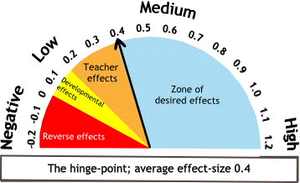
POSITIVE
TEACHER-STUDENT RELATIONSHIPS=
.55 EFFECT SIZE
Chapter 3 | Risk-Taking, Trust, & the
Teacher-Student Relationship

Slide 17
POSITIVE RELATIONSHIPS
“It is teachers who have created positive teacher student relationships that are more likely to have the above average effects on student achievement.” (John Hattie)
Chapter 3 | Risk-Taking, Trust, & the
Teacher-Student Relationship

Slide 18
POSITIVE RELATIONSHIPS IMPROVE:
Engagement
Motivation
Academic Achievement
(Research by Delpit, Hattie, Noddings, Pianta, Wentzel)
Chapter 3 | Risk-Taking, Trust, & the
Teacher-Student Relationship

Slide 19
POSITIVE
TEACHER-STUDENT RELATIONSHIPS=
STUDENT'S FEEL SAFE TO TAKE RISKS AND MAKE MISTAKES
Chapter 3 | Risk-Taking, Trust, & the
Teacher-Student Relationship

Slide 20
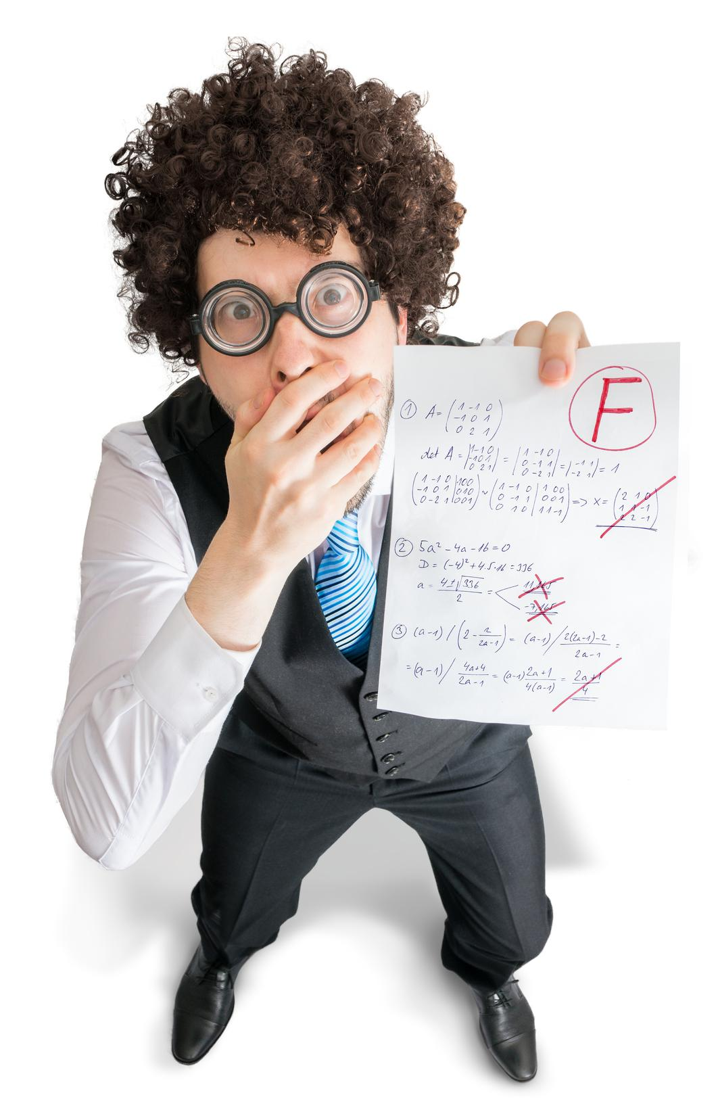
Yet–
WHEN WE GRADE EVERYTHING THROUGHOUT THE LEARNING PROCESS STUDENTS FEEL:
Chapter 3 | Risk-Taking, Trust, & the
Teacher-Student Relationship
Judged
Pressure to be Perfect
Anxious
Overwhelmed

Slide 21
"The message when everything is included in the grade is clear: You are always being judged and must show your absolute best performance in every respect–academic and nonacademic–every day. If you make a mistake, or even are just having a bad day, it's going to count against you.
There is no room for error,
no safe place to make mistakes."
(Feldman, 32)
Chapter 3 | Risk-Taking, Trust, & the
Teacher-Student Relationship

Slide 22
Grading can undermine the teacher-student relationship,
leading to distrust–
Chapter 3 | Risk-Taking, Trust, & the
Teacher-Student Relationship
Deceit--Copying & Cheating
Shame--Avoidance

Slide 23
"Most of us entered teaching to build meaningful relationships with young people, to engender in them a sense of trust and safety by accepting mistakes along a path to proficiency, but our traditional grading encourages us to judge nearly everything a student does or doesn't do, and we create pressure-cooker classrooms where no mistake goes unpenalized."
(Feldman, 32)
Chapter 3 | Risk-Taking, Trust, & the
Teacher-Student Relationship

Slide 24
Discussion Question
How does the element of trust in the student-teacher relationship influence a student's approach to the learning process, particularly for historically underserved student populations, and how does our traditional grading affect that trust?

Slide 25
CHAPTER 3: SECTION 2
THE "COMMODITY OF GRADES" & EXTRINSIC MOTIVATION

Slide 26
HOW DID GRADES GET SO VALUABLE?
Chapter 3 | The "Commodity of Grades"
and Extrinsic Motivation

Slide 27
EARLY ELEMENTARY–
Teacher feedback verbal: encouragement, supportive correction, reflection.
Grading throughout Schooling
LATER ELEMENTARY–
Teacher feedback shifting to currency of points: categorizing, tracking achievement.
MIDDLE/HIGH SCHOOL
Grading as economic system:
points w/incentives
and penalties

Slide 28
TEACHERS BELIEVE:
"Point economies are a
vital incentive and
feedback mechanism
to help students
successfully meet
class expectations."
(Feldman, 34)
Chapter 3 | The "Commodity of Grades"
and Extrinsic Motivation

Slide 29
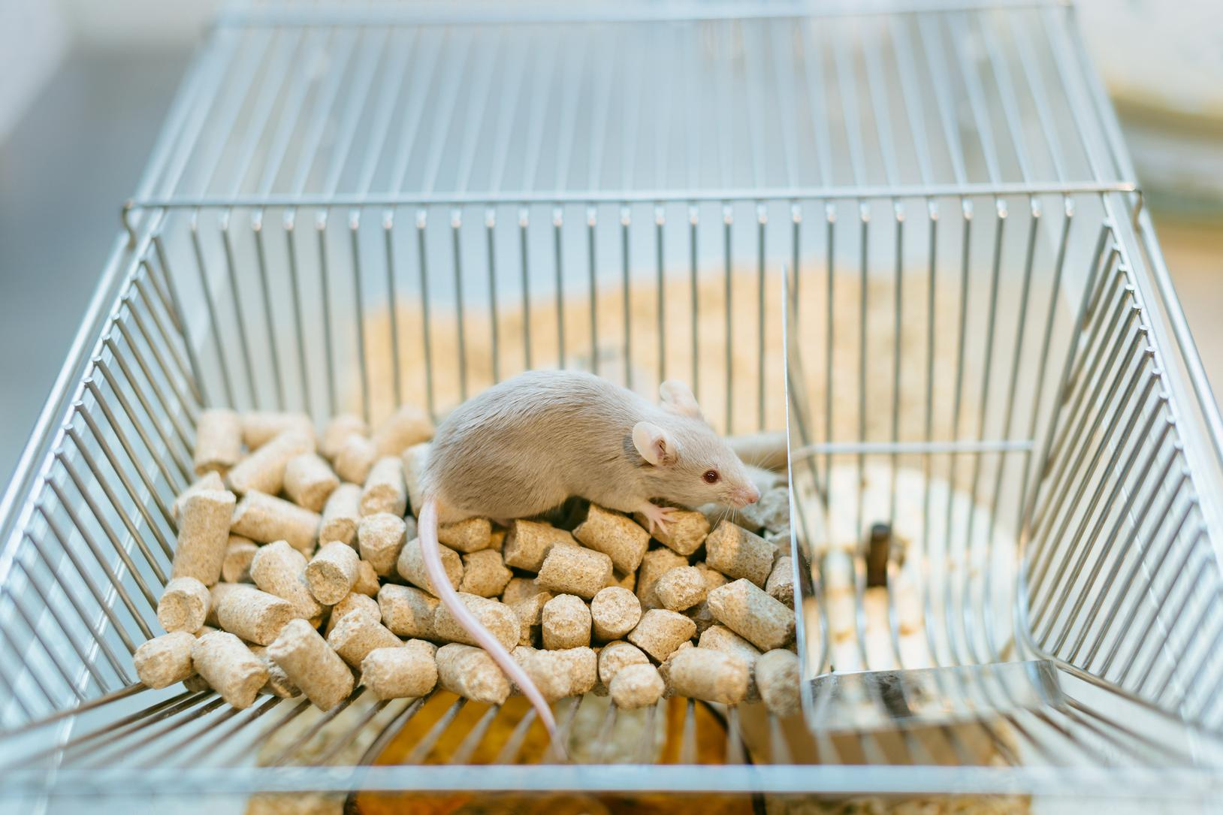
But–
USING POINTS TO MOTIVATE ASSUMES EXTRINSIC MOTIVATION IS MOST EFFECTIVE TO PROMOTE LEARNING
Chapter 3 | The "Commodity of Grades"
and Extrinsic Motivation
Remember Skinner and Behaviorism?

Slide 30
Now–
OUR UNDERSTANDING OF MOTIVATION HAS EVOLVED
Chapter 3 | The "Commodity of Grades"
and Extrinsic Motivation
Extrinsic motivation works for menial/repetitive tasks, NOT for higher-order and creative thinking.

Slide 31
EARLY ELEMENTARY–
Curious,
innate interest in learning
and growing
Learners throughout Schooling
MIDDLE/HIGH SCHOOL
"How many points
is this worth?"
Bargaining over points
Pleading not to lose points
Requests for extra credit

Slide 32
As a measure of learning, grades:
Chapter 3 | The "Commodity of Grades"
and Extrinsic Motivation
Curiosity
& Joy

Slide 33
The teacher is the Federal Reserve
of the classroom
Chapter 3 | The "Commodity of Grades"
and Extrinsic Motivation
Can "print" more currency
Can inject more points into the classroom economy when needed.

Slide 34
"WE PREACH
THE GOSPEL
OF LEARNING,
BUT WE MAKE STUDENTS GENUFLECT
TO THE ALTAR
OF POINTS."
(FELDMAN, 35)
Chapter 3 | The "Commodity of Grades"
and Extrinsic Motivation

Slide 35
POINTS = POWER
& THE POWER
IS HELD BY THE TEACHER
Chapter 3 | The "Commodity of Grades"
and Extrinsic Motivation

Slide 36
THE TEACHER'S GRADING POSITION OF POWER DECREASES STUDENT
TRUST & RISK-TAKING
Chapter 3 | The "Commodity of Grades"
and Extrinsic Motivation

Slide 37
WE OFTEN USE THE EXTRINSIC MOTIVATION OF POINTS EVEN MORE WITH STUDENTS:
Chapter 3 | The "Commodity of Grades"
and Extrinsic Motivation
-FROM LOW INCOME FAMILIES
-WHO HAVE STRUGGLED ACADEMICALLY
-WHO HAVE BEEN HISTORICALLY UNDERSERVED

Slide 38
WE TRY TO BRIBE THEM WITH POINTS
Chapter 3 | The "Commodity of Grades"
and Extrinsic Motivation
BUT THIS ONLY CREATES
THE ILLUSION OF
ENGAGEMENT & MOTIVATION

Slide 39
"Using only extrinsic motivation incentives to inspire learning is a form of educational engineering that implicitly views students as inferior, inert, and in need of motivation. Such an orientation dims our awareness of learners' own determination
and promotes their dependency."
(Dr. Margery Ginsberg, 2015)
Chapter 3 | The "Commodity of Grades"
and Extrinsic Motivation

Slide 40
We complain that some students only care about points or we wish we had more trusting relationships with students,
but "our approach to grading
may be to blame."
(Feldman, 37)
Chapter 3 | The "Commodity of Grades"
and Extrinsic Motivation

Slide 41
Discussion Question
How do "points" in grading, often used to incentivize compliance, divert a student's focus away from intrinsic motivation to learn and instead toward the teacher's extrinsic rewards?
Select a member to report out for your group number!

Slide 42
Thank you
for participating
in this learning journey!
NEXT QUESTION
NEXT STEP
NEXT WEBINAR
How effective are the use of points for students who are the least motivated and engaged? (Q4, p. 37)
Read and Reflect
on Chapter 3
Tuesday, 6/16 @ 9am
Chapter 4 Preview
Traditional Grading Hides Information, Invites Biases, and Provides Misleading Information

Slide 43
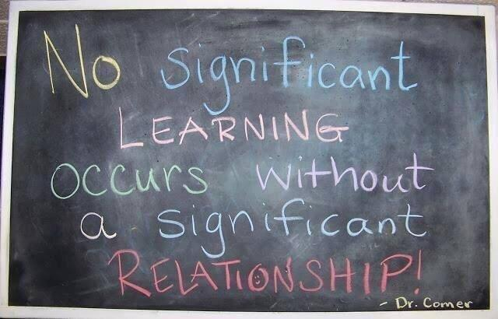
FINAL WORDS

