Slide 1
Educational Provisions Orientation for Foster Care School District Points of Contact
Gina Googins, LSW, MSW
Regional Associate Director
Office of Child and Family Services
Maine DHHS
Bobbi Johnson, LMSW
Foster Care DHHS Point of Contact
Associate Director
Child Welfare Services
Maine DHHS
Julie A. Smyth Foster Care Statewide Point of Contact
Director, O3S Maine Department of Education

Slide 2
Acronyms
DOE: Department of Education
O3S: Office of School and Student Supports
DHHS: Department of Health and Human Services
OCFS: Office of Child and Family Services
CPS: Child Protective Services
BID: Best Interest Determination
MOU: Memorandum of Understanding
IEP: Individualized Education Plan
POC: Point of Contact (4)
School District Foster Care POC
District Foster Care POC (related to entire state – 8 in total)
DOE Foster Care POC
DHHS Foster Care POC

Slide 3
For Foster Care Points of Contact
Our video training will be recorded for future use. Consider taking notes as there will be a quiz at the end.
When you complete the quiz and score at least an 80%, you will earn your Certificate of Completion for SY 2022-23.
Any feedback or questions? Share those with Julie Smyth, Statewide Foster Care Point of Contact at the DOE – Julie.a.smyth@maine.gov (Please insert Foster Care in subject line!)

Slide 4
Why Educational Stability
Frequent school transitions may have lasting academic, social, and emotional impacts
Maximizing educational stability can
improve attendance
minimize educational gaps
help families stay connected

Slide 5
Foster Care - Title I Part A Provisions
Ensures educational stability
Establishes specific educational rights
Requires a district foster care point of contact
Requires a state foster care point of contact at both DOE (Julie Smyth) and DHHS (Bobbi Johnson)

Slide 6
Definition of Students in Foster Care
24-hour out-of-home care, placed away from their parents; DHHS has placement + care responsibilities
Students previously identified as “awaiting foster care” under McKinney-Vento
Includes resource homes - foster and kinship placements; crisis programs; and children’s residential care facilities

Slide 7
Educational Rights of Students in Foster Care
School of Origin and Transportation
Best Interest Determination
Immediate Enrollment

Slide 8
School of Origin
The school the student was attending when placed in foster care, or at the time of a subsequent change in foster care placement. Students should remain enrolled in their school of origin, unless, after a best interest determination, it is decided NOT to be in their best interest.
Notes:
If a child is in Lewiston, then placed with a foster family in Auburn, Lewiston is the school the student was attending when placed in foster care. Then, if there's a subsequent change in foster care placement, where Auburn family says we can't do this anymore, and the child moved to Turner with a new family, Lewiston would remain the school of origin

Slide 9
Best Interest Determination (BID)
Decisions about which school a student will attend should be made collaboratively and should consider a wide variety of factors.
Collaboration should include those in the best position to understand the student’s unique needs.
Student should remain in their school of origin until the BID is complete.

Slide 10
Student, parent/guardian, foster parent
Educational decision maker (surrogate parent), legal representative (Guardian ad litem)
CPS Caseworker and/or CPS Supervisor
School District Foster Care POC liaison, special education, counselor, teacher
*CPS District POC/Educational Liaison (one of 8 in Maine)
Who should be involved in the Best Interest Determination?

Slide 11
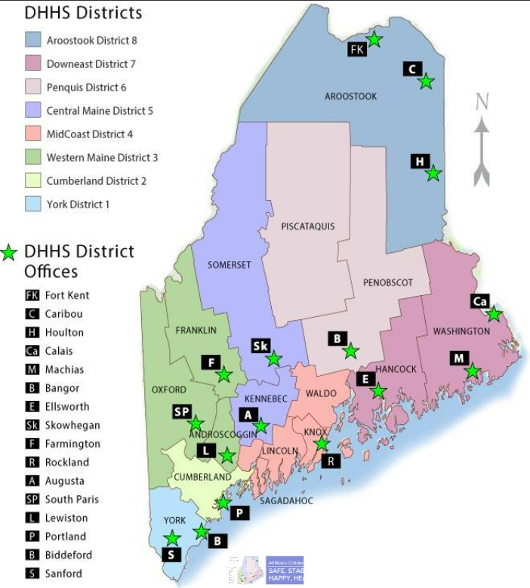
OCFS Foster Care Points of Contact for Education
Email addresses for foster care points of contact all follow the same format:
first name.middle initial (IF PROVIDED).last name@maine.gov
District 1 - Angela Burgess
District 2 - Aurelie Bush
District 3 - Paul Josephson
District 4 - Christina Gilbert
District 5 - Lindsey Caron
District 6 - Jennifer E. Brewer
District 7 - Shannon Prout
District 8 - Chad Kelley
Statewide - Bobbi Johnson

Slide 12
What should we consider when making a best interest determination for school placement?

Slide 13
Consider the unique needs of the student, including but not limited to the following:
student’s age and grade level;
student’s preference, when age appropriate;
student’s attachment to the school, including meaningful relationships with staff and peers;
placement of the student’s sibling(s);
distance/length of time to travel to/from school;

Slide 14
time of academic year, academic performance, and skills;
anticipated length of time in placement, and whether reunification is the family goal;
number of placements to date;
ability to maintain family relationships and engagement (including in extracurricular activities, where appropriate);

Slide 15
clinical/behavioral issues;
influence of the school climate on the student, including safety issues;
availability and quality of the services in the school to meet the student’s educational and social emotional needs; and
availability of special education/504 services, if applicable.

Slide 16
Other Considerations for BID
Is the school of origin in the best interest for a limited duration of time (e.g., until the end of the school year, the end of a testing or grading period, or the end of a particular grade)?

Slide 17
Other Considerations (cont’d)
Transportation costs should NOT be a factor in determining the best interest.

Slide 18
Transportation
Districts and DHHS must collaborate to establish policies to ensure students who need transportation to remain in their school of origin can do so.
Districts (i.e. POCs) should document all costs associated with this transportation.

Slide 19
DOE-DHHS Transportation MOU (est. 2019)
Follow these steps to determine how transportation will be provided:
If the student has an IEP with transportation service → DOE reimburses (DOE contact – lori.freeman@maine.gov )
If the student does NOT have an IEP, check with CPS Caseworker or Supervisor to see if they can assist with transportation
If CPS cannot assist with transportation, any additional transportation costs will be split 50/50 between school districts

Slide 20
Transportation Strategies
Liaise with school and transportation staff and shelter workers.
Assess access to school buses (including special education).
Coordinate formal/informal agreements with districts where students covered under McKinney-Vento cross district lines.
Access public transit, including supporting parents to travel with younger children.
Consider approved carpools, van or taxi services, Uber, etc.
Provide vouchers for families with access to cars.
Pursue inter-agency solutions.

Slide 21
Immediate Enrollment
If BID supports attending school locally (where placed in foster care), districts must enroll immediately, with or without documentation, including academic, health, discipline and/or special education records.
DHHS provides notice to school district, which includes emergency contact, residence, CPS Caseworker, record release, transportation needs, etc.

Slide 22
School Selection Disputes
After the BID, DHHS has the authority to make final decisions about the best interest, but a school district may dispute. During the dispute resolution process, the student must attend the school selected by DHHS. Transportation must be provided if needed.

Slide 23
Role of School District Foster Care POC
Ensure that students in foster care are…
identified and supported through coordination between School Districts and OCFS.
are enrolled in and regularly attending school.

Slide 24
School District Foster Care POC, cont’d:
Participate in making and documenting BIDs with OCFS representatives.
Ensure school enrollment of students and timely transfer of records.
Develop procedures for coordinating cost-effective transportation.
Facilitate professional development for district staff.

Slide 25
School and Student Supports
| Department of Education (maine.gov)

Slide 26
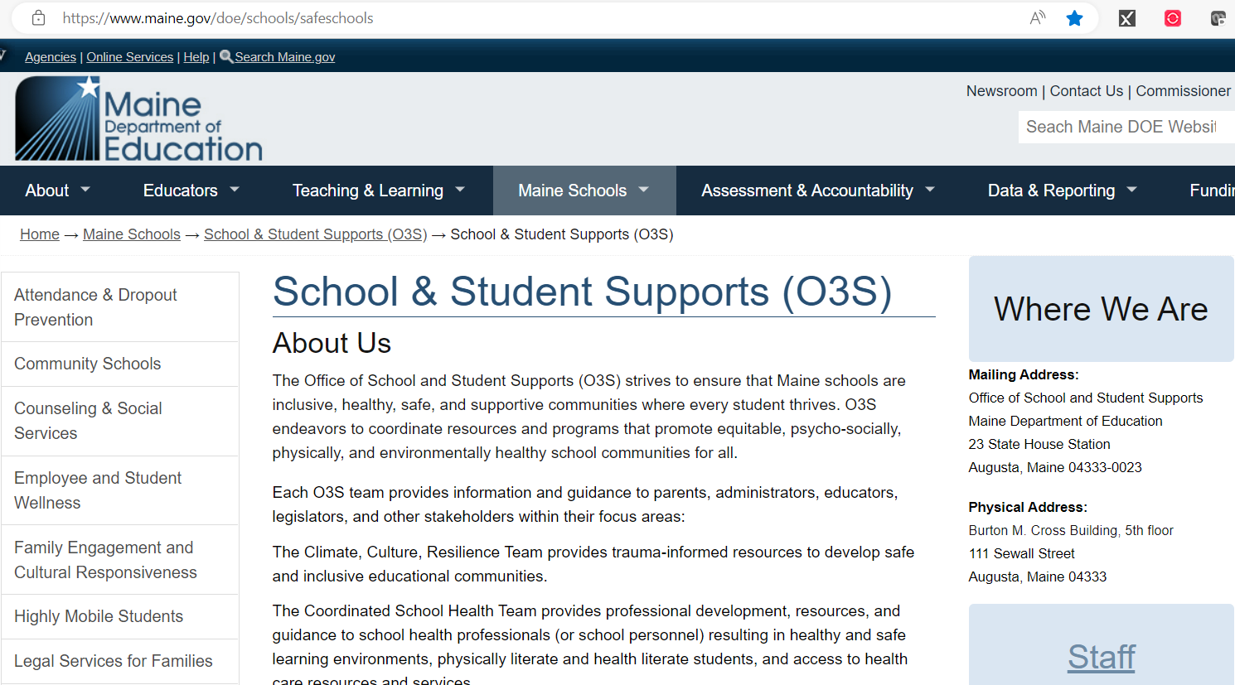
https://www.maine.gov/doe/schools/safeschools

Slide 27
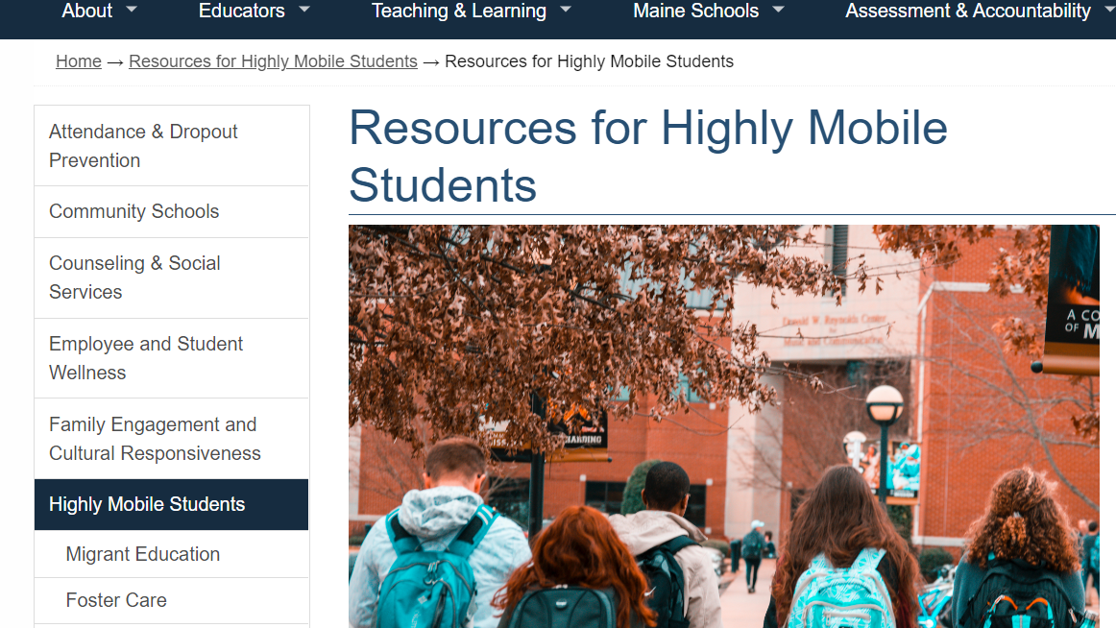
https://www.maine.gov/doe/highmobility

Slide 28
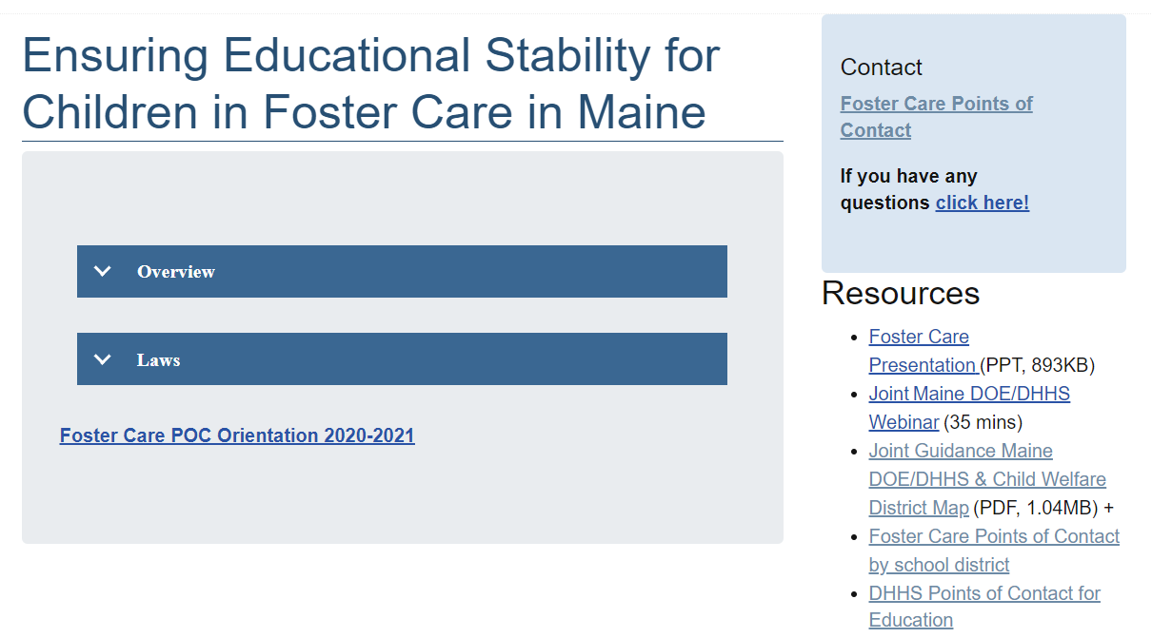

Slide 29
Neo.maine.gov

Slide 31
Link to required quiz for 2022-2023
Click here to complete the Point of Contact Quiz to check comprehension (required for all district POCs annually) – a certificate will be sent to you after completion
Or copy and paste this link to the quiz: https://forms.office.com/Pages/ResponsePage.aspx?id=q6g_QX0gYkubzeoajy-GTh3ciwadsupAk4Irx08pO-1UMEY2NlVRMTY1UDVBMklVWlZGNzBHVzZDTS4u

Slide 32
Contact
Julie A. Smyth, Director O3S
State Foster Care Point of Contact
Julie.a.smyth@maine.gov
Staci H. Warren, Administrative Asst.
staci.h.warren@maine.gov

