Slide 1
Essential Programs and Services Overview
Joint Standing Committee
Education and Cultural Affairs
Department of Education Briefing
February 1, 2021

Slide 2
BACKGROUND OF THE ESSENTIAL PROGRAMS AND SERVICES FUNDING FORMULA
Essential Programs and Services (EPS) is designed to ensure that all schools have the programs and resources that are essential for all students to have an equitable opportunity to achieve Maine’s Learning Results.
The EPS model provides a basis for adequacy and greater equity in the funding of PreK-12 education because it is cost driven instead of expenditure driven.
The model is designed to respond to student needs and is based on years of research and information gleaned from high performing cost effective school units.
Notes:
The Essential Programs and Services (EPS) Funding formula was developed by the Maine State Board of Education’s Committee to Study Essential Programs & Services and School Funding and enacted into law in 2003 (Public Law 2003, chapter 504). EPS was a significant change from prior funding formulas, which were driven by historical expenditures, i.e., the more school units spent, the more state funds they were likely to receive, all other factors remaining constant.
By contrast, the EPS formula was designed to be a cost model, determining how much money a school unit needs to fund its essential programs and services (its allocation), as determined by research-based information. The total amount that the unit would require for these programs and services is called the “total allocation” for the district.

Slide 3
How does the State determine what funds are needed for school districts?
Essential Programs & Services formula (EPS)
An adequacy funding model
Provides funding equity statewide
Utilizes data (information) provided by each school district
Accounts for school district characteristics (populations)
Distributes shares between school district members and the state
Establishes monthly state payment schedule
Required by state statute to be reported out to school districts by Feb 1 of prior fiscal year
Reported out to school districts on ED279 reports

Slide 4
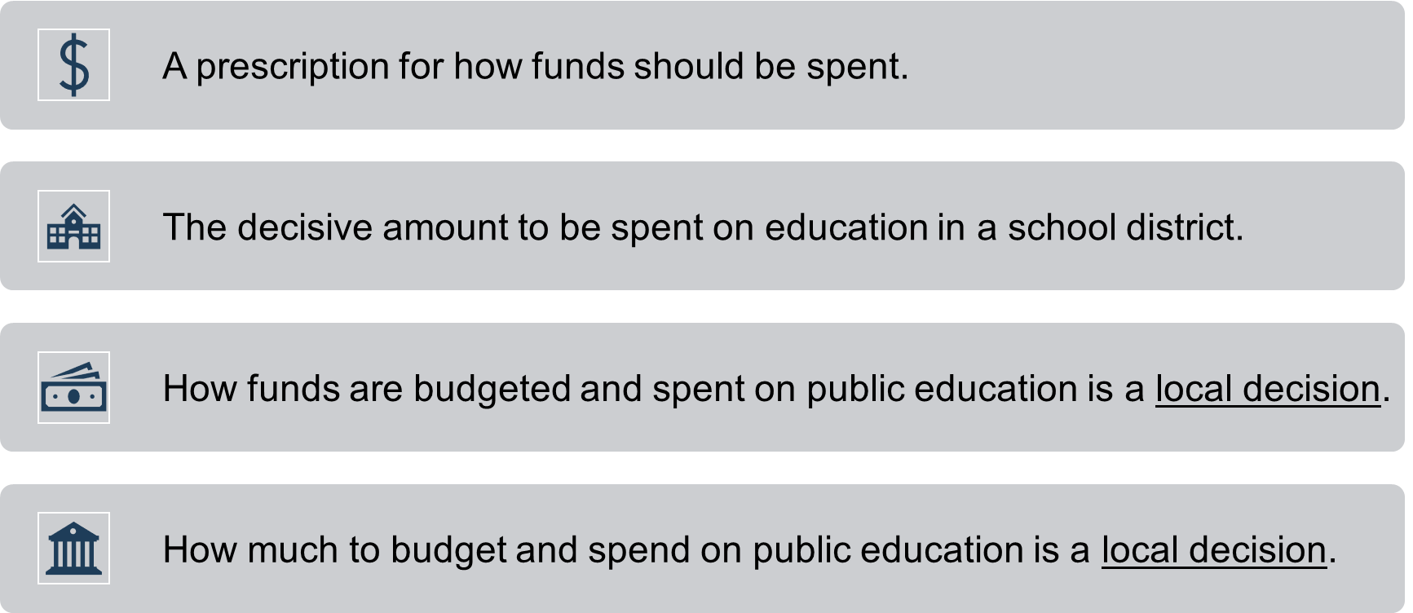
What EPS is NOT?

Slide 5
Why EPS?
The EPS formula provides the state with a mechanism for establishing a minimum sufficient funding level for achieving the state learning results and an equitable way to distribute the funding responsibility between local communities and the state.

Slide 6
How much pie do you need and/or have to distribute?

Slide 7
ED 279 Section 1: Computation of EPS Rates
ED 279 Section 2: Finding the Basic Operating Cost Allocations
ED 279 Section 3: Finding the Additional Operating Cost Allocations
ED 279 Section 4: Calculation of Required Local Contribution
ED 279 Section 5: Adjustments made to State & Local Contributions
ED 279 Section 6: Schedule of Payments

Slide 8
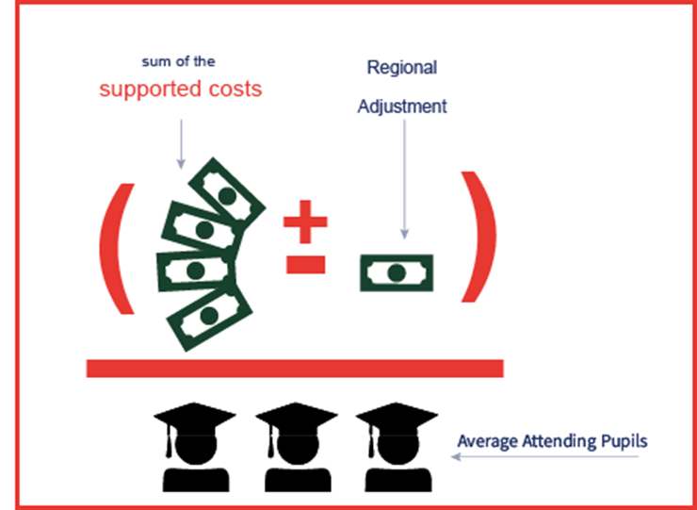
EPS Per-Pupil Rates – ED 279 Section 1
Elementary and secondary per-pupil rates are calculated for each school district; which is the per pupil rate of a student that needs no supplementary support. Elements used in this calculation:
Number of students attending the schools in the district
EPS Staff Positions:
Experience and education level of staff
Ratios of students to staff
Salary matrixes
(using State average salaries)
Percentages for benefits
Other Support Per-Pupil Costs
Regional Adjustments

Slide 9
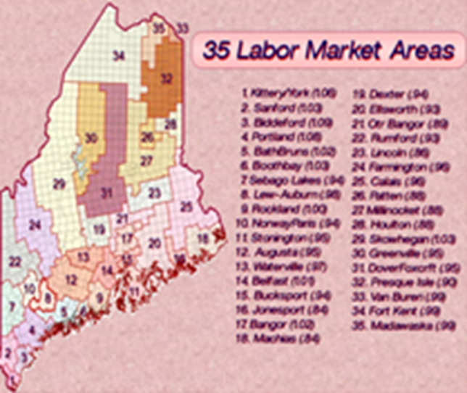
EPS Per-Pupil Rates – ED 279 Section 1
Regional Adjustments
The regional index is a factor using the 35 Labor Market Areas to account for variations in Income Levels and the Cost of living throughout the State of Maine; and the fact that we are using an Average Salary Scale for the entire State when determining the amount of salary to allow in the EPS calculation.

Slide 10
EPS Per-Pupil Rates – ED 279 Section 1
2-year average attending students by grade level used to determine necessary staffing levels for:
Other School Level Costs:

Slide 11
Operating Cost Allocations – ED 279 Section 2
Key components for operating allocations
Subsidizable student counts:
4YO/PreK, K-8, and 9-12 (using current and prior year October average for K-12)
Adult Ed course counts for 16-20 year olds
Equivalent instruction
Weighted student Counts:
Economically Disadvantaged
English Learners
Additional Targeted Funds:
Assessment
Technology Resources
4YO/PreK and PreK-2
Economically Disadvantaged
Isolated & Small School Adjustments
Notes:
Explain how subsidizable differs from attending

Slide 12
Additional Operating Cost Allocations – ED 279 Section 3
Key components for other allocations
Other Subsidizable Costs
Approved Gifted & Talented programs
Special Education (multi-component calculation & maintenance of effort adjustment)
Transportation Operating – EPS Allocation
Approved Bus Purchases
Teacher Retirement – Normalized Cost (employer share)
Debt Service Allocations
Principal & Interest Payments for approved school construction projects
Approved Costs for Instructional Space Leases
Insured Value Factor for Private School Tuition

Slide 13
Now that the Total Allocation is Determined:
Now that we know how much pie we need for each district.
How do we cut up the State share of the pie and equitably distribute the cost between the State and local towns?

Slide 14
State and Local Shares – ED 279 Section 4
Key components for determining State and Local shares
Subsidizable Student Counts
Total Allocations are summed and divided within each district based on percentage of subsidizable pupils by member municipality
Operating Allocation (Section 2 totals)
Other Subsidizable Cost Allocation (Section 3)
Teacher Retirement Allocation (Section 3)
Debt Service Allocation (Section 3)
Fiscal Capacity – State Valuation by Town
Lesser of 3-Year Average Valuation or Previous year Valuation
Local contributions determined by multiplying the town valuation by the Mil rate
The Mil rate is determined using the total cost of education, available state resources, and statewide property valuation
State Appropriation = Required local contribution subtracted from the Total Allocations by town.

Slide 15
Adjustments to State & Local Contributions – ED 279 Section 5
Section 5 = Total Allocation/Local Contribution/State Contribution Amounts
Section 5A = Adjustments made to both State and local contributions
Section 5B = Adjustments made to State contribution only
Local and State percentages Prior to adjustments
Local and State percentages After adjustments

Slide 16
Adjustments – ED 279 Section 5
List of adjustments where applicable:
Minimum State Allocation Adjustment (5%) (Minimum Receiver)
Minimum Special Education Adjustment (50%) (Minimum Receiver)
Adjustment for Debt Service (Minimum Receiver)
Minimum Economically Disadvantaged Student Adjustment (Minimum Receiver)
Audit Adjustments
Adjustment for Unappropriated Local Contribution
Long-Term Drug Treatment Centers Adjustments
Career and Technical Education (CTE)
Education Service Center (ESC) Member Allocation
Minimum Teacher Salary Adjustment
Maine Care Seed Adjustment

Slide 17
Minimum Receiver Status – what does it mean?
When a district/town's ability to pay is greater than their required local contribution, then they are considered a minimum receiver.
Remember, the EPS funding formula is used to equitably distribute funds to the areas that need them the most.
As a result, if your district has a higher valuation, (aka: higher ability to pay), the EPS formula will provide less funds to you, so it can provide more funds to school units that do not have as great an ability to pay.

Slide 18
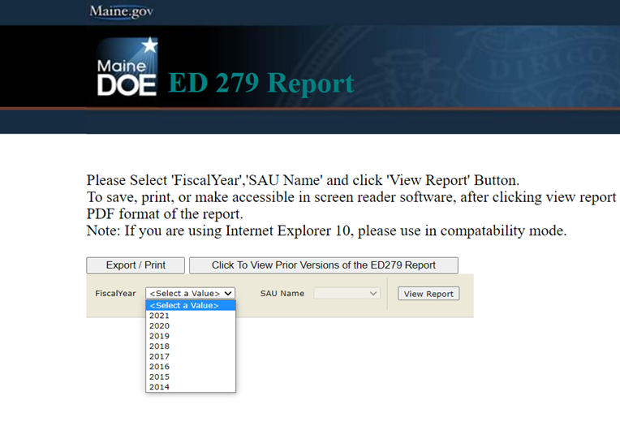
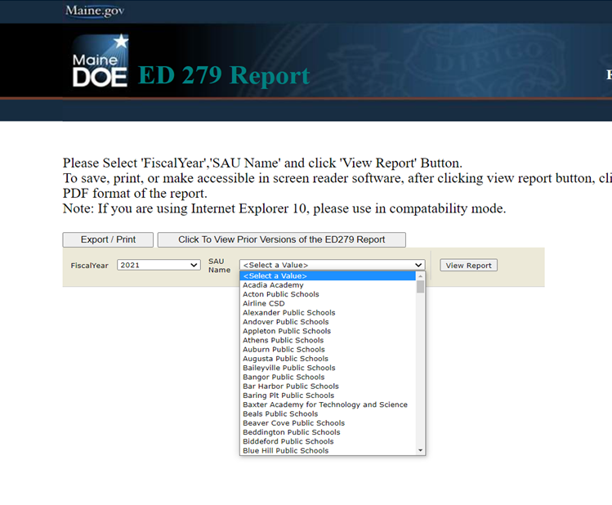
How do I access the ED 279 reports? Go to https://neo.maine.gov/DOE/NEO/eps/public/ed279.aspx
Choose Fiscal Year:
Choose SAU:

Slide 19
Other Resources
Essential Programs & Services website:
https://www.maine.gov/doe/funding/gpa/eps
Subsidy Printouts (ED279) for school districts:
https://neo.maine.gov/DOE/NEO/eps/public/ed279.aspx
Law: 20-A MRSA Chapter 606-B:
http://www.mainelegislature.org/legis/statutes/20-A/title20-Ach606-Bsec0.html

Slide 20
School Finance Contacts:
Tyler Backus School Finance Compliance Coordinator phone: 207-624-6635 tyler.backus@maine.gov
Paula Gravelle School Finance Manager phone: 207-624-6792 paula.b.gravelle@maine.gov
Ida Batista School Finance Coordinator phone: 207-624-6795 ida.batista@maine.gov

