Slide 1
Essential Programs & Services (EPS) Important Web Links

Slide 2
Maine DOE – Home Page
https://www.maine.gov/doe/home

Slide 3
Maine DOE - FUNDING
https://www.maine.gov/doe/funding

Slide 4
Maine DOE – Budgets & Accounting
https://www.maine.gov/doe/funding/accounting

Slide 5
Maine DOE – Fiscal Reports
https://www.maine.gov/doe/funding/reports

Slide 6
Maine DOE – Fiscal Review, Compliance, & Audit
https://www.maine.gov/doe/funding/fiscalreview

Slide 7
Maine DOE – Essential Programs & Services (EPS)
https://www.maine.gov/doe/funding/gpa/eps

Slide 8
Maine DOE – EPS Resources
https://www.maine.gov/doe/funding/gpa/eps/resources

Slide 9
Maine DOE – School Finance Training Materials
https://www.maine.gov/doe/funding/training-materials

Slide 10
Maine DOE – Help Desk Website
https://www.maine.gov/doe/data-reporting/collection/helpdesk

Slide 11
NEO – Maine Education Data Management System
https://neo.maine.gov/DOE/NEO/Dashboard/Home/Index/
Click Here

Slide 12
Student Data Needs
October 1st Enrollment Report (Public Schools & CTE):
Attending Students – those student attending a school in your district
Resident Students – those students that reside in a town in your district
Superintendent Transfer Students – those students that reside in a town outside of your district, but for purposes of the EPS calculation will be counted as a resident of your district.
Equivalent Instruction Students – Home School students taking a course(s) in your district.
Economic Disadvantaged Students – Currently defined as any student that meets the qualifications for federal free or reduced lunch.
English Learners – students that are identified as English learners.
Special Education Students – students identified as special education students.
CTE Enrollment – Students enrolled in CTE programs.
Synergy – State’s Student Information System
https://www.maine.gov/doe/data-reporting/collection/helpdesk/resources/synergy_instructions

Slide 13
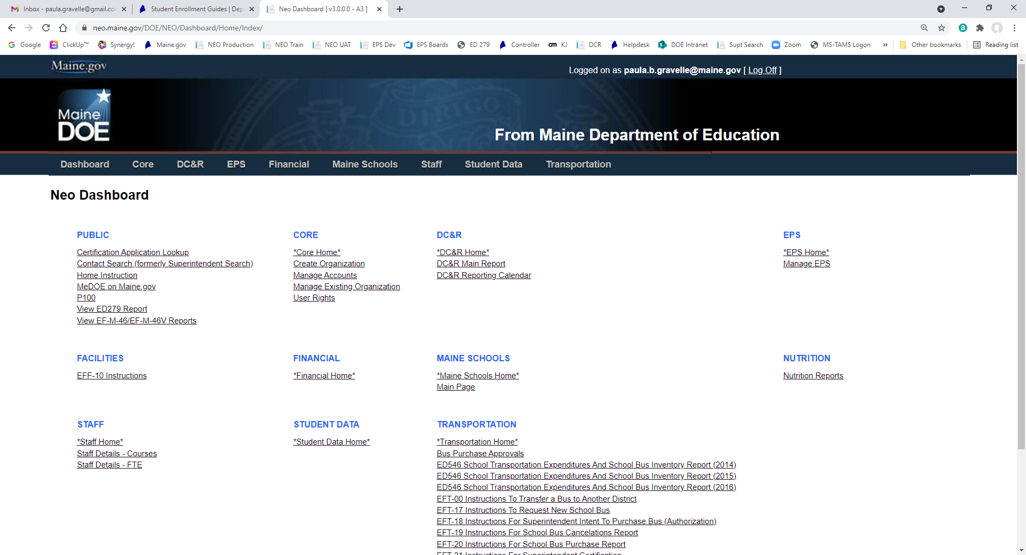
Student Data Verification
NEO – New Education Ontology (yes, someone liked the Matrix)
https://neo.maine.gov/DOE/NEO/Dashboard/Home/Index/
Click Here

Slide 14
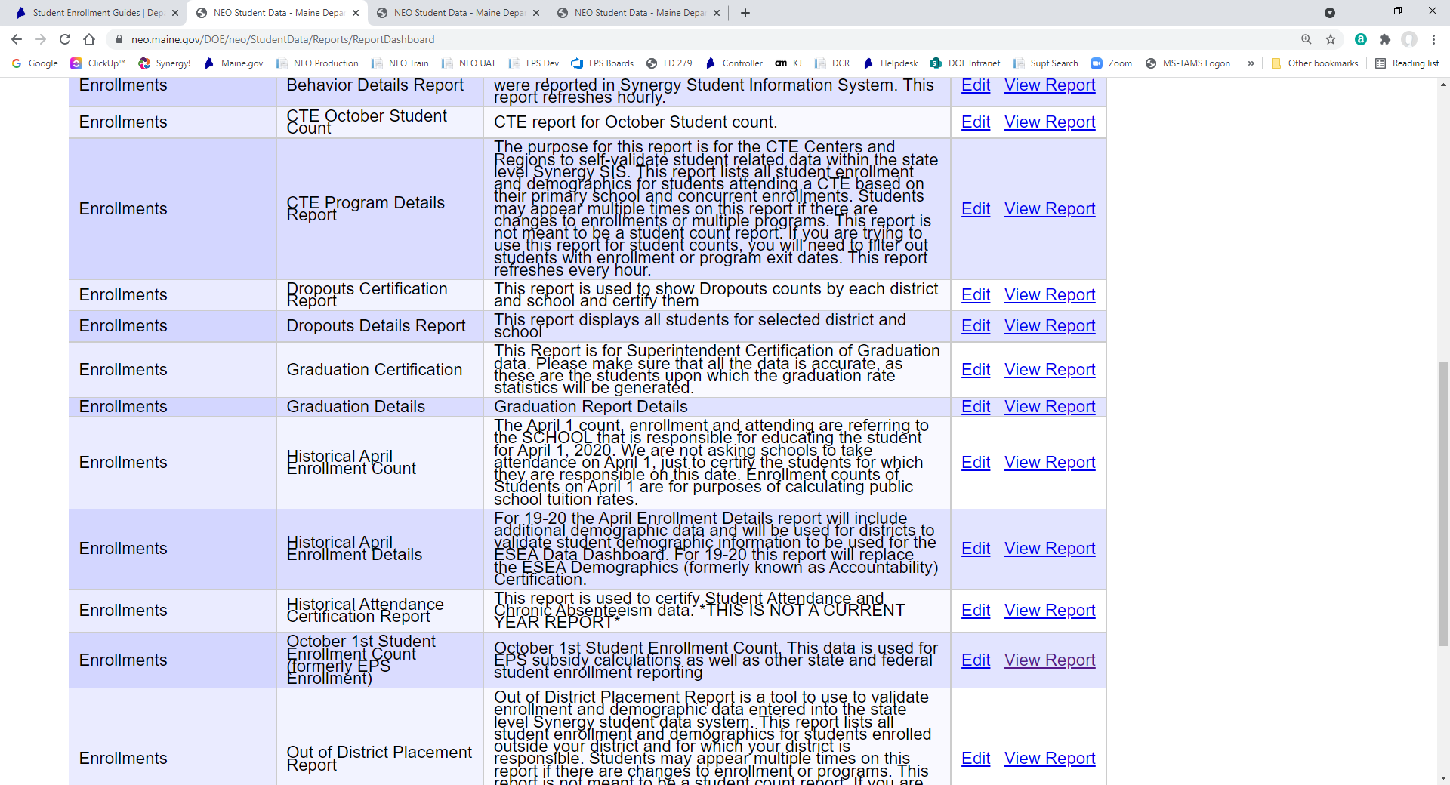
Student Data Verification
Student Reports
Click Here

Slide 15
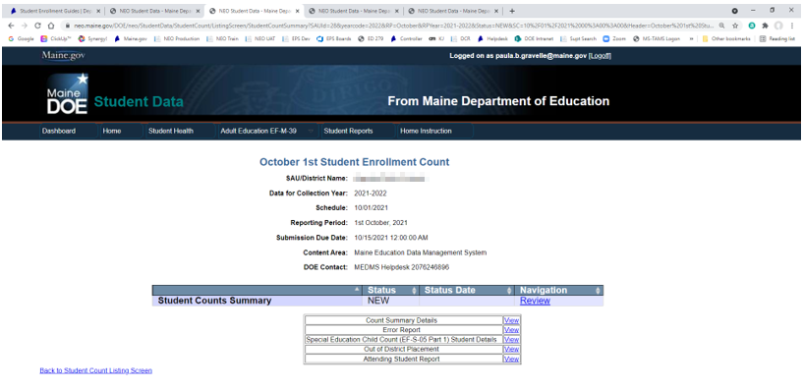
Student Data Verification

Slide 16
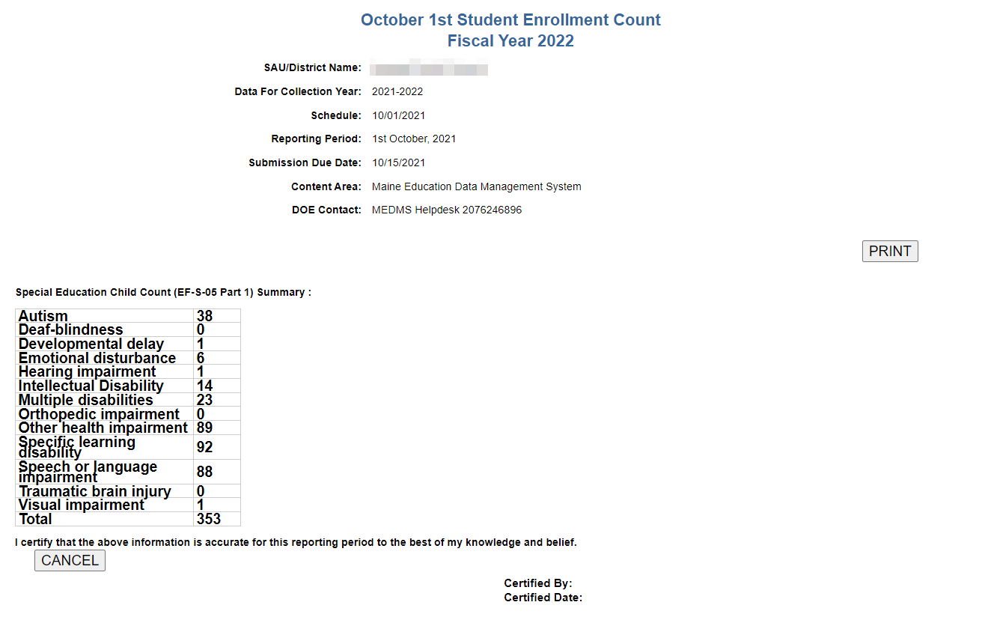
Student Data Verification

Slide 17
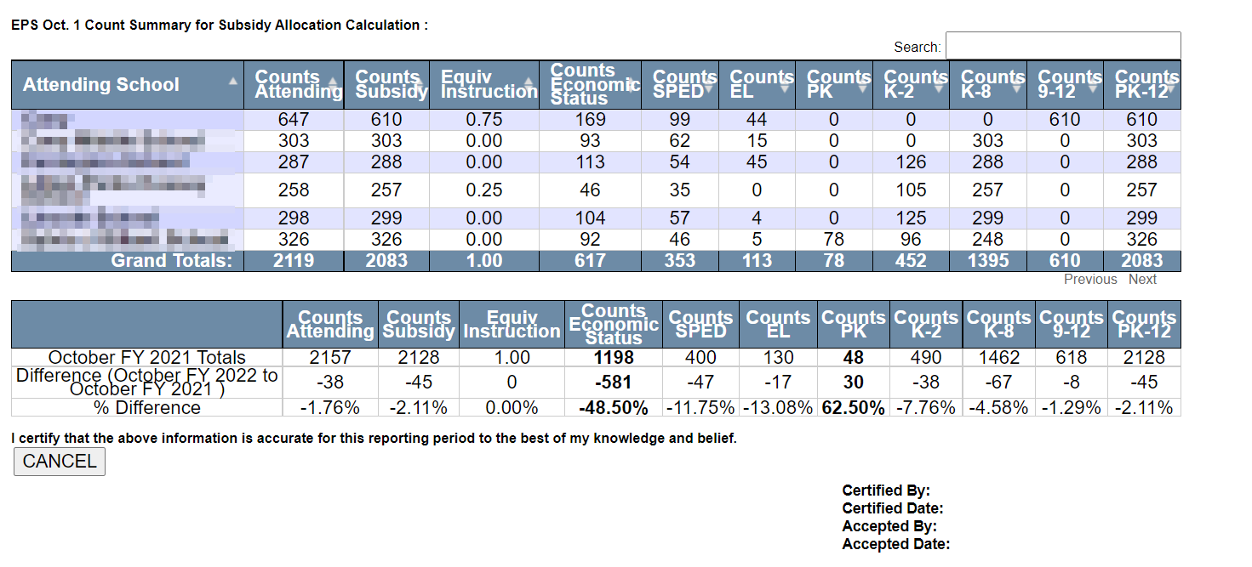
Student Data Verification

Slide 18
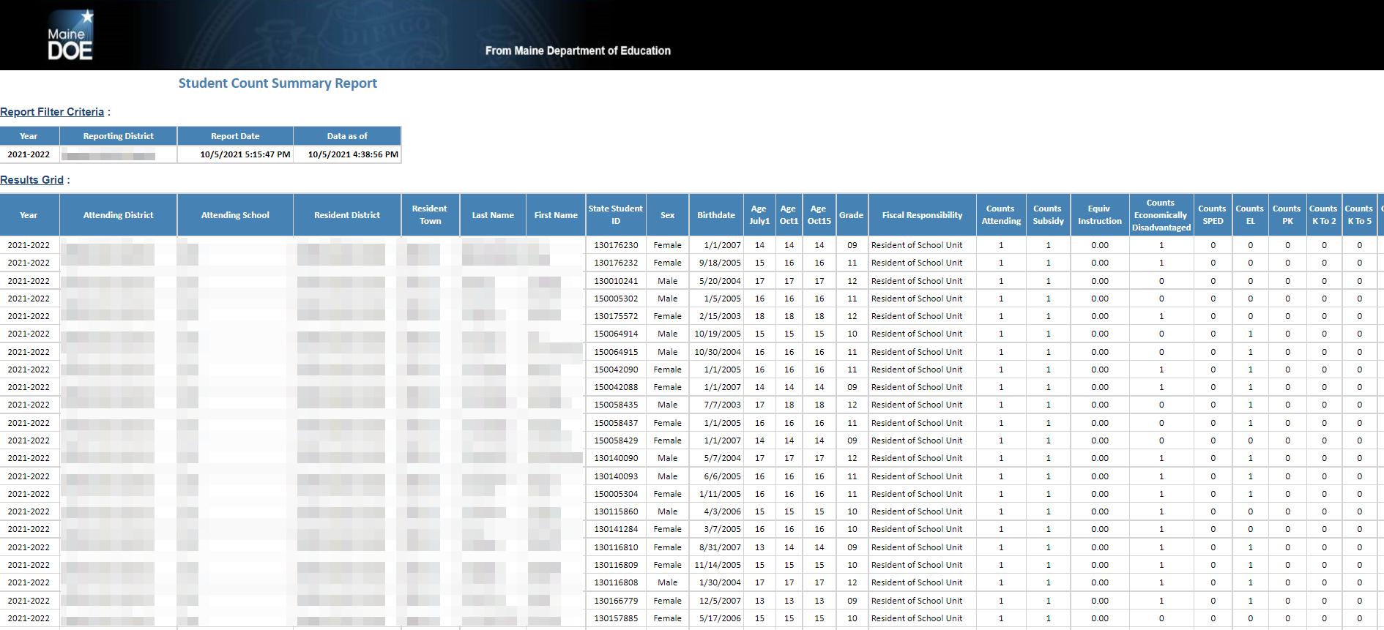
Student Data Verification – Count Summary Details Report

Slide 19
Staff Data Verification
NEO – New Education Ontology (yes, someone liked the Matrix)
https://neo.maine.gov/DOE/NEO/Dashboard/Home/Index/
Click Here

Slide 20
Staff Data Verification
Click Here

Slide 21
Staff Data Verification
Click Here

Slide 22
Staff Data Verification
Click Here

Slide 23
Staff Data Verification
Click Here

Slide 24
Federal Emergency Relief Programs
https://www.maine.gov/doe/covid-19/fedrelief
Click Here

Slide 25
ESEA Federal Programs - Titles
https://www.maine.gov/doe/learning/esea
Click Here

Slide 26
Office of Special Services
https://www.maine.gov/doe/learning/specialed/fiscal
Click Here

Slide 27
State of Maine – Master Agreements
https://www.maine.gov/dafs/bbm/procurementservices/reports/contract-search
Click Here

Slide 28
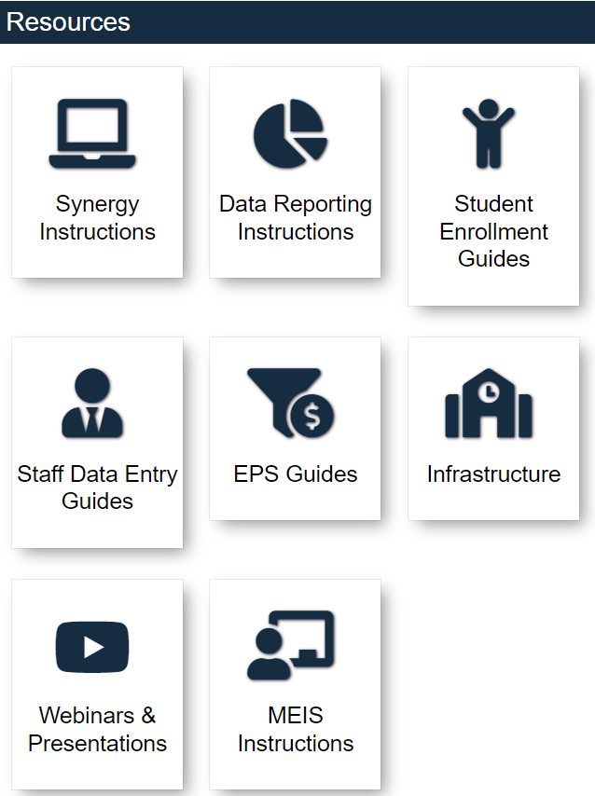
Help Desk - Again
https://www.maine.gov/doe/data-reporting/collection/helpdesk

Slide 29
School Finance Team Contact Information

Slide 30
School Finance Team

