Slide 1
New/ish Business Manager School Finance Training
EPS – Other subsidizable costs: Gifted & Talented, Transportation, Special Ed, and CTE

Slide 2
Gifted & Talented Allocation
ED279 Section 3A1
Compares
Q1 budget expenditures for Program code 4900 to
Q4 actual expenditures for Program code 4900
Allocation is the lesser of the two
https://www.maine.gov/doe/mtss/funding/gpa/gt

Slide 3
Special Education Allocation & High-Cost Out-of-District (HCOOD)
ED279 Section 3A2
5 components: Base, Prevalence, Size, High Cost In-District (HCID), Maintenance of Effort (MOE) = Special ed allocation
Related component with its own allocation is High-Cost Out-of-District (HCOOD)
ED279 Section 3A3

Slide 4
Special Education Allocation cont.
Base = 1.5 * SAU EPS per pupil(pp) rate* Special ed population w/o state wards (sw) or state agency clients (sac) that are up to 15% of the SAU’s subsidy population
Prevalence = 0.38 * SAU EPS (pp) rate* Special ed population w/o (sw) or (sac) that are greater than 15% of the SAU’s subsidy population
Size = for SAU’s with less than 20 special ed population 0.29 * SAU EPS (pp) rate* Special ed population w/o (sw) or (sac)

Slide 5
Special Education Allocation cont.
HCID = prior year HCID * inflation factor
Maintenance of Effort (MOE)
Uses most recent special ed actual net expenditure data* and associated special ed count w/o (sw) & (sac) to create a pp amount most recent FY
Compares total expenditures = pp amount most recent FY * current year special ed count w/o (sw) & (sac) to
Sum of Base, Prevalence, Size, and HCID
If total expenditures is greater than Sum then MOE is the difference, else it is 0
*Nets Revenue and HCOOD

Slide 6
High-Cost Out-of-District (HCOOD)
ED279 Section 3A3
Utilizes EF-S-07
Adjustment in Spring utilizing EF-S-214
Looks at individual placement expenditures and placement threshold (Private 4, Public 3, Public Region 2)
Utilizes a state ave special ed rate to set placement threshold costs: (Base + Prevalence + Size + HCID)/ state special ed pop w/o (sw) & (sac)
Allocation is the sum of differences between Actual expenditures and threshold costs

Slide 7
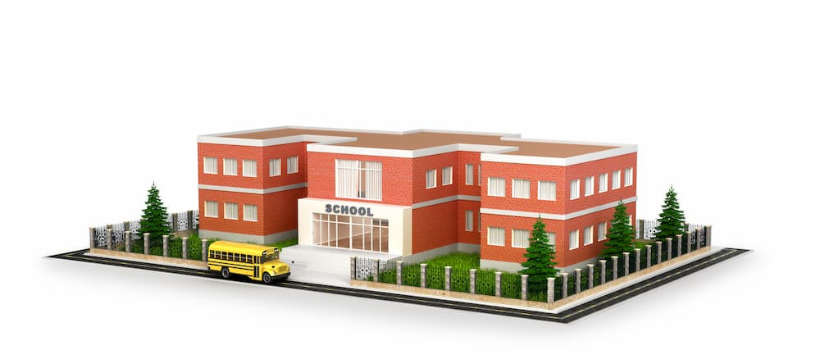
Transportation Operating Allocation
ED279 Section 3A4
Compares
Prior Year allocation inflated to
90% & 105% of actual transportation operating expenditures
The allocation can be no less than 90% nor no greater than 105% of actual transportation operating expenditures

Slide 8
CTE Funding Model
ED279 Section 5B6
Present since FY2019
Cost model
State side funds only
Model allocation amount should be considered a floor.

Slide 9
The EPS Pie - State and Local Shares
Total Cost of Education FY 23 EPS Calculation = $2,461,557,483
CTE $61M (4.5%)
Of State share
FY 23 State Appropriation for Education = $1,357,197,032
Notes:
For those new, this is the proverbial EPS pie which illustrates the state and local shares. For FY23, the total cost of education is 2.461B with the state share being $1.357B calculated with a 7.10 Mil Rate. Within the state share is the $61M (4.5%of state share) slice of pie reserved for CTEs and paid for by all taxpayers.

Slide 10
CTE Funding Model - Inputs
Enrollment
School and Program
Oct. 1
3 Year Averaged
Programs
Number & Type By Oct 15.
Sq. Footage
Nov 30
Notes:
There are three primary inputs for the CTE funding model:
Attending CTE student enrollment as of Oct. 1 for both the school and program. A 3 year average is used to smooth spikes and dips.
Any new, split, or unsuspended program applications & notifications have to be completed and submitted to Me DOE CTE by Oct 15.
And any additional or removed instructional space sq. footage measurements need to be reported to me by Nov.30th
.

Slide 11
CTE Funding Model - Five Components
Instruction
Central Admin
Operations & Maintenance
Supplies
Student and Staff Supports

Slide 12
Instruction
Teachers
FTEs based on program enrollment
Salary & Benefits
Ed Techs
FTEs for specific programs based on program enrollment
Salary & Benefits
Clinical Supervisors
Amount per 8 students
Substitutes
Per pupil amount

Slide 13
Central Administration
Director
1 FTE per CTE, Salary and Benefits
Asst. Director
FTE based on school size, Salary and Benefits
Business Manager
1 FTE per CTE Region, Salary and Benefits
Clerical Staff
1 FTE per 245 students, Minimum 1 FTE per CTE, Salary and Benefits
Other Central Adm Costs
Percentage of Central Adm Salaries and Benefits

Slide 14
Operations & Maintenance
An amount per sq. foot

Slide 15
Supplies
Amount per program
Varies by program
A per pupil per program amount

Slide 16
Student and Staff Supports
Guidance Counselor
FTE by school size, Salary and Benefits
Coordinator
1 FTE per CTE, Salary and Benefits
Technology, Per pupil amount
Co-curricular, Per pupil amount
Professional Development, Per pupil amount
Safety, Per pupil amount
Assessment, Per pupil amount
Program Transportation, Inflated expenditures

Slide 17
School Finance Contact:
Ida Batista School Finance Coordinator phone: 207-624-6795 ida.batista@maine.gov

