Slide 1
EF-S-07/214 Special Education Tuition and Board Report
Stephanie J. Clark
Fiscal Compliance Consultant
Finance, Compliance, & Audit

Slide 2
EF-S-07 vs EF-S-214
EF-S-07 Opens July 1 Due October 15th
Reporting the previous fiscal year. Includes all tuition Expense amounts.
EF-S-214 Opens March 1 Due April 15th
Reporting high-cost tuition for the current fiscal
year. Projecting tuition amounts to June 30.
Thresholds for the reporting amounts are provided on the EF-S-214 form.

Slide 3
Before the End of the Fiscal Year
Confirm all Out of District (OOD) placements are correct in Synergy
If the student does not have a concurrent enrollment the SAU will not be able to claim the tuition on the 07. It is imperative that the enrollment for the student is correct.
Notes:
Check with your enrollment people to confirm that all enrollments are correct.

Slide 4
NEO Special Education Module
Notes:
Log in to NEO and go to Special Education → Forms → EF-S-07

Slide 5
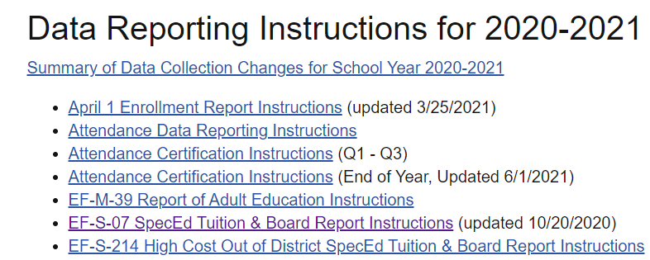
EF-S-07 Landing Page
Instructions Link
Instructions page → scroll to EF-S-07
Notes:
The link to the instructions is at the top of the landing page, when you click on that it will bring you to the DATA Reporting instructions page, scroll to the 07 instructions to download.

Slide 6
Choose Create & Import Out Placements
Import Out Placements
Notes:
Once you are ready to start the 07 choose create on the appropriate district, this will bring up the 07 data entry form. Click import out placements.

Slide 7
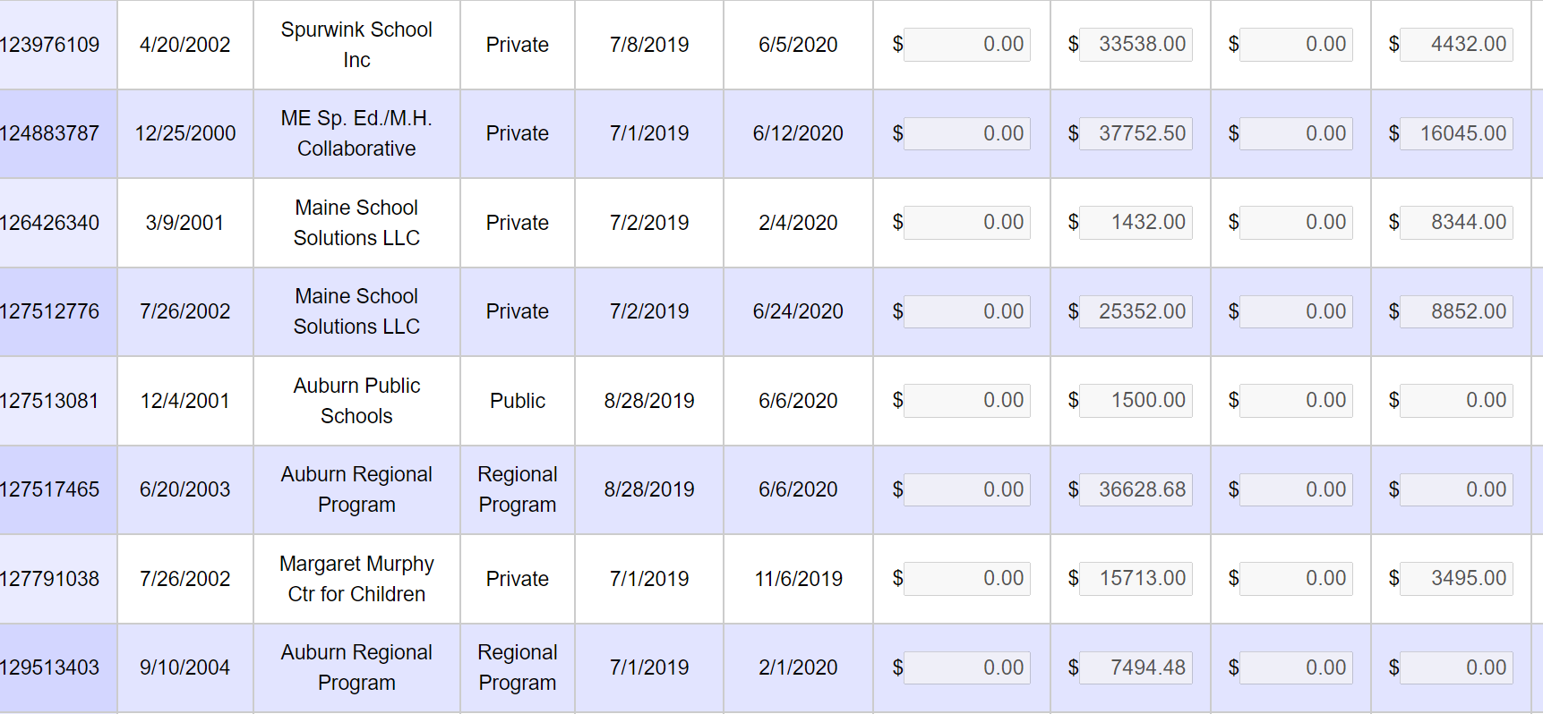
Import Out Placements
Notes:
This will bring in students who have a concurrent enrollment, this is a tool and should not be expected to bring in all the students. It may but it is possible you will have to use the Add Student tool as well. Click save a draft. Save often as the system may time out and you will lose data you have entered.

Slide 8
Remove Students
When using the Import Students button some students may come in that do not have out of district tuition expense or may import duplicate students. Click remove to delete the duplicates or wrong students from the report and enter the total amount in one line.
Notes:
When using the Import Students button some students may come in that do not have out of district expense or you may see duplicate students. Click remove to delete the duplicates or wrong students from the report and enter the total tuition amount in one line.

Slide 9
Add Local & Federal Tuition Costs
Notes:
Add the tuition amounts in either the Local funds or the Federal Funds. Do not include related services when reporting the tuition. This includes, ot pt speech transportation ed tech’s one on one etc.

Slide 10
Add Student
Click Add Student-enter student ID-click search
Notes:
If there are students that did not import automatically you will need to use Add Student function. Click add student and type in their state student ID and click search.

Slide 11
Select Placement-enter tuition expense
Select placement, enter tuition expense, click add
Notes:
Confirm you have the correct student and choose the proper placement from the drop-down list. Enter the tuition is entered click add. If the placement is not listed this may indicate that there wasn’t a concurrent enrollment entered in Synergy, you will not be able to claim the student tuition. When this happens enter the tuition amount in the comment box so I can use it to reconcile with the MEFS financials.

Slide 12
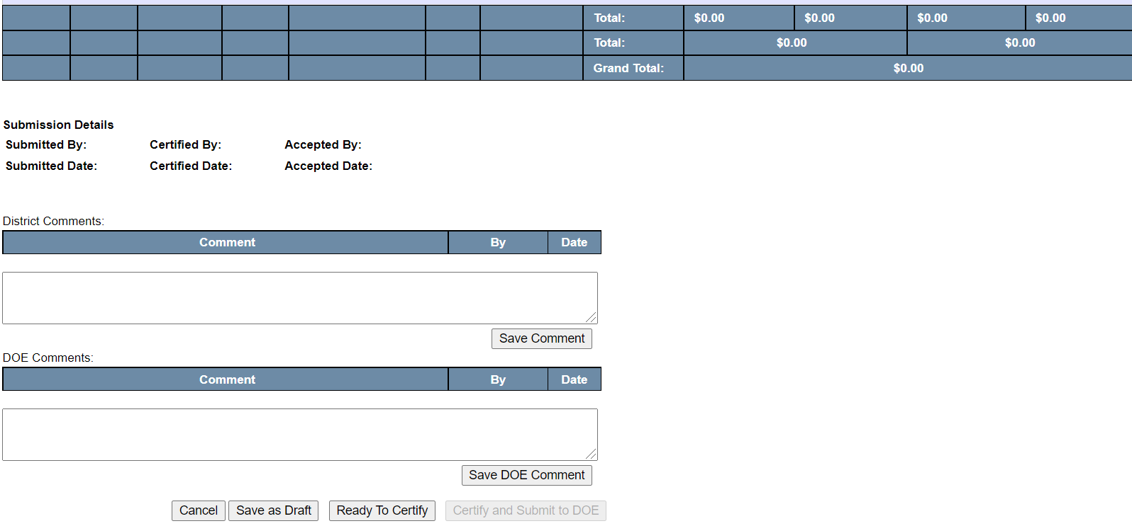
Ready to Certify & Send to Business Manager
Click Save as Draft to trigger the Ready to Certify Button or to save and come back later.
Click Ready to Certify to send to Business Manager
Notes:
Continue to enter the students, once you have completed the data entry and all looks good. Click save as draft, then Ready to Certify. Contact the business manager to let them know the 07 is ready for reconciliation.

Slide 13
Proper Coding
Public school tuition
time spent in resource rooms
xxxx-2200-1000-5610-950/990
time spent in self-contained room
xxxx-2300-1000-5610-950/990
Regional program school tuition
xxxx-2300-1000-5610-950/990
Private school tuition
xxxx-2300-1000-5630-950/990
Out of state tuition
xxxx-2300-1000-5620-950/990
Boarding cost for private schools
xxxx-2300-1000-5140-950/990
Notes:
These are the only codes that I look for when approving the 07.

Slide 14
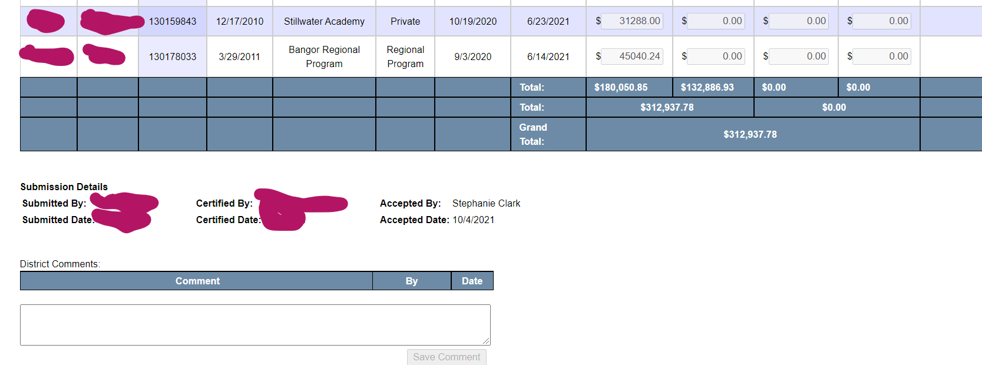
Business Manager Certifies and Submits to DOE
EF-S-07 totals must reconcile with Quarter 4 financials in MEFS
Once coded and reconciled click Certify and Submit to DOE
Notes:
This is how I verify that the two reports reconcile I go into MEFS and download your quarter 4 actual expenditures and filter on the program code and the Object code. I compare what is listed on the 07 to the tuition in the MEFS Financials.

Slide 15
Successful Submission
Report OOD tuition only. Do not include OT, PT, Speech, Transportation, Ed Tech or anything else that isn’t tuition
Quarter 4 financials reconcile with what is entered in the 07
DOE approves with first submission!
Notes:
If the two reports reconcile you have a successful submission!

