Slide 2
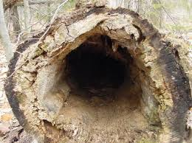
hollow
http://www.strangehistory.net/2015/10/18/real-tree-trunk-deaths/
Notes:
A word in the story is hollow.
In Spanish it is hueco (weh-koh).
Hollow means empty on the inside.
Let’s say the word hollow together. Ready?
“Hollow.” When you say hollow, I hear a /h/ sound at the beginning of the word.
Look, hollow begins with the letter h.
Here is a picture that shows hollow. This tree is empty on the inside.

Slide 3
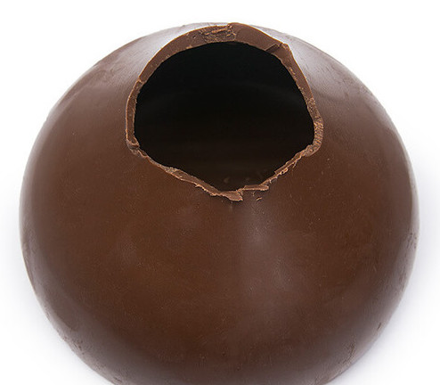
hollow
https://www.candywarehouse.com/hersheys-giant-kiss-milk-chocolate-12-ounce-gift-box
Notes:
Here is another picture of hollow.
How does this picture show the meaning of hollow? Turn and talk to your partner.
This chocolate is hollow. It is empty on the inside.
How many syllables are in the word hollow? Let’s find out by clapping. Ready?
“Hol-low.” Two syllables.
Now, let’s say hollow three times by clapping the syllables. Ready?
“Hol-low, hol-low, hol-low.”

Slide 4
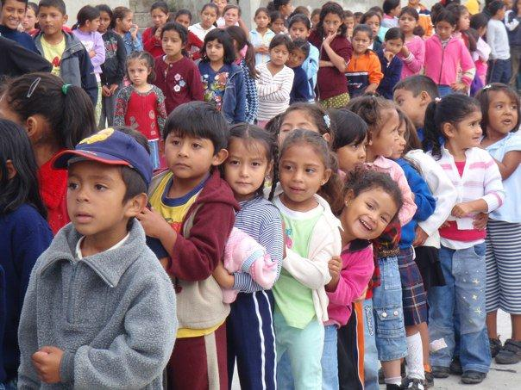
patient
https://tilson.wordpress.com/2010-photos/45131_432112911574_561461574_4899916_640824_n-1/
Notes:
A word in the story is patient.
In Spanish it is paciente (pah-syehn-teh).
Patient means able to wait without getting upset.
Let’s say the word patient together. Ready?
“Patient.” When you say patient, I hear a /p/ sound at the beginning of the word.
Look, patient begins with the letter p.
Here is a picture that shows patient. These kids are being very patient while they are waiting in line.

Slide 5
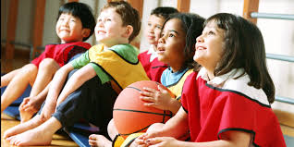
patient
http://ddsayspracticemakesperfect.blogspot.com/2016/02/
Notes:
Here is another picture of patient.
How does this picture show the meaning of patient? Turn and talk to your partner.
These kids are being patient as they wait for their turn in gym class; they are waiting patiently.
How many syllables are in the word patient? Let’s find out by clapping. Ready?
“Pa-tient.” Two syllables.
Now, let’s say patient three times by clapping the syllables. Ready?
“Pa-tient, pa-tient, pa-tient.”

Slide 6
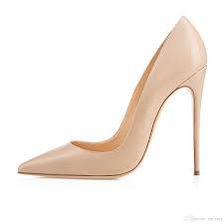
slim
https://www.dhgate.com/product/zandina-ladies-handmade-fashion-aso-kate/393164113.html#redirect_detail=WAP2PC
Notes:
A word in the story is slim.
In Spanish it is delgado (dehl-gah-doh).
Slim means not thick.
Let’s say the word slim together. Ready?
“Slim.” When you say slim, I hear a /s/ sound at the beginning of the word.
Look, slim begins with the letter s.
Here is a picture that shows slim. The heels on these shoes are very slim. They are not thick at all.

Slide 7
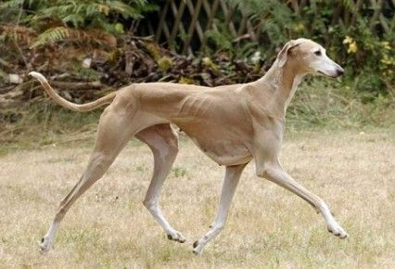
slim
https://www.pinterest.com/pin/340584790544844956/
Notes:
Here is another picture of slim.
How does this picture show the meaning of slim? Turn and talk to your partner.
This dog is very slim. He is not big or thick, he is skinny or slim.
How many syllables are in the word slim? Let’s find out by clapping. Ready?
“Slim.” One syllable.
Now, let’s say slim three times by clapping the syllables. Ready?
“Slim, slim, slim.”

Slide 8
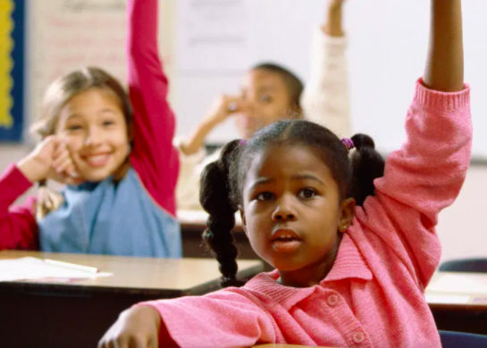
raise
https://www.additudemag.com/classroom-rules-that-work-for-students-with-adhd/
Notes:
A word in the story is raise.
In Spanish it is levantar (leh-bahn-tahr).
Raise means to lift carefully.
Let’s say the word raise together. Ready?
“Raise.” When you say raise, I hear a /r/ sound at the beginning of the word.
Look, raise begins with the letter r.
Here is a picture that shows raise. The kids raise their hands because they have something to say.

Slide 9
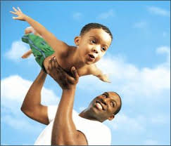
raise
https://legacyproject.human.cornell.edu/category/young-children/
Notes:
Here is another picture of raise.
How does this picture show the meaning of raise? Turn and talk to your partner.
This man is raising the child up in the air. He is lifting him up.
How many syllables are in the word raise? Let’s find out by clapping. Ready?
“Raise.” One syllable.
Now, let’s say raise three times by clapping the syllables. Ready?
“Raise, raise, raise.”

Slide 10
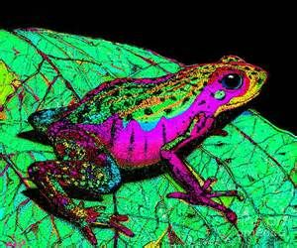
rare
https://www.pinterest.com/pin/149674387600350390/
Notes:
A word in the story is rare.
In Spanish it is raro (rrah-roh).
Rare means not many or very few.
Let’s say the word rare together. Ready?
“Rare.” When you say rare, I hear a /r/ sound at the beginning of the word.
Look, rare begins with the letter r.
Here is a picture that shows rare. This is a rare frog. There are not many of them in the world. It is very rare.

Slide 11
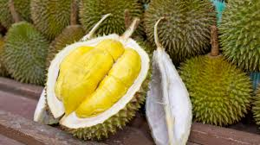
rare
https://theculturetrip.com/asia/singapore/articles/8-things-you-need-to-know-about-durian-the-worlds-smelliest-fruit/
Notes:
Here is another picture of rare.
How does this picture show the meaning of rare? Turn and talk to your partner.
This is a fruit that is rare in Boston, called a durian. These are hard to find in a store or fruit stand. However, in Thailand and Malaysia, they are not rare at all; they are quite common.
How many syllables are in the word rare? Let’s find out by clapping. Ready?
“Rare.” One syllable.
Now, let’s say rare three times by clapping the syllables. Ready?
“Rare, rare, rare.”

