Slide 1
Go Figure
Rummaging through Maine’s Familiar Civil War

Slide 2
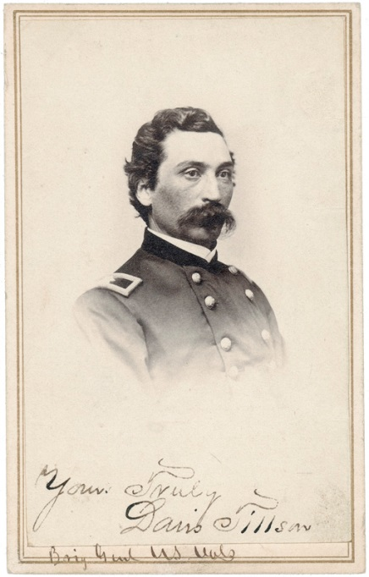
Storm gathers
Governor Lot Morrill
Adj. Gen. Davis Tillson

Slide 3
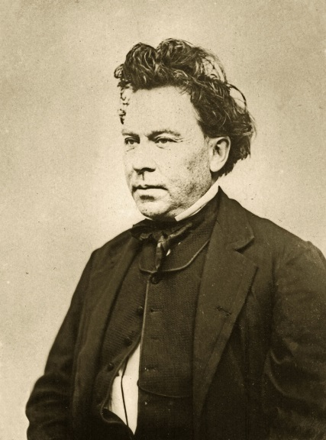
New Administration
Israel Washburn
John Hodsdon

Slide 4
By the Numbers
Maine Civil War statistics
Population in 1860 628,279
Number of Maine men 17-40: 112,466
Number who served in army/navy 72,945
Average size: 5’7.5” 145 lbs.
Age of majority: 18 years, 6 mos.
Average age: 23 years
Principal occupation: farming, 48 %
Military service: Army 56,000
Navy 14,000

Slide 5
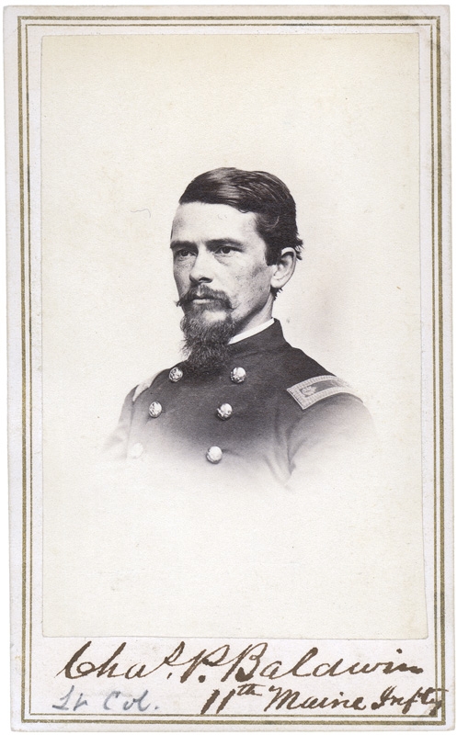
Bangor Bomber
Captain Charles Baldwin
26, Bangor
Company B
11th Maine Volunteer Regiment
Commanded Mortar Battery:
Morris Island

Slide 6
Looking Long range
8th Maine Volunteer Infantry Regiment
Muster in: September 7, 1861 Muster out: January 18, 1866
Length of service 3 years, extended
Number served 1,586
Killed/died of wounds 134
Died of disease: 247
Wounded: 355
Died in Confederate prison: 35
Engagements:
Fort Pulaski Jacksonville
Drewry’s Bluff Ware Bottom Church
Petersburg Campaign Cold Harbor
Petersburg Chaffins Farm
Fort Gregg Fort Baldwin
Rice’s Station Appomattox

Slide 7
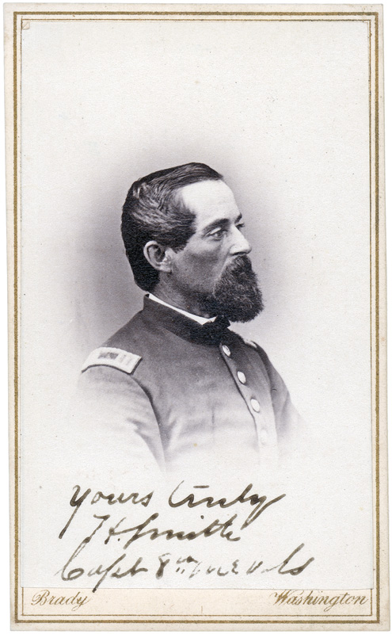
First Parrott Heads
Captain Hillman Smith
Hampden
Company K
8th Maine Volunteer Regiment
Parrott Rifles at Fort Pulaski
Rifling provided greater velocity, range,
accuracy, and penetrating power,
rendered smoothbore siege guns obsolete.

Slide 8
Tools of the Trade
Name | Weight ofprojectile | Weightof gun | Lengthof gun | Range
4.2 inch Parrott rifle(30-pdr Parrott rifle) | 25 lb.(shell) | 4,200 lb. | 132 in. | 6,700 yd.@ 25°
6.4-inch Parrott rifle(100-pdr Parrott rifle) | 90 lb.(shell) | 9,700 lb. | 155 in. | 8,845 yd.@ 35°
8-inch Parrott rifle(200-pdr Parrott rifle) | 150 lb.(shell) | 16,500 lb. | 162 in. | 8000 yd.@35°
10-inch Parrott rifle(300-pdr Parott rifle) | 250 lb.(shell) | 26,500 lb. | 177 in. | ---

Slide 9
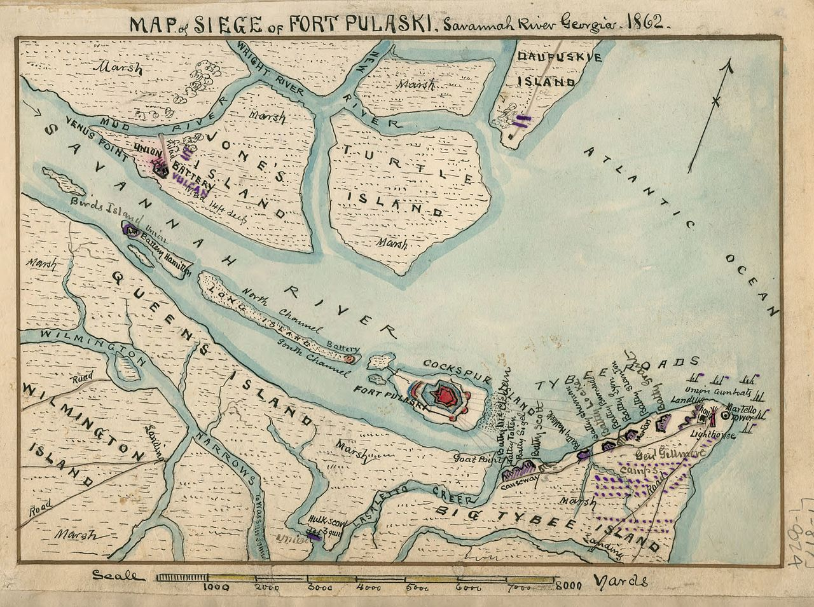
Saving Savannah

Slide 10
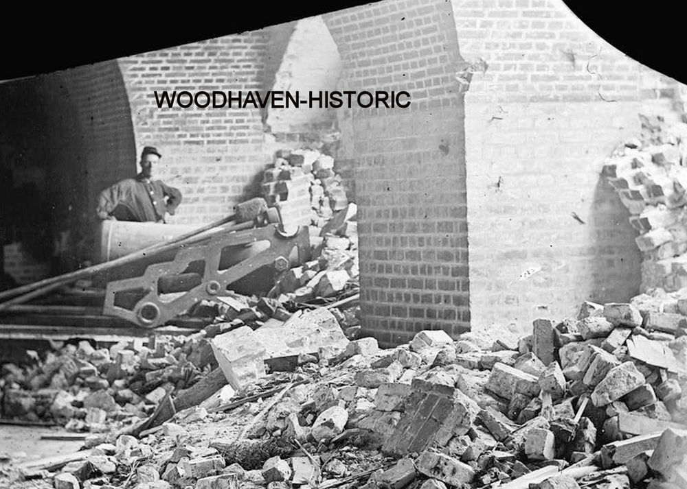
So Much For That
“They cannot breach your
walls at that distance.”
~ Confederate General
Gen. Robert E. Lee, to
Col. Charles Olmstead
Fort Pulaski Commander
November, 1861

Slide 11
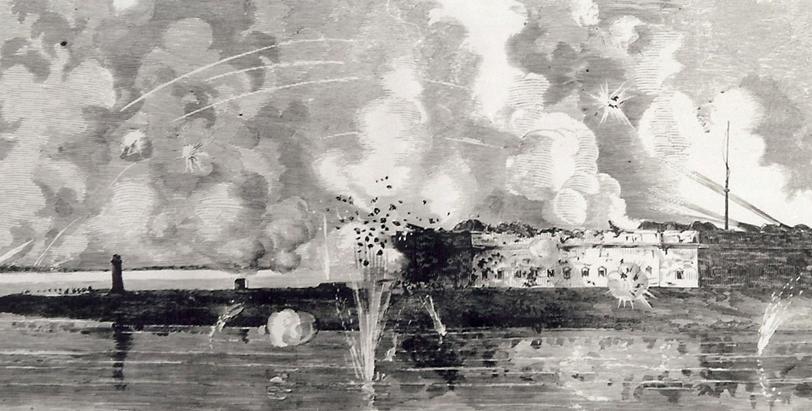
Pounding Pulaski

Slide 12
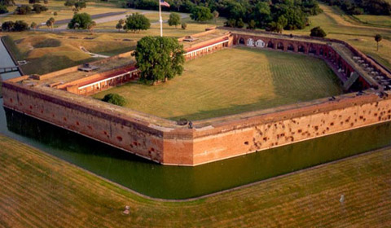
Hit the Bricks
Fort Pulaski
$1 Million
15 years to build
21 million bricks
7.5 ft. thick walls
385 soldiers
1 killed
363 captured
Defeated in 36 hours

Slide 13
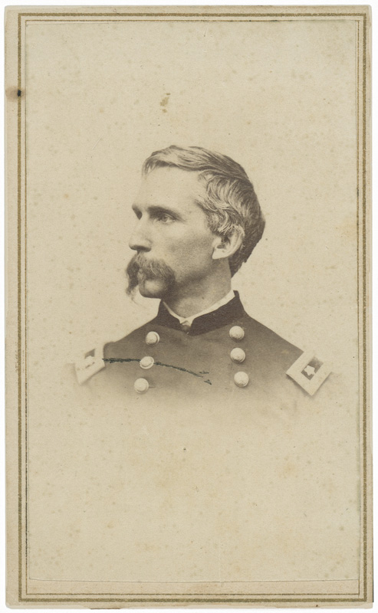
Little Known Volunteer
“…but, I fear, this war, so costly of blood and treasure, will not cease until the men of the North are willing to leave good positions, and sacrifice the dearest personal interests, to rescue our country from desolation, and defend the national existence against treachery at home and jealousy abroad.”
Bowdoin Professor Joshua Chamberlain To Gov. Israel Washburn
July 14, 1862

Slide 14
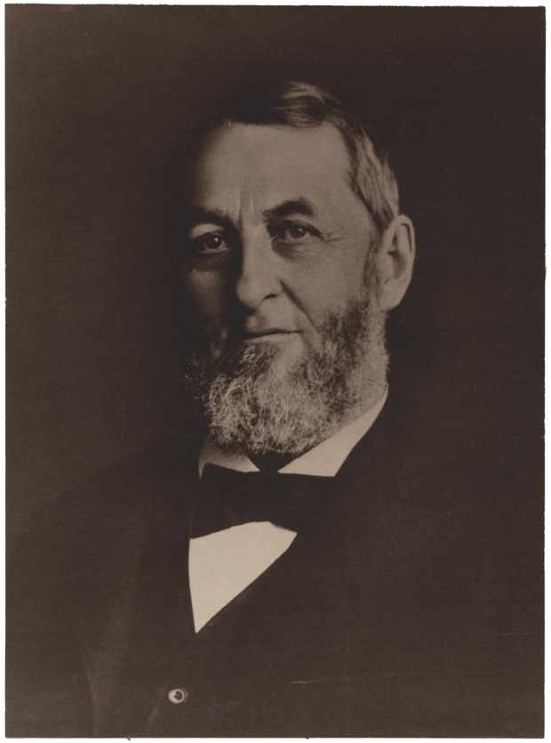
Ask A Friend
“Have you appointed Chamberlain Col. of the 20th? His old classmates etc. here say you have been deceived: that C. is Nothing at all: that is the universal expression of those who knew him.”
Attorney General Josiah Drummond
To Gov. Israel Washburn July 21, 1862

Slide 15
Take a Look
16th Maine: Sacrificed at Gettysburg
https://video.mainepublic.org/video/sixteenth-maine-gettysburg-sixteenth-maine-gettysburg/
Forlorn Hope: 1st Maine Heavy at Petersburg
https://www.pbs.org/video/forlorn-hope-cecgug/

Slide 16
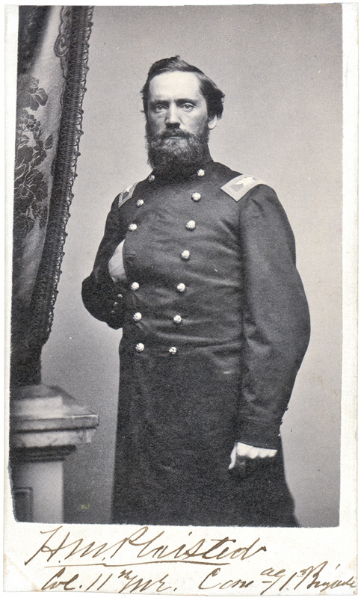
Capable Commander
Colonel Harris Plaisted
Bangor
11th Maine Infantry Regiment
Commanded at:
Morris Island – Fort Wagner
Charleston – Fort Sumter

Slide 17
Busy Boys
11th Maine Volunteer Infantry Regiment
Muster in: November 12, 1861 Muster out: February 2, 1866
Length of service: 3 years, extended
Number killed or died of wounds: 122
Number died of disease: 237
Engagements:
Yorktown Williamsburg White Oak Swamp Malvern Hill
Gloucester Court House Fernandina
Siege of Charleston Chester Station
Bermuda Hundred Petersburg
Second Deep Bottom New Market Heights
New Market Roads Darbytown Road
Fort Gregg Appomattox

Slide 18
Different Roles
Excluded from service:
Women
Men younger than 18
Men older than 35
Teachers
Judges
Members of Congress
Telegraph Operators
Railroad Engineers
Munitions workers

Slide 19
Nurses’ Special Qualities
“All nurses are required to be plain looking women, Their dresses must be brown or black, with no bows, no curls, no jewelry, and no hoopskirts.”
Dorothea Dix, Hampden
Superintendent of Union Army Nurses

Slide 20
Humbly Qualified
“I have been a Nurse for over 15 years, am over 30, and have a cheerful temperament; and think as a Nurse I could do a great deal of good, as well as receive some little compensation, for my services…I cannot offer my services gratuitously, as some generous souls have done, because I am too poor, have no home, and am dependent upon myself entirely for a living. I can procure certificates if necessary of my moral character and qualifications as a Nurse.”
Cynthia Averill, Waterville
To Gov. Israel Washburn, May 1862

Slide 21
Government Program
Maine Conscription (Draft) Civil War
Total drafted: 16,087
Furnished substitutes 1,737
Paid commutation 1,937
Exempted: Physical disability 6,115
Alienage 292
Non-residence 396
Unsuitable age 653
Sect. 2, Enrolment Act 1,780
Uncertain identity 11
Promotion 4
Felony conviction 1
In Service, March 3, 1863 374
Drafted twice 25
Illegally drafted 2
Permitted to remain home till further orders 5
Died since drafted 34
Failed to report 1,913
Drafted and entered service 808

Slide 22
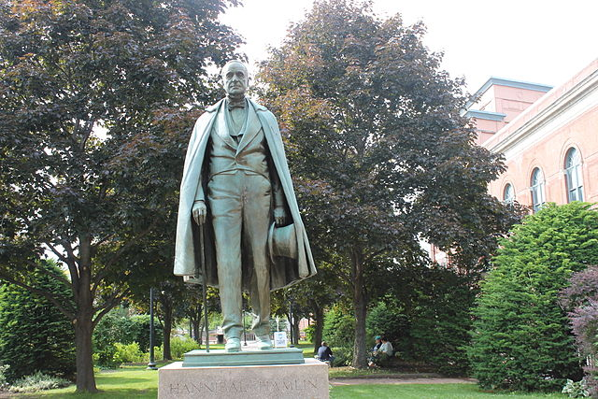
Summer Soldier
Hannibal Hamlin:
Private
Maine Coast Guards
Company A
Fort McClary
Kittery, Maine
Summer, 1864

Slide 23
Tally Ho
Maine Civil War deaths: 9,398
Battle 3,184
Disease 5,592
Confederate Prison 541
Drowning 118
Murdered 13
Sunstroke 6
Suicides 5
Executions 5
Missing in action 616
Disabled by injury/illness 11,309
Civil War veterans buried in Maine 38,000
(Maine Adjutant General’s Reports, cumulative, 1861-1866)

Slide 24
Home Help
Maine State Aid to Wartime Families
Number of families 46,034
Number of family members 122,183
Aid amount 1862- 66 $1,960,801.99
(“Maine in the War For the Union – A History of the part borne by Maine Troops in the Suppression of the American Rebellion”
William Whitman, Charles True, 1865, Dingley Pub., Lewiston)

