Slide 1
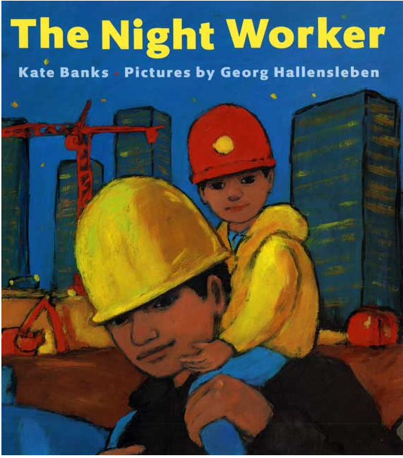
Notes:
engineer: a person who designs and builds machines or public works
survey: to examine, gather and record information about a topic or an area of land; a tool that gathers data (give images for both meanings)
motion: movement

Slide 2
engineer
https://sghijabgirl.wordpress.com/2011/01/25/whoever-said-that-wearing-a-hijab-is-a-hindrance-to-ones-hopes-and-dreams/
Notes:
A word in the story is engineer.
In Spanish it is ingeniero o ingeniera (eeng-heh-nyeh-roh/rah).
An engineer is a person who designs and builds machines or public works.
Let’s say the word engineer together. Ready?
”Engineer.” When you say engineer, I hear the /e/ sound at the beginning of the word.
Look, engineer begins with the letter e.
Here is a picture that shows engineer. This engineer is making a model of a machine she developed. She will test her ideas to make sure her design works well.

Slide 3
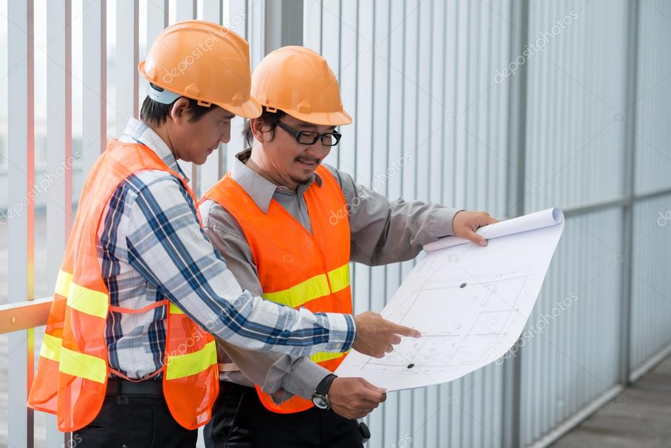
engineer
https://depositphotos.com/85787608/stock-photo-vietnamese-engineers-examining-blueprint.html
Notes:
Here is another picture of engineer.
How does this picture show the meaning of engineer? Turn and talk to your partner.
These two engineers are checking the plans they drew to decide the next steps in the construction process.
How many syllables are in the word engineer? Let’s find out by clapping. Ready?
“En-gi-neer.” 3 syllables.
Now, let’s say engineer three times while clapping the syllables. Ready?
“En-gi-neer, en-gi-neer, en-gi-neer.”

Slide 4
survey
https://reefs.com/2015/07/11/astronaut-takes-a-dive-into-the-new-england-aquarium/
Notes:
Another word in the story is survey.
In Spanish it is inspeccionar (eens-pehk-syoh-nahr).
To survey means to examine, gather, and record information about a topic or an area of land. It is a verb, an action people do. We also take surveys in class, such as when I ask you, “Would you rather be a lion or a dolphin? In that case the word is a noun, a thing. There are two different ways of using the word, as a verb or a noun. In this text, people will survey a place.
Let’s say the word survey together. Ready?
”Survey.” When you say survey, I hear the /s/ sound at the beginning of the word.
Look, survey begins with the letter s.
Here is a picture that shows the verb or action survey. The diver is surveying the ocean floor to collect information about the different plants and animals in that area.

Slide 5
survey
https://www.constructionplacements.com/how-to-properly-inspect-a-construction-site-for-hazardous-materials/
Notes:
Here is another picture of survey.
How does this picture show the meaning of survey? Turn and talk to your partner.
These engineers are surveying the construction site. They are gathering information to make sure things are being built right and in a safe manner.
How many syllables are in the word survey? Let’s find out by clapping. Ready?
“Sur-vey.” 2 syllables.
Now, let’s say survey three times by clapping the syllables. Ready?
“Sur-vey, sur-vey, sur-vey.”

Slide 6
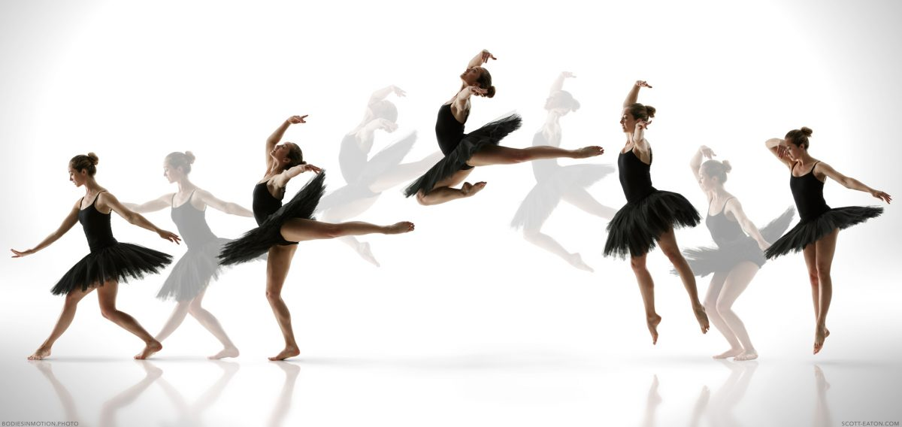
motion
https://blog.bodiesinmotion.photo/bim-vi-new-ballet-motions/
Notes:
A word in the story is motion.
In Spanish it is movimiento (moh-bee-myehn-toh).
Motion means movement. These two words are synonyms. They have the same meaning.
Let’s say the word motion together. Ready?
”Motion.” When you say motion I hear the /m/ sound at the beginning of the word.
Look, motion begins with the letter m.
Here is a picture that shows motion. The photographer captured all the movements the dancer did for the jump. He captured the dancer’s motion.

Slide 7
motion
https://economictimes.indiatimes.com/news/sports/from-pv-sindhu-to-s-jaishankar-india-is-on-a-running-movement/the-goal/slideshow/77648584.cms?from=mdr
Notes:
Here is another picture of the word motion.
How does this picture show the meaning of motion? Turn and talk to your partner.
This person is running. He does motions with his arms and legs.
How many syllables are in the word motion? Let’s find out by clapping. Ready?
“Mo-tion.” 2 syllables.
Now, let’s say motion three times by clapping the syllables. Ready?
“Mo-tion, mo-tion, mo-tion.”

