Slide 1
Coding
Mary Randall

Slide 2
https://www.maine.gov/doe/funding/training-materials

Slide 3
Salary & Benefit Matrix

Slide 4
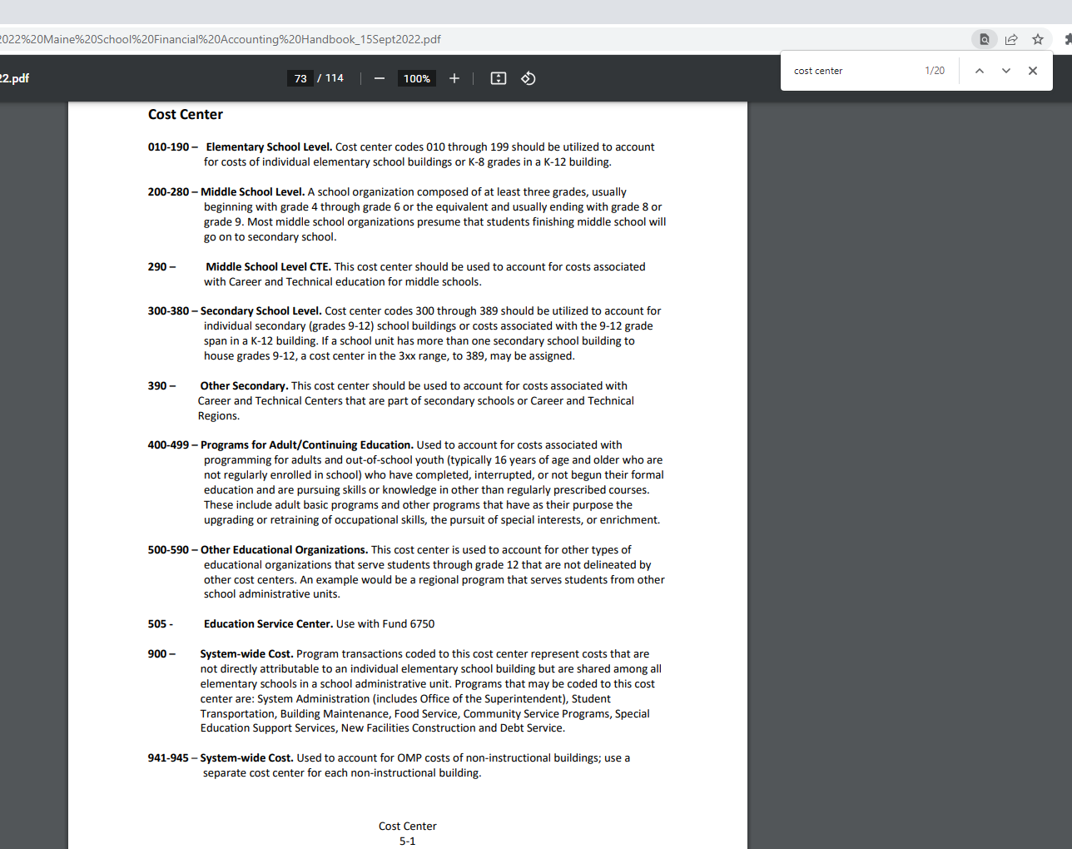
Accounting Handbook- Find

Slide 5
E-Rate 2016 Update

Slide 6
https://www.maine.gov/doe/funding/accounting/handbook

Slide 7
https://www.maine.gov/doe/funding/accounting/handbook

Slide 8
https://www.maine.gov/doe/sites/maine.gov.doe/files/inline-files/AccountCodingCheatSheet_Revenue.pdf

Slide 9
Helpful Dates to keep in mind
Quarter 1 Actuals (July, August, September) are due October 30
Quarter 2 Actuals (October, November, December) are due January 30
Quarter 3 Actuals (January, February, March) are due April 30
Quarter 4 Actuals (April, May, June) are due August 30

