Slide 1
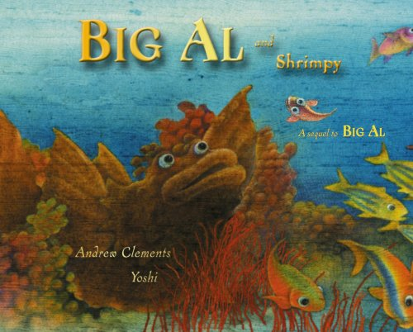

Slide 2
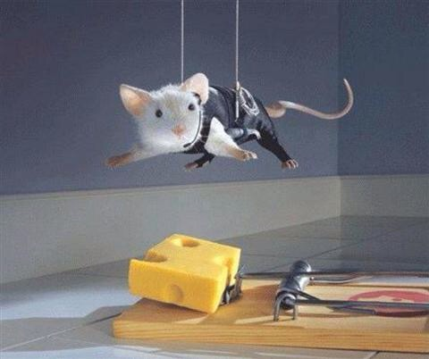
clever
Notes:
A word in the story is clever.
In Spanish it is listo (lees-toh).
Clever means smart.
Let’s say the word clever together. Ready? “Clever.”
When you say clever, I hear a /c/ sound at the beginning of the word.
Look, clever begins with the letter c.
Here is a picture that shows clever. See this mouse, he is being clever, or smart, by hanging over the mousetrap to try and get the cheese.

Slide 3
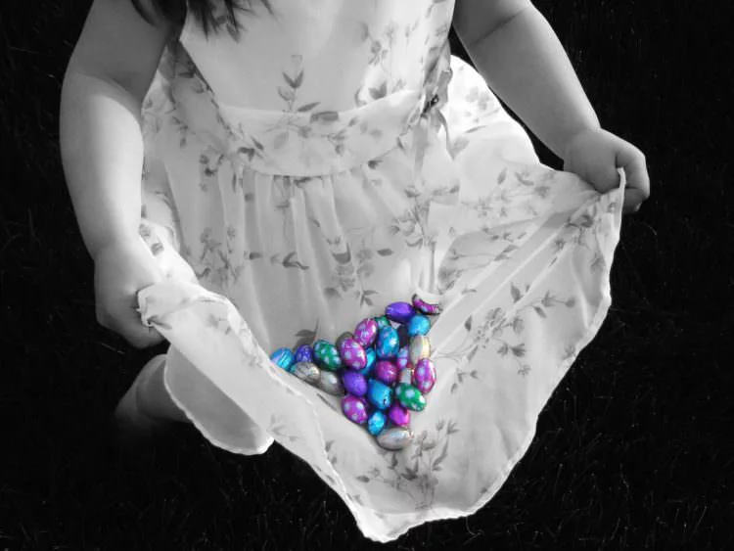
clever
Notes:
Here is another picture that shows clever.
How does this picture show clever? Turn and talk to your partner.
This girl is being clever, she is found a way to use her dress to carry all the jelly beans.
How many syllables are in the word clever? Let’s find out by clapping. Ready?
“Cle-ver.” Two syllables.
Now, let’s say clever three times by clapping the syllables. Ready?
“Cle-ver, cle-ver, cle-ver.”

Slide 4
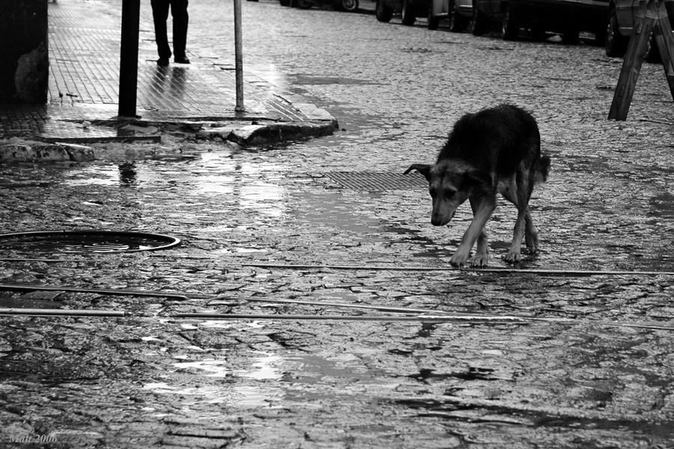
lonely
Notes:
Another word in the story is lonely.
In Spanish it is solo (soh-loh).
Lonely means sad and by yourself.
Let’s say the word lonely together. Ready? ”Lonely.”
When you say lonely, I hear a /l/ sound at the beginning of the word.
Look, lonely begins with the letter l.
Here is a picture that shows lonely.
See this dog, he is lonely. He is walking down the street all by himself. Look how sad he looks with his head facing down.

Slide 5
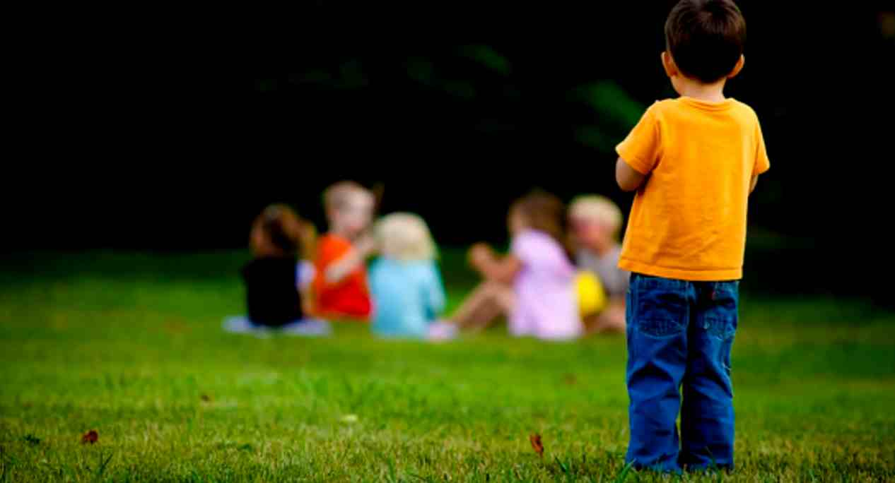
lonely
Notes:
Here is another picture of lonely.
How does this picture show the meaning of lonely? Turn and talk to your partner.
No one is playing with this little boy, he is sad and all by himself. He is feeling lonely.
How many syllables are in the word lonely? Let’s find out by clapping. Ready?
“Lon-ely.” Two syllables.
Now, let’s say lonely three times by clapping the syllables. Ready?
“Lon-ely, lon-ely, lon-ely.”

Slide 6
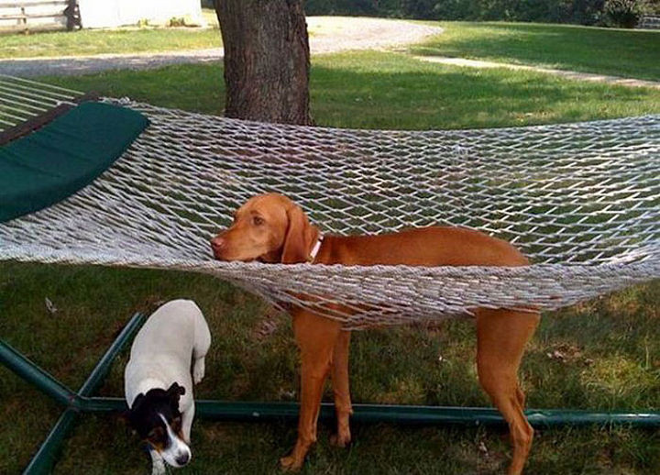
stuck
Notes:
Another word in the story is stuck.
In Spanish it is atascar (ah-tahs-kahr).
Stuck means that you cannot get out.
Let’s say the word stuck together. Ready? ”Stuck.”
When you say stuck, I hear the /s/ sound at the beginning of the word.
Look, stuck begins with the letter s.
Here is a picture of stuck. See this dog, he is stuck in the netting of the hammock and cannot get out.

Slide 7
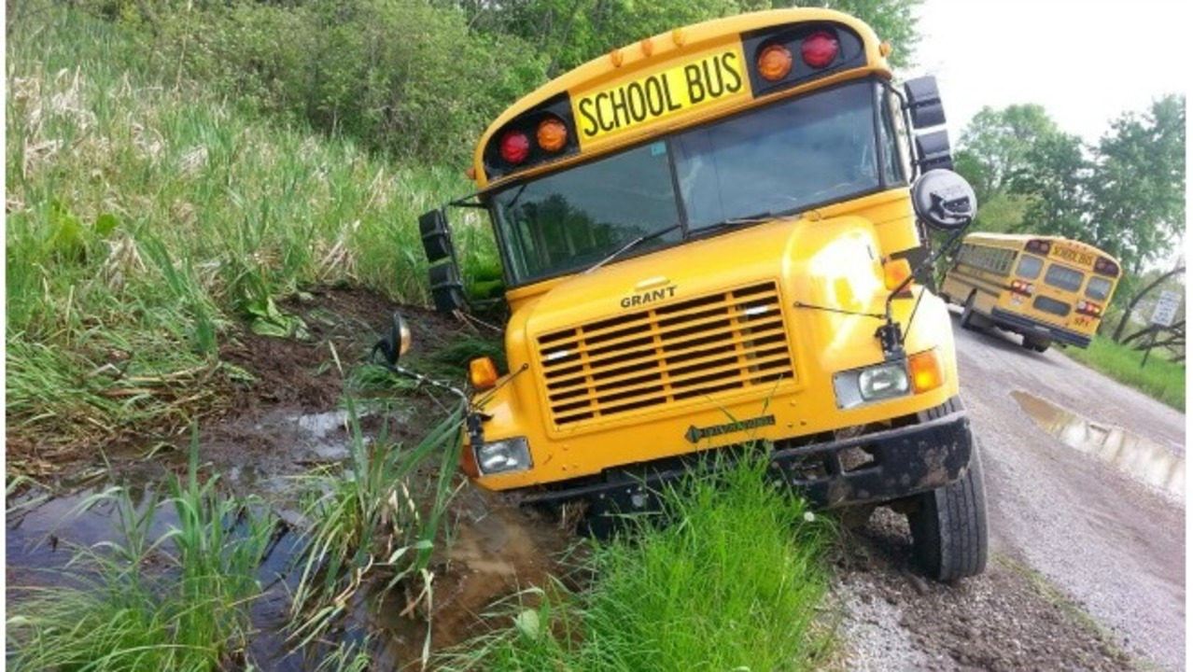
stuck
Notes:
Here is another picture of stuck.
How does this picture show the word stuck? Turn and talk to your partner.
This school bus is stuck in mud and cannot get out.
How many syllables are in the word stuck? Let’s find out by clapping. Ready?
“Stuck.” 1 syllable.
Now, let’s say stuck three times by clapping the syllables. Ready?
“Stuck, stuck, stuck.”

