Slide 1
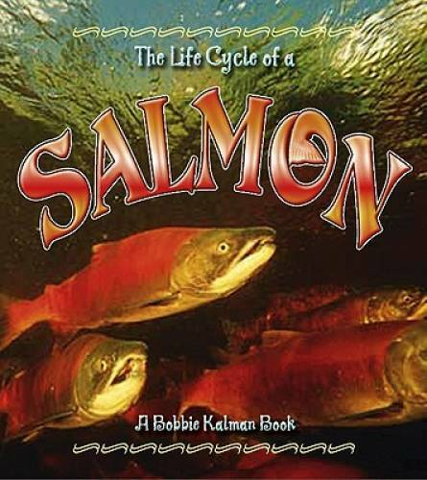

Slide 2
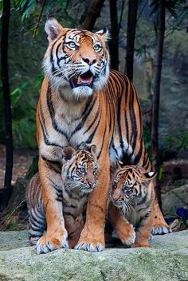
protect
https://www.pinterest.com/brill310582/a-the-big-cats/22-tigers-cubs/
Notes:
A word in the story is protect.
In Spanish it is proteger (proh-teh-hehr).
Protect means to keep safe.
Let’s say the word protect together. Ready?
”Protect”
When you say protect, I hear a /p/ sound at the beginning of the word.
Look, protect begins with the letter p.
Here is a picture that shows protect. This tigress is protecting her cubs from danger. She keeps the cubs safe.

Slide 3
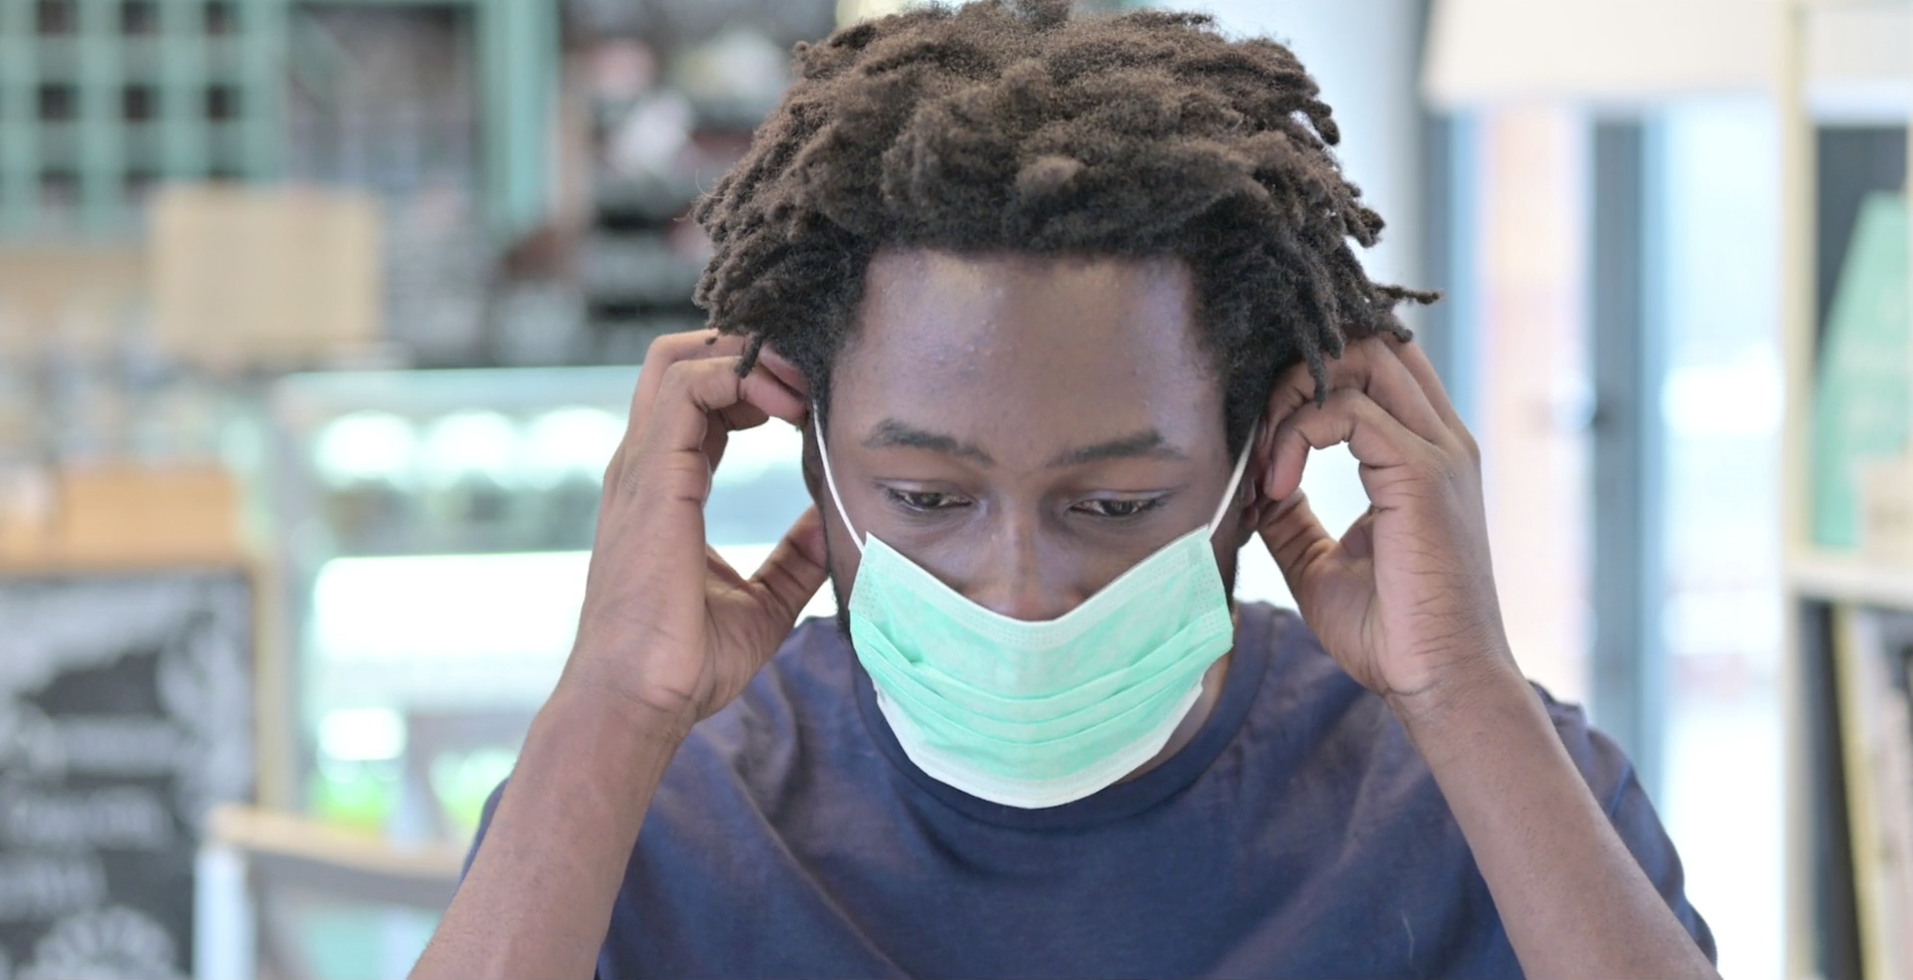
protect
https://med.stanford.edu/news/all-news/2020/06/stanford-scientists-contribute-to-who-mask-guidelines.html
Notes:
Here is another picture of protect.
How does this picture show the meaning of protect? Turn and talk to your partner.
This person wants to keep himself and others safe from COVID-19 droplets. He wants to protect all around him from getting infected.
How many syllables are in the word protect? Let’s find out by clapping. Ready? “Pro-tect.” Two syllables.
Now, let’s say protect three times by clapping the syllables. Ready?
“Pro-tect, pro-tect, pro-tect.”

Slide 4
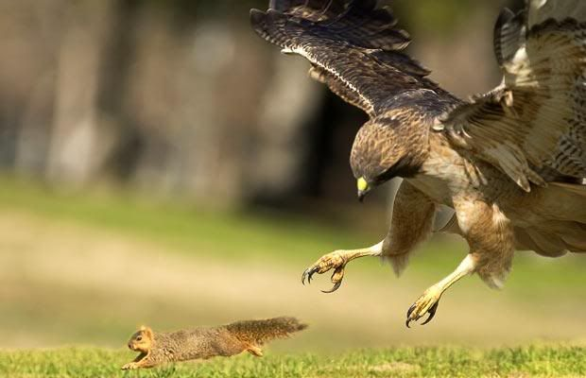
predator
https://www.pinterest.com/pin/44121271319065872/
Notes:
A word in the story is predator.
In Spanish it is depredador (deh-preh-dah-dohr).
Predator means an animal that hunts other animals for food.
Let’s say the word predator together. Ready?
“Predator.” When you say predator, I hear a /p/ sound at the beginning of the word. Look, predator begins with the letter p.
Here is a picture that shows predator. The hawk is a predator because it hunts squirrels for food.

Slide 5
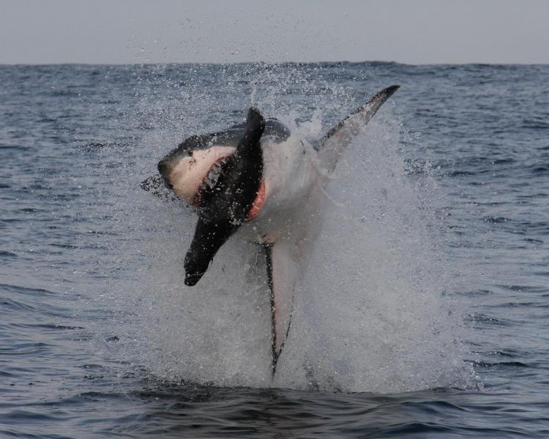
predator
https://ocean.si.edu/ocean-life/sharks-rays/breaching-sequence-1
Notes:
Here is another picture of predator.
How does this picture show the meaning of predator? Turn and talk to your partner.
The shark is a predator because it hunts seals for food.
How many syllables are in the word predator? Let’s find out by clapping. Ready? “Pred-at-or.” Three syllables.
Now, let’s say predator three times by clapping the syllables. Ready?
“Pred-at-or, pred-at-or, pred-at-or.”

Slide 6
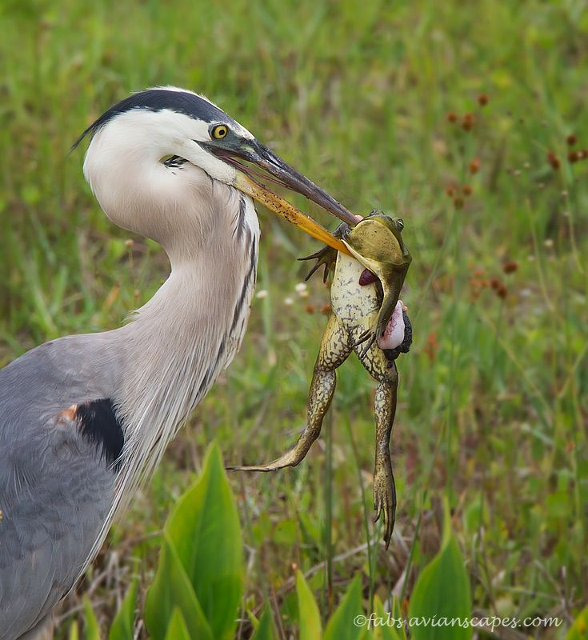
prey
https://www.pinterest.com/pin/461759768015921267/
Notes:
A word in the story is prey.
In Spanish it is presa (preh-sah).
Prey means an animal that is hunted for food.
Let’s say the word prey together. Ready?
“Prey.” When you say prey, I hear a /p/ sound at the beginning of the word.
Look, prey begins with the letter p.
Here is a picture that shows prey. The frog is a prey of the blue heron because the blue heron hunted it for food.

Slide 7
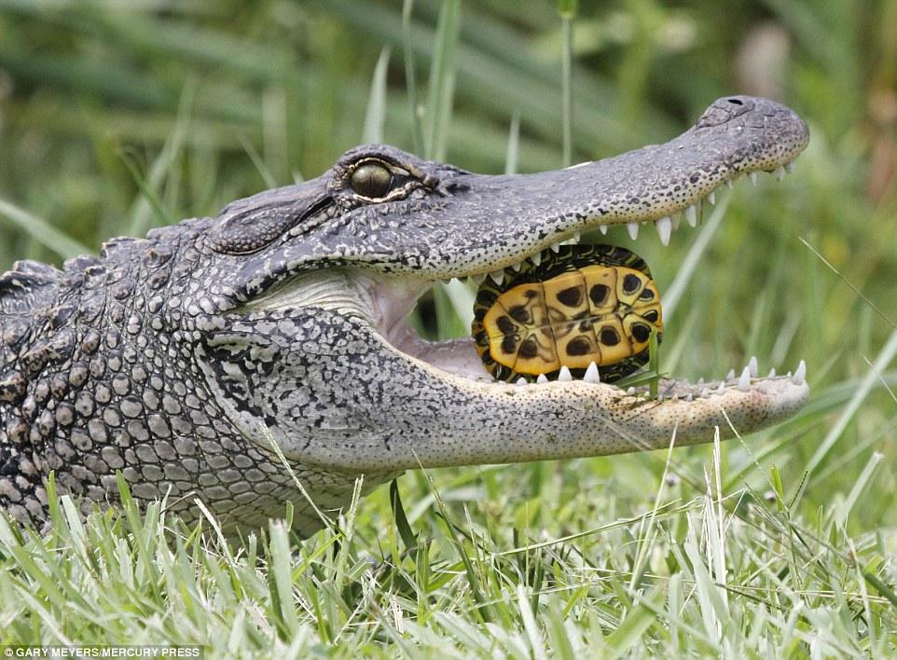
prey
https://www.dailymail.co.uk/news/article-3352527/Turtle-y-delicious-Hungry-alligator-gulps-two-reptiles-one-go.html
Notes:
Here is another picture of prey.
How does this picture show the meaning of prey? Turn and talk to your partner.
The turtle is a prey of the alligator because the alligator hunts it for food .
How many syllables are in the word prey? Let’s find out by clapping. Ready?
“Prey.” One syllable.
Now, let’s say prey three times by clapping the syllables. Ready?
“Prey, prey, prey.”

Slide 8
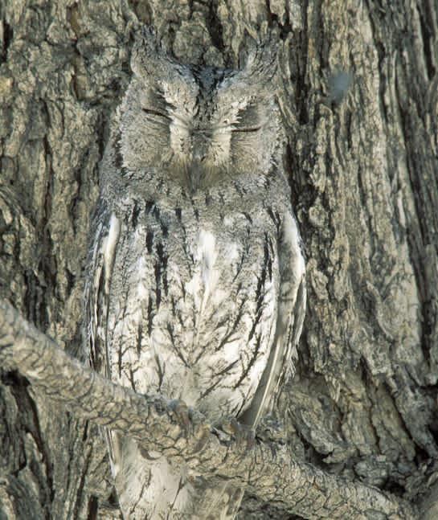
camouflage
https://mom.com/momlife/23755-best-camouflage-animals/
Notes:
A word in the story is camouflage.
In Spanish it is camuflaje (kah-moo-flah-heh).
Camouflage means hiding or blending the color and shape of their bodies with the surroundings. Animals use camouflage as a way to protect themselves from predators.
Let’s say the word camouflage together. Ready?
“Camouflage” When you say camouflage, I hear a /c/ sound at the beginning of the word.
Look, camouflage begins with the letter c.
Here is a picture that shows camouflage. The color of the owl’s feathers and their shape help it camouflage against the bark of the tree. It is hard to see it. At first, I thought it was part of the tree.

Slide 9
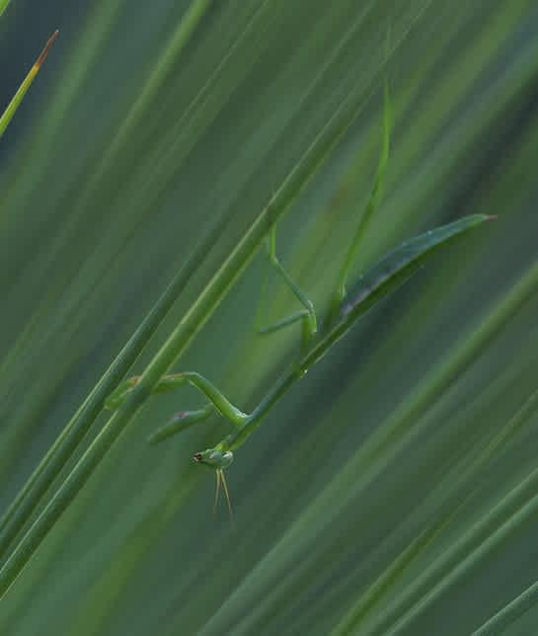
camouflage
https://mom.com/momlife/23755-best-camouflage-animals/
Notes:
Here is another picture of camouflage.
How does this picture show the meaning of camouflage? Turn and talk to your partner.
The praying mantis camouflages with the blades of grass. The long and skinny shape of its body and its color look just like one more blade of grass.
How many syllables are in the word camouflage? Let’s find out by clapping. Ready?
“Ca-mou-flage.” Three syllables.
Now, let’s say camouflage three times by clapping the syllables. Ready?
“Ca-mou-flage, ca-mou-flage, ca-mou-flage.”

