Slide 1
Biography Verbs
Writing Week 7, Day 3

Slide 2
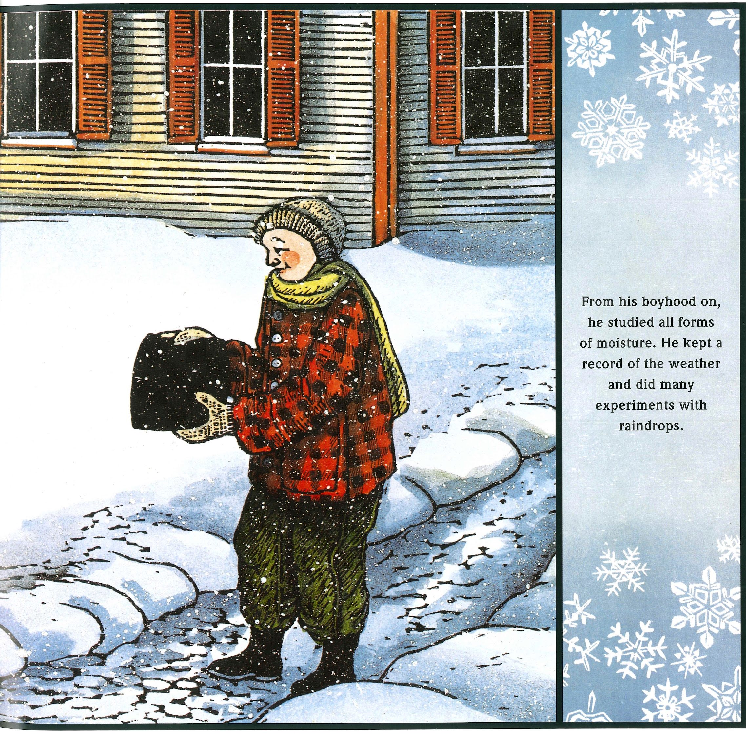
Slide 1
From his boyhood on, he studied all forms of moisture. He kept a record of the weather and did many experiments with raindrops.

Slide 3
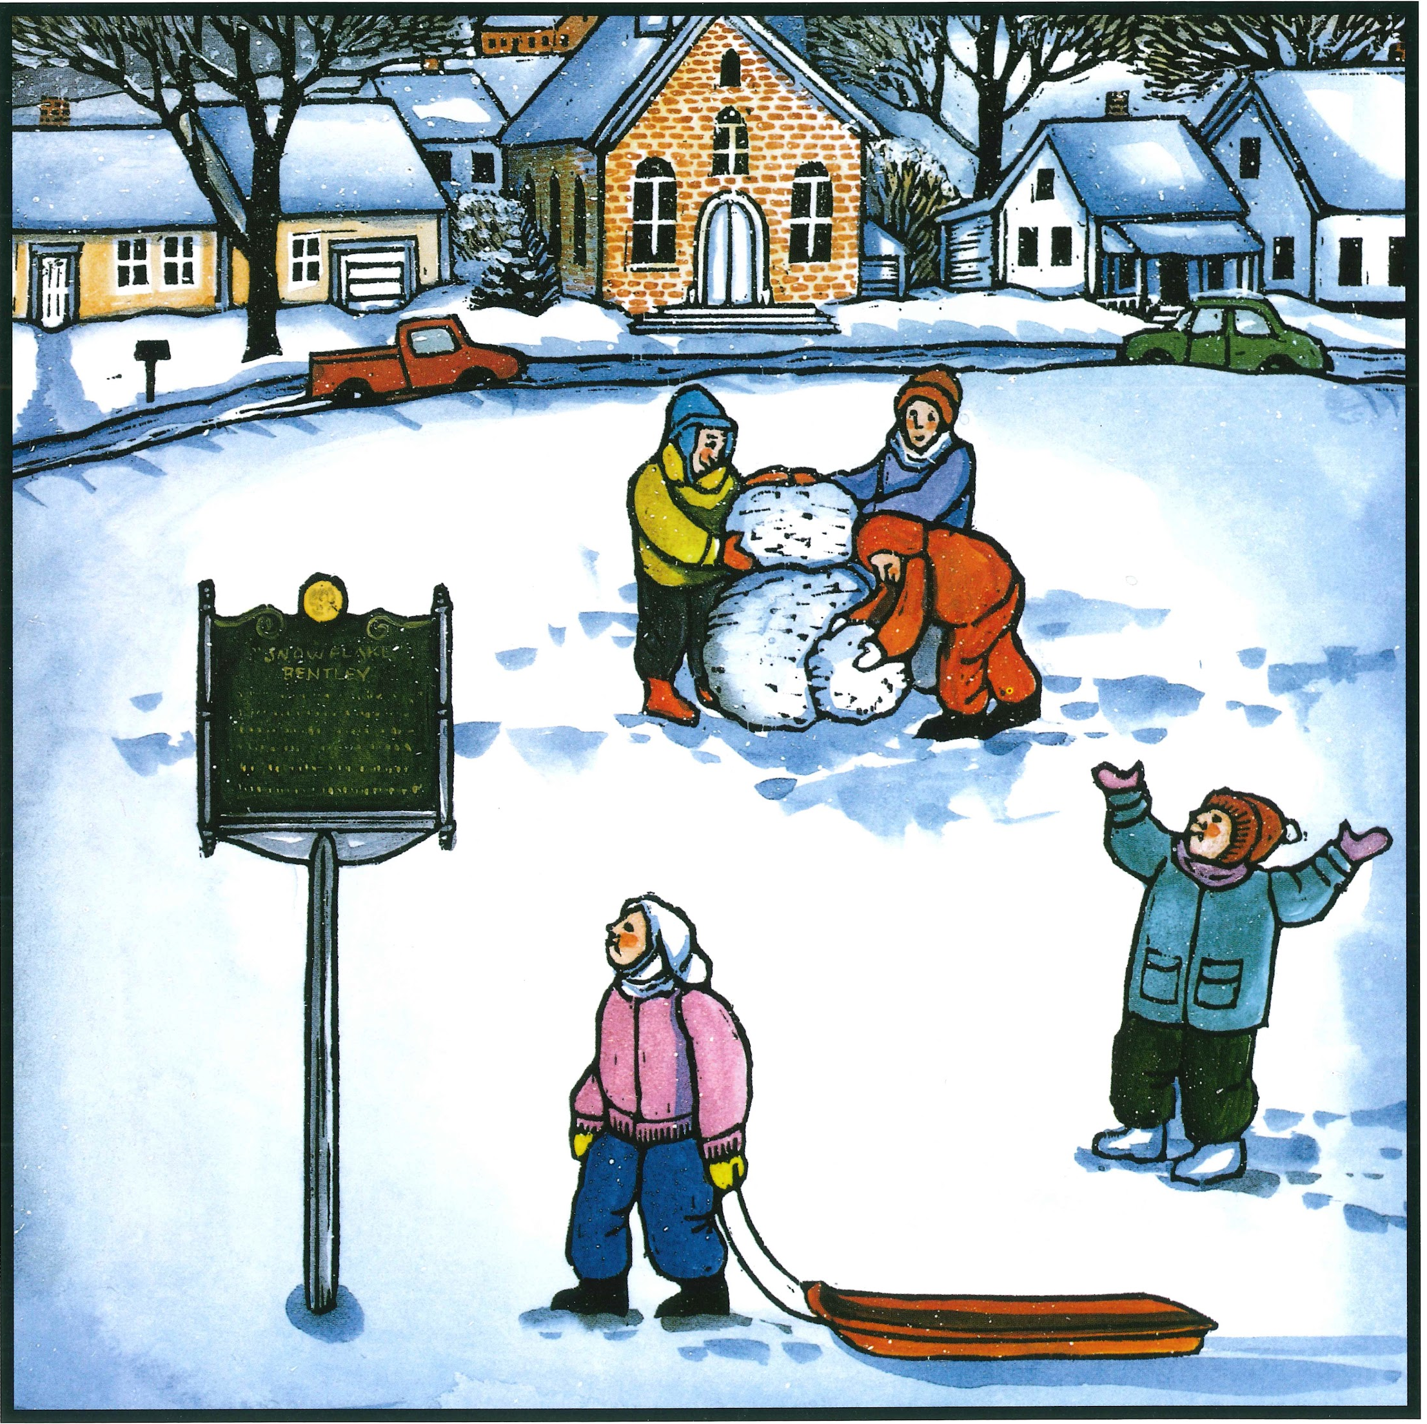
Slide 2
A monument was built for Willie in the center of town...Forty years after Wilson Bentley’s death, children in his village worked to set up a museum in honor of the farmer-scientist. And his book has taken the delicate snow crystals that once blew across Vermont, past mountains, over the earth. Neighbors and strangers have come to know of the icy wonders that land on their own mittens— thanks to Snowflake Bentley.

Slide 4
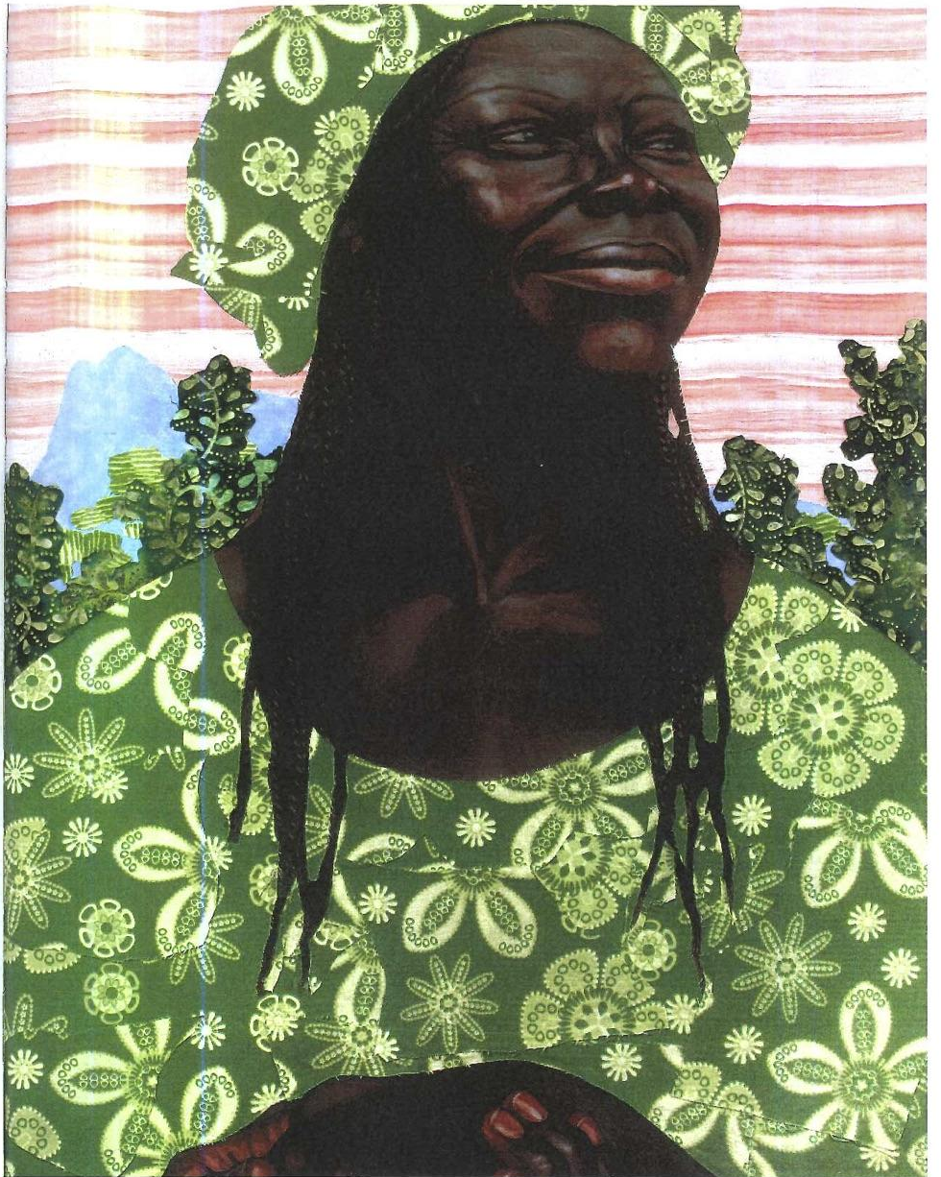
Slide 3
Wangari changed a country, tree by tree. She taught her people the ancient wisdom of peace with nature. And now she is teaching the rest of the world. She is known these days as Mama Miti—the mother of trees.

