Slide 1
Phrases of Time
Writing Week 6, Day 4

Slide 2
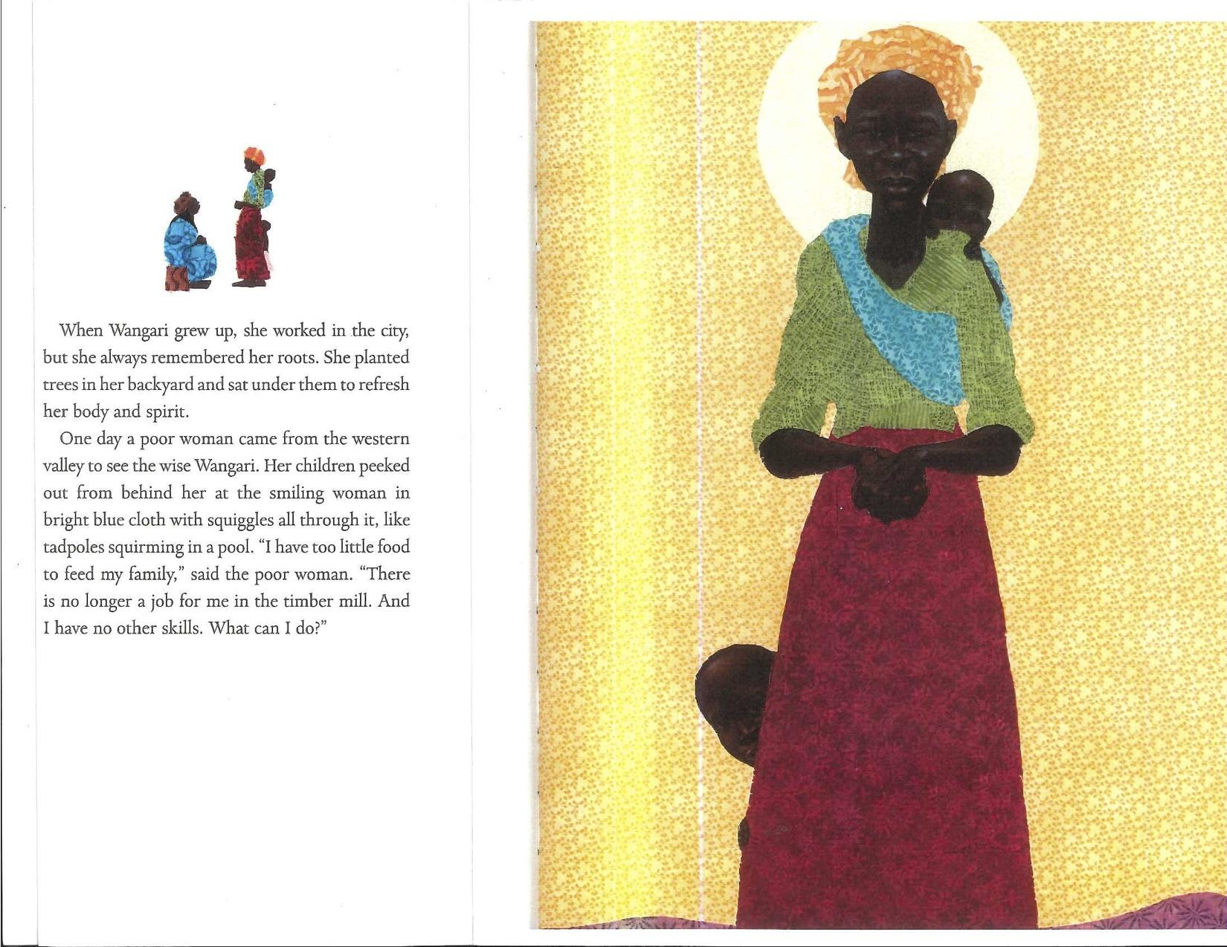
Slide 1

Slide 3
Slide 2
When Wangari grew up, she worked in the city, but she always remembered her roots. She planted trees in her backyard and sat under them to refresh her body and spirit.

Slide 4
Slide 3
One day a poor woman came from the western valley to see the wise Wangari. Her children peeked out from behind her at the smiling woman in bright blue cloth with squiggles all through it, like tadpoles squirming in a pool...

Slide 5
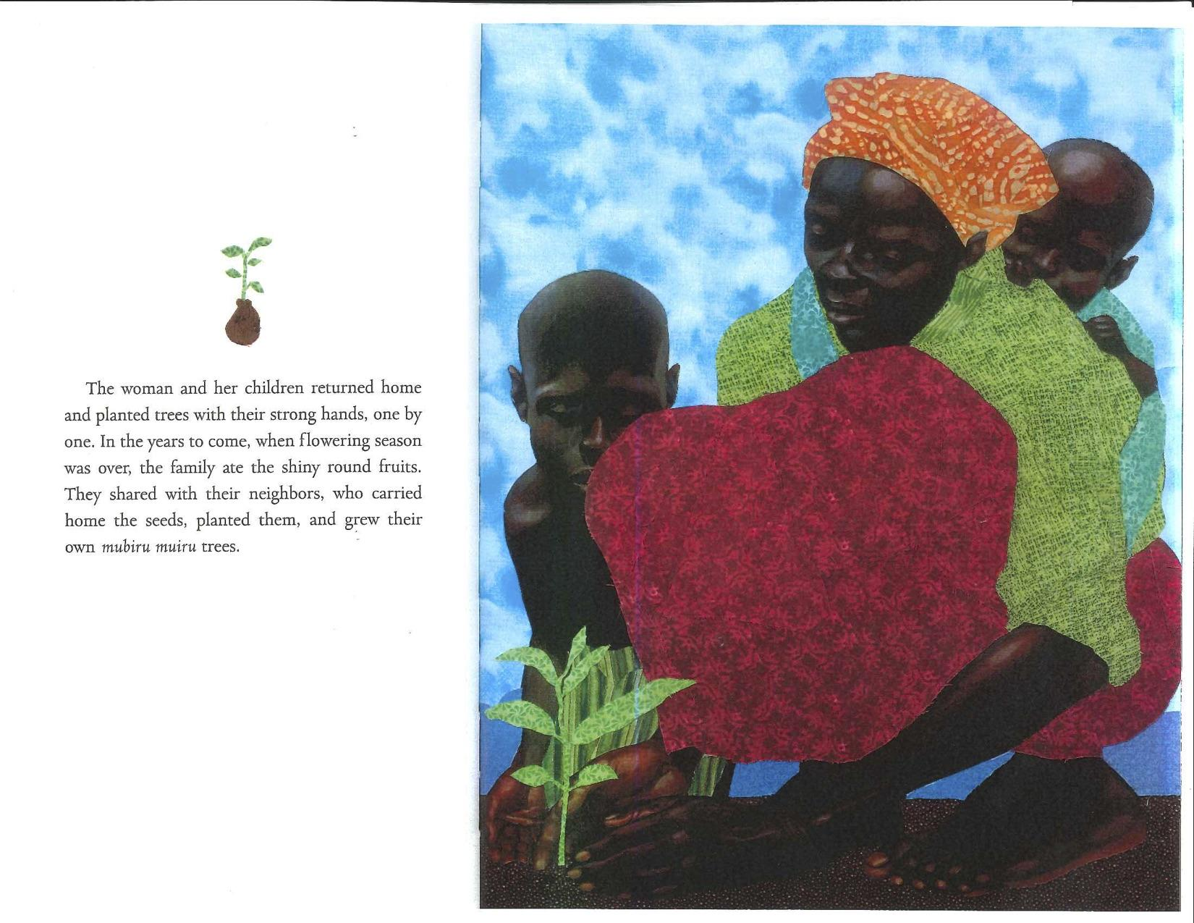
Slide 4

Slide 6
Slide 5
The woman and her children returned home and planted trees with their strong hands, one by one. In the years to come, when flowering season was over, the family ate the shiny round fruits.

Slide 7
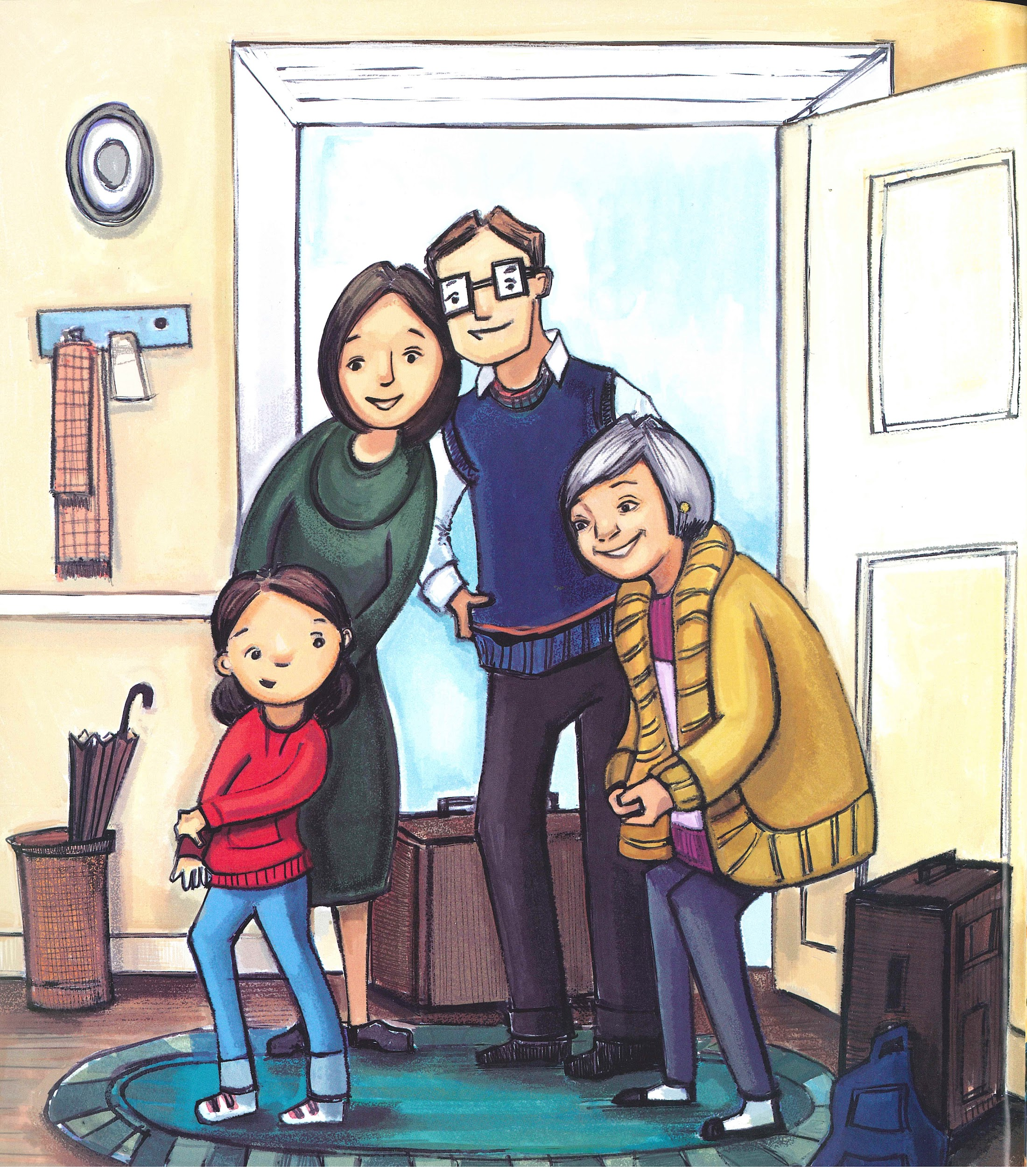
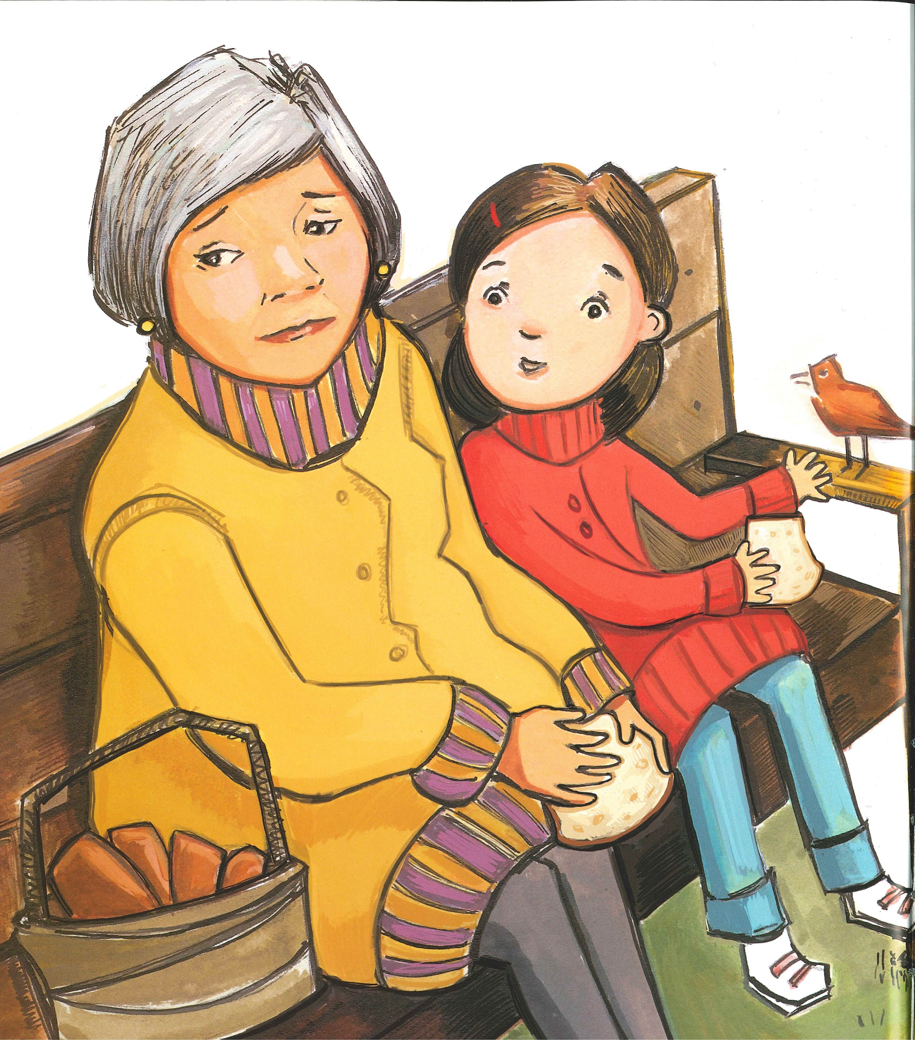
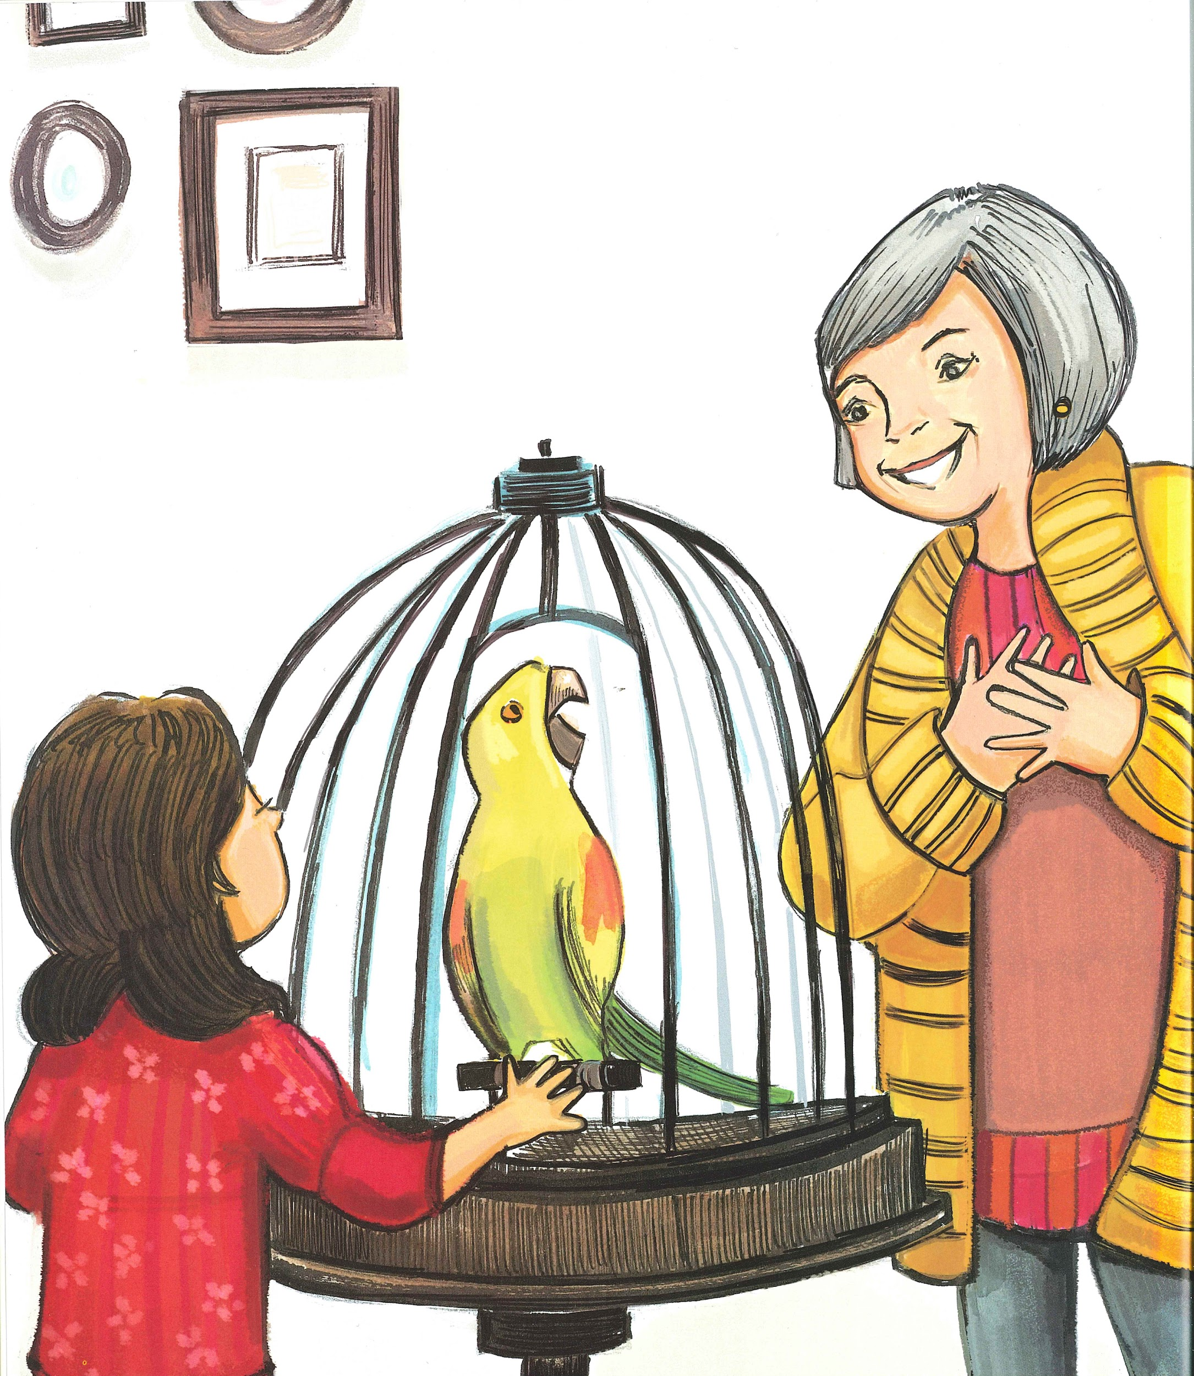
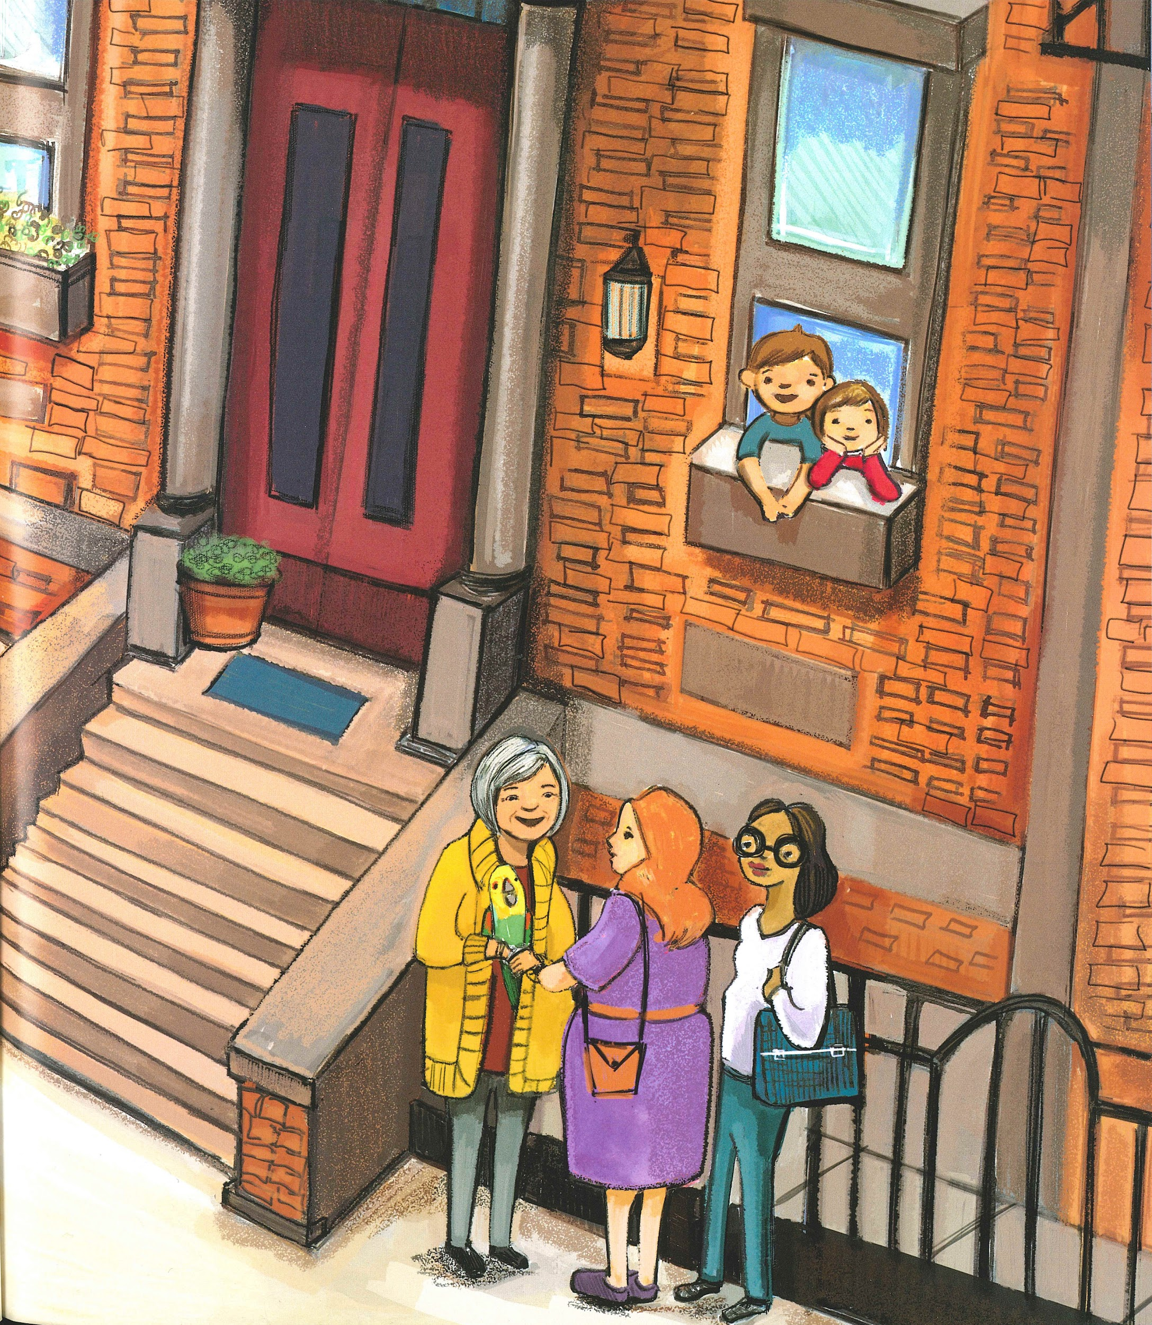
Slide 6
in winter | the rest of the winter
when we bring him home | before long

