Slide 1
Explanation Verbs
Writing Week 5, Day 2

Slide 2
Procedure Verbs

Slide 3
Personal Recount Verbs

Slide 4
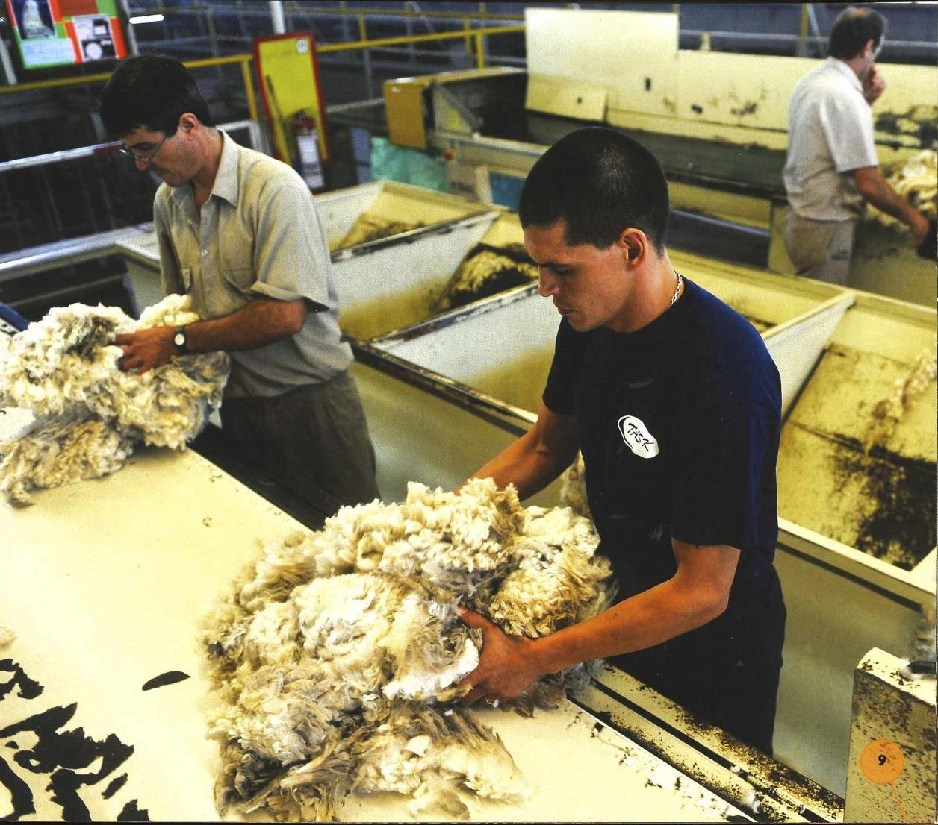

Slide 5
Explanation Verbs
Workers sort the wool. They
remove wool that is dark or dirty.
They keep thick wool that is light
in color.

Slide 6
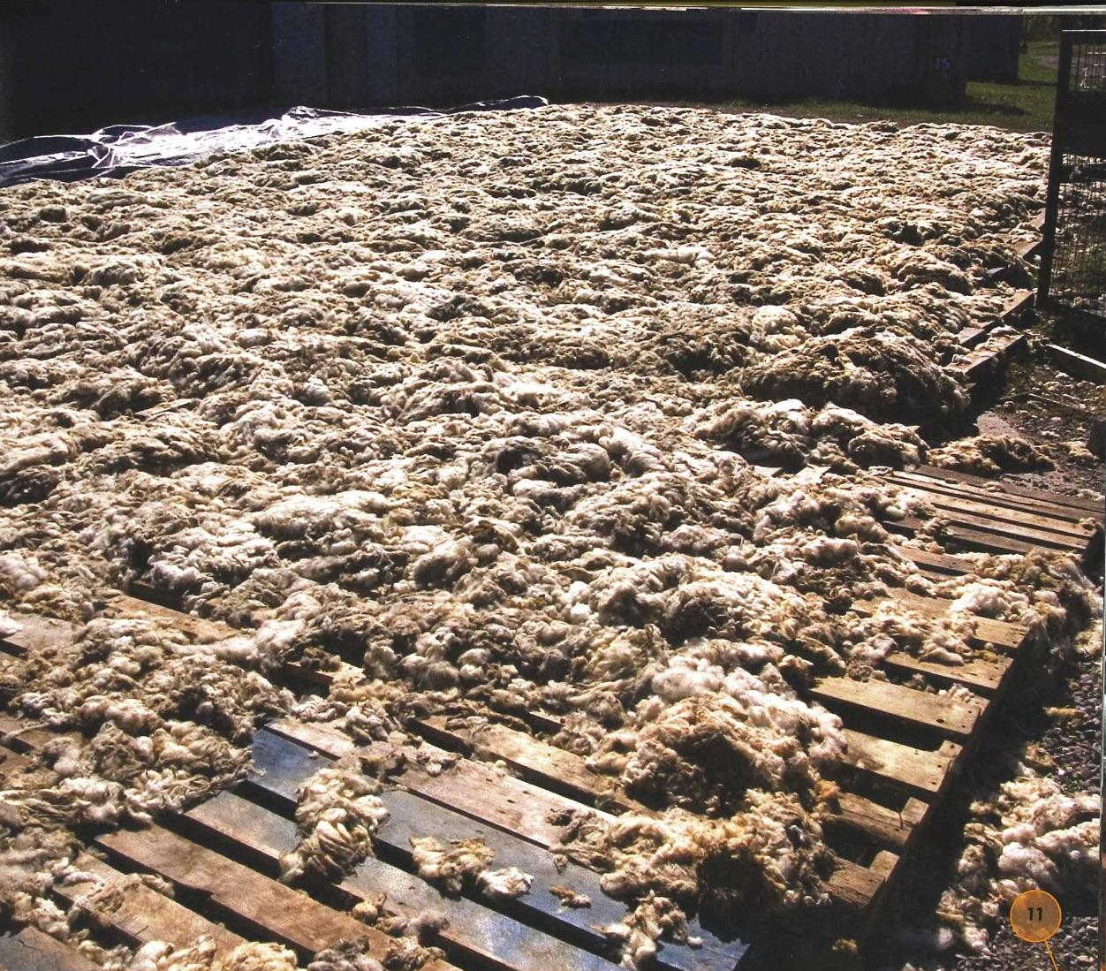
Revise Explanation Verbs: Practice
Workers washed the wool many times.
Workers wash the wool many times.

Slide 7
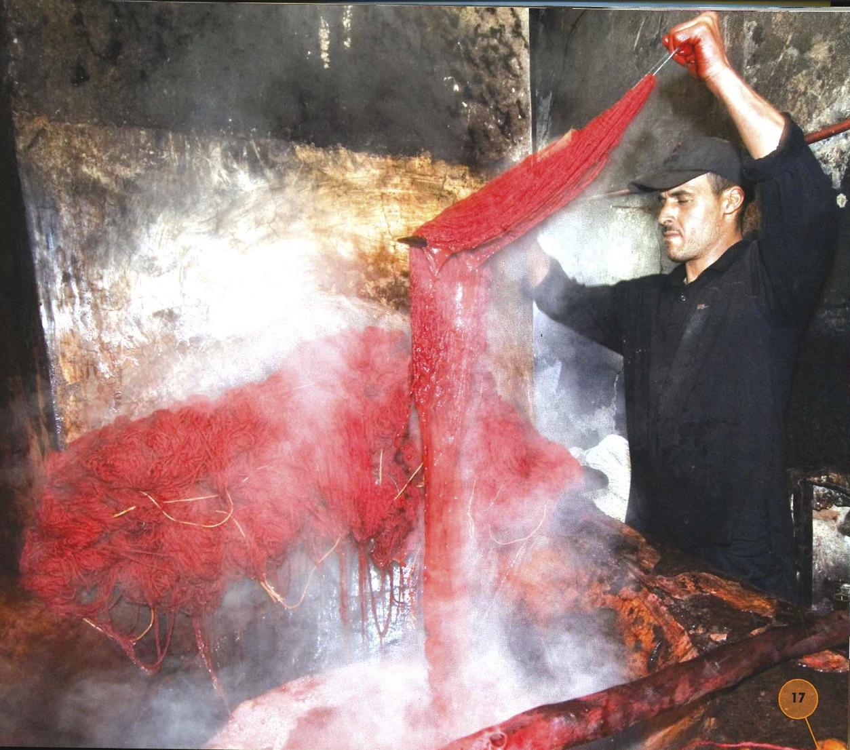
Revise Explanation Verbs: Practice
The yarn is red.
Workers dye the yarn red.

Slide 8
Revise Explanation Verbs
Your turn!
Underline the verbs.
Are they in the present tense?
Are they action verbs?
If not, change them so they are
present tense action verbs.

