Slide 1
Adjectives
Writing Week 3, Day 1

Slide 2
Slide 1

Slide 3
Slide 2
What? shoes
Which ones? Whose?
those
What like?
black, with two white stripes
perfect shape
What kind?
high-tops

Slide 4
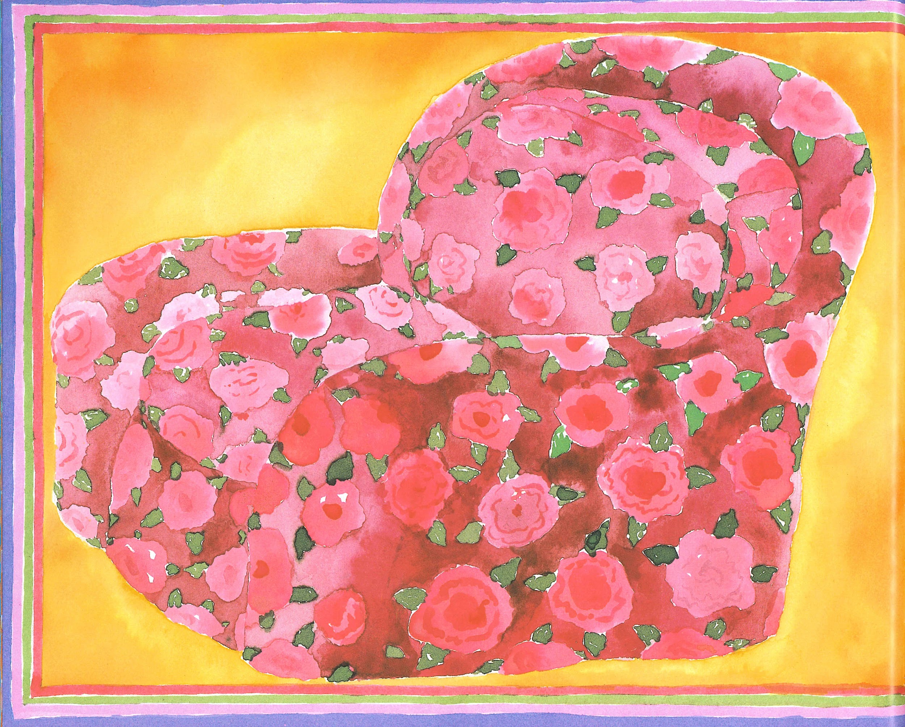
Slide 3

Slide 5
Slide 4
What? chair
Which ones? Whose?
the best in the whole world
What like?
wonderful
beautiful
fat
soft
covered in velvet
with roses all over it
What kind?
armchair

Slide 6
Slide 5
What? ring
What like?
so soft it bends
What kind?
golden

