Slide 1
Rhythm
Writing Week 2, Day 5

Slide 2
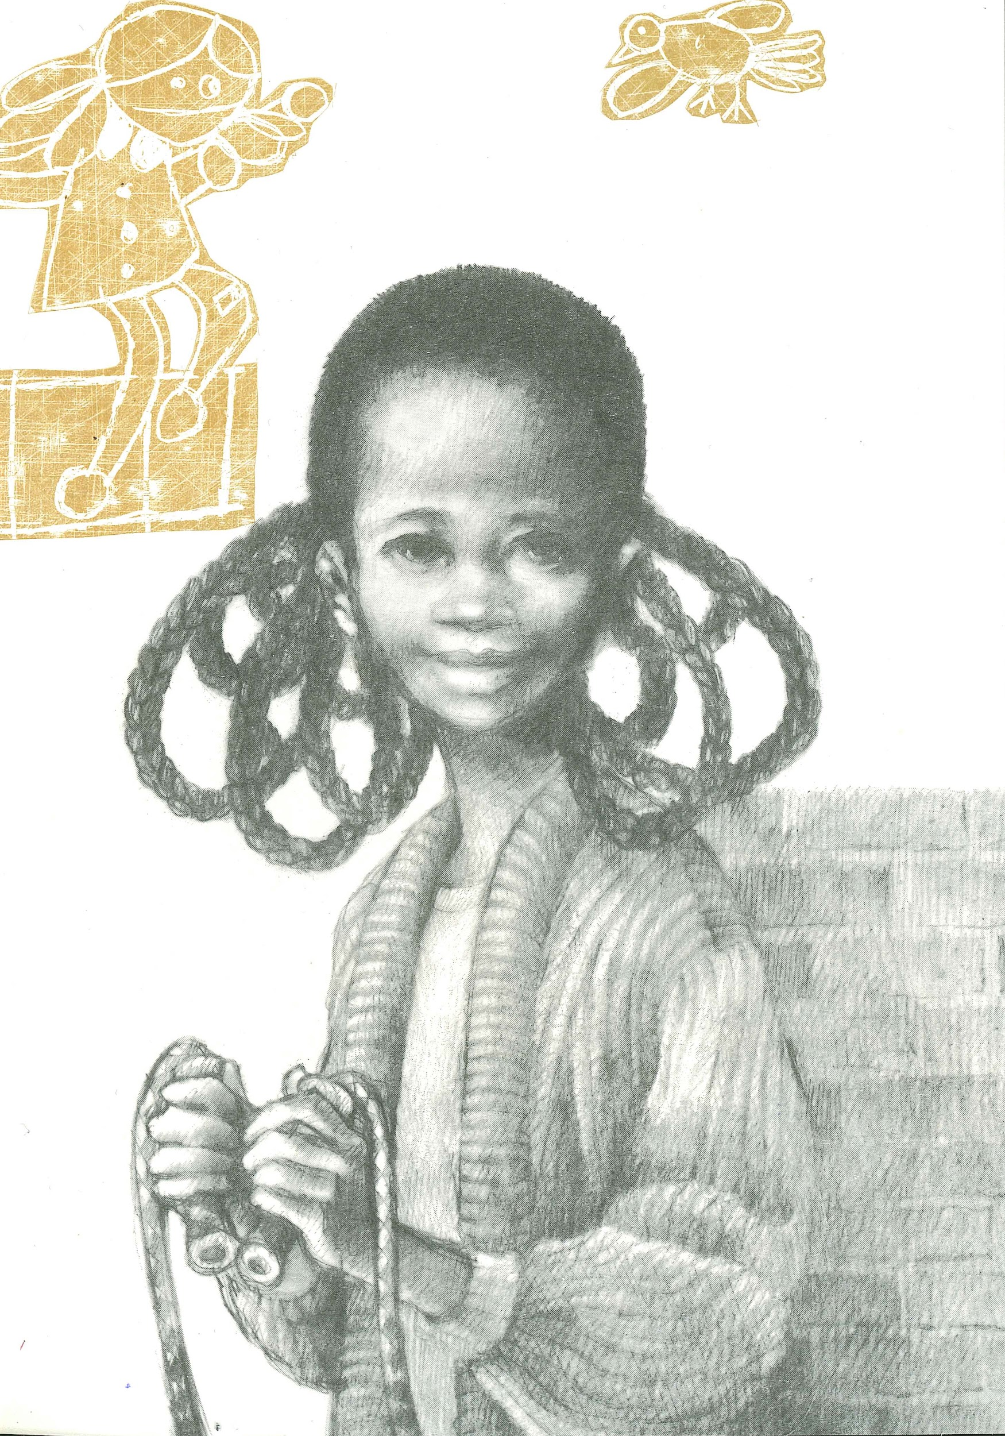
Slide 1
Rope Rhyme By Eloise Greenfield Get set, ready now, jump right in Bounce and kick and giggle and spin Listen to the rope when it hits the ground Listen to that clappedy-slappedy sound Jump right up when it tells you to Come back down, whatever you do Count to a hundred, count by ten | Start to count all over again That’s what jumping is all about Get set, ready now, jump right out!

Slide 3
Slide 2
Trips by Nikki Giovanni eeeveryyee time when i take my bath and comb my hair (i mean mommy brushes it till i almost cry) and put on my clean clothes and they all say MY HOW NICE YOU LOOK and i smile and say “thank you mommy cleaned me up” | then i sit down and mommy says GET UP FROM THERE YOU GONNA BE DIRTY ‘FORE I HAVE A CHANCE TO GET DRESSED MYSELF and i want to tell her if you was my size the dirt would catch you up faster too

Slide 4
Slide 3
Rope Rhyme by Eloise Greenfield
8 | Get set, ready now, jump right in | 8 | Start to count all over again
8 | Bounce and kick and giggle and spin | 8 | That’s what jumping is all about
10 | Listen to the rope when it hits the ground | 5 | Get set, ready now,
11 | Listen to that clappedy-slappedy sound | 1 | jump
8 | Jump right up when it tells you to | 1 | right
8 | Come back down, whatever you do | 1 | out!
8 | Count to a hundred, count by ten

Slide 5
Slide 2
Trips by Nikki Giovanni
3 | eeeveryyee time | 5 | “thank you mommy cleaned
5 | when i take my bath | 2 | me up”
6 | and comb my hair (i mean | 8 | then i sit down and mommy says
10 | mommy brushes it till i almost cry) | 10 | GET UP FROM THERE YOU GONNA BE DIRTY
6 | and put on my clean clothes | 10 | ‘FORE I HAVE A CHANCE TO GET DRESSED MYSELF
5 | and they all say MY | 9 | and i want to tell her if you was
4 | HOW NICE YOU LOOK | 6 | my size the dirt would catch
6 | and i smile and say | 5 | you up faster too
Trips by Nikki Giovanni

