Slide 1
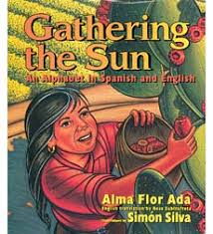
“Farmworkers”
From Gathering the Sun, by Alma Flor Ada
Shared Reading Week 8

Slide 2
Farmworkers is the name we give
To the people who work the land,
Who harvest the fields,
United beneath one sky.

Slide 3
Thank you, farmworker,
For the fruits your hands have brought me.
I will grow stronger and kinder
as I eat what you have grown.

