Slide 1
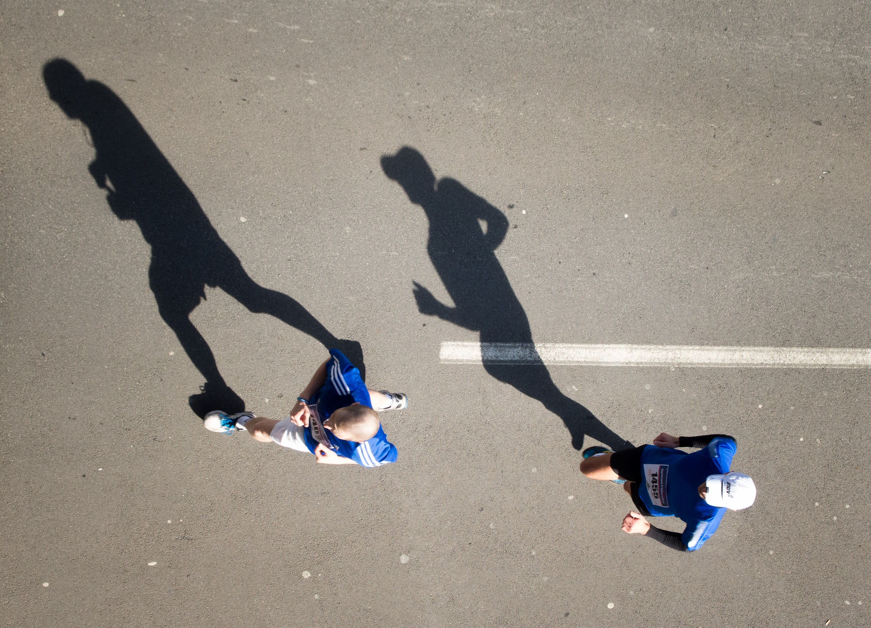
Shadow Race
by Shel Silverstein
Shared Reading Week 5

Slide 2
Every time I've raced my shadow
When the sun was at my back,
It always ran ahead of me,
Always got the best of me.

Slide 3
But every time I've raced my shadow
When my face was toward the sun,
I won.

Slide 4
