Slide 1
Shared Reading Week 5

Slide 3
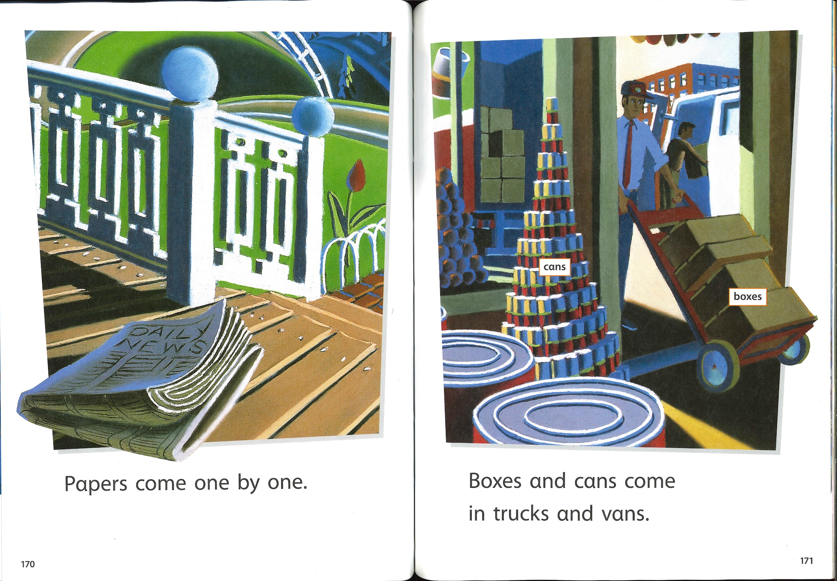

Slide 6
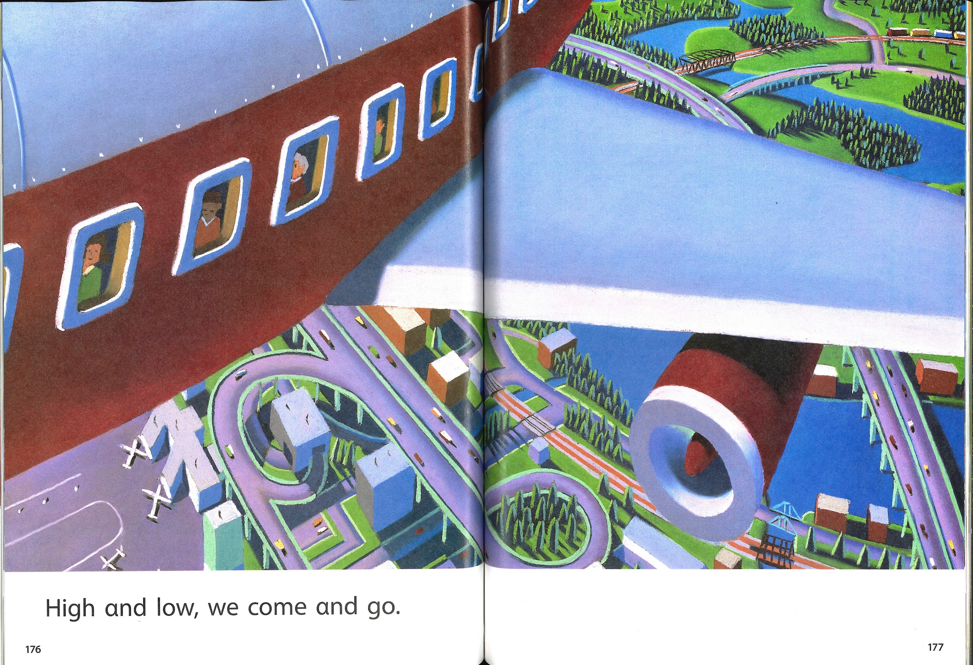

Slide 10
