Slide 1
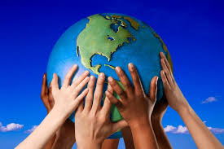
We’ve Got the Whole World in Our Hands
Shared Reading Week 5

Slide 2
We've got the whole world in our hands.
We've got the whole world in our hands.
We've got the whole world in our hands.
We've got the whole world in our hands.

Slide 3
We've got our brothers and our sisters in our hands.
We've got our friends and our family in our hands.
We’ve got our pets and our neighbors in our hands.
We've got the whole world in our hands.

Slide 4
We’ve got the fish in the sea in our hands.
We’ve got the birds in the sky in our hands.
We’ve got the animals on land in our hands.
We’ve got the whole world in our hands.

Slide 5
We've got the whole world in our hands.
We've got the whole world in our hands.
We've got the whole world in our hands.
We've got the whole world in our hands.

