Slide 1
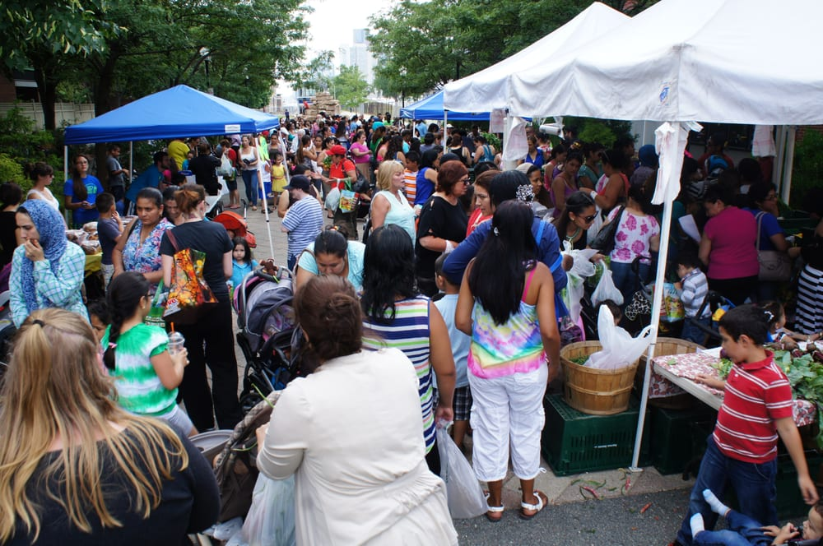
Market Day
By Raffi
https://ebnhc.org/en/food-access/farmers-market.html
Shared Reading Week 4

Slide 2
On market day, market day
Folks are out to work and play
On market day, market day
Hooray for market day

Slide 3
Early in the morning
The farmers come to town
With foods they’ve grown to sell
By the box and by the pound

Slide 4
They tend their stalls, make them nice
For those who wait in line
And families soon gather round
To see what they can find

Slide 5
On market day, market day
Folks are out to work and play
On market day, market day
Hooray for market day

