Slide 1
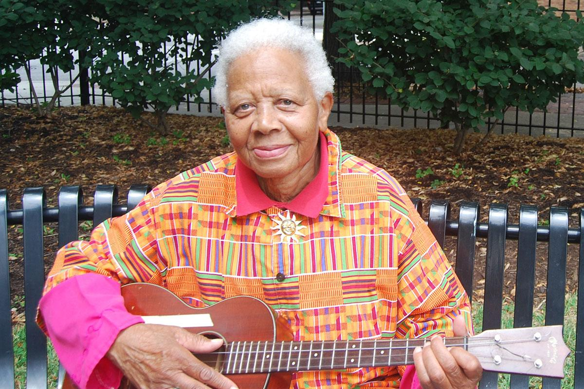
You’ll Sing a Song and I’ll Sing a Song
Ella Jenkins
Shared Reading Week 2

Slide 2
You’ll sing a song, and I’ll sing a song,
And we’ll sing a song together.
You’ll sing a song, and I’ll sing a song
In warm or wintry weather.

Slide 3
You’ll hum a line, and I’ll hum a line,
And we’ll hum a line together.
You’ll hum a line, and I’ll hum a line
In warm or wintry weather.

Slide 4
Photo citation:
Smithsonian Folkways Recordings
https://folkways.si.edu/news-and-press/ella-jenkins-60-years-with-folkways-is-honored-by-the-national-endowment-for-the-arts

