Slide 1
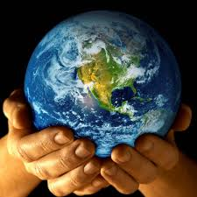
Giving Thanks
by Beres Hammond
https://www.joniandfriends.org/whole-world-his-hands/
Shared Reading Week 2

Slide 2
Right now, I'm taking it easy,
Check my steps, I'm not in a hurry,
Soon I’ll have the things that I need so bad.

Slide 3
Morning sun rising behind me,
Stars at night come out to remind me,
To give thanks for all of the things that I have.
All is well, I've got my health and in such good shape,
Pocket's broke and I've got nothing
waiting for that break.

Slide 4
So I’m giving thanks now,
Yes I’m giving thanks, for all I’ve got,
I’m giving thanks, whether or not,
I’m giving thanks for the life in me,
I’m giving thanks now.

