Slide 1
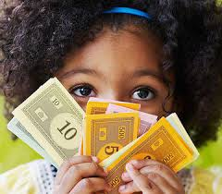
What Can We Do With Money?
Text Talk Week 7, Day 4

Slide 2
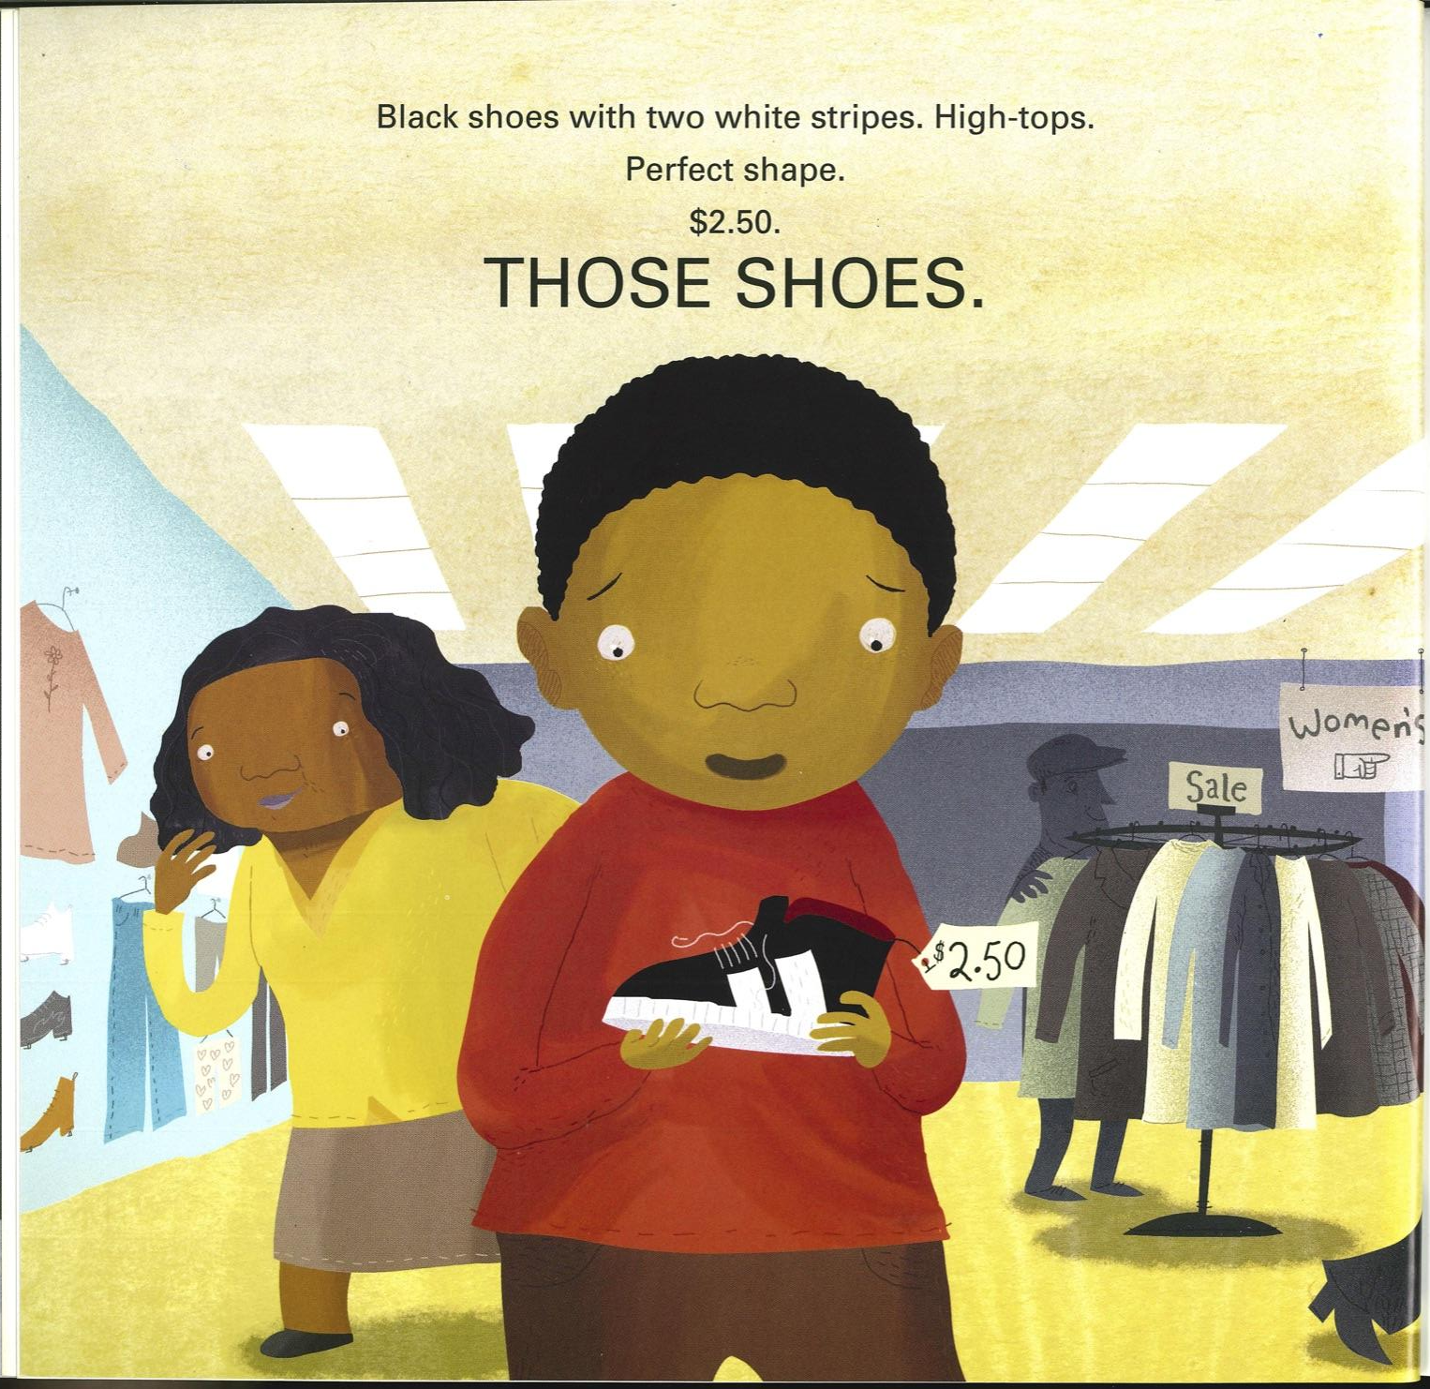
Slide 1

Slide 3
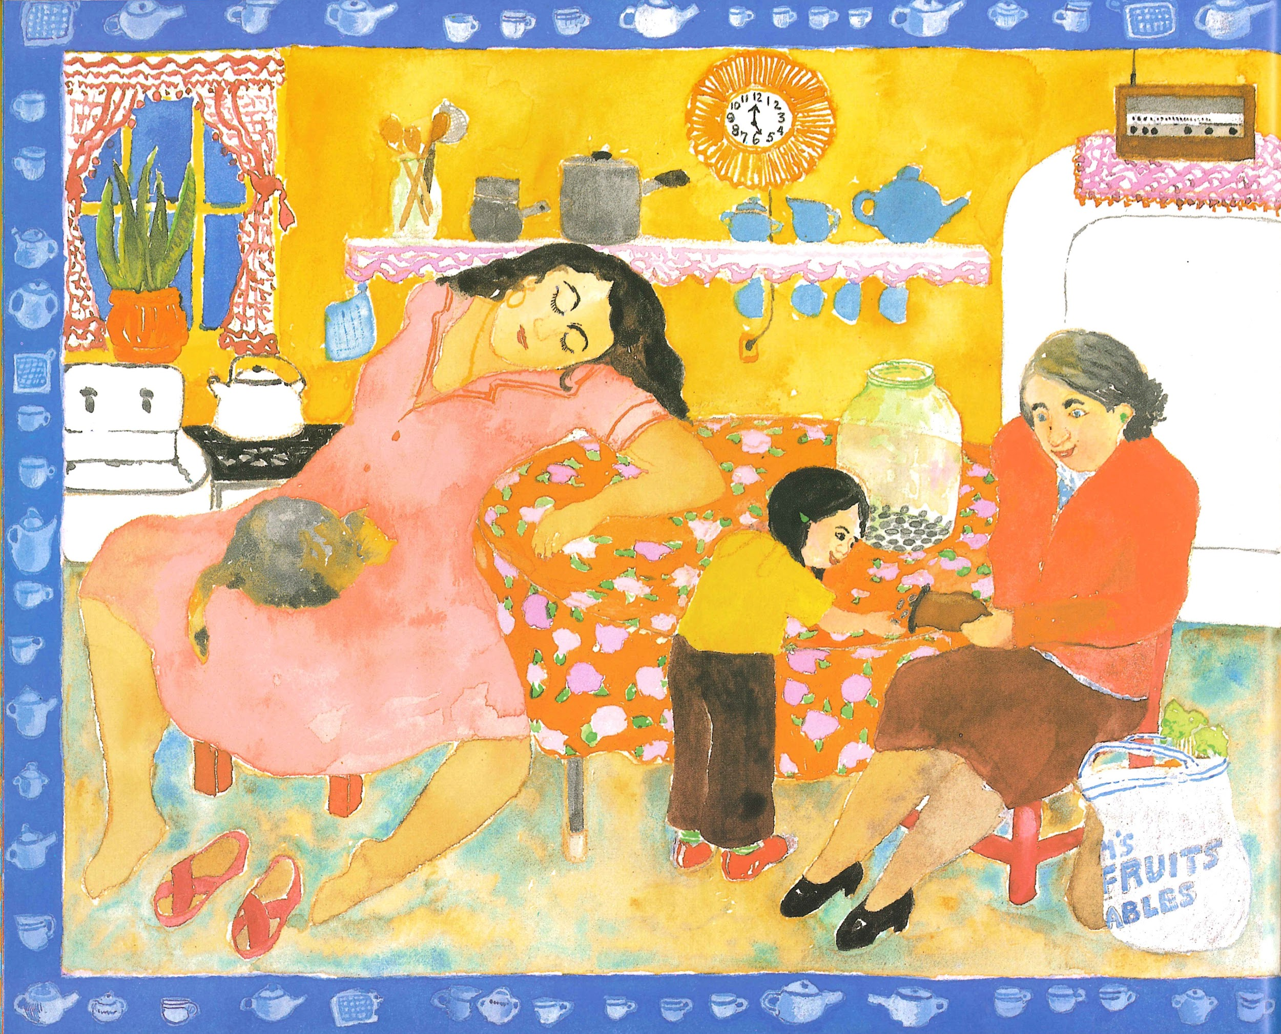
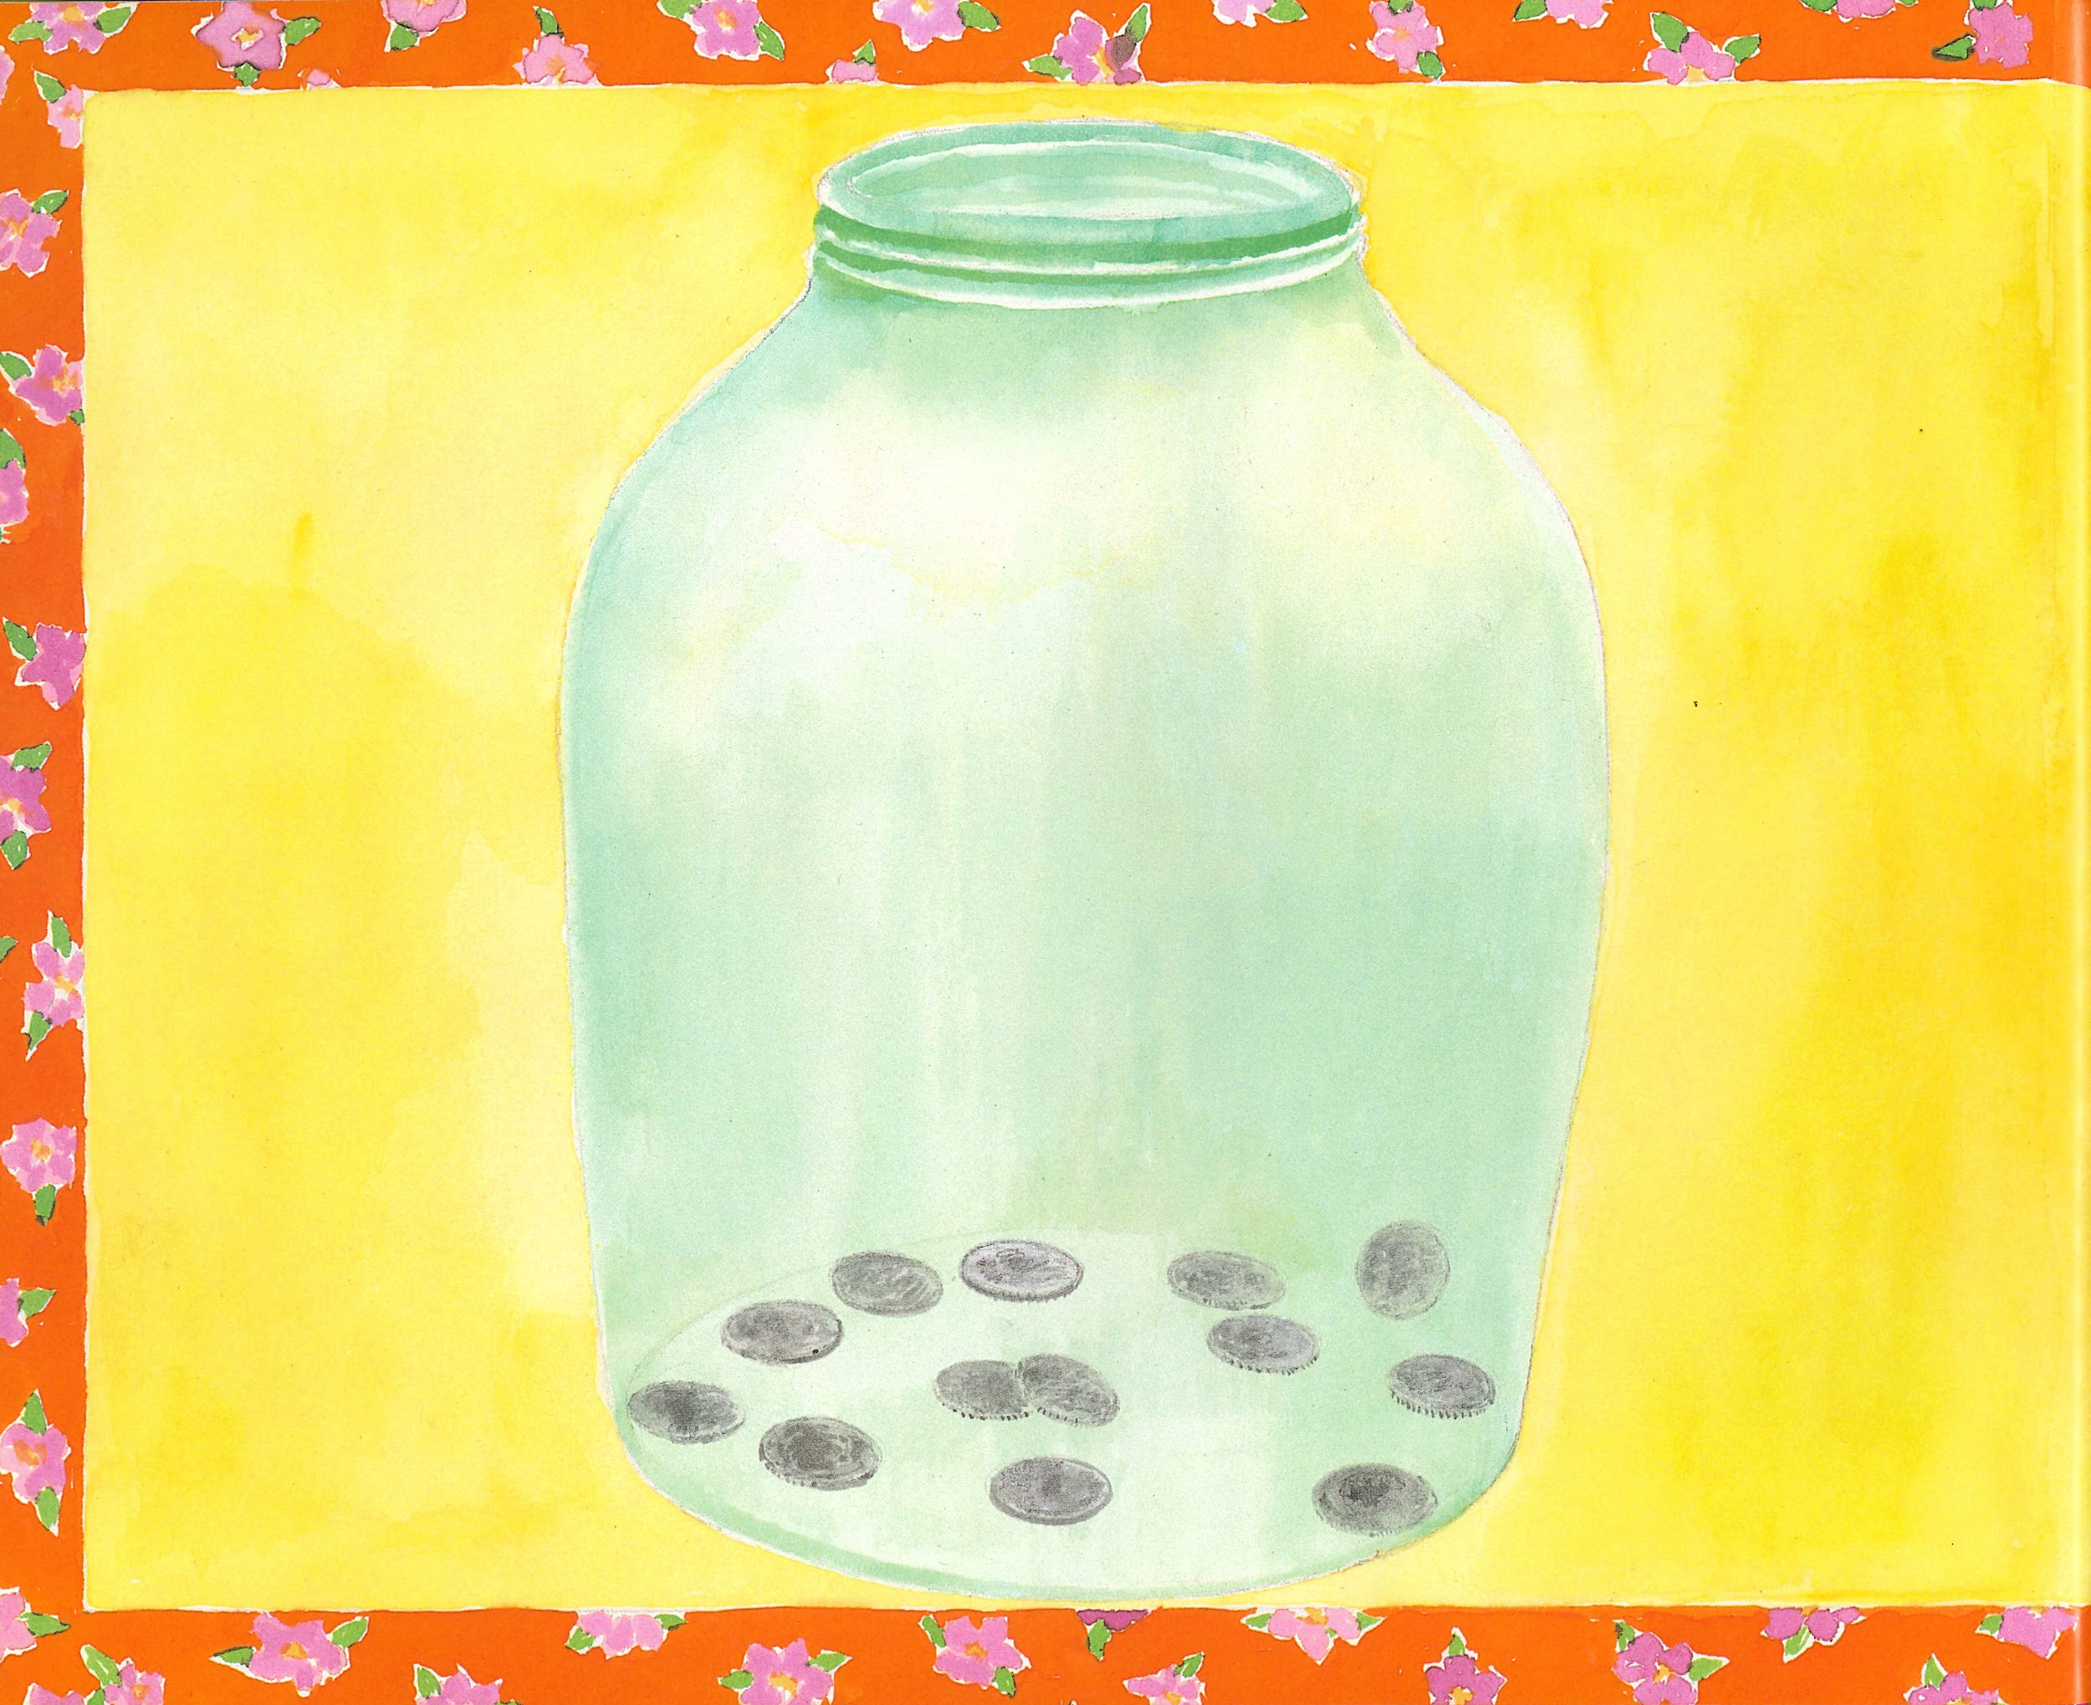
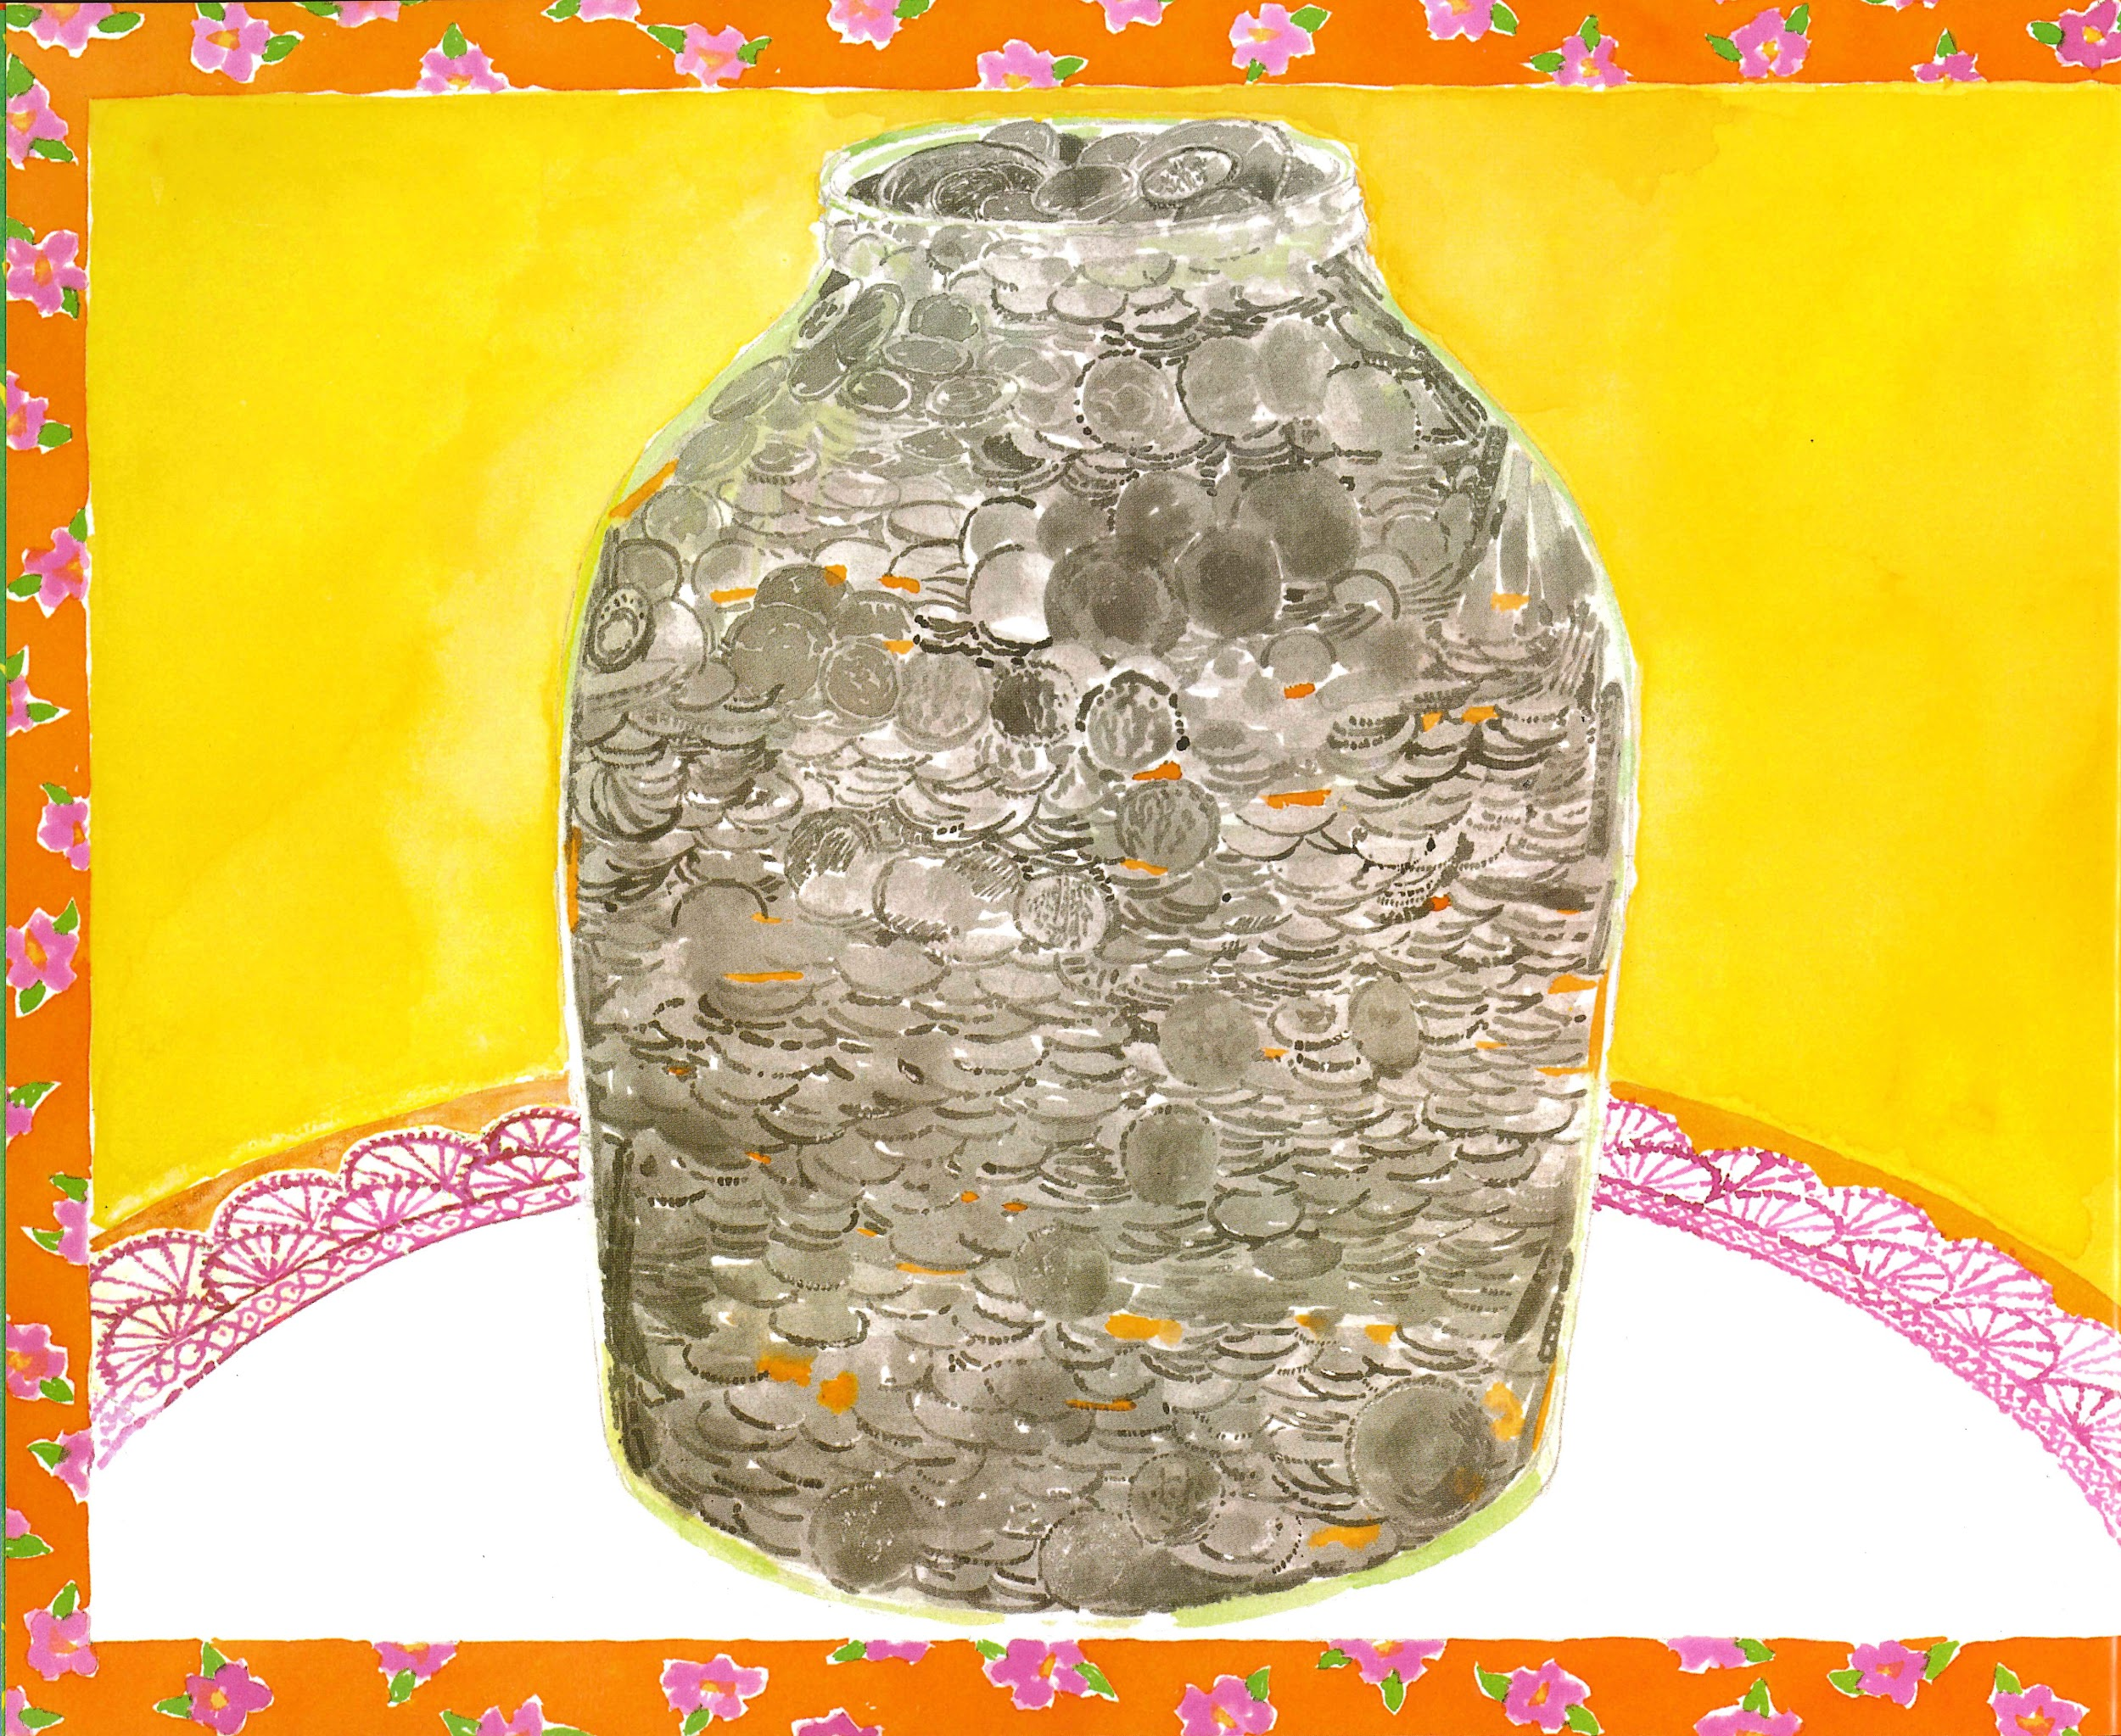
Slide 2

Slide 4
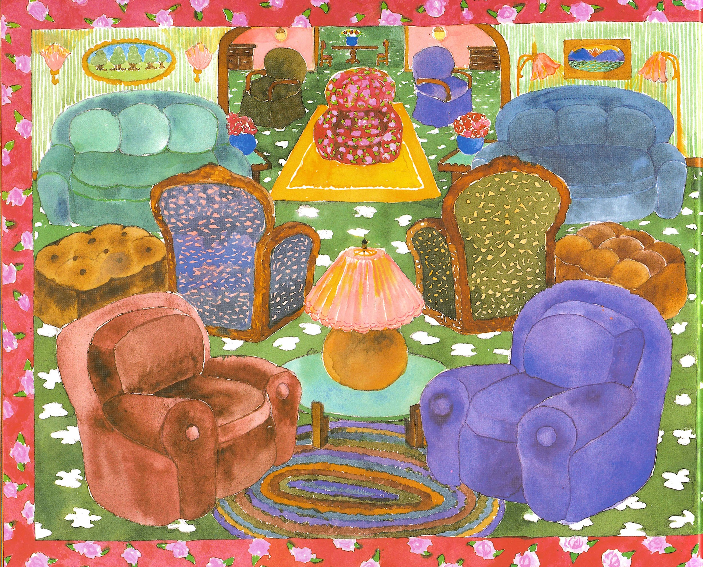
Slide 3

Slide 5
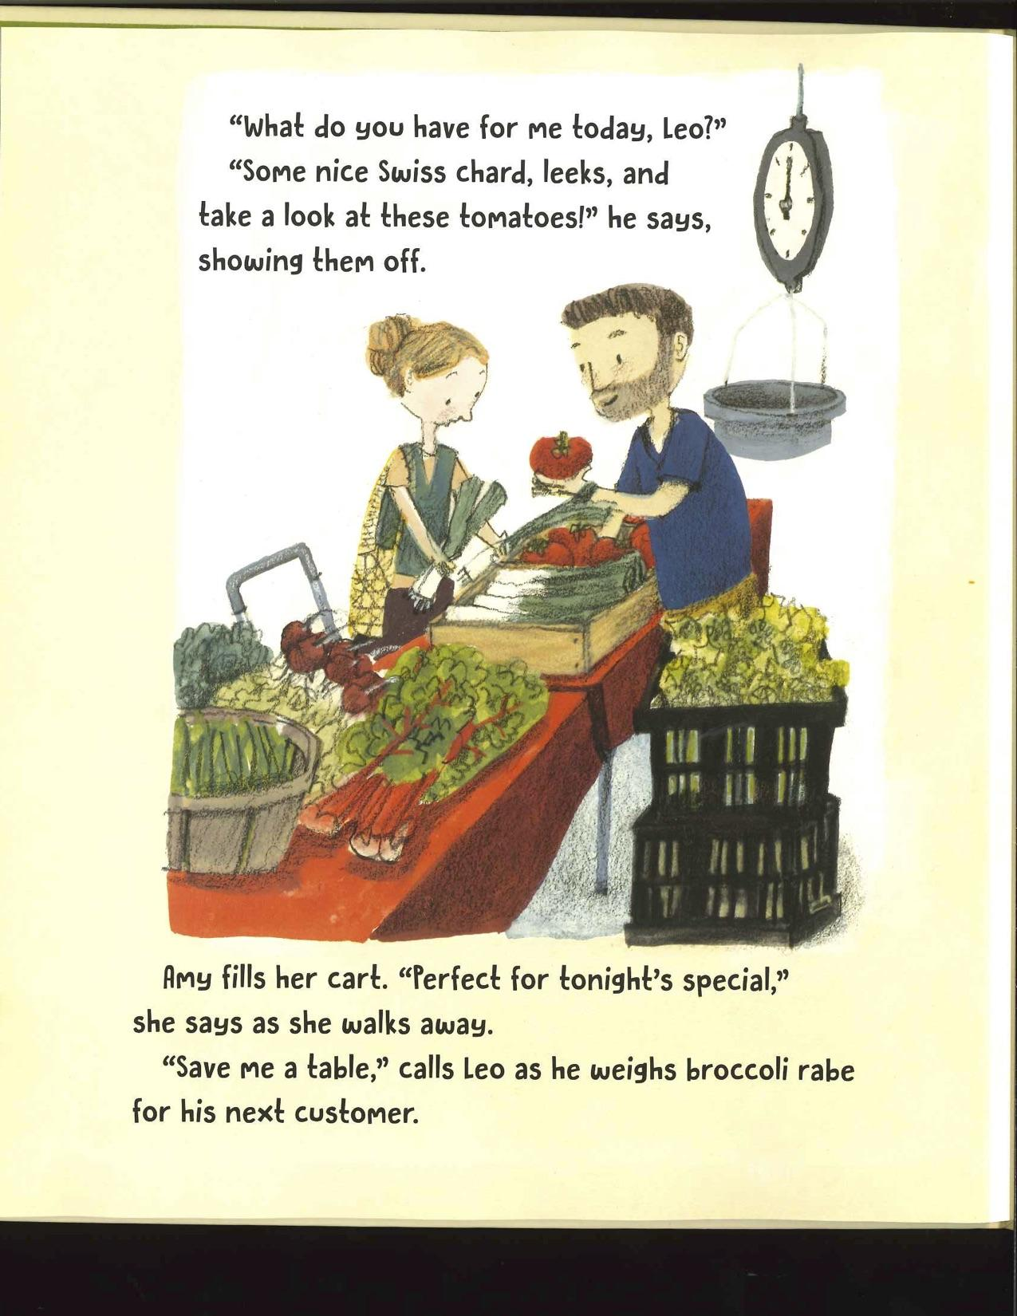
Slide 4

Slide 6
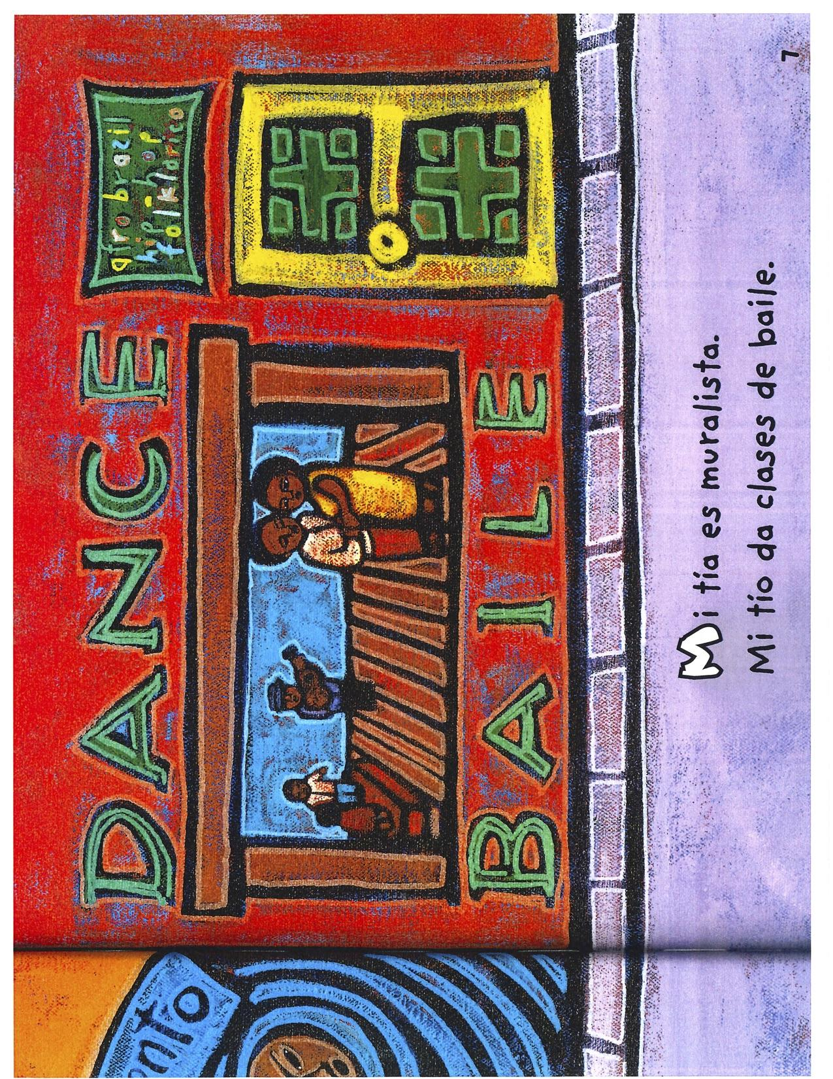
Slide 5

Slide 7
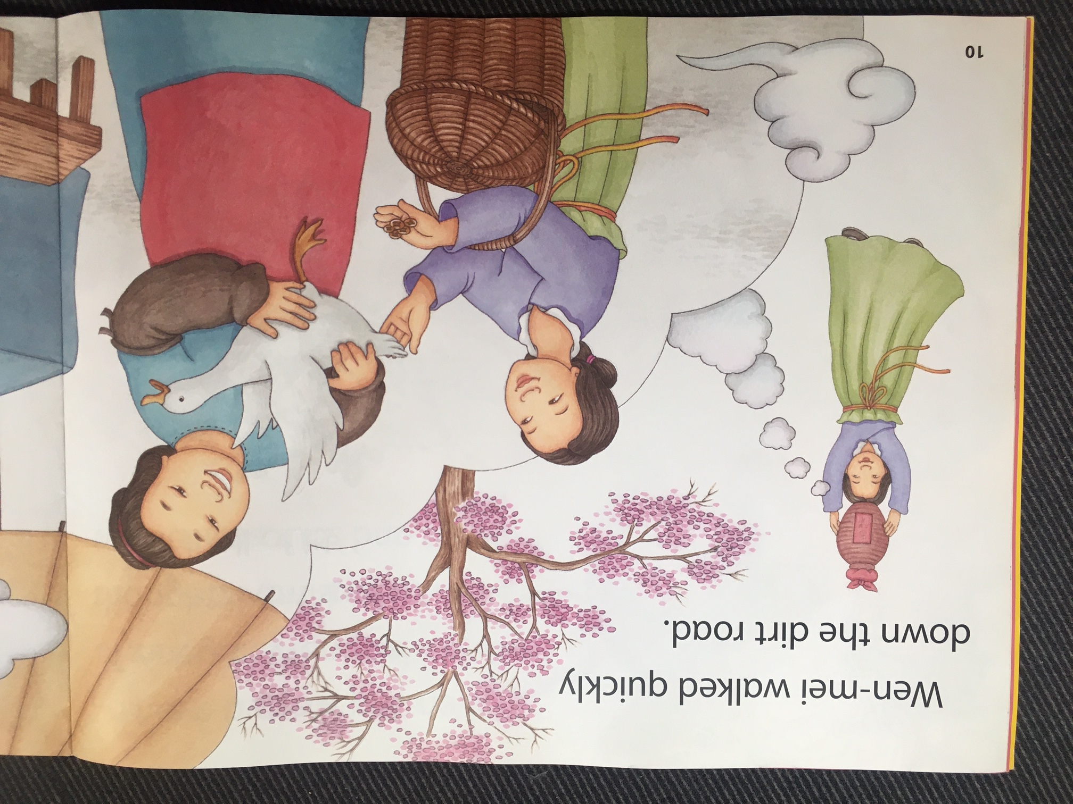
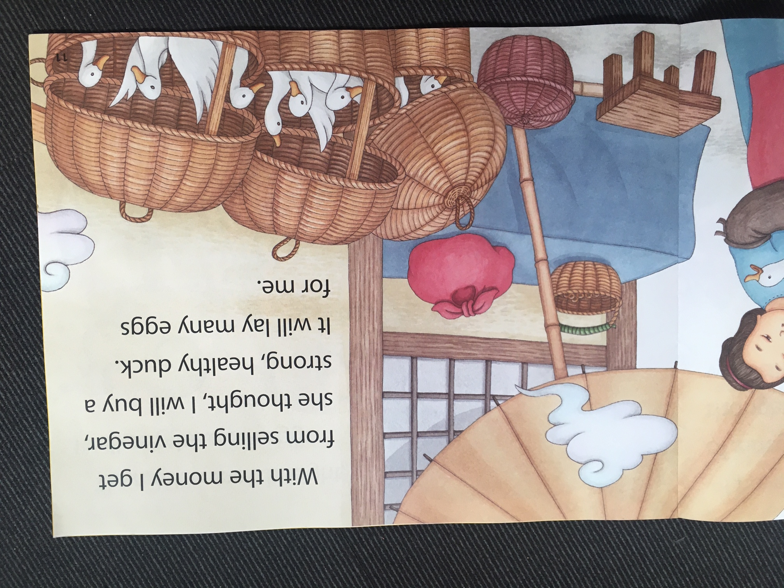
Slide 6

Slide 8
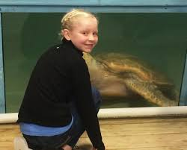
Slide 7

Slide 9
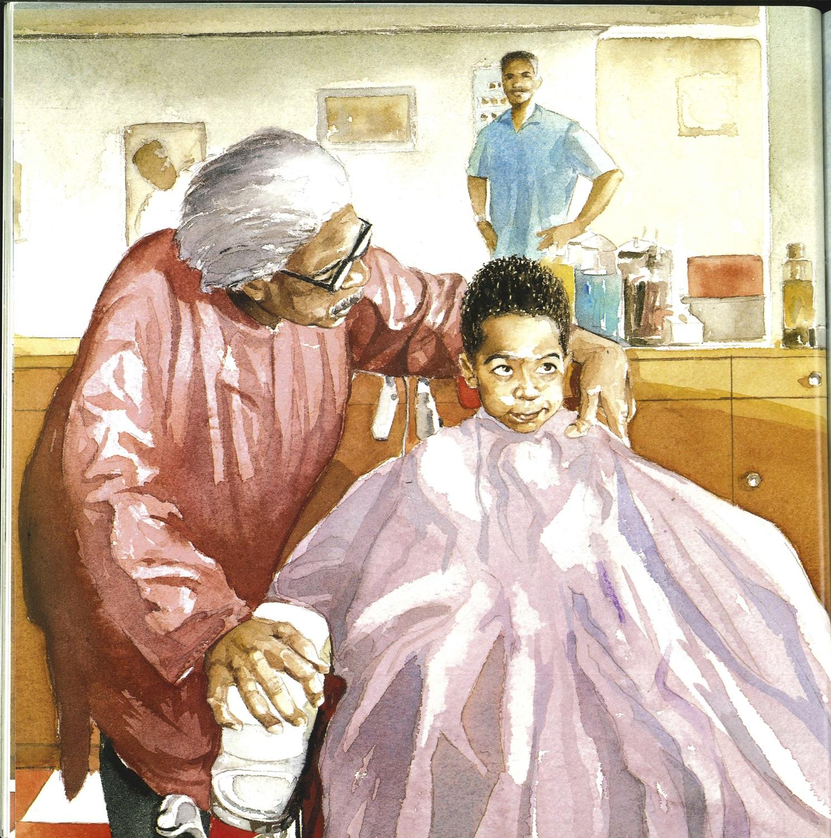
Slide 8

Slide 10
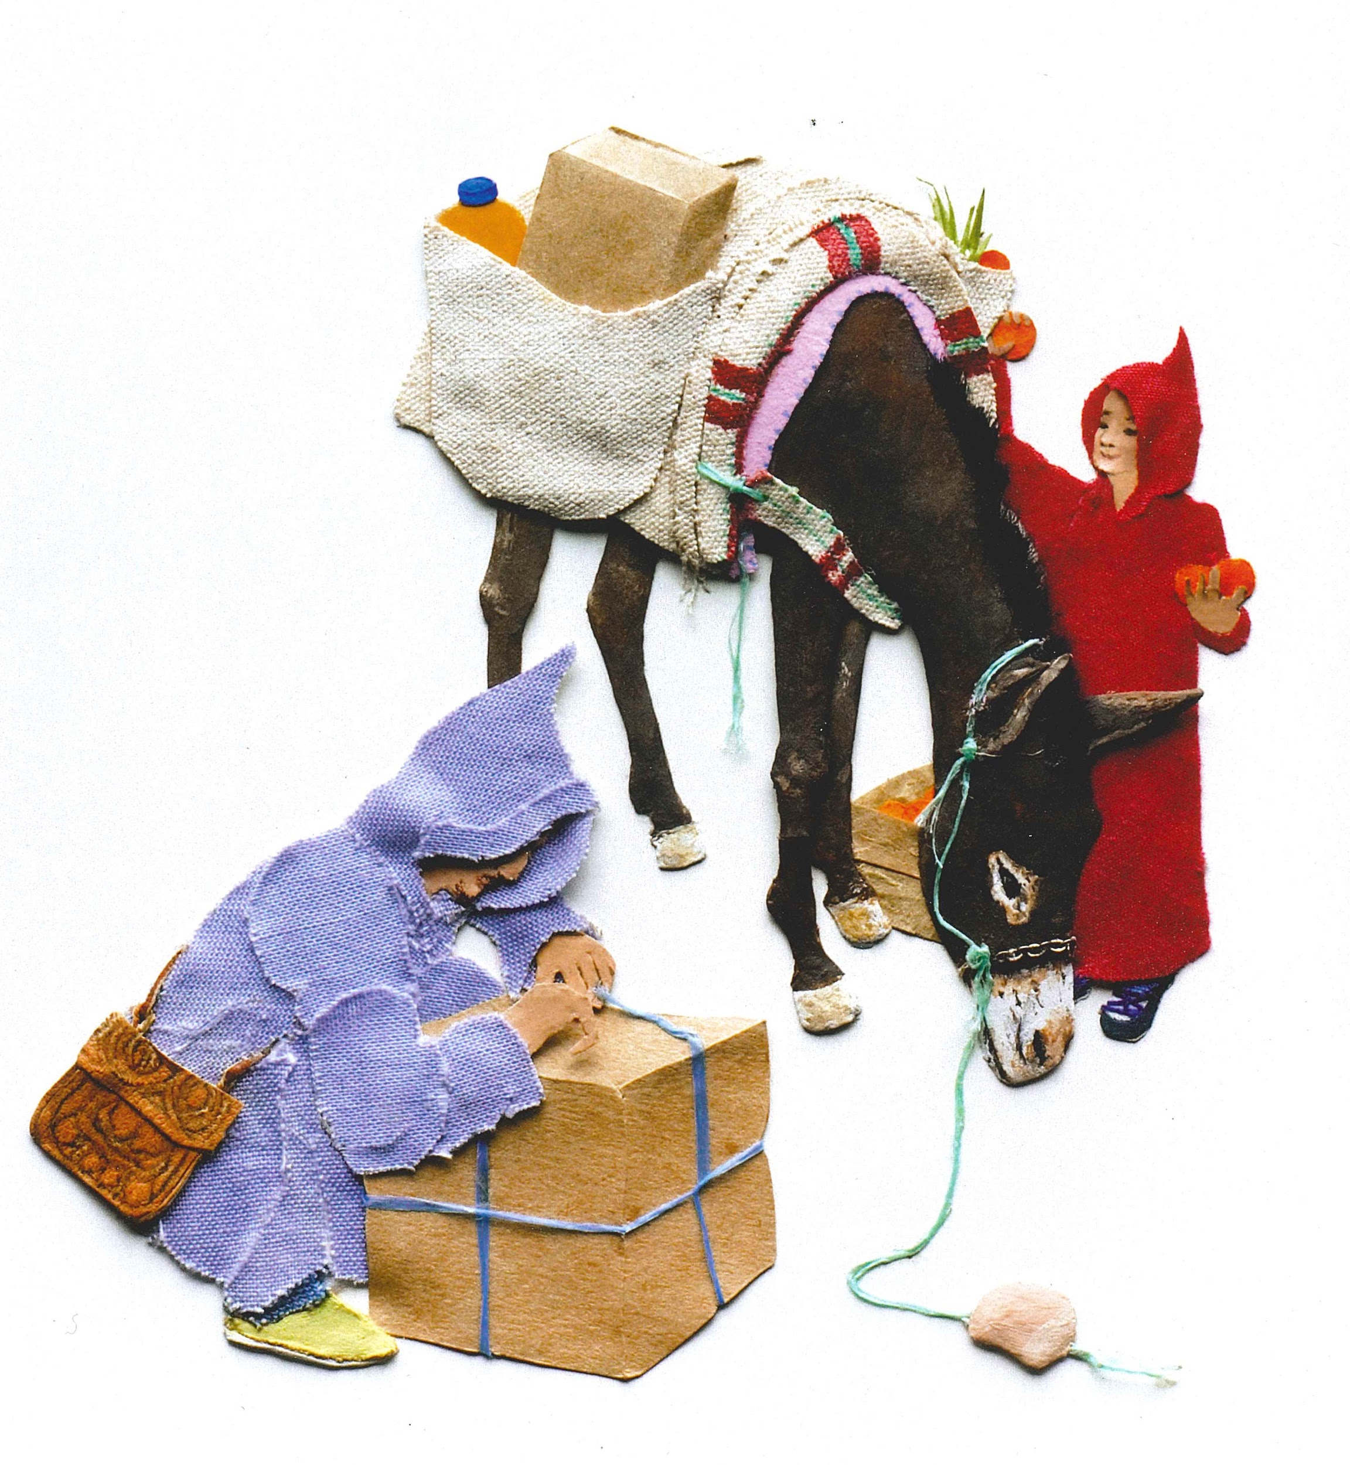
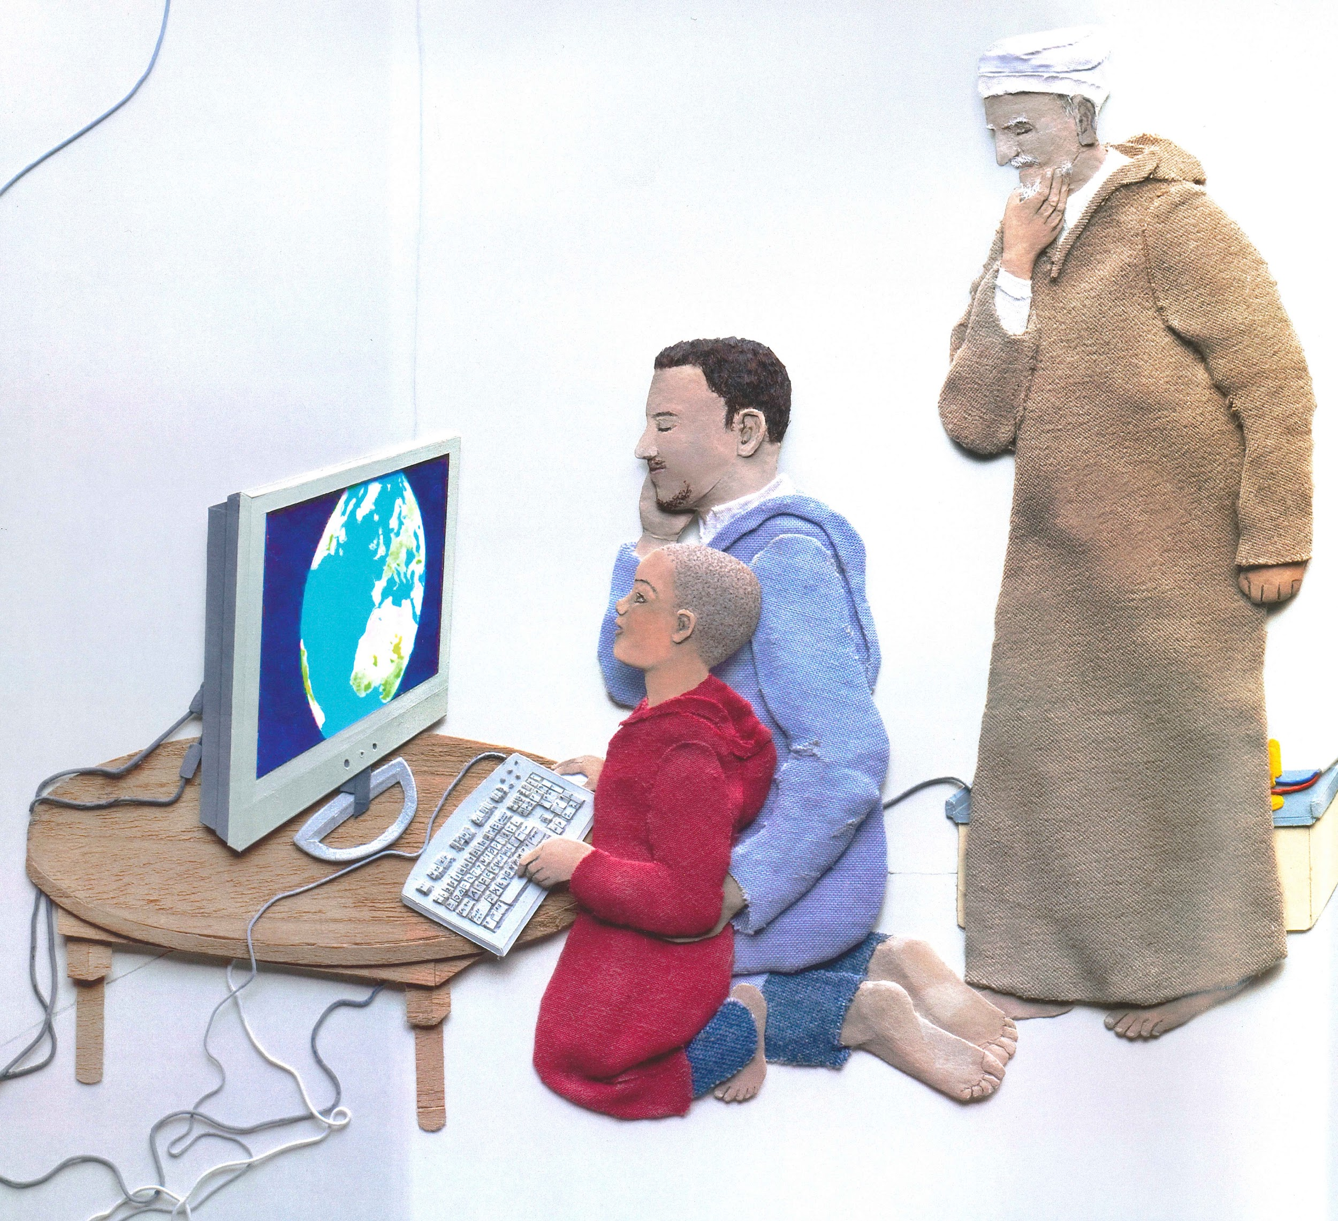
Slide 9

Slide 11
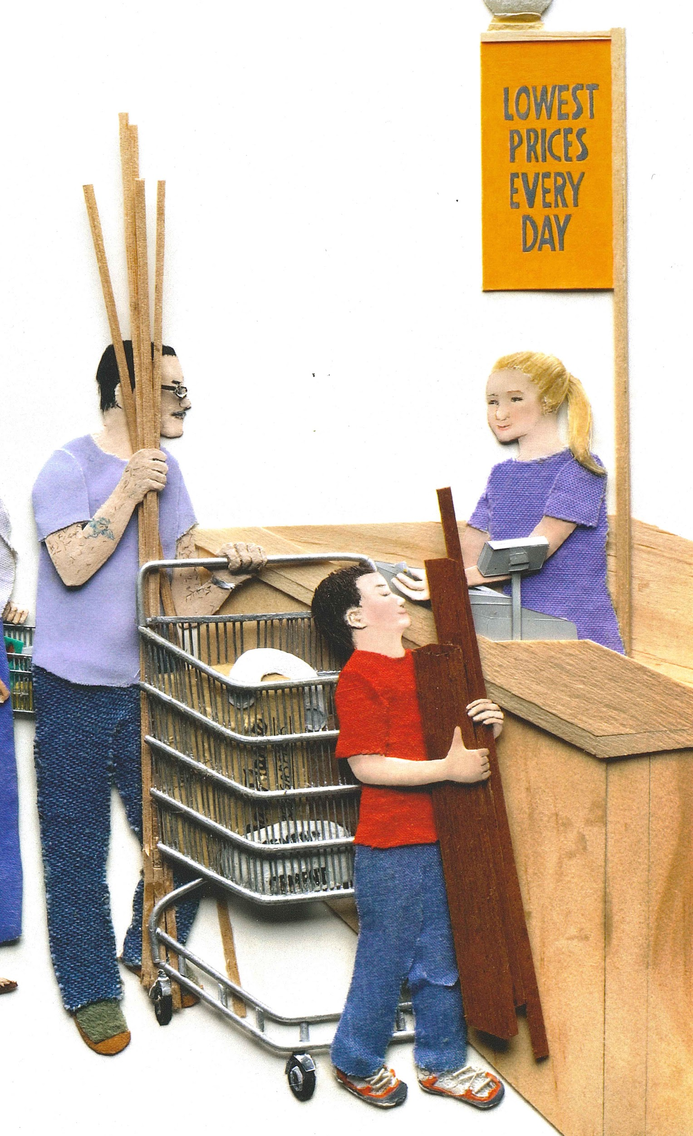
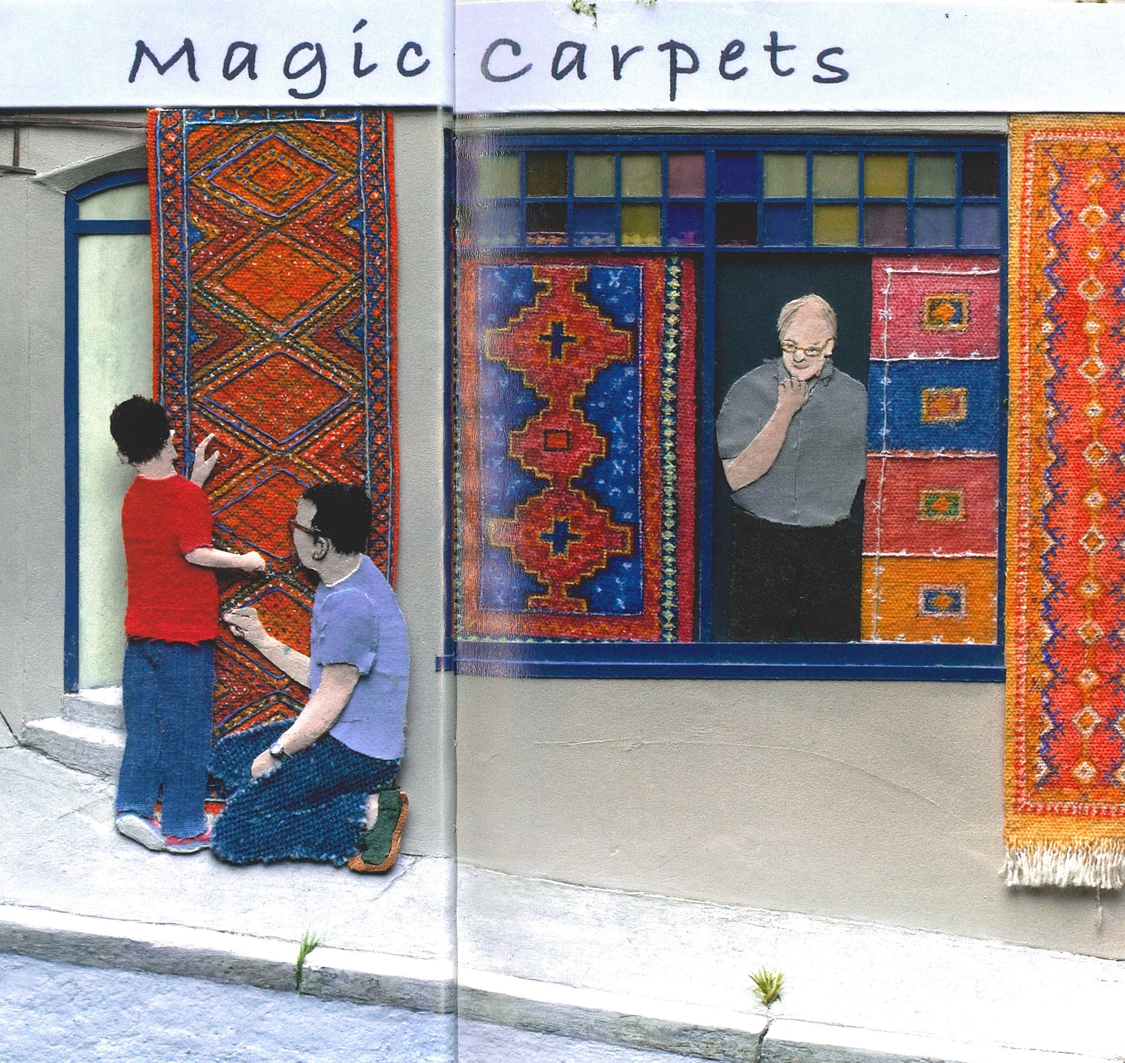
Slide 10

Slide 12
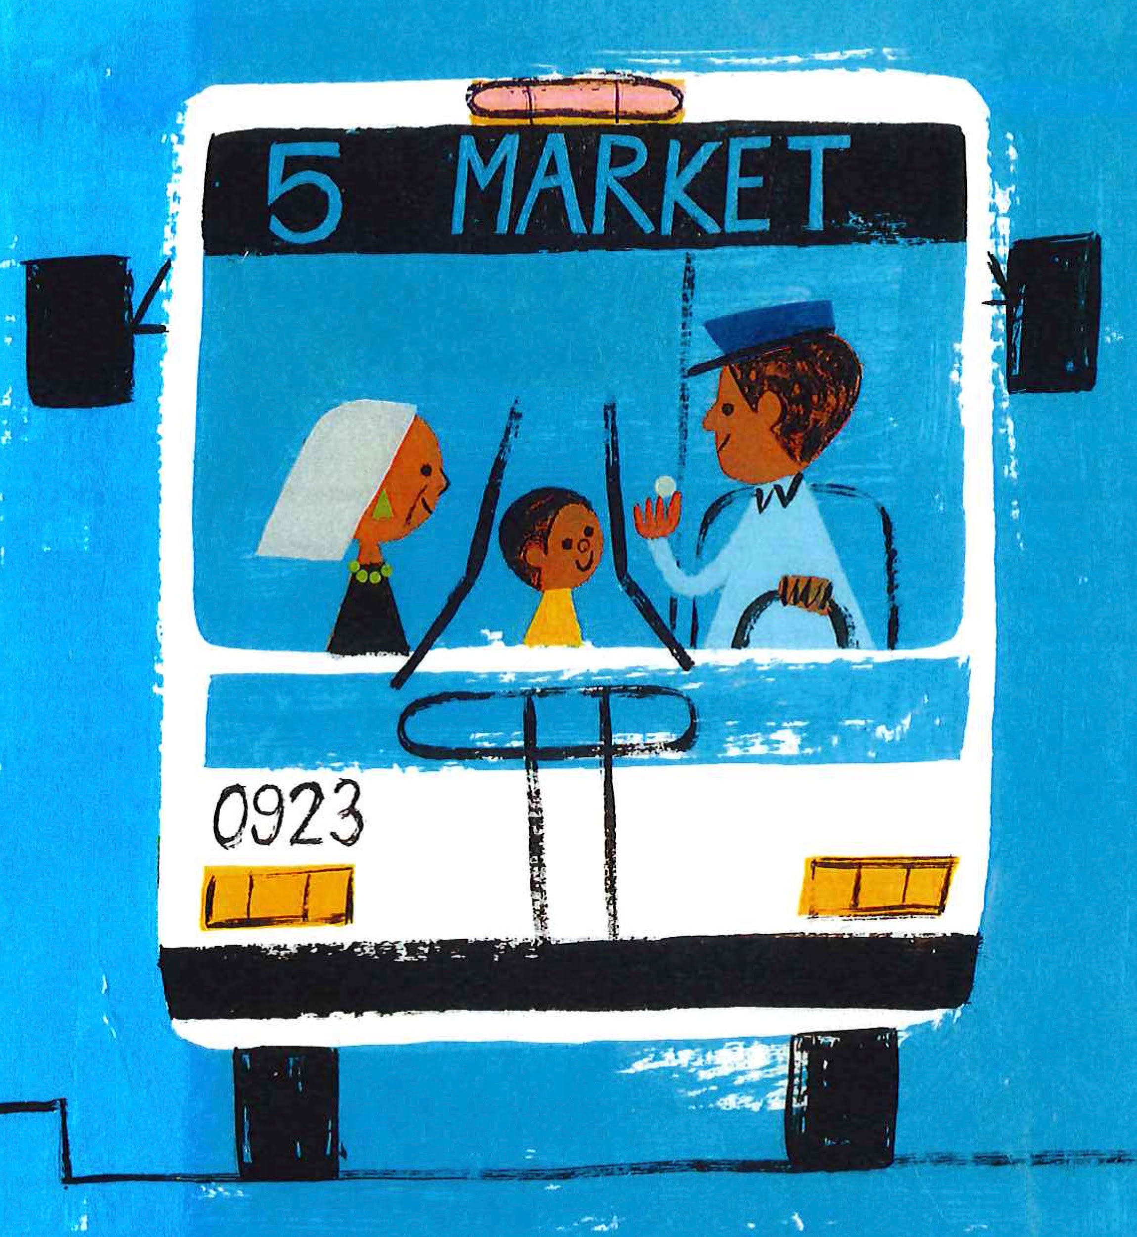
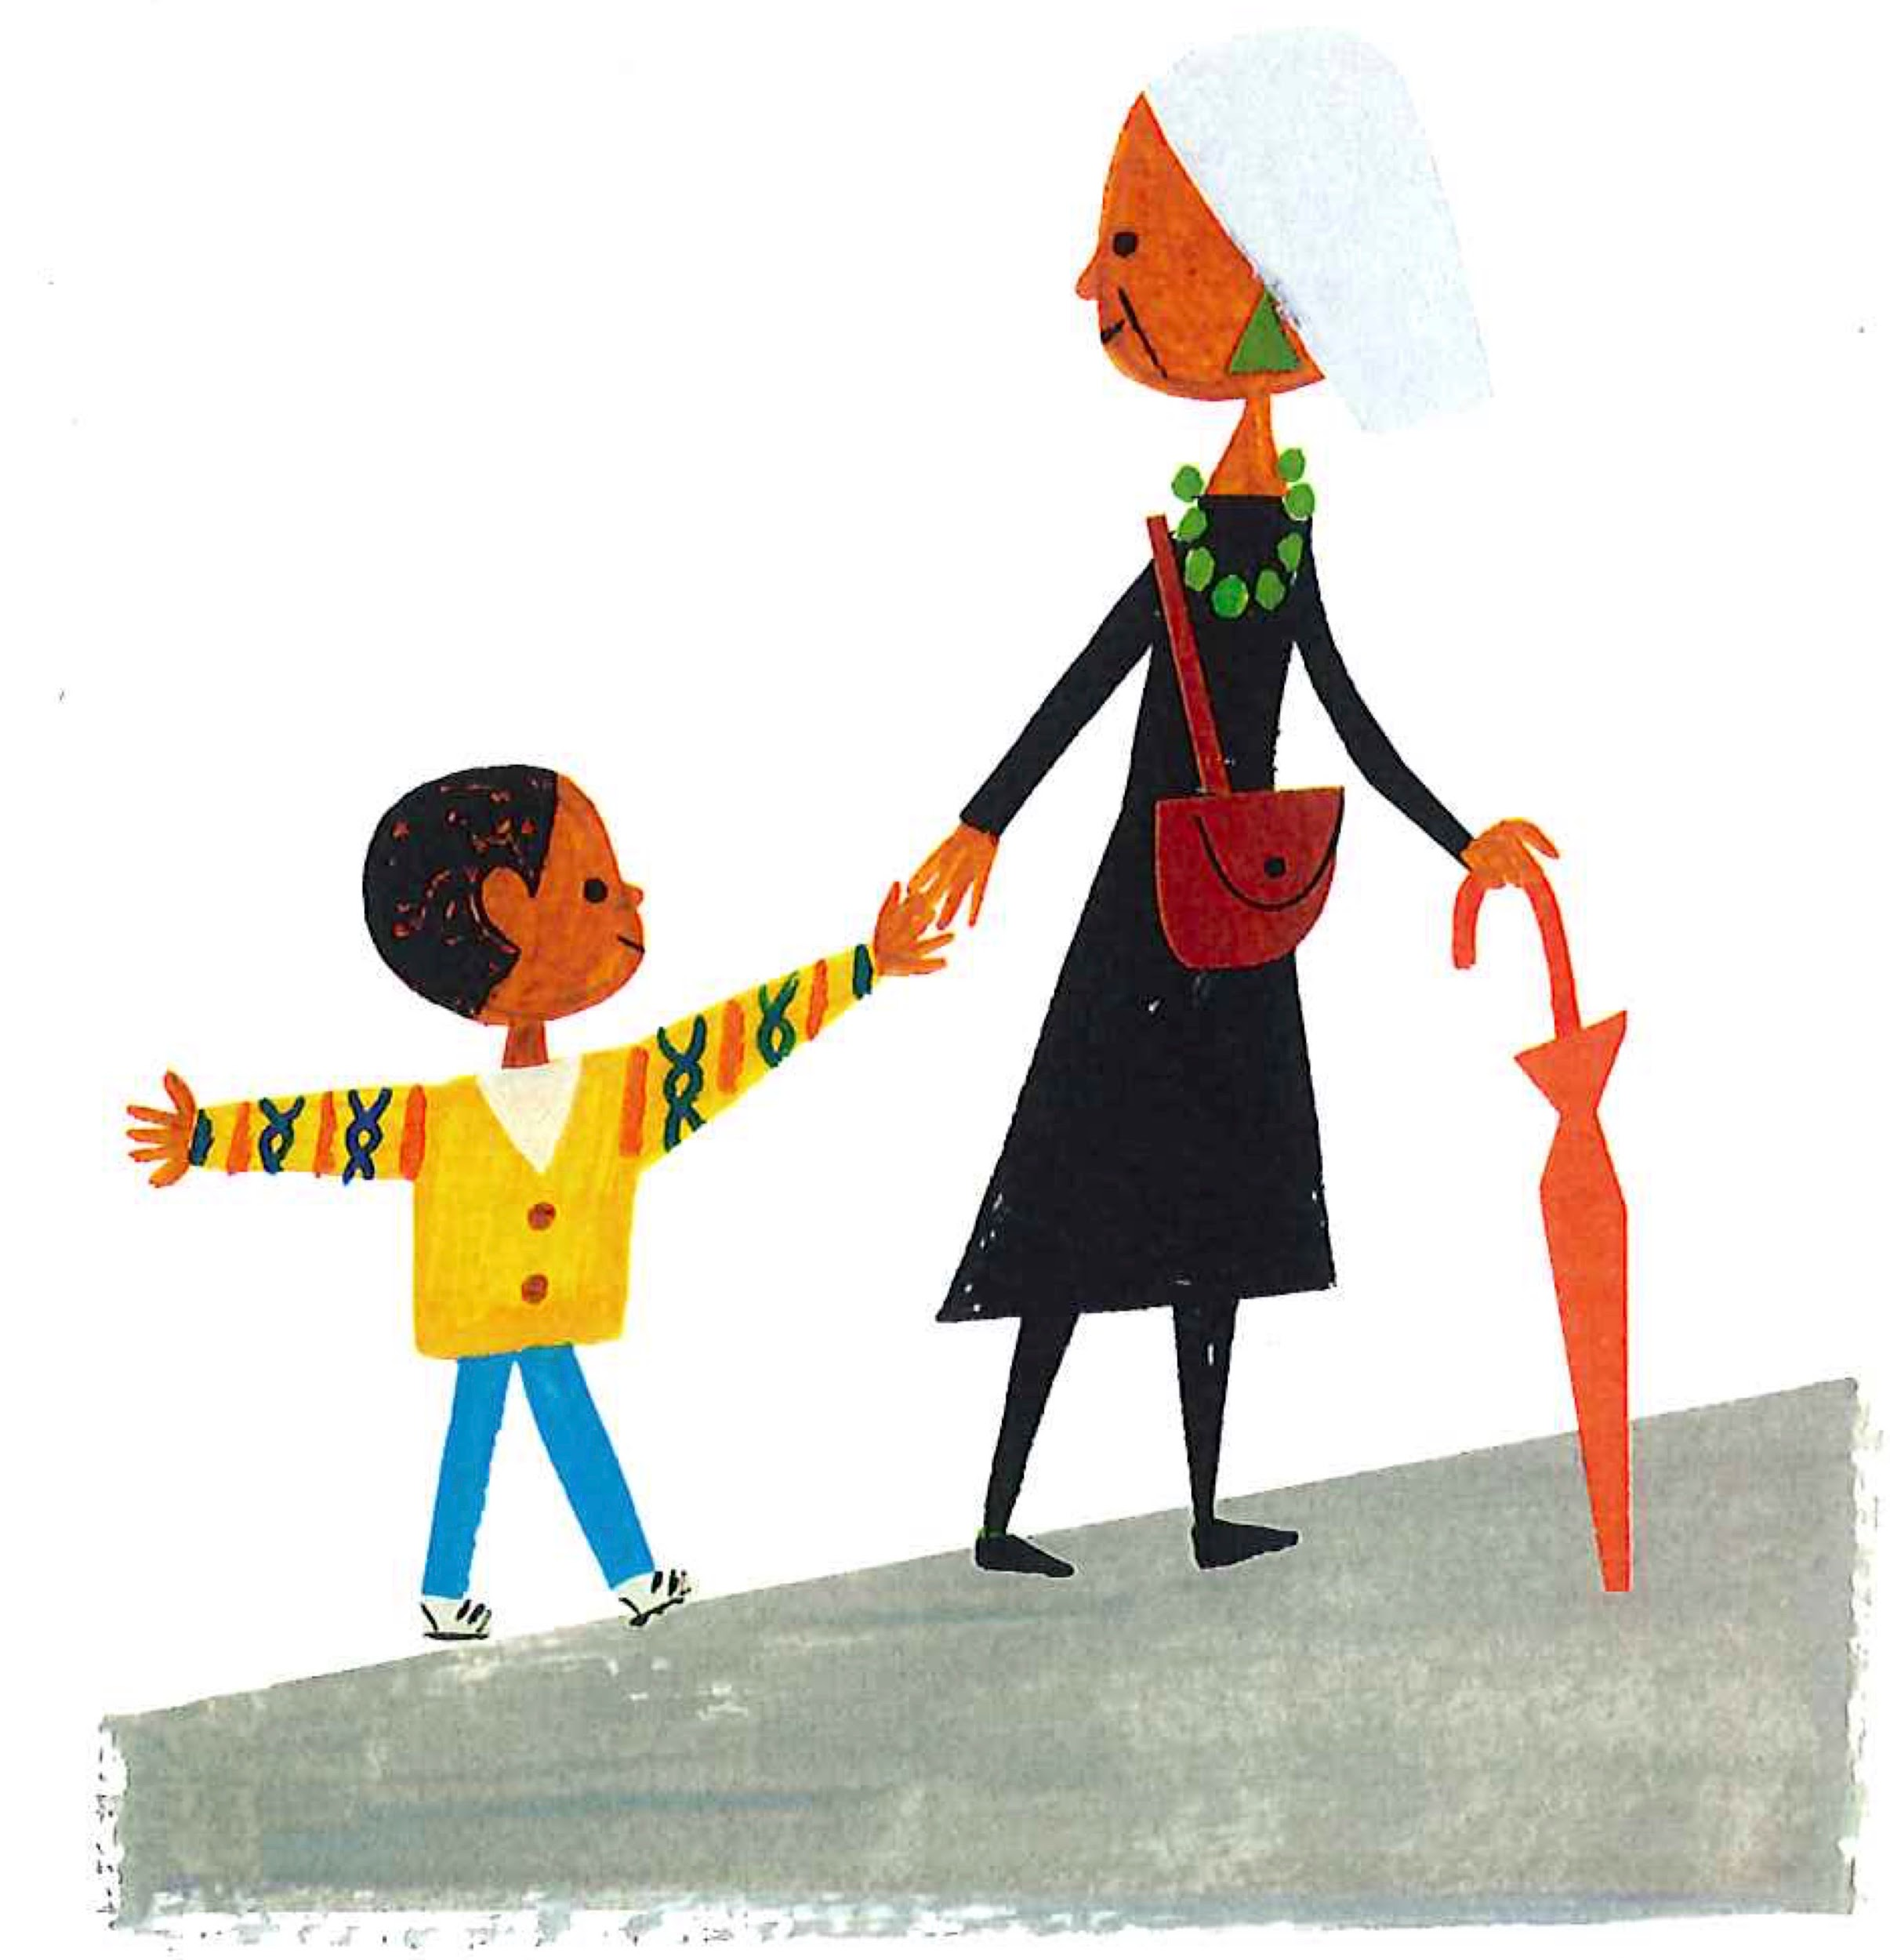
Slide 11

Slide 13
Slide 12

Slide 14
Citations
Title slide: https://sheilaritter.com/what-money-habits-are-you-teaching-your-children/
Slide 1: Nora Z. Jones, Those Shoes
Slides 2 and 3: Vera B. Williams, A Chair for My Mother
Slide 4: G. Brian Karas, On the Farm, At the Market
Slide 5: José Ramírez, Quinito’s Neighborhood
Slide 6: Grace Lin, Wen-mei and Her Clay Pot
Slide 7: https://www.ledgertranscript.com/Peterborough-middle-schooler-raising-money-for-endangered-turtles-22616739
Slide 8: E.B. Lewis, Bippity Bop Barbershop
Slides 9 and 10: Jeannie Baker, Mirror
Slide 11: Christian Robinson, Last Stop on Market Street
Slide 12: Ellen K. Mitten, Consumers and Producers

