Slide 1
Elijah Evans
Bikes Not Bombs
Text Talk Week 6, Day 3

Slide 2
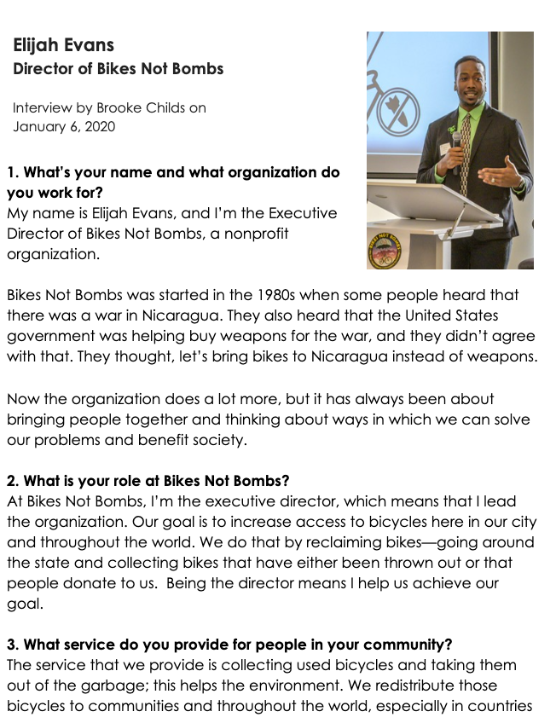

Slide 3
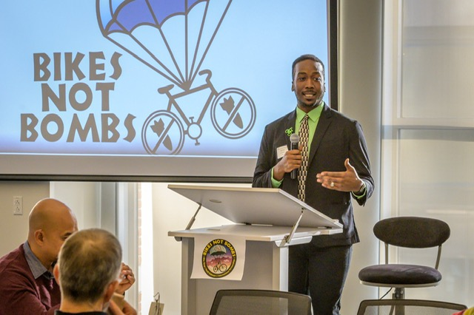
Slide 1
This is Elijah Evans. He is the leader of a nonprofit organization called Bikes Not Bombs.

Slide 4
Slide 2
“Our goal is to increase access to bicycles in our town and throughout the world. We do that by reclaiming bikes—going around the state and collecting bikes that have either been thrown out or that people donate to us.”
(Interview Question 2)

Slide 5
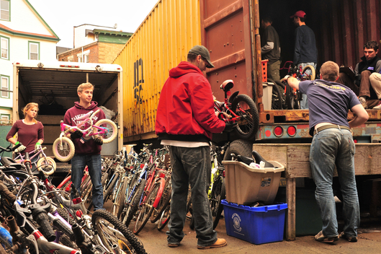
Slide 3

Slide 6
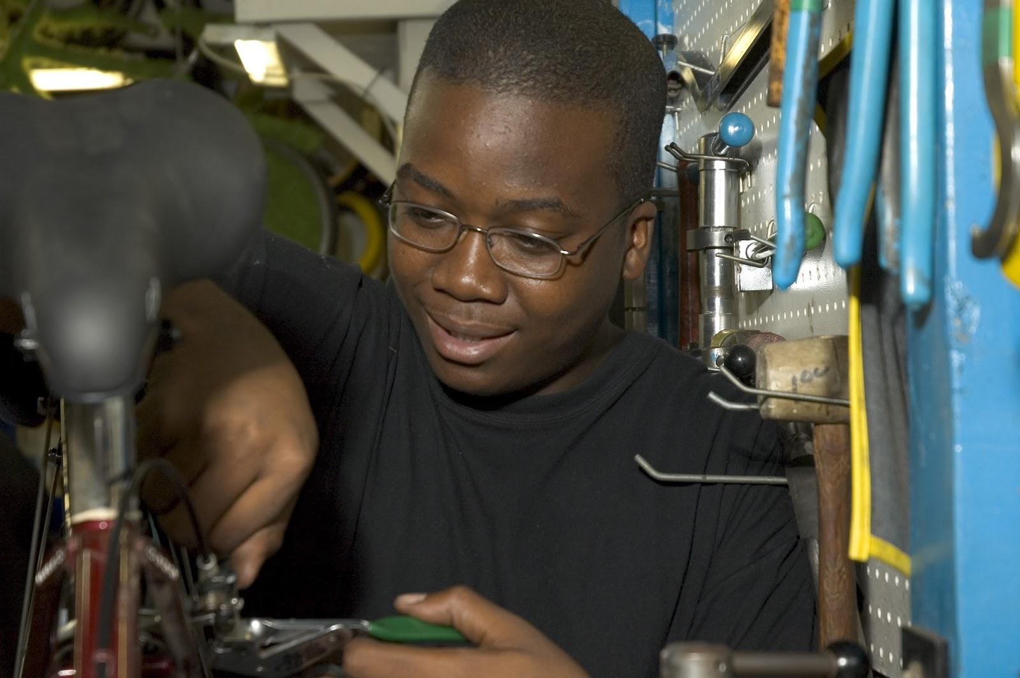
Slide 4
Elijah as a teenager, learning to fix bikes.
“I started 17 years ago, in 2003. I was a middle schooler going onto high school. ..In five weeks I built my first bike—it was an orange Mongoose bike. That really helped me realize that I could do something. It gave me some confidence.“ (Interview Question 4)

Slide 7
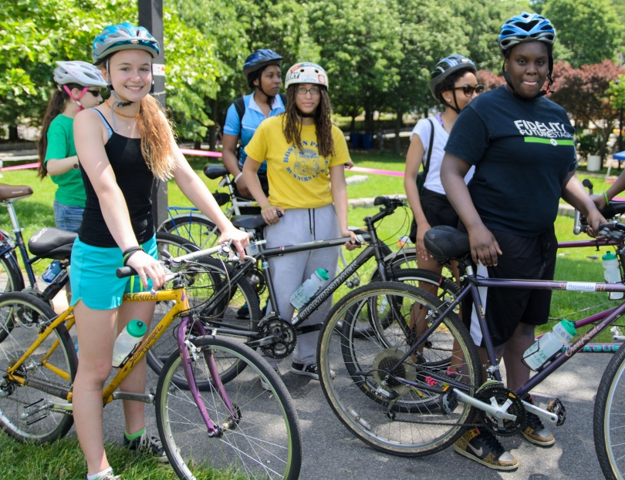
Slide 5
The Sisters In Action program at Bikes Not Bombs brings together girls and women. They learn bicycle mechanics and bicycle riding.

Slide 8
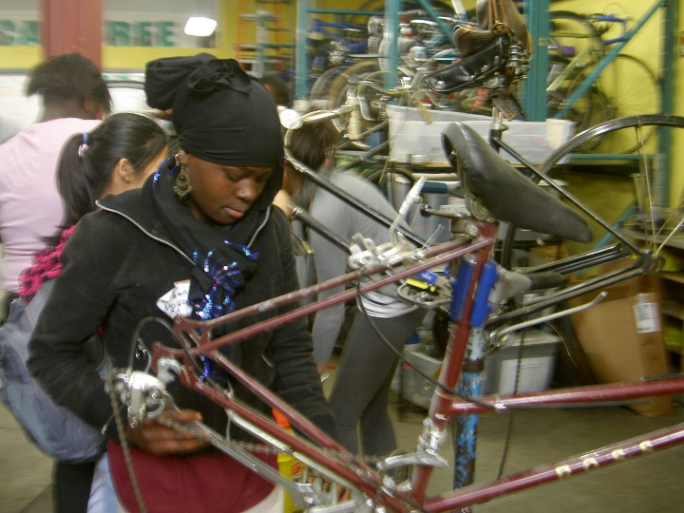
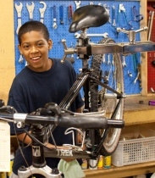
Slide 6
(Interview Question 6)
“You get to really challenge the idea in our society that young people don't teach adults. Why do we think that? So it's cool to be able to challenge ideas about what young people can do.”

Slide 9
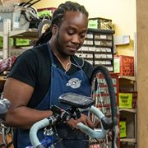
Slide 7
“You can find work that can pay you and also that drives you. You can find something to do that you’re excited about when you wake up every day.”
(Interview Question 8)

Slide 10
Citations
Compiled and written by Brooke Childs, Focus on First, 2019.
All images courtesy of Elijah Evans and Bikes Not Bombs.
https://bikesnotbombs.org/

