Slide 1
School Nurses
Keilah Acevedo and April Pumphret
Boston Public Schools
Text Talk Week 6, Day 1

Slide 2
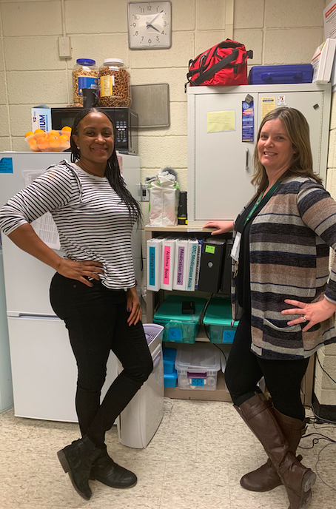
Slide 1
Meet Keilah Acevedo and April Pumphret.
They are school nurses at the Curley K-8 School..
Being a school nurse is a job, so Keilah and April receive a salary for their work.
Being a school nurse is also a way to provide a service to the community.
Keilah
April

Slide 3
Citations
Written by Brooke Childs, Focus on First, 2019.
Photo by Brooke Childs.

