Slide 1
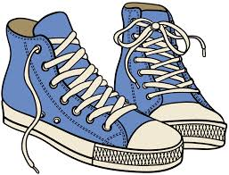
Where are the sneakers we buy made?
Text Talk Week 3, Day 4

Slide 2
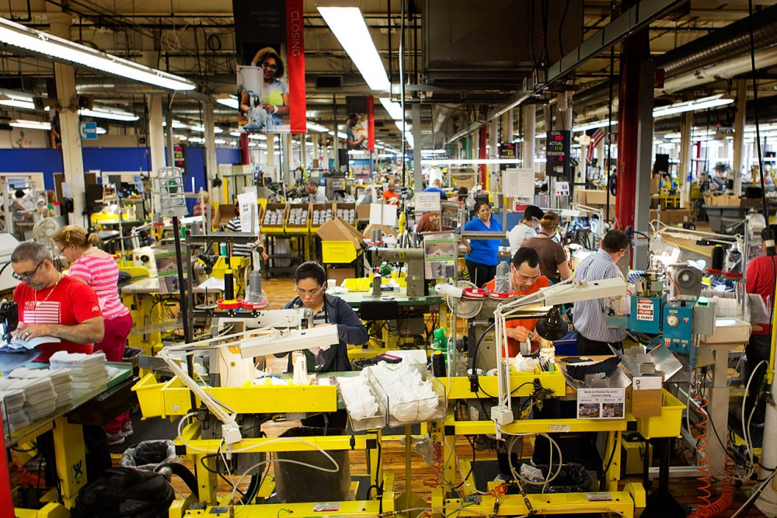
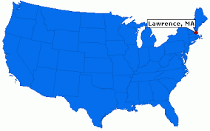
Slide 1
Some sneakers are made locally. Still, they use some materials that come from countries outside of the United States.

Slide 3
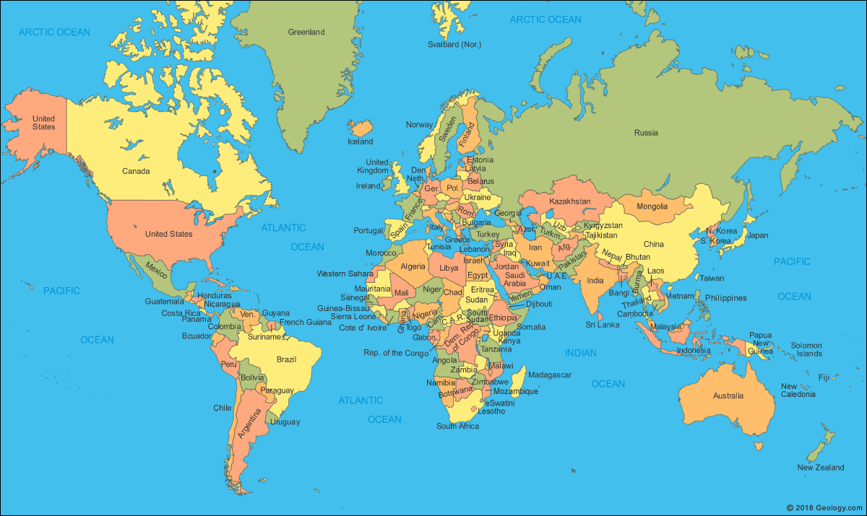
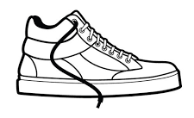
Slide 2
Most sneakers are made in countries in Asia, such as China, Vietnam, and Indonesia. Sneakers are part of a global industry.

Slide 4
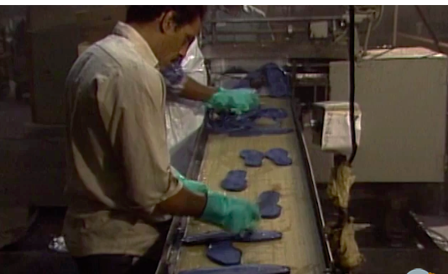
How are sneakers made?
Slide 3
Play video

Slide 5
Citations
Written and compiled by Brooke Childs, Focus on First, 2019.
Slide 1: https://www.wbur.org/news/2014/06/05/project-lawrence-jobs-unemployment
Slide 2: https://fdra.org/key-issues-and-advocacy/sourcing-compliance/
Slide 3: https://www.youtube.com/watch?v=RnRX7oYCwHI

