Slide 1
Phrases of Place
Vocabulary and Language Week 1, Days 3-4

Slide 2
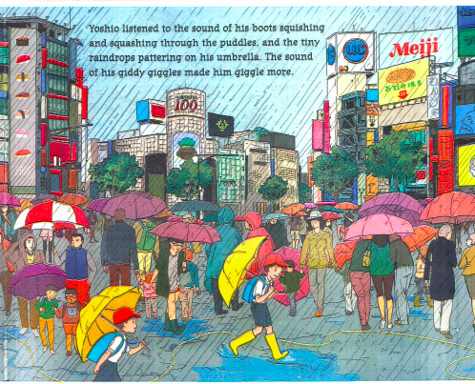
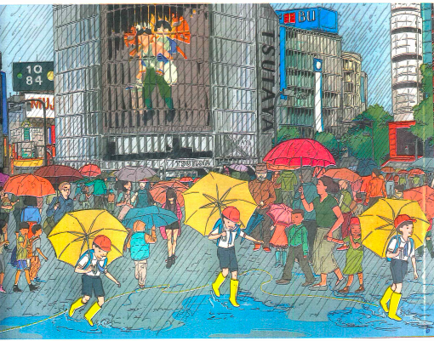
Slide 1

Slide 3
Slide 2
… the sound of his boots squishing and squashing through the puddles…
… the sound of his boots squishing and squashing through the puddles…
… the sound of his boots squishing and squashing through the puddles…

Slide 4
Slide 3
… and the tiny raindrops pattering on his umbrella …

Slide 5
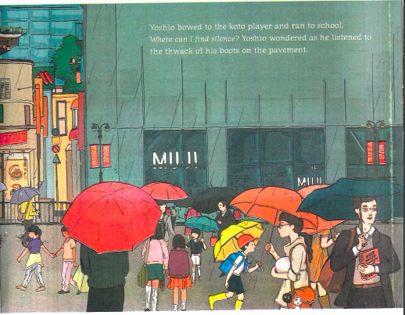
Slide 4
… the thwack of his boots on the pavement …

Slide 6
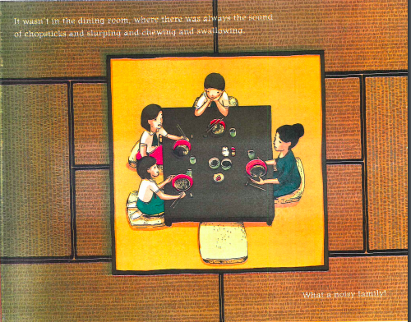
Slide 5
It wasn’t in the dining room, where there was always the sound of chopsticks and slurping and chewing and swallowing.

Slide 7
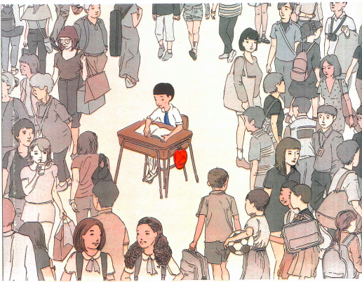
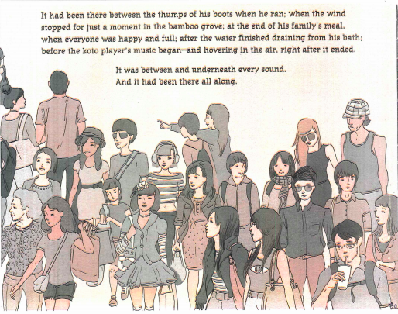
Slide 6

Slide 8
Slide 7
It had been there between the thumps of his boots when he ran…

Slide 9
Slide 8
… when the wind stopped for just a moment in the bamboo grove.

Slide 10
Slide 9
… and hovering in the air, right after it ended.

Slide 11
Slide 10
It was between and underneath every sound.

Slide 12
Slide 12
through | on | in
between | beneath | underneath

