Slide 1
This Training is being Recorded.
Please feel free to ask questions as they come up,
but we will have several Chat Box Check-Ins
throughout the training.

Slide 2
Present Level of Performance
Maine Department of Education
Office of Special Services & Inclusive Education
Supervision, Monitoring, and Support Team
1/24/2024

Slide 3
Introductions
Documenting Present Level and Goal Measurement in the IEP
Collecting and Analyzing Data
This Photo by Unknown Author is licensed under CC BY-SA

Slide 4
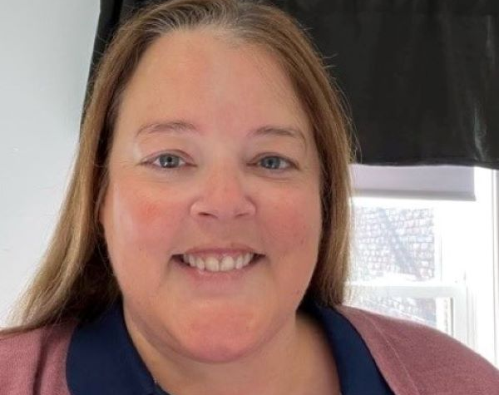
Meet The Team
Colette Sullivan
Federal Programs Coordinator
colette.sullivan@maine.gov
Jennifer Gleason
Educational Specialist
jennifer.gleason@maine.gov
Karlie Thibodeau
Educational Specialist
karlie.l.thibodeau@maine.gov
Ashley Satre
Educational Specialist
ashley.satre@maine.gov
Julie Pelletier
Secretary Associate
julie.pelletier@maine.gov

Slide 5
Individualized Education Plan IEP Alignment
Current Evaluation and Progress Results
Academic, Functional and
Developmental Strengths
Distinctly Measurable and Persistent Gaps in Academic Performance + How Statement
Distinctly Measurable and Persistent Gaps in Academic Performance + How Statement
Distinctly Measurable and Persistent Gaps in Functional Performance + How Statement
Distinctly Measurable and Persistent Gaps in Functional Performance + How Statement
Present Level
Present Level
Present Level
Present Level
Annual Goal
Annual Goal
Annual Goal
Annual Goal
Service(s)
Service(s)
Service(s)
Service(s)
Annually Updated and review of Supplementary Aids, Services and/or Supports
Least Restrictive Environment
(LRE)

Slide 6
Endrew F. v. Douglas County School District
“…a school must offer an IEP reasonably calculated to enable a child to make progress appropriate in light of the child’s circumstances.”
The “reasonably calculated” standard recognizes that developing an appropriate IEP requires a prospective judgment by the IEP Team.
The Supreme Court emphasized the requirement that “every child should have the chance to meet challenging objectives.”
https://sites.ed.gov/idea/idea-files/qa-endrew-f-v-douglas-county-school-district-case-qa/

Slide 7
Use of Data
Data should be used to:
assist in program effectiveness
determining the need for change

Slide 8
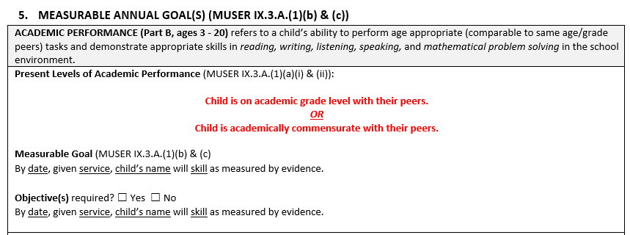
Section 5: Academic Performance – Present Level
IDEA requirement – MUST fill

Slide 9
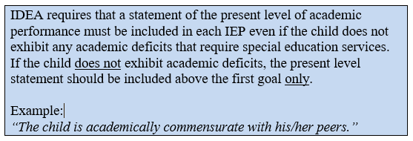
Special Education Required Forms Procedural Manual
Page 24

Slide 10
Section 5: Functional/Developmental Performance – Present Level
IDEA requirement – MUST fill

Slide 11
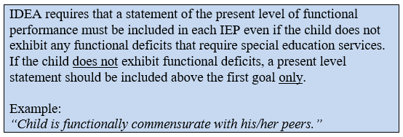
Special Education Required Forms Procedural Manual
Page 26

Slide 12
For each skill gap, what is the child’s present level of performance (baseline data)?
Evaluations
Academic and Functional Skill Gaps
Exceptionality Identification
One-to-one correspondence. There needs to be a present level for each skill gap listed in sections 4C
and 4D.
Present Level of Performance

Slide 13
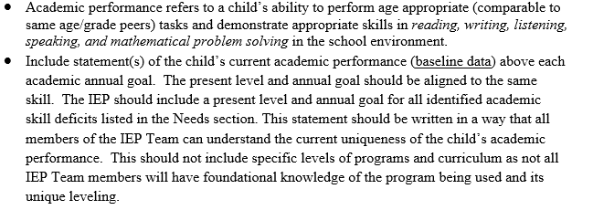
Special Education Required Forms Procedural Manual
Page 24

Slide 14
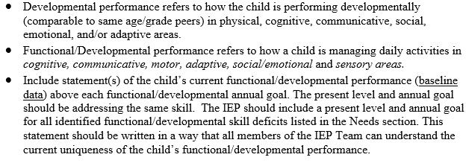
Special Education Required Forms Procedural Manual
Page 25

Slide 15
Present Level of Performance is:
Present Level
Of
Performance
Understandable to all, including parents
- Procedural Manual page 24 & 25

Slide 16
Present Level of Performance is:
Aligned with each Skill Gap in Sections
4C, 4D, & 4E
Present Level
Of
Performance
- Procedural Manual page 24 & 25

Slide 17
Present Level of Performance is:
Aligned with Goal Immediately Following
Present Level
Of
Performance
- Procedural Manual page 24 & 25

Slide 18
Alignment throughout the IEP document
Evaluations
Academic and Functional Skill Gaps
Disability Identification
Special Education and Related Services
Measurable Goals
Present Level of Performance
1-to-1 correspondence
Gap -> Present Level -> Goal

Slide 19
Present Level of Performance is:
Baseline
Data for Specific Skill Gap
Present Level
Of
Performance
- Procedural Manual page 24 & 25

Slide 20
Same Data Point
Present Level
Of
Performance
Baseline
Data
Measurable
Goal
Measurement
Data
Progress Monitoring

Slide 21
Present Level of Performance is not:
Subjective:
“struggles with”
“about”
“sometimes”
Present Level
Of
Performance

Slide 22
Present Level of Performance is not:
Approximate:
Less than 60%
About 55%
60-70%
~ 40%
Present Level
Of
Performance

Slide 23
Present Level of Performance is not:
Grades
Grade Level
Standard Scores
Percentile
Reading Level
Present Level
Of
Performance

Slide 24
Present Level of Performance is not:
Multiple Skills or Prerequisite Skills
Present Level
Of
Performance

Slide 25
Baseline
Data for Specific Skill Gap
Present Level
Of
Performance

Slide 26
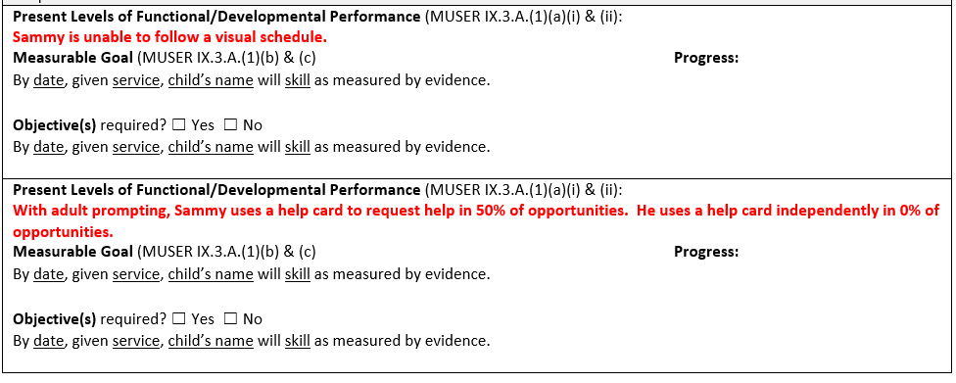
Present level of performance for each distinctly measurable and persistent skill gap.

Slide 27
Measurable Goal for each distinctly measurable and persistent skill gap.
Evaluations
Academic and Functional Skill Gaps
Exceptionality Identification
Present Level of Performance
Measurable Goals
One-to-one correspondence. There needs to be a goal for each skill gap listed in sections 4C and 4D.

Slide 28
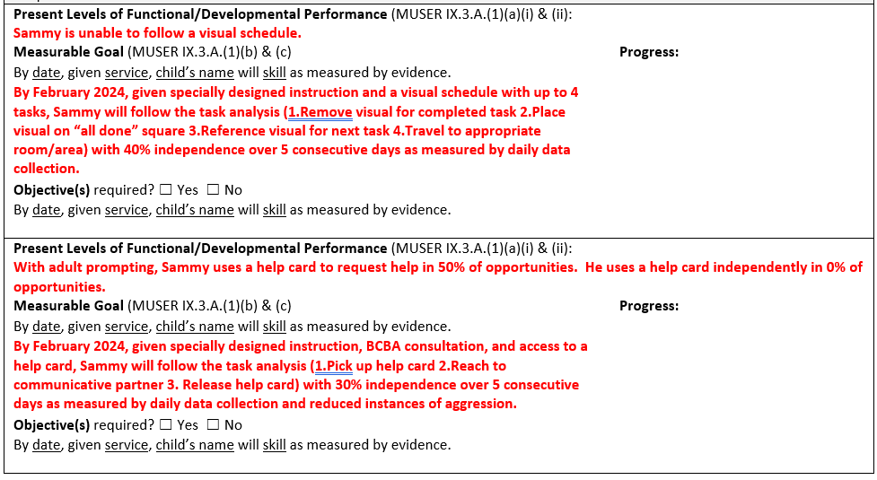
Measurable Goal for each distinctly measurable and persistent skill gap.

Slide 29
A note from recent case law:
Beer v. USD 512 Shawnee Mission
Source:
https://perryzirkel.com/2023/04/04/april-2023-legal-update/

Slide 30
Present Level of Performance
Data is:
Skill specific measurements/assessment
Qualitative data through teacher observation
Checklist or daily log
Running record
Work samples
Rubric (attach rubrics to the IEP)
Notes:
Rubric: Be sure that the goal aligns to specific skill gap and no vague language

Slide 31
Present Level of Performance
Data is not:
Eligibility / Evaluation Data
State and Local Assessments
Grades or Report Card
Specific Curriculum

Slide 32
What if I don’t have baseline data?
A quick probe will give you point-in-time baseline data.
Question: If you don’t know where the student is now (present level), how do you determine where they can go in one year (goal measurement)?
a school must offer an IEP that is reasonably calculated to enable a child to make progress
https://sites.ed.gov/idea/idea-files/qa-endrew-f-v-douglas-county-school-district-case-qa/

Slide 33
Questions?

Slide 34
Collecting and Analyzing Data
This Photo by Unknown Author is licensed under CC BY-SA
Data sheets will only be used with fidelity if they make sense to the person collecting data.

Slide 35
Data Sheets can be simple!

Slide 36
Sample Data

Slide 37
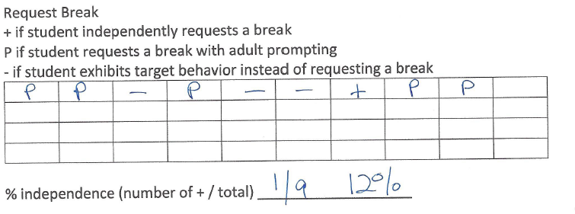
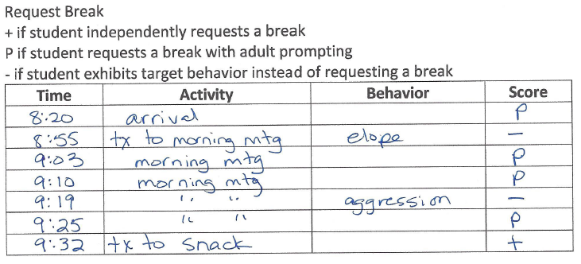
Sample Data

Slide 38
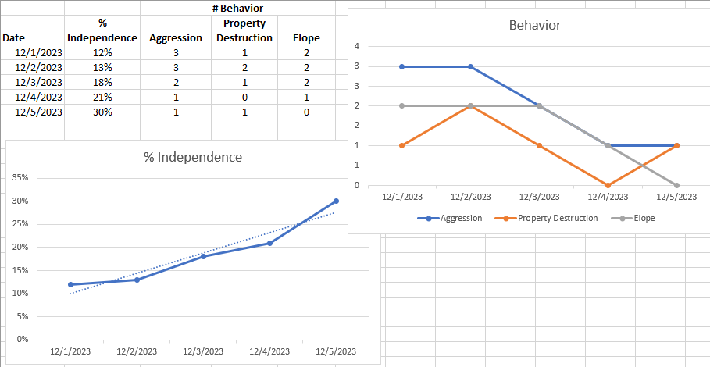
Request Break

Slide 39
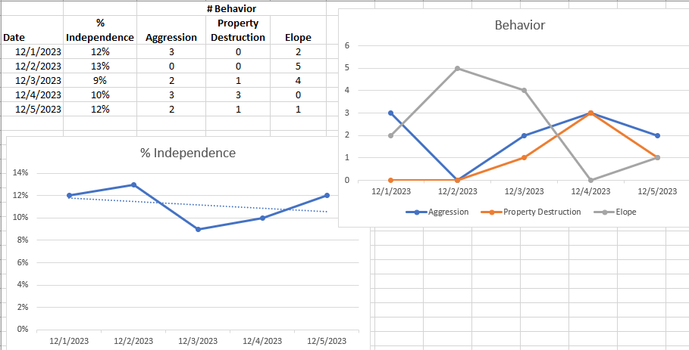
Request Break
What do I do when I see the
student isn’t progressing?

Slide 40
What do I do when I see the
student isn’t progressing?
1. Form hypothesis based on knowledge of child and past observations.
2. Do some observations.
3. Spend time working with the student and collecting data.
4. Inter-rater reliability check and training.

Slide 41
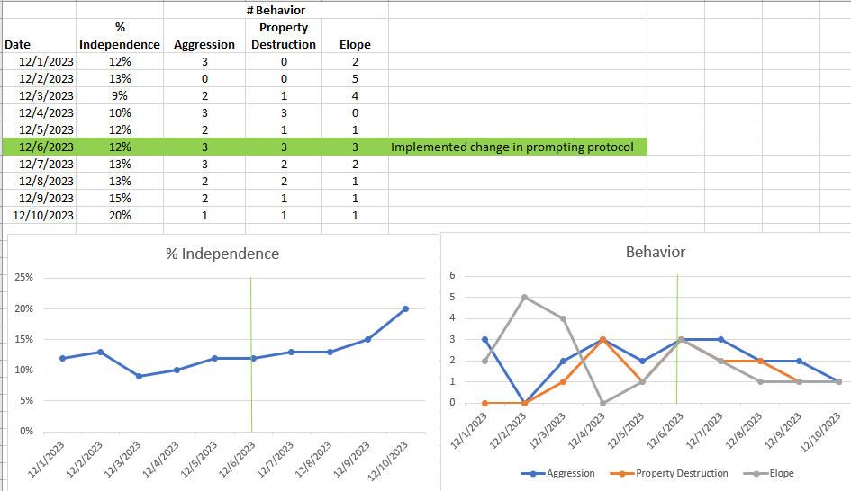
Request Break
Note when you make programming changes

Slide 42
How long do I take data before I know that the student is or isn’t making progress?
It depends on:
the student
the skill
the task
Your experience with and knowledge of the student will inform this decision.

Slide 43
Recap
The data sheet must make sense to the person collecting data.
Look at your data often. It will tell you when a student is not making progress.
If a student isn’t making progress, you need to change something. You may have to try several changes before you find the right one for that student.
Data analysis drives programming!

Slide 44
Office Hours Archives – Data Collection Modules

Slide 45
This Photo by Unknown Author is licensed under CC BY-NC

Slide 46
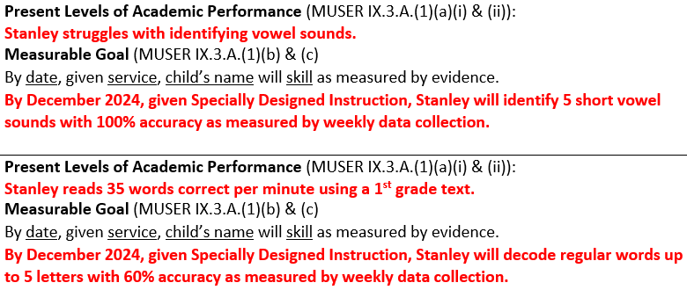
What’s wrong?
This Photo by Unknown Author is licensed under CC BY-NC-ND
Tell us in the Chat Box why this is not compliant.

Slide 47
What’s wrong?
This Photo by Unknown Author is licensed under CC BY-SA-NC
Subjective language
No baseline data
Present level and goal alignment

Slide 48
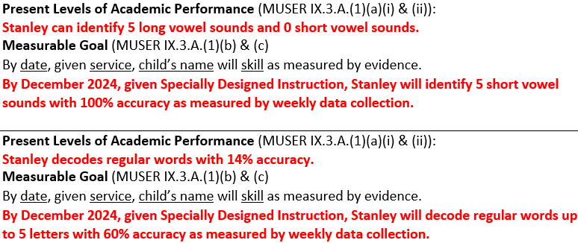
Instead

Slide 49
What’s wrong?
This Photo by Unknown Author is licensed under CC BY-NC-ND
Tell us in the Chat Box why this is not compliant.

Slide 50
What’s wrong?
This Photo by Unknown Author is licensed under CC BY-SA-NC
“approximately”
Range (“10-15%”)
No baseline data

Slide 51
Instead

Slide 52
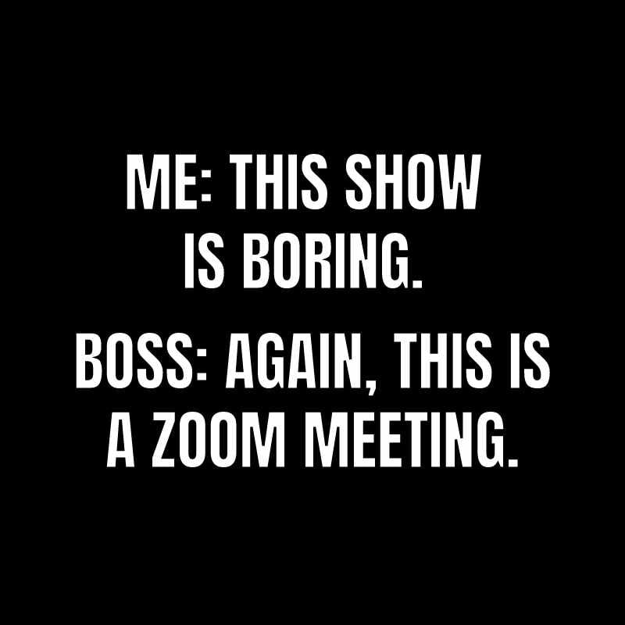
Questions?

Slide 53
Resources
Procedural Manual

Slide 54
Resources
Procedural Manual
Maine Unified Special Education Regulations (MUSER)

Slide 55
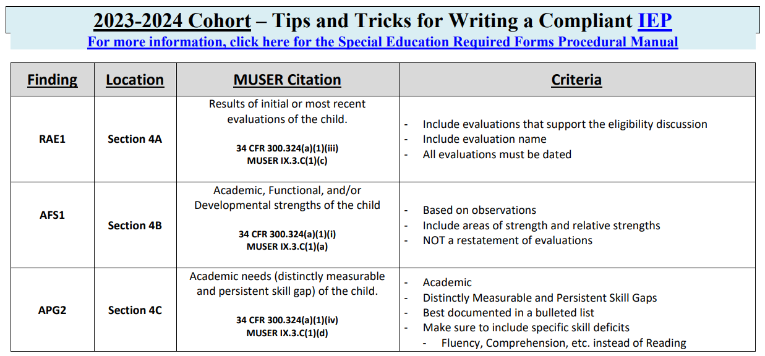
Resources
Procedural Manual
Maine Unified Special Education Regulations (MUSER)
2023-24 Cohort IEP Quick Reference Document

Slide 56
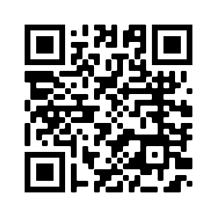
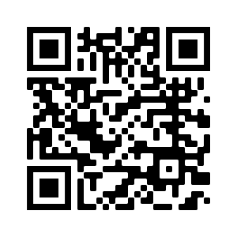
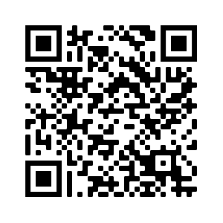
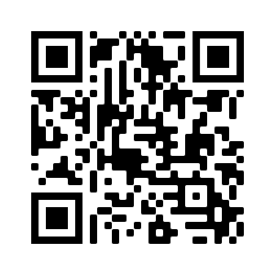
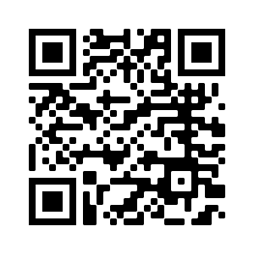
Resources
Professional Development Calendar
Link for Recordings and Power Points
Special Education Resources
Special Education Laws and Regulations
Special Education Forms and Reporting
Maine Unified Special Education Regulations (MUSER)
2023-24 Cohort IEP Quick Reference Document

Slide 57
Resources
Professional Development Calendar
Link for Recordings and Power Points
Special Education Resources
Special Education Laws and Regulations
Special Education Forms and Reporting
2023-24 Cohort IEP Quick Reference Document

Slide 58
2023-24 Professional Development
DATE | TOPIC/DESCRIPTION
Wednesday 9/13/23 | Resources
Wednesday 9/27/23 | Transition from CDS to Public School
Friday 9/29/23 | Q&A Session
Wednesday 10/11/23 | Abbreviated Day
Tuesday 10/24/23 | Fall All District IEP Training
Tuesday 10/24/23 | Fall All District B-13 Training
Wednesday 10/25/23 | Discipline & Manifestation Determination
Friday 10/27/23 | Q&A Session
*Wednesday 11/8/23* | *Alignment and DIB1 (Disability Alignment)*
Wednesday 12/13/23 | Orientation and Mobility
Wednesday 12/20/23 | Compliant Transition Plans
Tuesday 1/9/24 | Winter All District B-13 Training
Tuesday 1/9/24 | Winter All District IEP Training
Wednesday 1/10/24 | Advanced Written Notice & Written Notice

Slide 59
2023-24 Professional Development (cont.)
DATE | TOPIC/DESCRIPTION | REGISTRATION LINK
Wednesday 1/24/24 | Present Level of Performance | Present Level of Performance Registration Link
Friday 1/26/24 | Q&A Session | Q & A Registration Link
Wednesday 2/14/24 | Writing Measurable Functional Goals and Avoiding Outcomes | Writing Measurable Functional Goals Registration Link
Wednesday 2/28/24 | Transition from CDS to Public School | Transition from CDS to Public School Registration Link
*Wednesday 3/13/24* | *Least Restrictive Environment* | Least Restrictive Environment Registration Link
Wednesday 3/27/24 | Forms – (AE attached to WN) | Forms (AE attached to WN) Registration Link
Friday 3/29/24 | Q&A Session | Q & A Registration Link
Wednesday 4/10/24 | Special Education Law for General Education Teachers | Special Education Law for General Education Teachers Registration Link
Wednesday 4/24/24 | IEP Essentials | IEP Essentials Registration Link
Friday 4/26/24 | Q&A Session | Q & A Registration Link
Thursday 5/2/24 | Spring All District IEP Training | IEP Training Registration Link (5/2/24)
Thursday 5/2/24 | Spring All District B-13 Training | B-13 Training Registration Link (5/2/24)
Wednesday 5/8/24 | Consultation/Related Service Goals | Consultation/Related Service Goals Registration Link
Wednesday 5/22/24 | Data Collection | Data Collection Registration Link
Friday 5/24/24 | Q&A Session | Q & A Registration Link

Slide 60
Please consider sharing the links to these PD opportunities with general education teachers:
Wednesday 10/25/23 - Discipline & Manifestation Determination
Wednesday 4/10/24 - Special Education Law for General Education Teachers
Please consider sharing the links to these PD opportunities with related service providers:
Wednesday 2/14/24 - Writing Measurable Functional Goals and Avoiding Outcomes
Wednesday 5/8/24 - Consultation/Related Service Goals

Slide 61
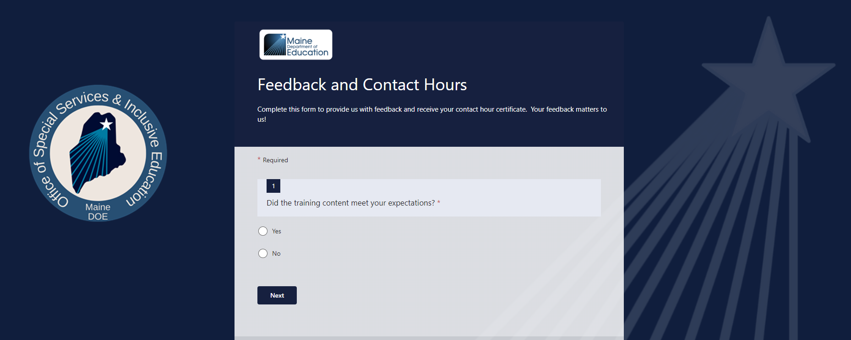
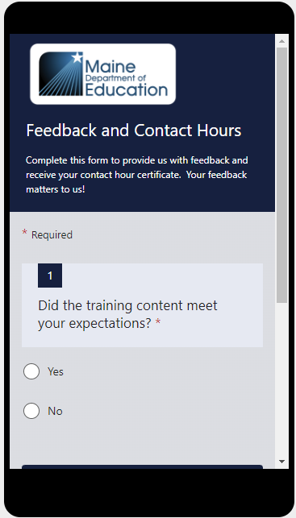
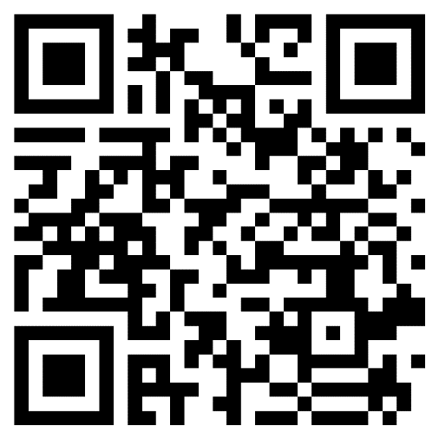
Professional Learning Feedback and Contact Hour Form.
Use the link to complete the form on your computer
OR
Use the QR code to complete the form on your mobile device
https://forms.office.com/g/by472QQLDJ

Slide 62
Stay Connected!
Find Us Online!
www.maine.gov/doe
@MaineDOEComm
@mainedepted
@mdoenews
@MaineDepartmentofEducation1

Slide 63
This Photo by Unknown Author is licensed under CC BY-NC
Colette Sullivan – Federal Programs Coordinator
colette.sullivan@maine.gov
Jennifer Gleason – Special Education Consultant
jennifer.gleason@maine.gov
Karlie Thibodeau – Special Education Consultant
karlie.l.thibodeau@maine.gov
Ashley Satre – Special Education Consultant
ashley.satre@maine.gov
Julie Pelletier – Secretary Associate
julie.pelletier@maine.gov
This Photo by Unknown Author is licensed under CC BY-NC

