Slide 1
Earth Day

Slide 2
Earth Day comes but once a year,
Let’s celebrate and give a cheer!

Slide 3
Pick up a sack,
and clean the trash,
Help the Earth get back on track.

Slide 4
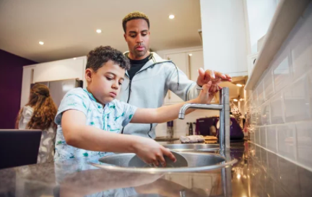
Turn off the tap,
To save some water,
Let the Earth have blue on her map.

Slide 5
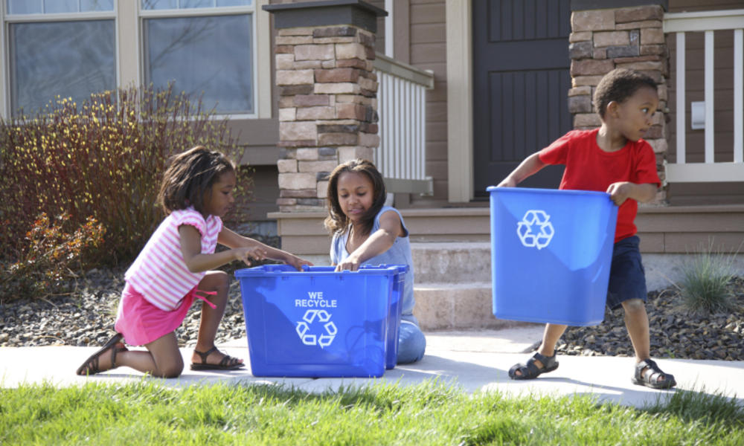
Earth Day comes but once a year,
Let’s celebrate and give a cheer!

