Slide 1
Talk Time
Unit 4, Week 6

Slide 2
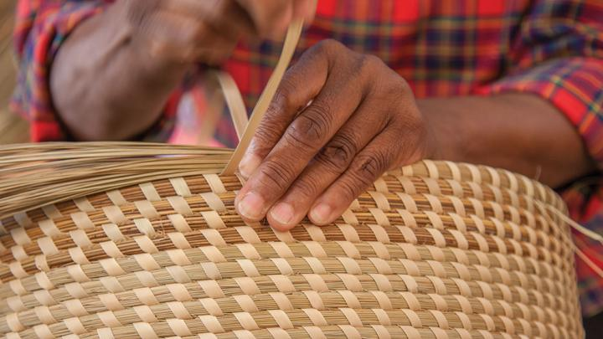
https://www.craftcouncil.org/post/addressing-threats-facing-traditional-basketmaking-materials
Notes:
What materials do you think this basketmaker is using?
What are some steps it might take to weave a basket?

