Slide 1
Parts of a Letter
Writing Week 7, Day 1
Recreate with YOUR letter from the Unit 3 Our Town project

Slide 2
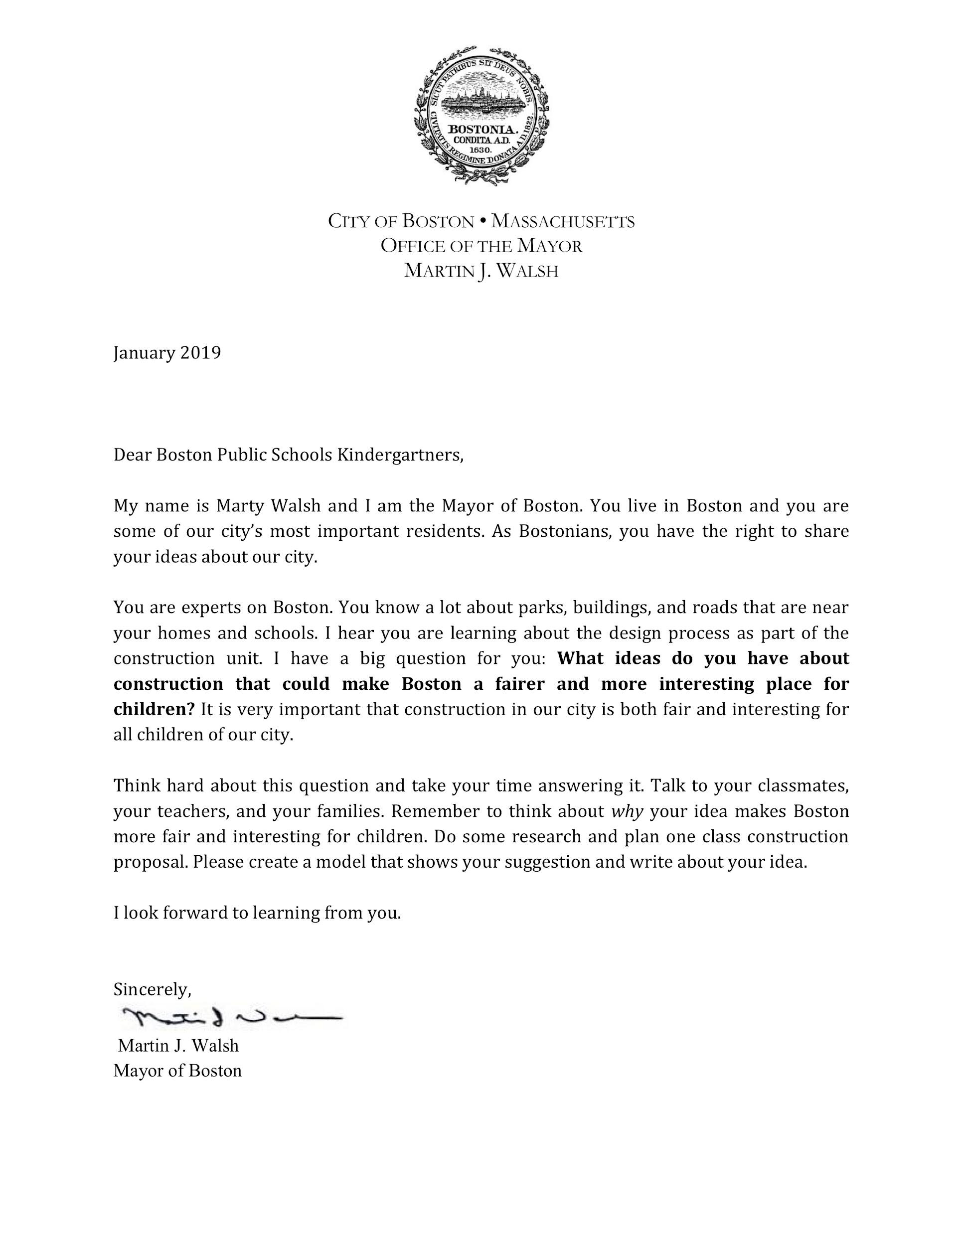
Slide 1

Slide 3
Slide 2
heading
greeting

Slide 4
Slide 3
body

Slide 5
Slide 3
closing
signature

