Slide 1
Library & Listening
Unit 4, Week 8

Slide 2
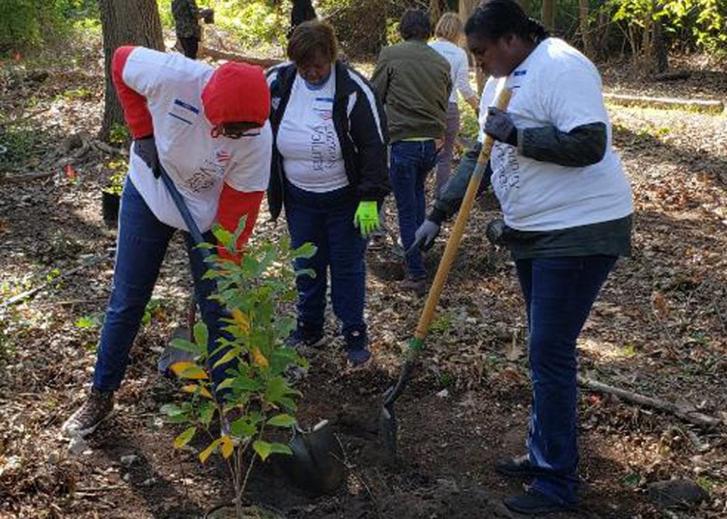
Caretaker of the earth plant trees
https://www.americanforests.org/blog/another-successful-tree-planting-season/

Slide 3
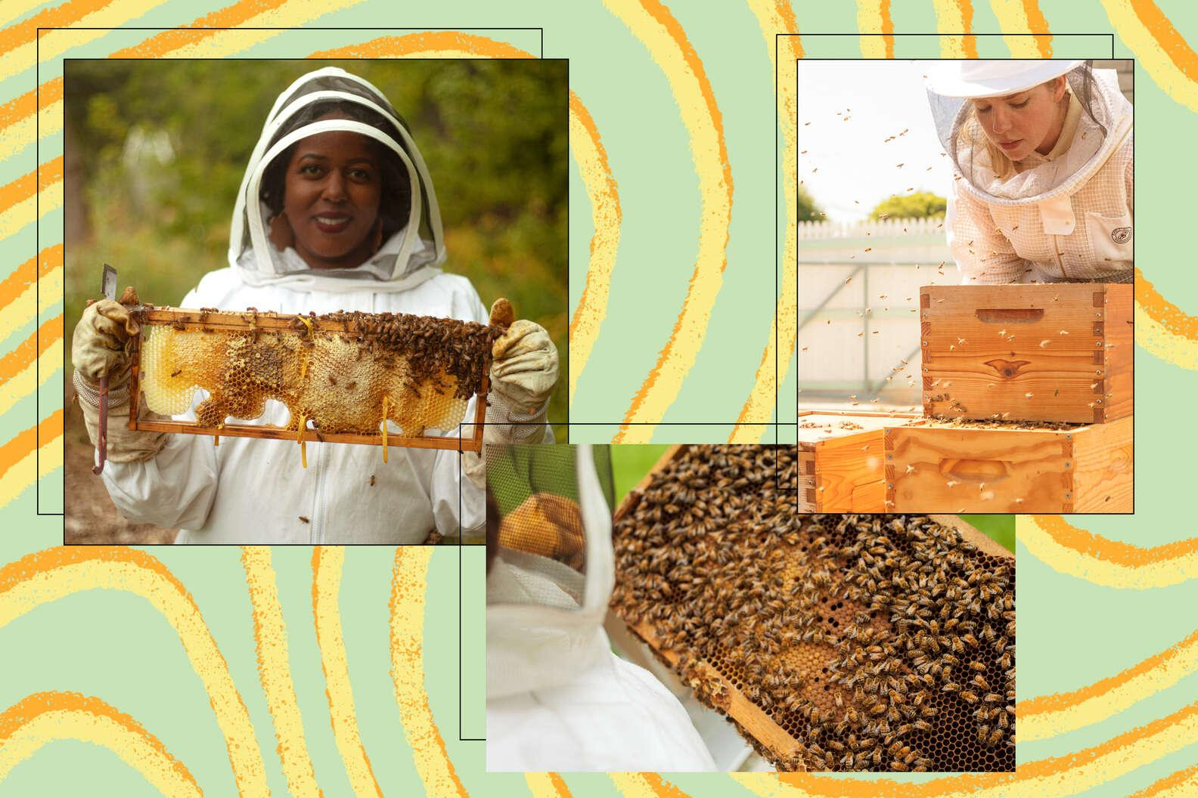
Caretakers of our earth keep bees
https://www.thrillist.com/eat/nation/urban-beekeeping-profile

Slide 4
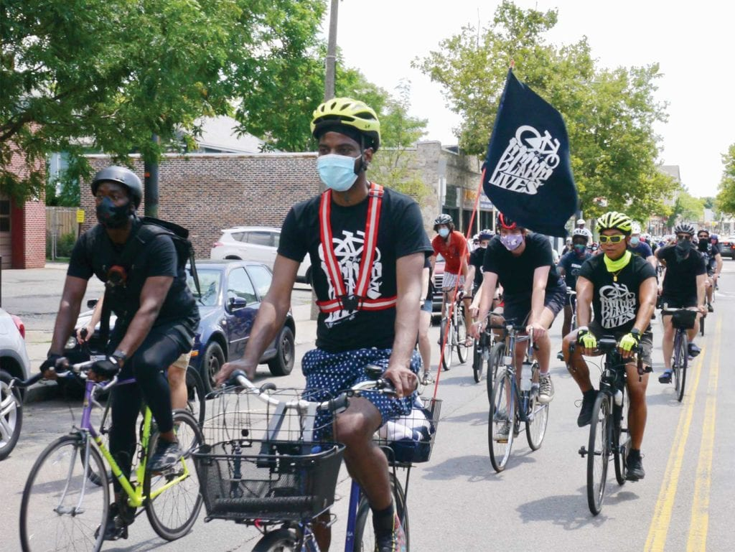
Caretakers of the earth ride bikes
https://www.baystatebanner.com/2020/07/30/ride-for-black-lives-takes-it-to-the-streets/

Slide 5
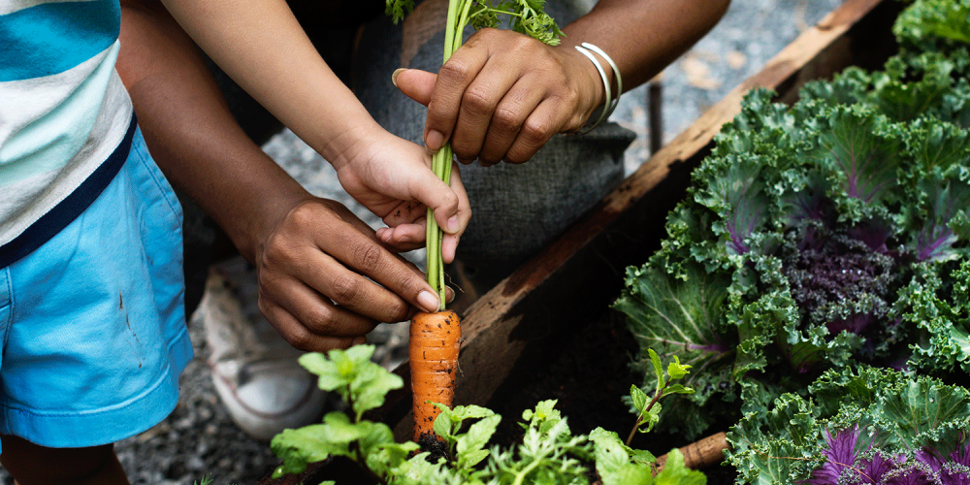
Caretakers of the earth grow vegetables
https://www.gse.harvard.edu/news/uk/18/07/let-it-grow

Slide 6
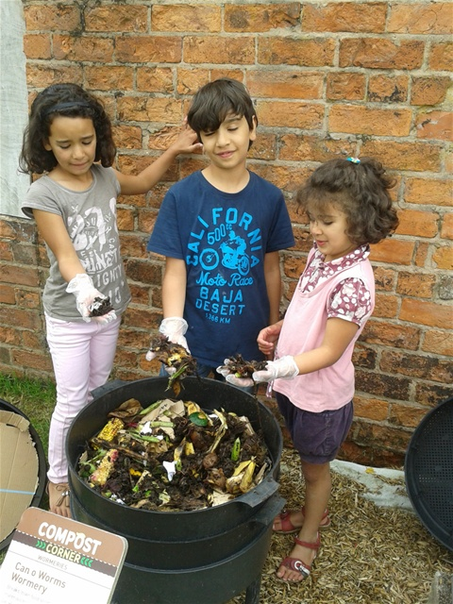
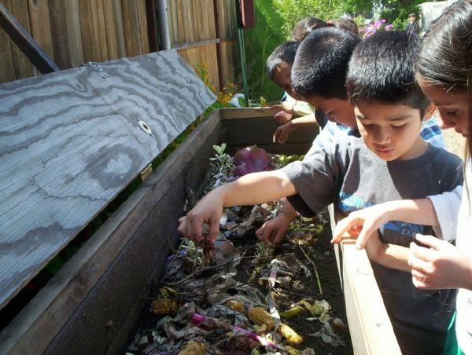
Caretakers of the earth compost
http://www.carryoncomposting.com/416920207
https://cleanriver.com/6-steps-start-organic-compost-program-school/

Slide 7
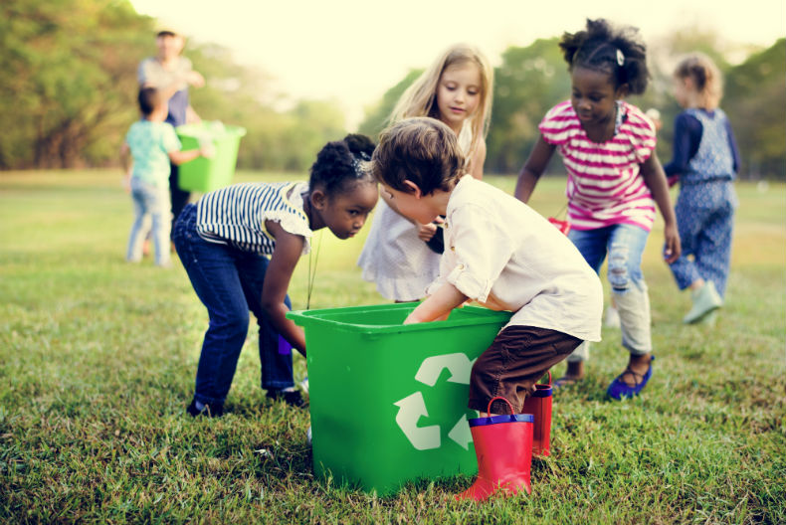
Caretakers of the earth recycle
https://www.jinga.life/blog/recycling-for-kids-how-to-teach-your-children-to-reduce-reuse-recycle

Slide 8
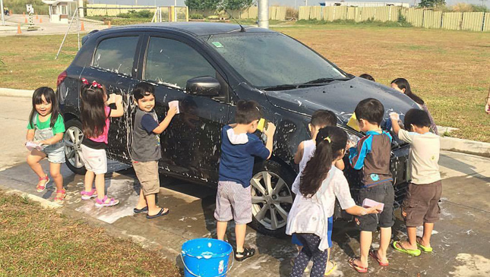
Caretakers of the earth save water
https://www.topgear.com.ph/features/feature-articles/creative-school-makes-children-wash-a-car-to-learn-about-transportation-a00051-20160126

