Slide 1
Notes:
drain: a pipe that takes away water
tap: faucet
leaky: letting a liquid or gas come out of a faucet or pipe

Slide 2
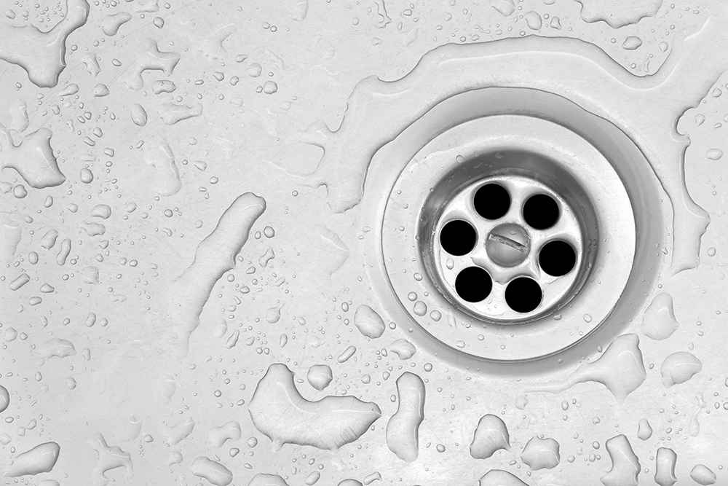
drain
https://ecocare.com.au/lp/how-to-unblock-drain
Notes:
A word in the story is drain.
In Spanish it is desagüe (dehs-ah-gweh).
A drain is a pipe that takes away water.
Let’s say the word drain together. Ready?
”Drain.” When you say drain, I hear the /d/ sound at the beginning of the word.
Look, drain begins with the letter d.
Here is a picture that shows drain. When we shower the water goes down the drain.

Slide 3
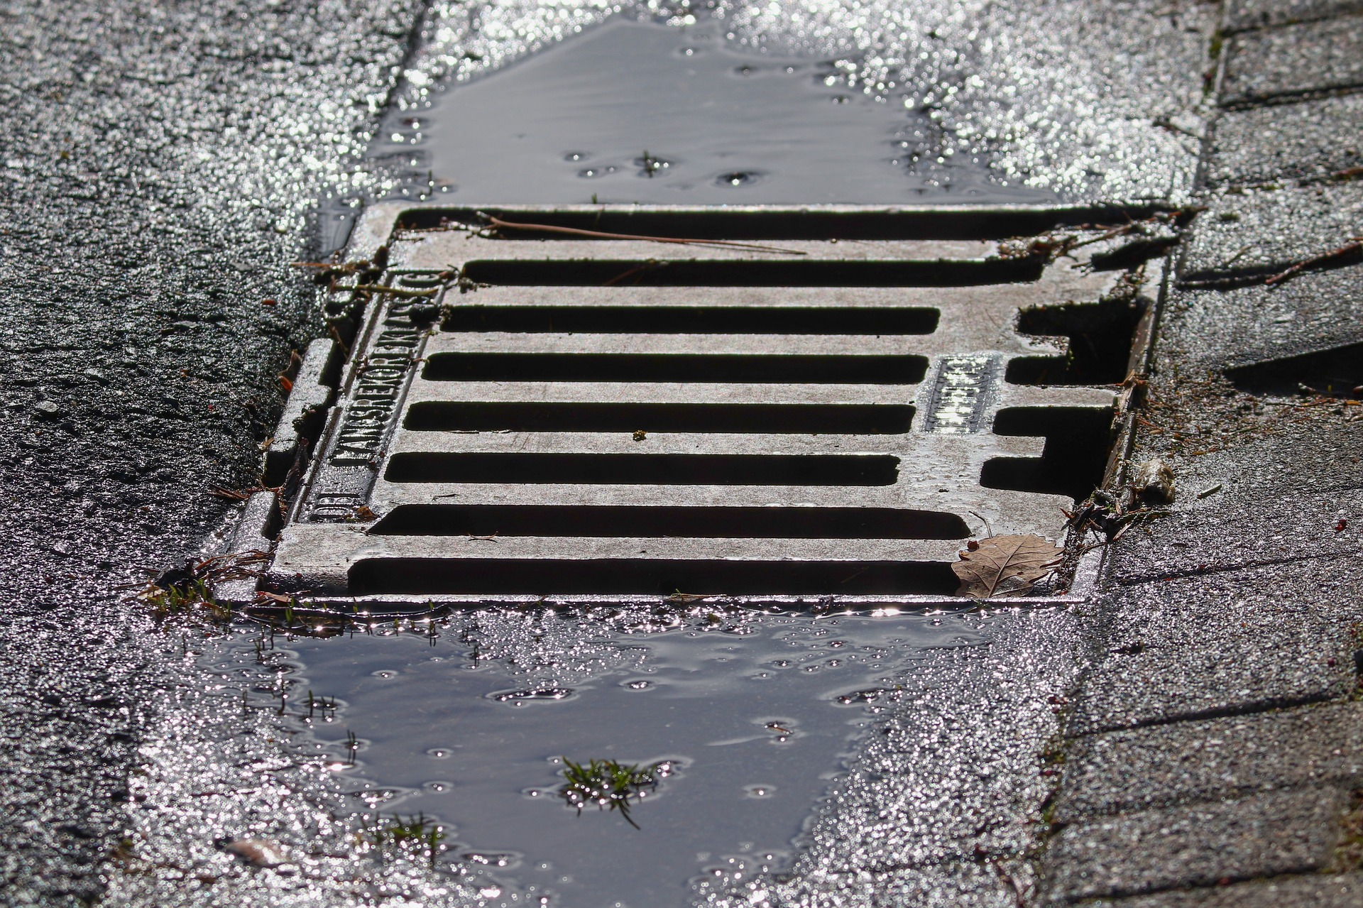
drain
https://www.bhiservice.com/why-does-my-house-smell-like-sewer-when-it-rains/
Notes:
Here is another picture of drain.
How does this picture show the meaning of drain? Turn and talk to your partner.
The rainwater goes down the drain in the street.
How many syllables are in the word drain? Let’s find out by clapping. Ready?
“Drain” 1 syllable.
Now, let’s say drain three times while clapping the syllables. Ready?
“Drain, drain, drain.”

Slide 4
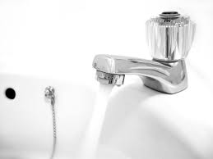
tap
https://en.wikipedia.org/wiki/Tap_water
Notes:
Another word in the story is tap.
In Spanish it is grifo (gree-foh).
Have you heard this word before? What do you know about it? [Gather a few ideas from the children.]
Sometimes “tap” is means a light hit, like a tap on the shoulder.
In this text, tap is a synonym of faucet—they mean the same thing.
Let’s say the word tap together. Ready?
”Tap.” When you say tap, I hear the /t/ sound at the beginning of the word.
Look, tap begins with the letter t.
This picture shows a tap. The water is coming out of the tap.

Slide 5
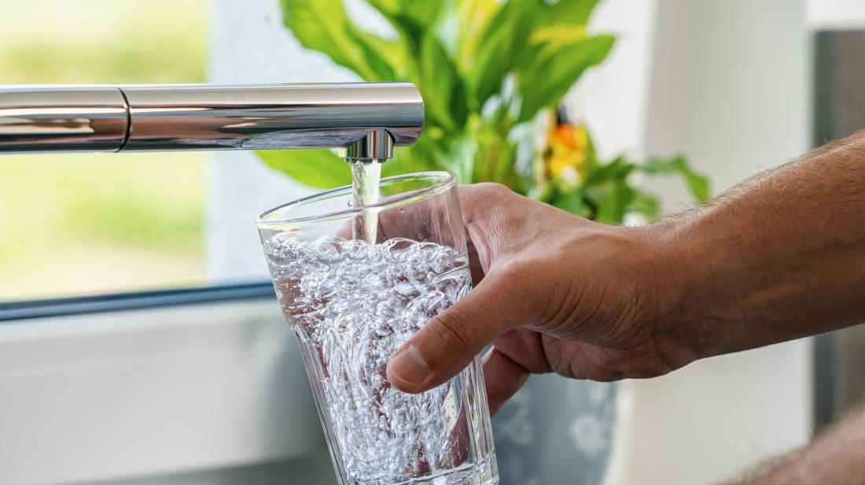
tap
https://centralalabamawellness.org/2020/01/02/medical-news-today-which-is-better-bottled-water-or-tap-water/
Notes:
Here is another picture of tap.
How does this picture show the meaning of tap? Turn and talk to your partner.
Someone is getting water from the tap. We can call this water “tap water.”
How many syllables are in the word tap? Let’s find out by clapping. Ready?
“Tap.” 1 syllable.
Now, let’s say tap three times by clapping the syllables. Ready?
“Tap, tap, tap.”

Slide 6
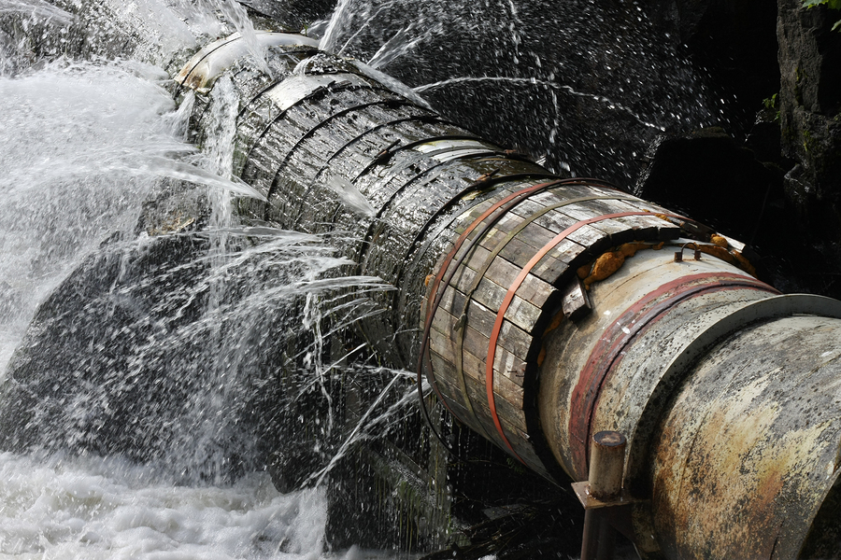
leaky
https://www.vitalorganizer.com/leaky-sales-pipelines/
Notes:
A word in the story is leaky.
In Spanish it is agujereado (ah-goo-heh-reh-ah-doh).
Leaky describes a faucet or pipe where a liquid or a gas comes out.
Let’s say the word leaky together. Ready?
”Leaky.” When you say leaky, I hear the /l/ sound at the beginning of the word.
Look, leaky begins with the letter l.
Here is a picture that shows leaky. The main pipe is leaky! A lot of water is being wasted because it’s not going where it’s supposed to. The pipe needs to be fixed.

Slide 7
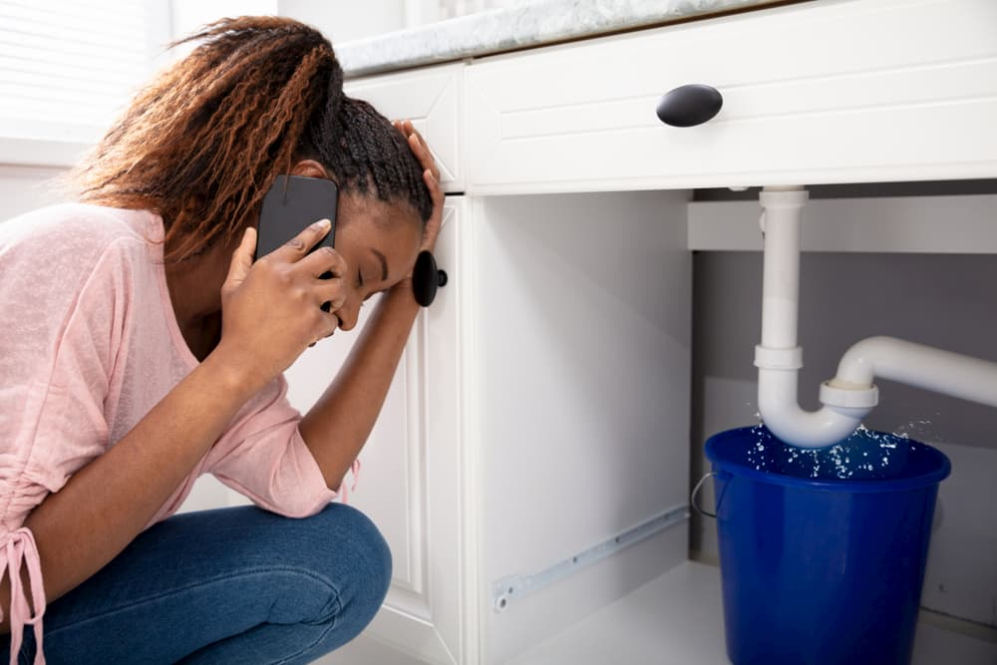
leaky
https://onbplumbing.com.au/blog/tenants-advice-for-plumbing-emergency/
Notes:
Here is another picture of leaky.
How does this picture show the meaning of leaky? Turn and talk to your partner.
The woman put a bucket under the leaky pipe to collect the water. She is probably calling a plumber to come fix it.
How many syllables are in the word leaky? Let’s find out by clapping. Ready?
“Leak-y.” 2 syllables.
Now, let’s say leaky three times by clapping the syllables. Ready?
“Leak-y, leak-y, leak-y.”

