Slide 1
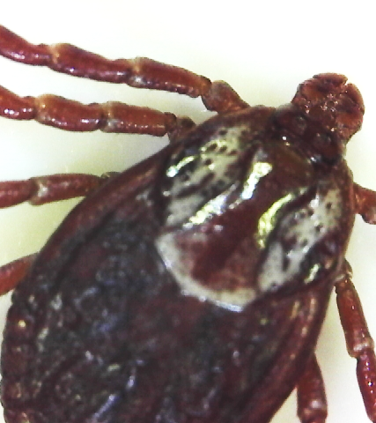
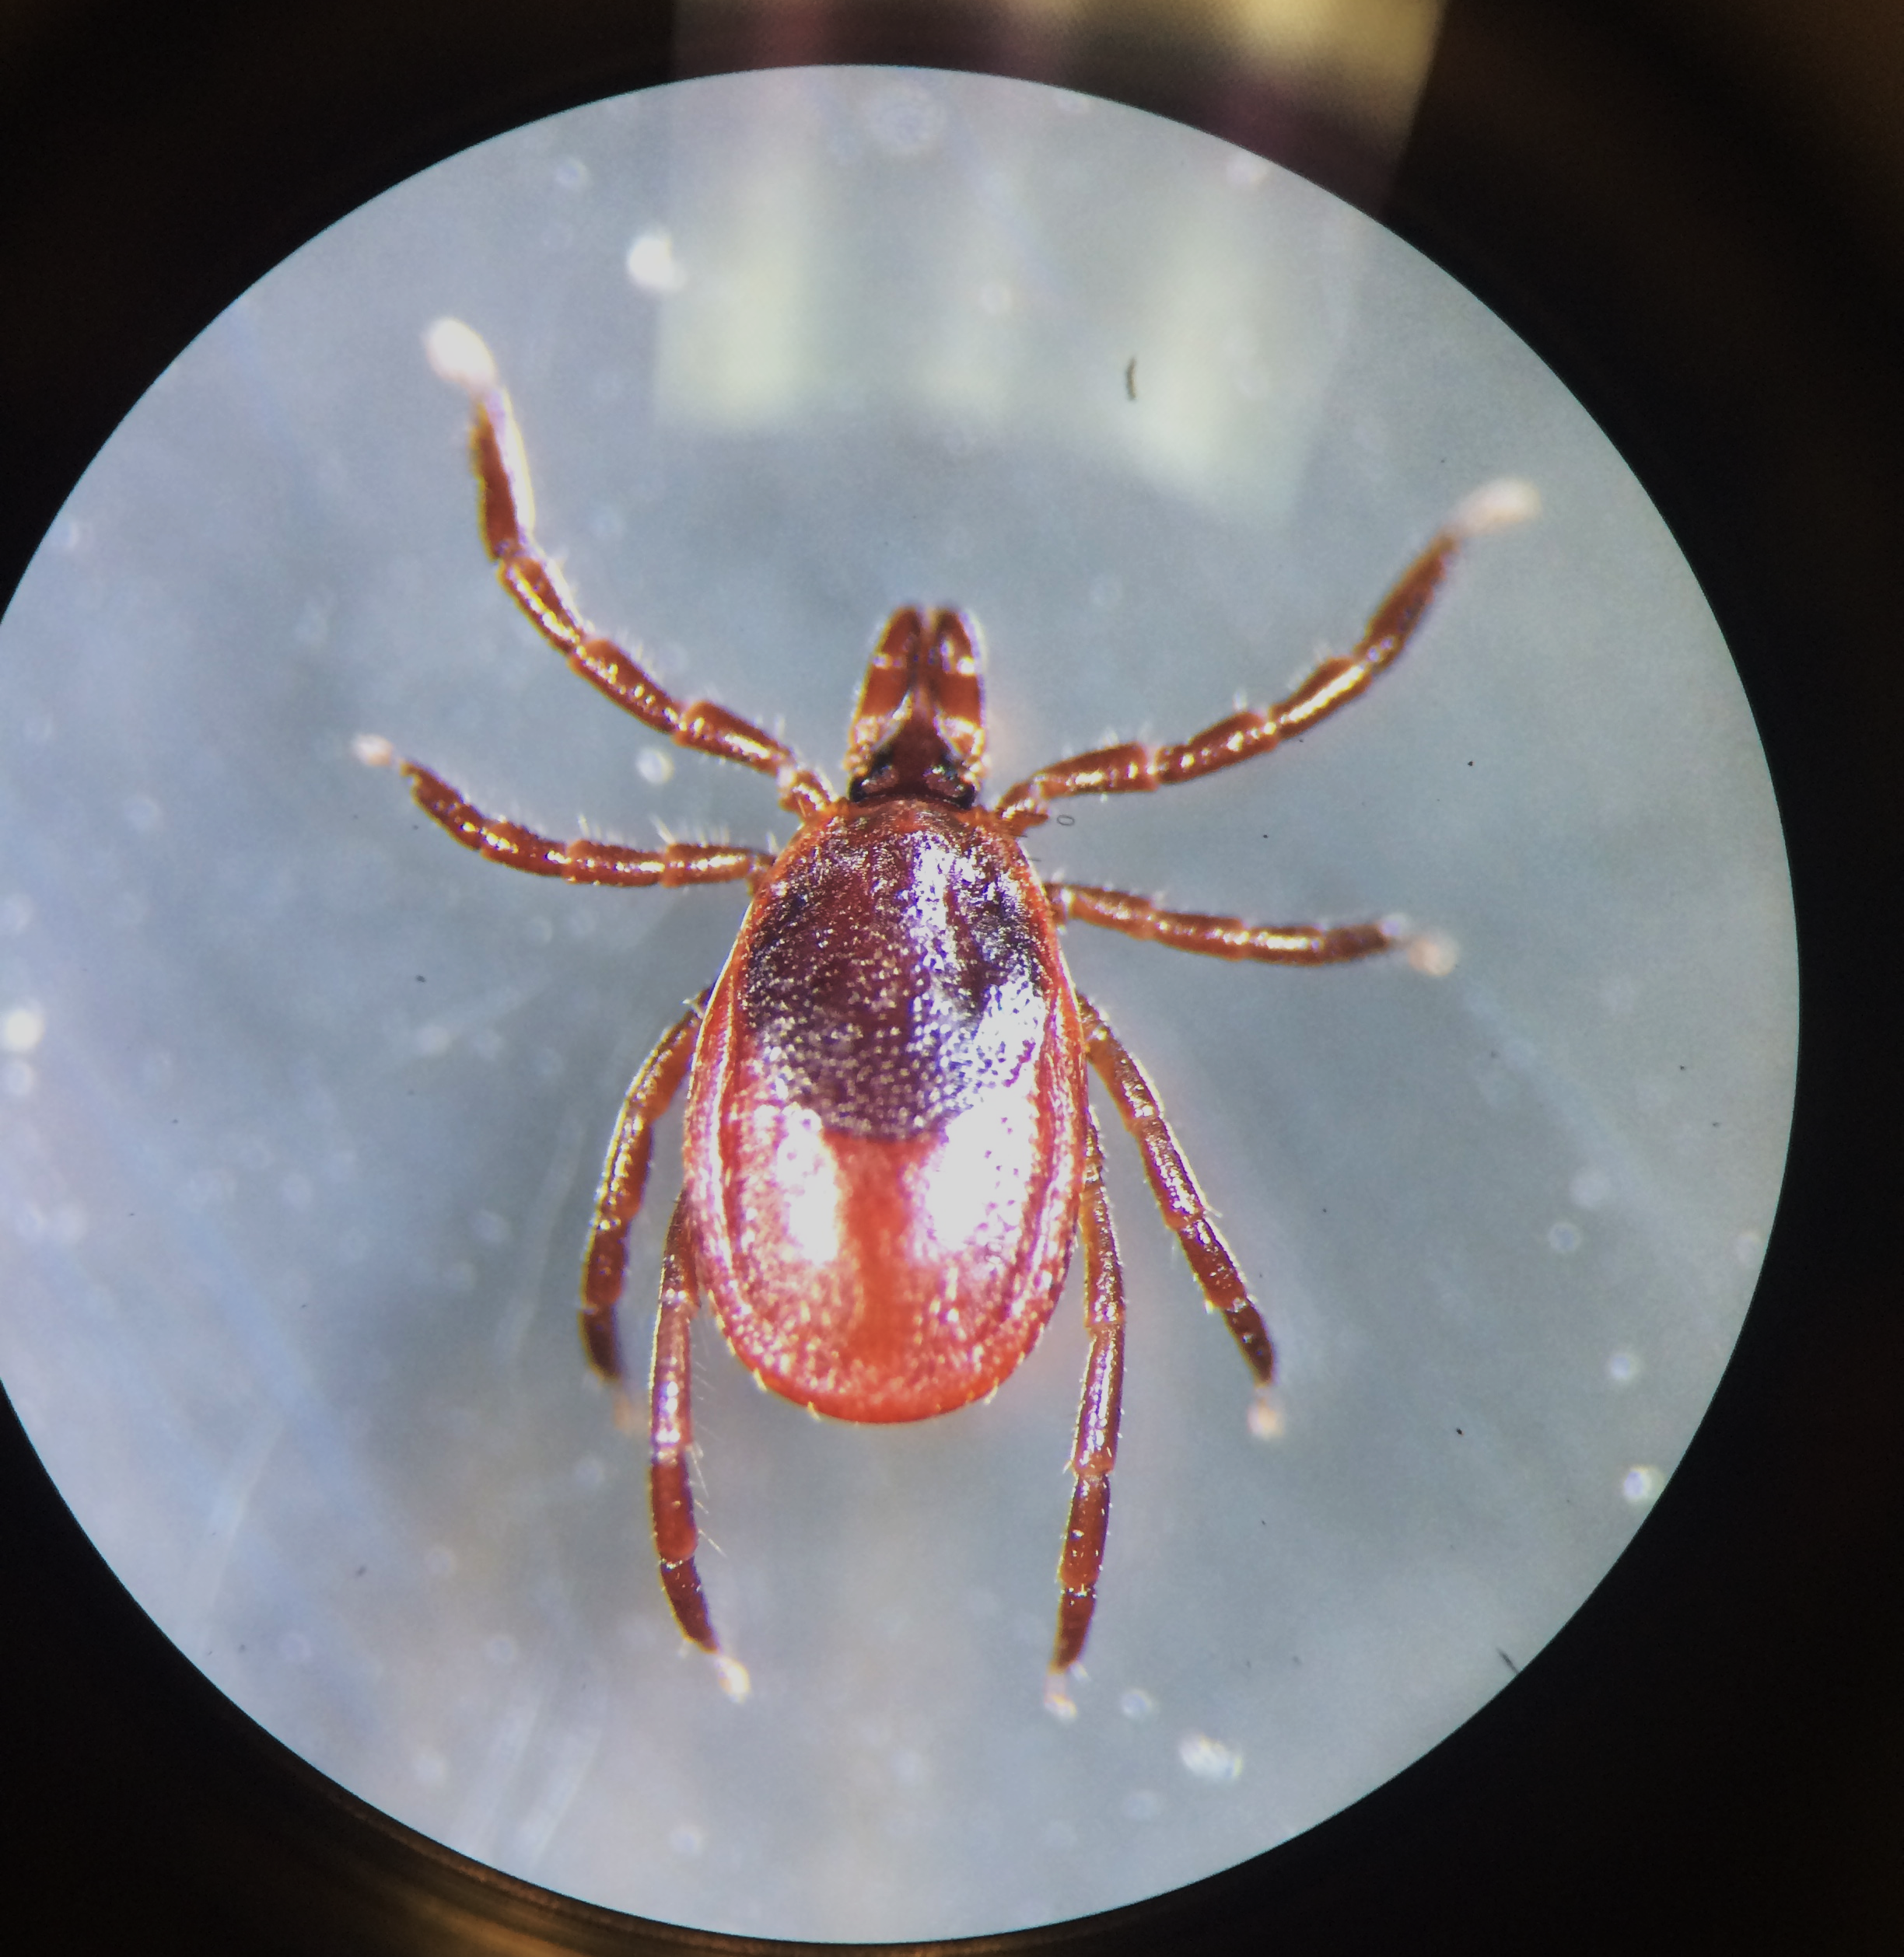
Tickborne Disease Trivia

Slide 2
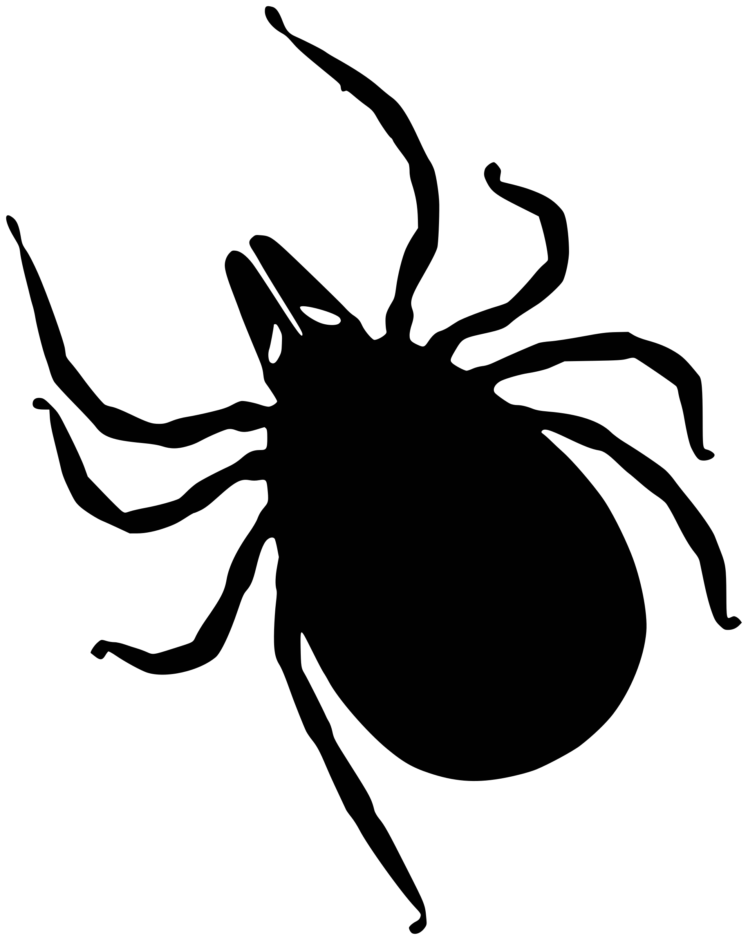
What is the scientific name for the bacteria that causes Lyme disease?
Answer

Slide 3
How long does it take for a tick to transmit the bacteria that can cause Lyme disease?
Answer

Slide 4
Which is smaller: Bacteria or virus?
Answer

Slide 5
What pathogens do dog ticks transmit to people in Maine?
Answer

Slide 6
True or False: Lyme can be transmitted from person to person.
Answer

Slide 7
What is the most common symptom of Lyme disease?
Answer

Slide 8
Will the bull’s eye rash only show up where a tick bit you?
Answer

Slide 9
True or False: You can’t get bitten by a tick in the winter.
Answer

Slide 10
During which stage in the lifecycle could deer ticks be approximately the size of a poppy seed?
Answer

Slide 11
What do ticks need to move on to the next stage?
Answer

Slide 12
How long can a tick spread a pathogen once it is infected?
Answer

Slide 13
Is Lyme disease caused by a virus or bacteria?
Answer

Slide 14
During which seasons is the risk of human infection the greatest?
Answer

Slide 15
During which stage in the lifecycle could deer ticks be approximately the size of a sesame seed?
Answer

Slide 16
Name one disease in Maine caused by a tick other than Lyme disease.
Answer

Slide 17
What color is on a dog tick’s scutum?
Answer

Slide 18
What is the term for a tick in the transmission cycle?
Answer

Slide 19
What is the name for a living animal or plant that provides food or shelter for another?
Answer

Slide 20
What type of habitat do deer ticks prefer?
Answer

Slide 21
What is the shape of Lyme bacteria?
Answer

Slide 22
What color clothing should you wear to make ticks easier to see?
Answer

Slide 23
What type of repellent is approved for use on clothing?
Answer

Slide 24
You should make sure that your repellent is approved by which group?
Answer

Slide 25
What type of clothing will protect your arms and legs from ticks?
Answer

Slide 26
What can you do to keep ticks from crawling up your pant legs?
Answer

Slide 27
What should you do frequently while outdoors, after you come inside, and at the end of every day?
Answer

Slide 28
What should you do with your clothes when you come inside to kill any ticks that may be crawling on them?
Answer

Slide 29
What should you do with a tick after you remove it?
Answer

Slide 30
Should you use petroleum jelly, a hot match, nail polish, or other products to remove a tick?
Answer

Slide 31
What is the best way to remove a tick?
Answer

Slide 32
Borrelia burgdorferi.
Back

Slide 33
24-48 hours.
Back

Slide 34
Virus.
Back

Slide 35
None, they are just a pest species in Maine.
Back

Slide 36
False.
Back

Slide 37
The bull’s eye rash.
Back

Slide 38
No. The rash can also show up in other places on your body.
Back

Slide 39
False.
Back

Slide 40
Nymph.
Back

Slide 41
Blood.
Back

Slide 42
Throughout its whole life.
Back

Slide 43
Bacteria.
Back

Slide 44
Summer.
Back

Slide 45
Adult.
Back

Slide 46
Anaplasmosis, babesiosis, Powassan, or Borrelia miyamotoi.
Back

Slide 47
White.
Back

Slide 48
Vector.
Back

Slide 49
Host.
Back

Slide 50
Woods.
Back

Slide 51
Corkscrew or spiral.
Back

Slide 52
Light-colored clothing (khaki, white, etc).
Back

Slide 53
Permethrin.
Back

Slide 54
EPA – Environmental Protection Agency.
Back

Slide 55
Long pants and long-sleeved shirts.
Back

Slide 56
Tuck pants into socks.
Back

Slide 57
A tick check.
Back

Slide 58
Put them in the dryer for 10 minutes on high heat.
Back

Slide 59
Put it in rubbing alcohol to kill it or put in sealed plastic bag.
Back

Slide 60
No.
Back

Slide 61
Use a tick spoon or tweezers to gently pull the tick out of the skin.
Back

