Slide 1

Don’t Let the Ticks Bite!
Maine Center for Disease Control and Prevention
Notes:
(Approximately 20 minutes)

Slide 2
…Ticks
* What do ticks look like?
* Are all ticks the same?
* Where do ticks live?
* Why remove a tick?
* What is Lyme disease?
* How will I know if I have Lyme
disease?
* How do I protect myself?
* What if I find a tick on me?
Notes:
In this presentation, we will address:
What do ticks look like?
Are all ticks the same?
Where do ticks live?
Why remove a tick?
What is Lyme disease?
How will I know if I have Lyme disease?
How do I protect myself?
What if I find a tick on me?

Slide 3
What do ticks look like?
Capitulum
(mouth parts)
There are 14 different species of ticks found in Maine.
Dorsal Shield
(Scutum)
- Ticks have eight legs
- No antennae
- Scutum or shield
Legs
Abdomen
Image courtesy of identify.us.com
Notes:
There are 14 different species of ticks found in Maine.
Ticks are arachnids—along with mites, spiders, and scorpions.
Ticks have eight legs, no antennae, and a flat, hard body. They have a capitulum, which is the mouthpart, the scutum, or shield near the back of the head, and an abdomen which is where germs are carried. Ticks start off hatching from eggs and grow larger as they get older.
Vocabulary:
Capitulum – mouthparts
Scutum – “shield”, a bony, horny, or chitinous plate; part of the back of the tick near the head
Abdomen – stomach, carries germs

Slide 4
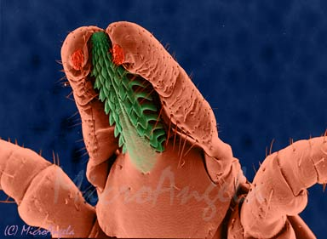
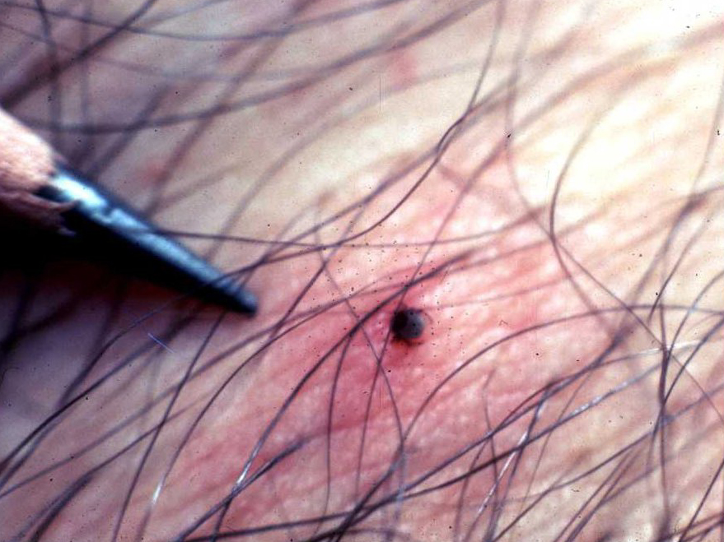
Bite is Worse than the Bark
*Ticks have a barbed beak
*A tick numbs your skin where it is biting so that you don’t notice it feeding on you
*Bottom image: a deer tick nymph attached to a person
Image courtesy of MicroAngela
Notes:
Ticks have a barbed beak that allows them to attach to your skin. The tick’s saliva has an anesthetic property that numbs the area on your skin that the tick is attaching to so that you do not even notice they are biting.
Vocabulary:
Barb—a point or pointed part projecting backward
Anesthetic—a substance causing loss of sensation/pain reliever. The tick has anesthesia in its saliva to numb your skin so you don’t know it is starting to bite.

Slide 5
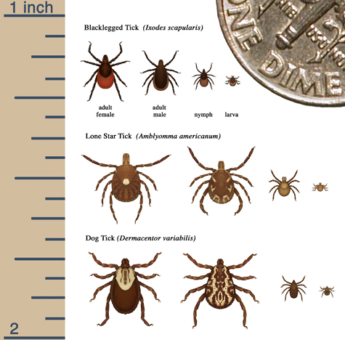
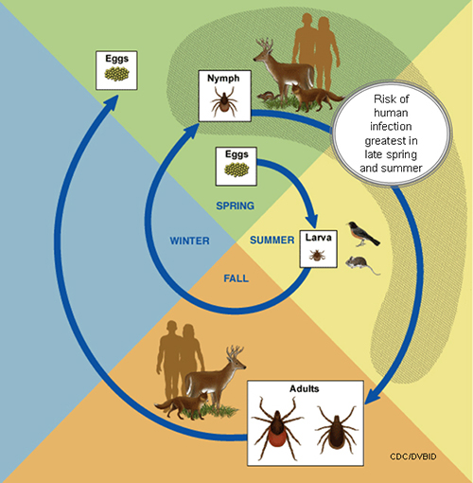
What size are ticks?
Ticks start off hatching from eggs and grow larger as they get older.
Image courtesy of emedicinehealth.com
Notes:
Ticks are different sizes at different stages in their lives.

Slide 6
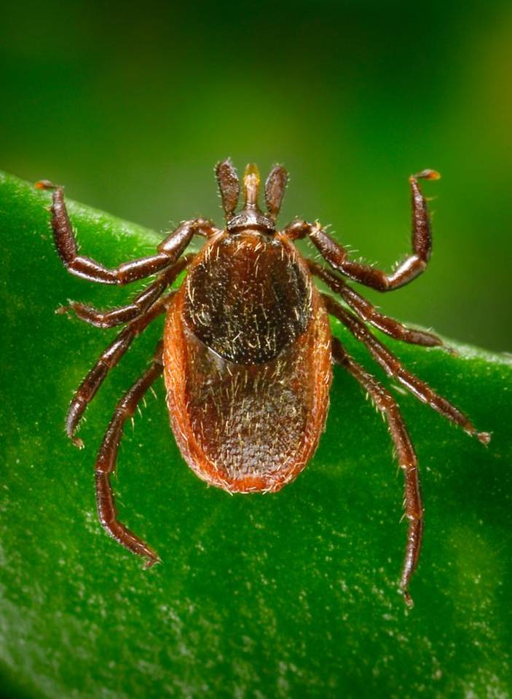
Are all ticks the same?
*Deer tick
  *Dark scutum (dot/shield behind the head)
  *More common in the spring and fall
Deer tick, larger than actual size
Notes:
The two most common ticks in Maine are deer ticks (also known as Black Legged Ticks) and dog ticks. Deer ticks can transmit the bacteria that causes Lyme disease, but dog ticks don’t, so it’s a good idea to know the difference.
These are some of the key differences between deer ticks and dog ticks:
Deer tick females have a black scutum—the part on the back near the head—and a reddish abdomen/belly.
Deer tick nymphs (the immature or child-like stage of a tick) are about the size of poppy seed and are active from June through August, while the adults are a bit larger (about the size of an apple seed) and are active from October to December, and March to May.
Vocabulary:
Nymph – pre-adult stage of the tick life cycle; very tiny, about the size of a poppy seed, so they can be difficult to see

Slide 7
Are all ticks the same?
*Dog tick
  *White scutum or white “racing stripes”
  down their back
  *More common in the summer
Dog tick, larger than actual size
Notes:
Dog ticks are a pest in Maine. They are not known to cause diseases in Maine but can carry germs that cause diseases in other parts of the country. They are larger than deer ticks and are active from April through July.
Dog ticks have white markings on their backs. To tell the difference between dog ticks and deer ticks, it’s a good idea to look for the whitish markings. With practice it gets easier to tell the difference between deer and dog ticks.

Slide 8
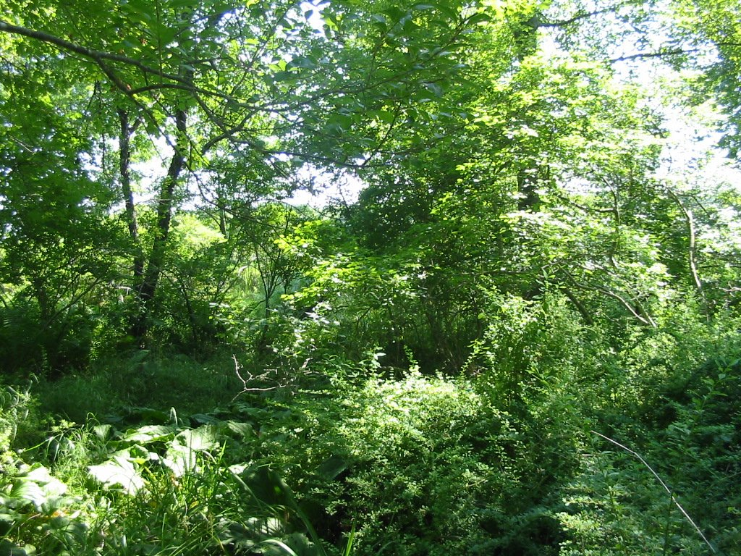
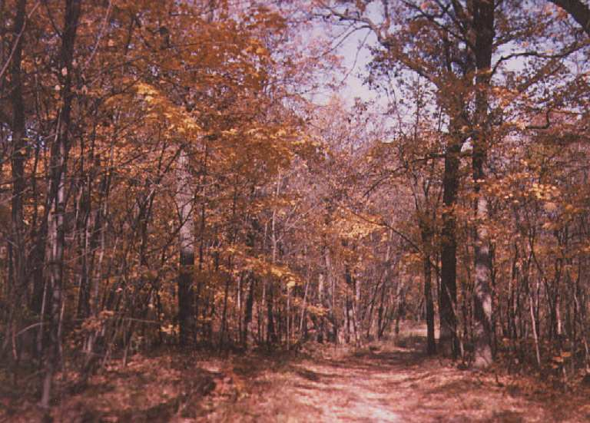
Where do ticks live?
Favorable habitat
  *Leafy tree covered areas
  *Forests
  *Shrubby areas
Notes:
Deer ticks prefer protective environments, like forests and forest edges. They are more common in forests with trees that lose their leaves seasonally such as oaks and maple trees because they make a thick leaf layer as shelter for them.
Deer ticks are also found in groups of bushes, which provide food for the hosts of a tick, such as deer, mice, and birds. The bushes also protect the ticks from being dried out by the sun and wind.
Generally, deer ticks prefer woods, while dog ticks prefer grassy meadows.
Ticks do not like open, dry habitats where there is no protection from the sun and wind. Ticks like moist areas.
Vocabulary:
Host – a living animal or plant that provides food or shelter for another organism

Slide 9
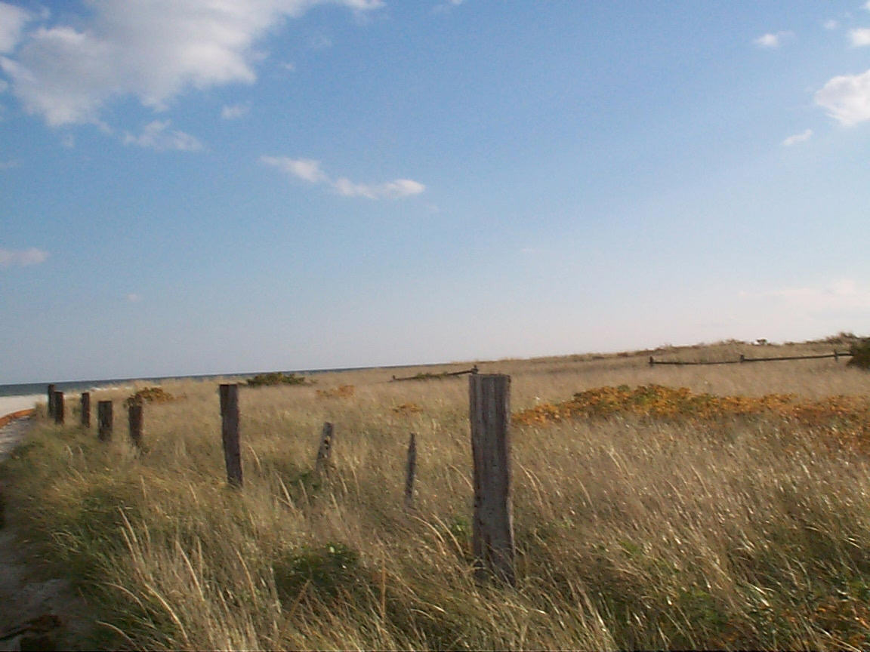
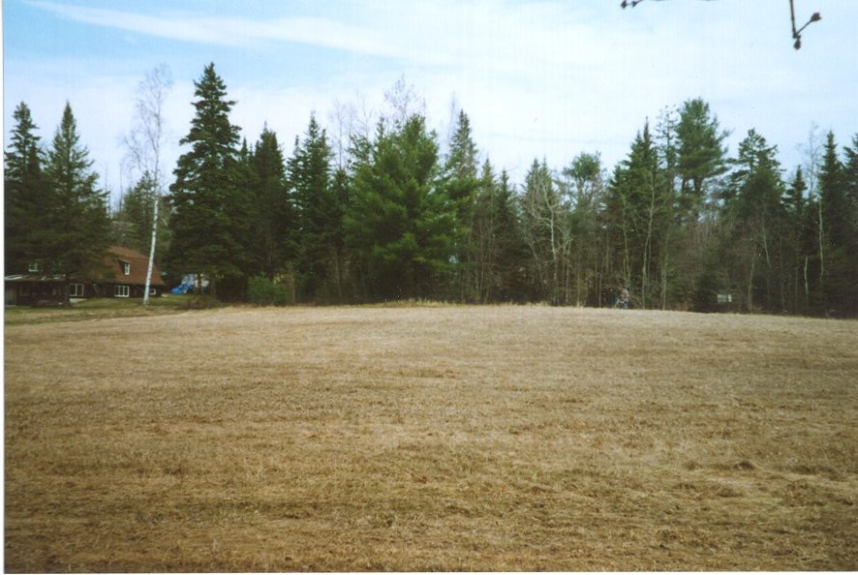
Ticks and Habitat
*Unfavorable habitat
  *Open, dry habitats
Photos: MMCRI
Notes:
These examples show areas unsuitable for deer ticks; there is no protection for the ticks from the sun and wind

Slide 10
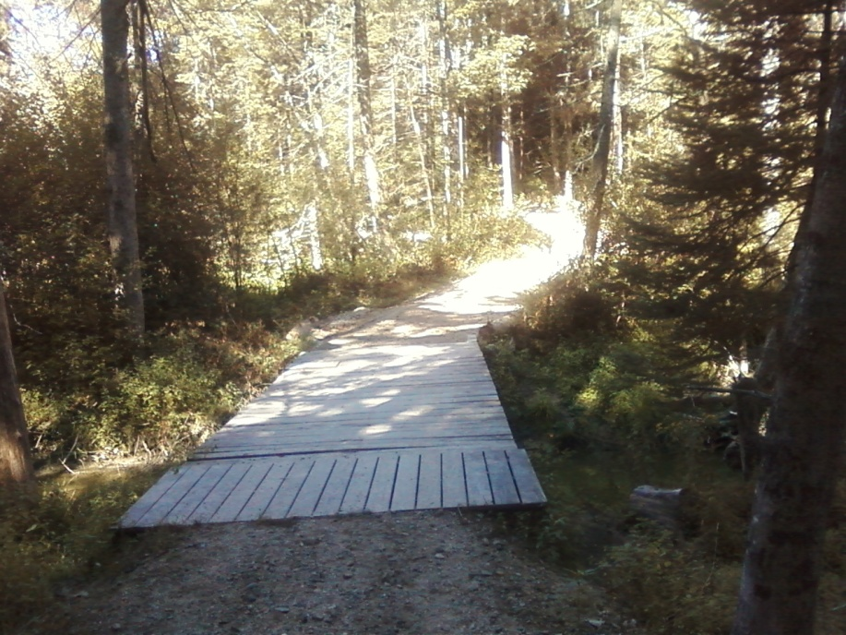
How Ticks Move
*Ticks do not fly or jump
*Ticks grab onto people or their
clothes when they walk through
a grassy or wooded area
*A tick will crawl to a feeding spot
on the person’s skin
Notes:
Ticks cannot jump or fly so they will wait on grasses and shrubs for a person or animal to brush up against them. They grab onto clothing or fur when someone walks by (like a hitchhiker). Once the tick is on your body, it will crawl around to find a good place to feed.

Slide 11
Diseases that Maine ticks can cause
*Lyme disease
*Anaplasmosis
*Babesiosis
*Powassan
Notes:
Different ticks can transmit different germs and some ticks, such as the deer tick, can carry more than one disease-causing germ.
Maine ticks can cause: Lyme disease, Anaplasmosis (ANA-PLAZ-MOSIS), Babesiosis (BA-BEEZ-IOSIS), and Powassan (PUH-WOSS-AN).
It is important to note two things:
1) Not all types of ticks carry germs that can make you sick, and
2) Not all deer ticks carry the bacteria that causes Lyme disease.
Vocabulary:
Lyme disease – tickborne disease caused by the bacterium Borrelia burgdorferi
Anaplasmosis – tickborne disease caused by the bacterium Anaplasma phagocytophilum
Babesiosis – tickborne disease caused by the parasite Babesia microti
Powassan – tickborne disease caused by the Powassan virus

Slide 12
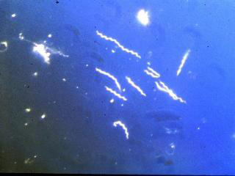
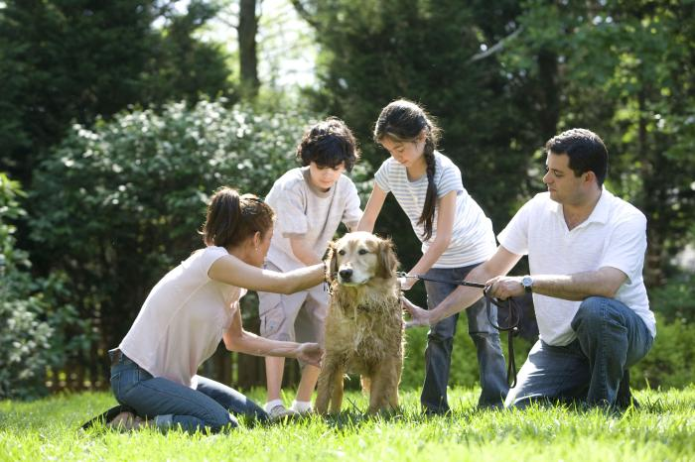
What is Lyme disease?
*Lyme disease is caused by the bacteria Borrelia burgdorferi
  *The bacteria can make people and pets sick
Notes:
The scientific name for the bacteria that causes Lyme disease is Borrelia burgdorferi, which can pass from the tick into your body. The image on this slide is a microscopic view of the bacteria. Ticks can get the bacteria by biting and feeding on mice, birds, and other small animals that have the bacteria.
Note that not all animals and not all ticks carry the bacteria that can cause Lyme disease. Once a tick gets the bacteria it has it for the rest of its life.
People and pets can get sick if they get bitten by a tick that carries these bacteria.
The disease bacteria that can cause Lyme disease are in the belly of the tick. It takes 24-48 hours for the bacteria to go from the belly of the tick and into a person after the tick starts feeding on your blood.
Many people, when bitten by a deer tick, quickly develop a red area at the site of the bite. This red area is not the ‘bull’s-eye rash’ (which we’ll discuss more shortly) but just a reaction to the tick bite. Depending on the person’s individual sensitivity, the red area may remain itchy for several days after removing the tick.

Slide 13
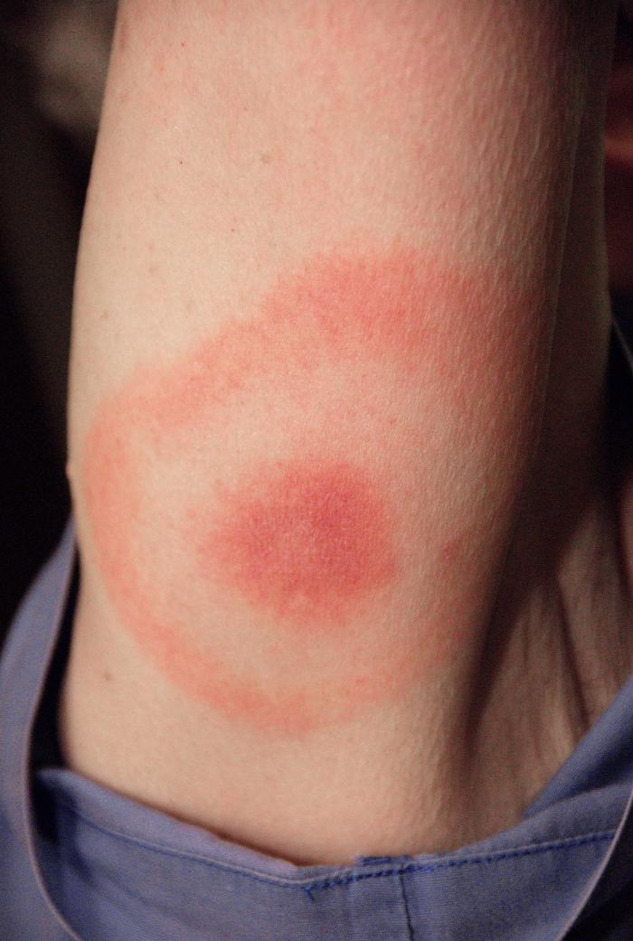
How will I know if I have Lyme disease?
Symptoms
  *Bull’s-eye rash (not always present at the site of the bite; sometimes multiple rashes will occur)
  *Sore muscles
  *Very tired
  *Chills, fever, and headache
  *Swollen lymph nodes
  If you have any symptoms, see your doctor
Notes:
Different symptoms of Lyme disease can be present but the most common is the ‘bull’s-eye rash’, also known as erythema migrans. It looks like a bull’s-eye or a target with a dark red circle in the middle, a clear area, and then a lighter red circle surrounding it. The rash may not show up where the tick bit you, so it is important to check your whole body (including the back and head).
While some people do not have a rash at all, others might have multiple rashes from a single bite.
You can also have swollen knees or other joints, sore muscles, or become very tired.
If you are experiencing flu-like symptoms (like those mentioned above) during the summer months, you should contact your provider.
Vocabulary:
Bulls-eye rash (erythema migrans)– a red, expanding rash that looks like a target or a bull’s eye. This is the most common symptom of Lyme disease.

Slide 14
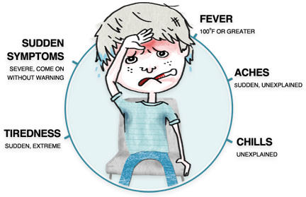
Symptoms of diseases other than Lyme
Typical symptoms of additional diseases caused by ticks
Anaplasmosis: Fever, headache, muscle pain, tiredness, chills, nausea, abdominal pain, cough and confusion
Babesiosis: Flu-like symptoms, most often fever and fatigue
Powassan: Headache, fever, nausea, vomiting, stiff neck, and sleepiness
Image courtesy of invitehealthblog.com
Notes:
Anaplasmosis, babesiosis, and Powassan all have different symptoms to be aware of.
Anaplasmosis can cause fever, headache, muscle pain, tiredness, chills, nausea, abdominal pain, cough and confusion.
Babesiosis can cause flu-like symptoms, most often fever and fatigue.
Powassan can cause headache, fever, nausea, vomiting, stiff neck, and sleepiness.
If you have these symptoms you should also check with your doctor.

Slide 15
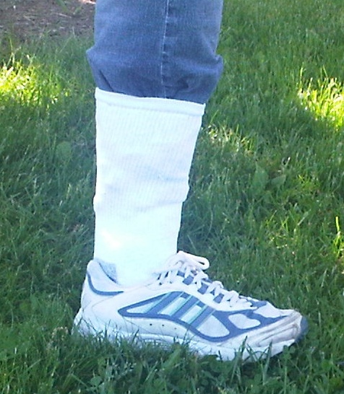
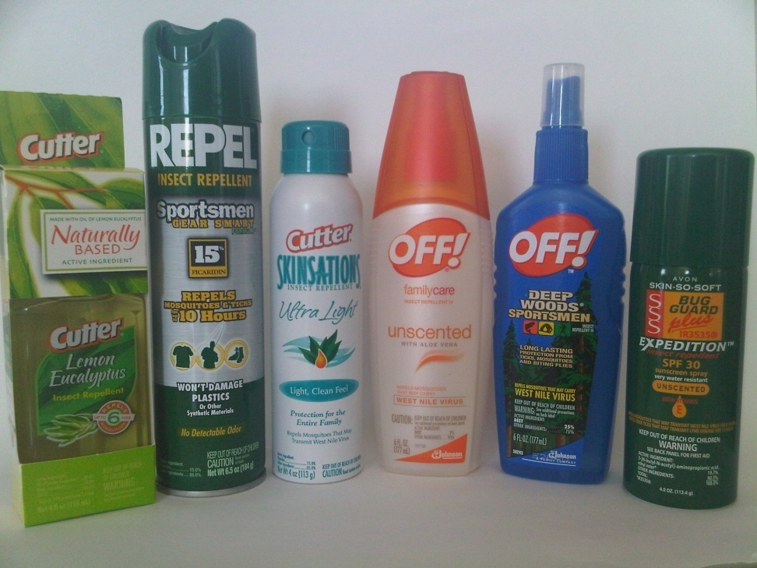
How do I protect myself?
1. Wear protective clothing
  Tuck your pants into your socks and wear long pants and long-sleeved shirts
  Wear light-colored clothing so you can see ticks more easily
2. Use a repellent
3. Be careful in tick-infested areas
  Walk in the middle of trails and paths
  Don’t brush up against bushes
4. Perform daily tick checks
Notes:
Wear long pants and long-sleeved shirts to reduce the amount of your skin that is uncovered. Tuck your pants into your socks to form a barrier to your skin. Light-colored clothing makes ticks easier to see.
Use a repellent (also known as “spray”) that is approved by the EPA (Environmental Protection Agency) for repelling ticks.
When using a repellent, follow the label instructions carefully. You can find the repellent that will work best for you here: http://cfpub.epa.gov/oppref/insect/
Since ticks cannot jump, they wait for you to brush up against them so they can attach to you. When you are walking in the woods, stay in the center of the trail so you do not brush up against grasses and bushes where ticks are waiting.
After coming inside, you can place your clothes in a dryer for ten minutes. Laundry detergents alone will not generally kill ticks, but the heat from the dryer will kill ticks that might be on clothing. The clothes may then be washed to remove ticks from them.
Perform a tick check daily. Check your body for ticks, looking particularly for what may look like nothing more than a new freckle or speck of dirt.
Remember, ticks need to feed for at least 24 hours in order to transmit the bacteria that can cause Lyme disease, so quick removal can prevent Lyme disease.
Vocabulary:
Repellent – a spray applied to skin to prevent insect bites
EPA (Environmental Protection Agency) – federal agency devoted to protecting human health and the environment
Tick check– use your finger tips and your sight to feel around your body for ticks; it is recommended to do tick checks every time you come in from the outdoors, especially if you have been in a tick habitat.

Slide 16
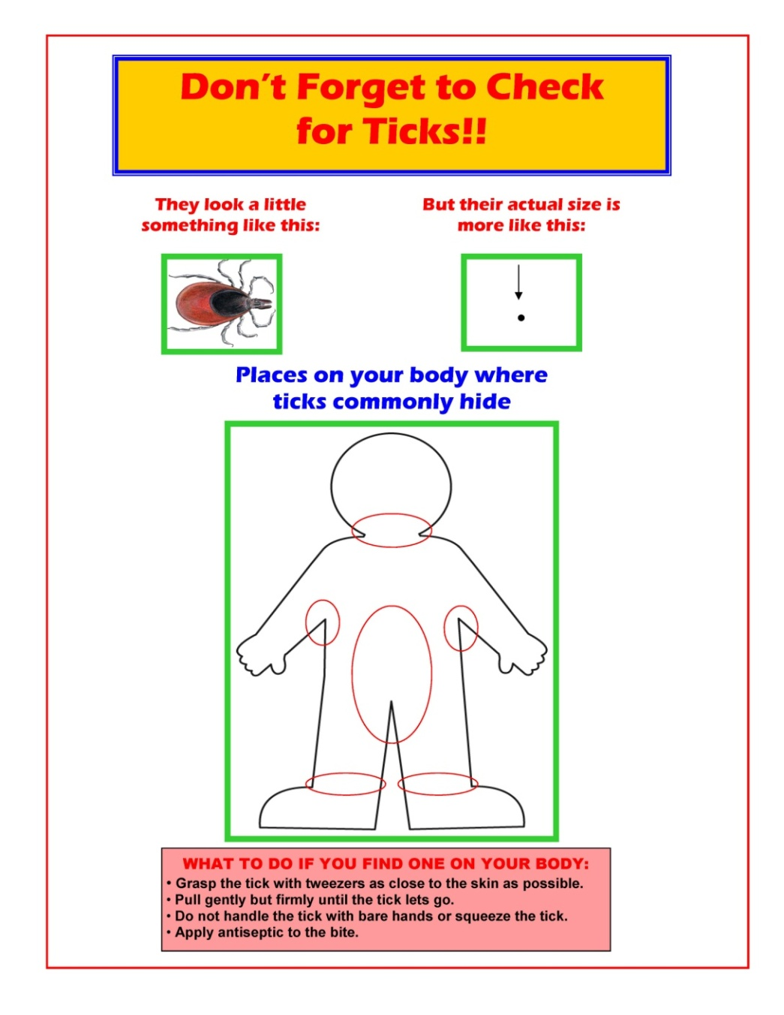
Check your body daily!
  Perform a “Tick Check”:
  Use your finger tips and your sight to feel around your body for ticks
  Pay attention to: your head, hairline, neck, armpits, waist, between your legs, thighs, and behind your knees
  Check your pets, too!
Notes:
Perform a “Tick Check” – inspect your body after being outdoors, and again a few hours later.
Ticks like damp, dark places so pay attention to your head, hairline, nape of the neck, armpits, waist, between your legs, thighs, and behind the knees. Check your pets, too.
Nymphal ticks can be very small (the size of a poppy seed), so use your hands to feel your skin along with a close visual inspection. Ticks can blend in with freckles too, so if you have a lot of freckles or moles, check to make sure none of your freckles have legs!

Slide 17
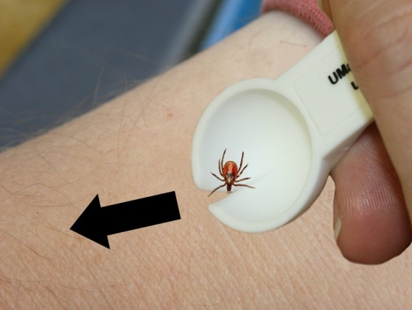
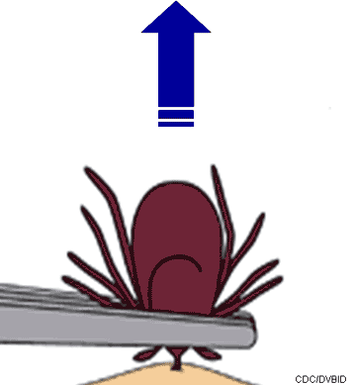
What if I find a tick on me?
Ask a grown-up to take it off
With a Tick Spoon
With Tweezers
*Put the wide part of the notch on the skin near the tick (hold skin tight if necessary)
*Applying a little pressure on the skin, slide the spoon forward so the small part of the notch is framing the tick
*Continue sliding the spoon until the tick detaches
*Grasp the tick close to the skin with tweezers
*Pull gently until the tick lets go
Notes:
Tell a grown-up as soon as you notice a tick on your skin, so that they can help you take it off.
Use fine-tipped tweezers or a tick spoon to remove the tick.
Do not use petroleum jelly, a hot match, nail polish, or other products to remove a tick. These will only upset the tick and may cause it to vomit what’s in its stomach back into your body, which can cause irritation.
Clean your skin with soap and warm water.
Do not worry if the tick’s mouthparts remain in the skin. Once the mouthparts are removed from the rest of the tick, it can no longer transmit the germs that cause disease.
Ticks are difficult to kill, and may climb back out if you simply put them in the trash. To kill ticks, drop them into a small container of rubbing alcohol.

Slide 18

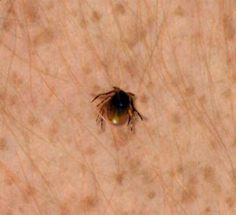
Why remove a tick?
*Ticks can cause diseases so we want to remove them as soon as possible
Photo: Massachusetts Department of Public Health
Notes:
If you have a tick on you, it is important to remove the tick from you as soon as you notice it. It takes time for a tick to pass along germs that can make you sick, so you want to remove it right away.

Slide 19
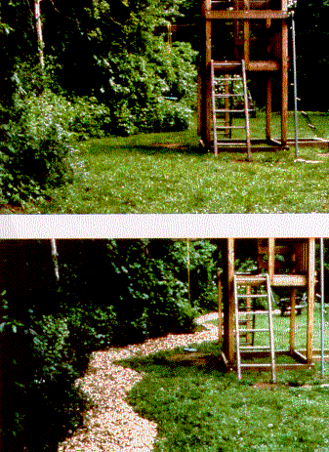
Make your yard safer
*Remove brush, leaf litter and tall grass
*Create a dry border between woods and lawn
*Remove plants that attract deer and construct physical barriers that may discourage deer from entering your yard
Before
After
Notes:
What more can we do to keep ourselves safe from ticks?
You can reduce ticks in your yard by keeping the grass mowed and raking piles of leaves.
Wood chips, gravel, or mulch can be placed between the woods and the grass in your yard as a barrier. When the ticks cross the path to enter the yard, they would be in direct sunlight and therefore at risk for drying out (remember, ticks like moist areas).
The barrier also acts as a reminder to people that crossing the path puts them into the wooded area, where they may be at higher risk of having ticks bite them.
You can also remove plants that attract deer and other animals to your yard that might carry ticks.

Slide 20
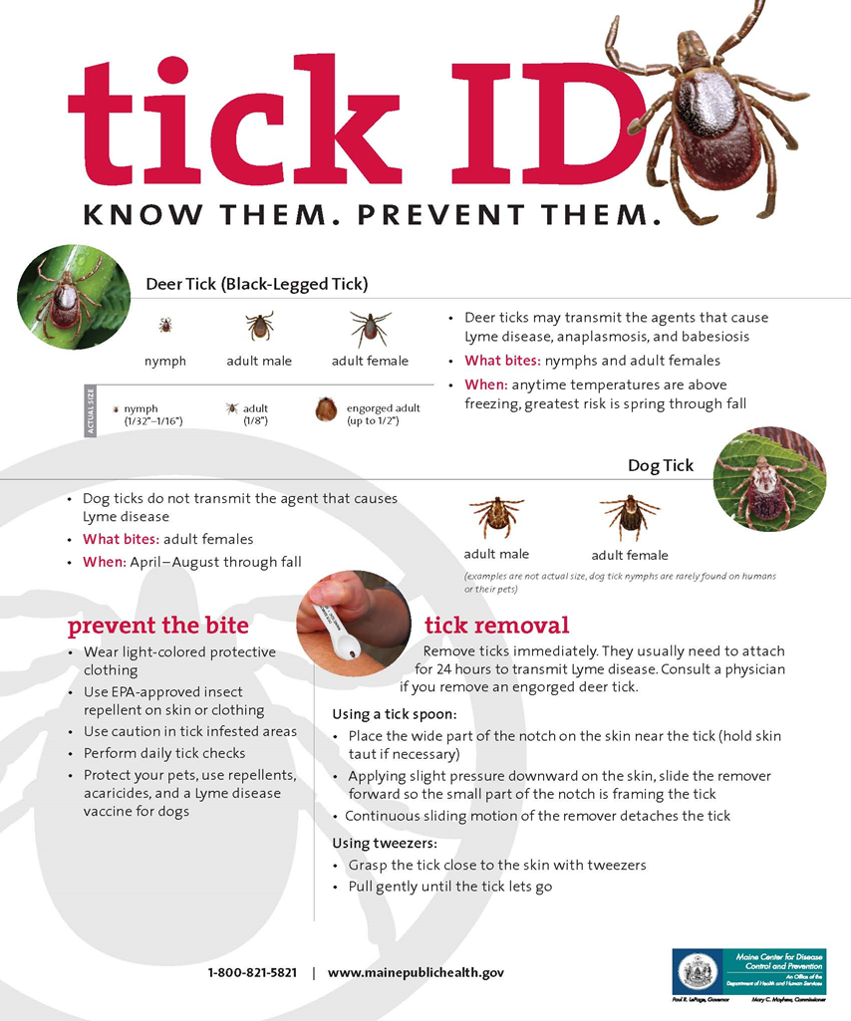

Slide 21


Questions?
* Maine CDC disease reporting and consultation: 1-800-821-5821,
Disease.reporting@maine.gov
* Maine CDC Vector-Borne Disease Website: www.maine.gov/dhhs/mecdc/infectious-disease/epi/vector-borne/index.shtml
* Maine Medical Center Research Institute – Vector-borne Disease Lab: 207-396-8246 Website: www.mmcri.org/lyme
* UMaine Cooperative Extension Tick ID Lab: 207-581-3880
Website: www.extension.umaine.edu/ipm/tickid/
Notes:
Questions?

