Slide 1
Fight the Bite!
Maine Center for Disease Control and Prevention
Notes:
(Approximately 20 minutes)

Slide 2
…Mosquitoes?
What do mosquitoes look like?
Where do mosquitoes live?
Can mosquitoes carry diseases?
What can happen if a disease-carrying mosquito bites me?
How can I prevent a mosquito from biting me?
Notes:
In this presentation, we will address:
What do mosquitoes look like?
Where do mosquitoes live?
Can mosquitoes carry diseases?
What can happen if a disease-carrying mosquito bites me?
How can I prevent a mosquito from biting me?

Slide 3
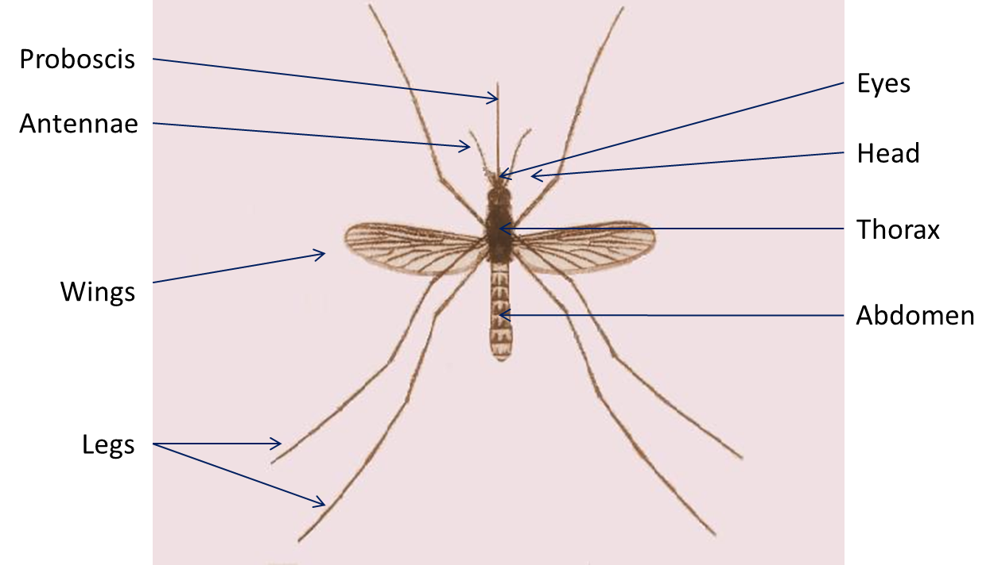
What do mosquitoes look like?
In Maine, there are many different kinds of mosquitoes
Notes:
There are 48 different species of mosquitoes found in Maine.
Mosquitoes have antennae (long, feathery sensory organs on the mosquito’s head, used to hear and smell), proboscis (long, jagged mouth part on the mosquito’s head that is used to pierce the skin and suck out the blood), wings, legs, head, eyes, thorax (the part of the mosquito between the head and the belly, where the wings and legs attach), and abdomen (part of the mosquito’s body that hangs from the thorax and serves as the mosquito’s stomach and lungs).
Only female mosquitoes have a proboscis for piercing skin, and only the females feed on blood. Male mosquitoes typically feed on plant nectar.
Vocabulary:
Antennae (antenna) – long, feathery sensory organs on the mosquito’s head, used to hear and smell
Proboscis – long, jagged mouth part on the mosquito’s head that is used to pierce the skin and suck out the blood
Thorax – the part of the mosquito between the head and the abdomen, where the wings and legs attach
Abdomen – part of the mosquito’s body that hangs from the thorax and serves as the mosquito’s stomach and lungs, holds the blood that the female takes in, as well as stores the female’s eggs

Slide 4
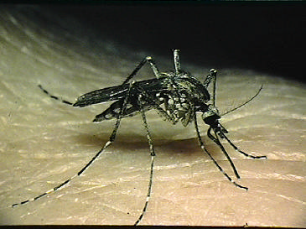
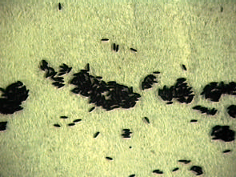
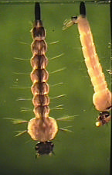
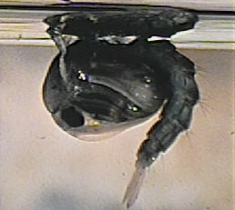
Mosquito Life Cycle
Adult
Eggs
Larva
Pupa
Notes:
Mosquitoes grow from immature to adult in a process called metamorphosis (meta=change, morph=shape), just like a caterpillar turns into a moth. During their life cycle, the mosquito goes through four different stages: egg, larvae, pupae, and adult.
The egg, larval and pupal stages all require the mosquito to live in water.
Vocabulary:
Metamorphosis (“meta” = change; “morph” = shape) - the process of development from immature to adult
Eggs – the adult female mosquito lays between 50 – 300 eggs about every third day of her lifespan. The eggs can be laid as “rafts”, floating on the surface of standing water, or laid on an area of ground that floods on a regular basis. The egg stage lasts for 2 – 3 days.
Larvae (larva) – (also called wigglers or wrigglers) part of the mosquito lifecycle that comes after the eggs hatch. The larvae hang from the surface of water and breathe through tubes. The larval stage lasts for about 1 week. Pupae (pupa) – (also called tumblers) part of the mosquito lifecycle that come after the larvae stage; pupae are partially encased in a cocoon. The pupa’ stage lasts for about 4 days before it becomes an adult mosquito.
Adult – emerges from the pupa and rests on the surface of the water until it dries its wings and can fly away.

Slide 5
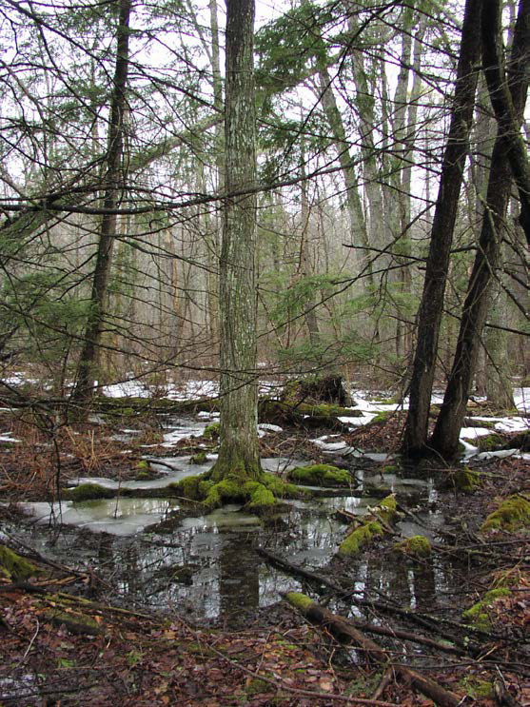
Where do mosquitoes live?
Some mosquitoes like bogs and swamps with:
Different kinds of plants
Clear or tea colored water
This is the favored habitat for mosquitoes carrying Eastern equine encephalitis (EEE) virus
Notes:
While all mosquitoes require water for their larvae to develop, different species like different types of water habitats. Generally, mosquitoes lay eggs in two types of habitats: permanent water and floodwater.
Some mosquitoes prefer to live in bogs with clear or tea colored water, and where there are different kinds of plants. This is the favored habitat for mosquitoes that can spread a disease called Eastern equine encephalitis (EEE) (more on this shortly).
Vocabulary:
Permanent water – water sources that are present for long periods of time and can support the growth of different types of plants
Flood water – water sources that alternate between periods of dry and wet, such as when water overflows as a result of a flood or melting snow

Slide 6
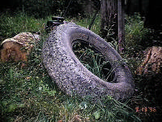
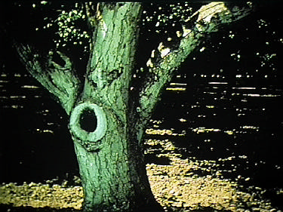
Other Mosquito Habitats
Some mosquitoes like:
Artificial containers
Catch basins
Flower pots
Discarded tires
Stagnant (motionless)
temporary pools
Holes in trees
These are the favored habitats for mosquitoes carrying West Nile Virus (WNV)
Notes:
Man-made containers are also important mosquito habitats. Mosquitoes can use buckets, cans, flower pots, or old tires to lay their eggs. Many of these man-made containers can be found around our houses and are important sources of mosquitoes near our homes.
Some species live in natural containers, such as the spots between branches of trees, where water collects; some live in the holes formed in trees when branches break off.
These are the favored habitats for mosquitoes that can carry West Nile virus (which we will discuss shortly).
Vocabulary:
Man-made containers – buckets, pail, flowerpots and other containers that can hold water and become part of mosquitoes’ habitat
Natural containers – containers found in nature that can hold water, such as the junction in between tree branches, where water can collect

Slide 7
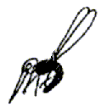
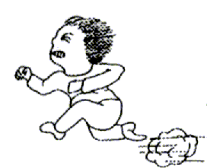
Mosquitoes and People
Far: Carbon Dioxide
Near: Heat, Moisture, Vision
Artwork courtesy of Mosquitoes in the Classroom
Notes:
All humans and animals exhale carbon dioxide when you breathe, which attracts mosquitoes. When a female mosquito (remember, only the female mosquitoes bite humans and other animals) senses carbon dioxide, she flies toward it. As she gets closer, she is attracted by the heat and moisture your body gives off.
Vocabulary:
Carbon dioxide – the chemicals that all animals exhale that can attract mosquitoes from several hundred feet away

Slide 8
Can mosquitoes carry diseases?
YES. Two of the most common diseases in Maine are:
Eastern Equine Encephalitis (EEE) virus
One of the most serious mosquito-borne diseases in the United States
West Nile Virus (WNV)
Occurs throughout the United States
Notes:
Mosquitoes can carry diseases and different mosquitoes can carry different diseases.
Mosquitoes can pick up viruses when they bite an animal or someone with a disease (also known as a host). They then spread the disease by biting another animal or human.
The most common diseases in Maine are: Eastern equine encephalitis (EEE) virus and West Nile Virus (WNV).
Vocabulary:
Host - The animal from which the mosquito feeds on
Eastern equine encephalitis (EEE) virus – EEE is a disease that can be transmitted to humans by the bite of an infected mosquito
West Nile virus (WNV) – WNV is a disease that can be transmitted to humans by the bite of an infected mosquito

Slide 9
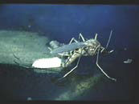
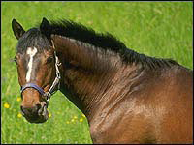
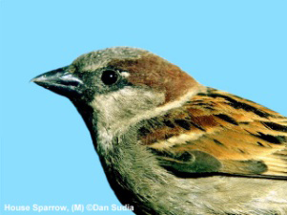
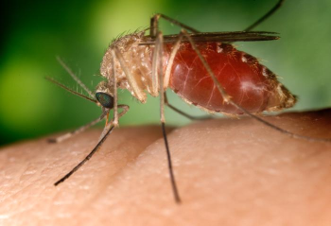
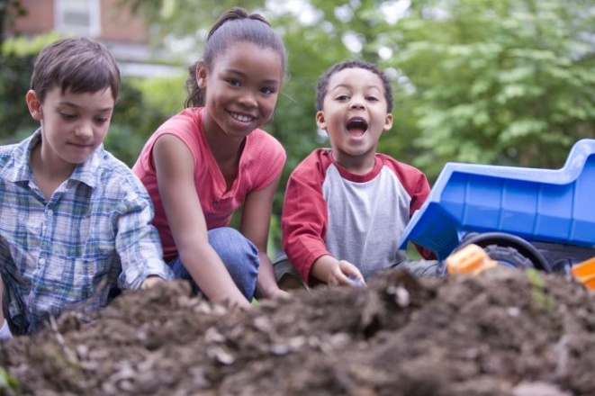
EEE and WNV Transmission Cycle
Bridge mosquito vectors
Amplification cycle
“Dead-end”
hosts
Notes:
The Transmission Cycle is the system in which a pathogen, or germ that causes disease in its host, continues. It consists of the pathogen, the mosquito, and the hosts that become infected and serve as a source of the pathogen to infect other mosquitoes if they bite the new host.
Eastern equine encephalitis virus and West Nile Virus use birds as reservoirs, or organisms that will carry the germ but that will not get the disease itself.
Normally, the virus infects a bird; a mosquito feeds on the bird; then the mosquito feeds on another bird to keep the cycle going and growing (also known as the amplification cycle). Humans become infected when one of the infected mosquitoes bites them. Fortunately, humans can’t infect other mosquitoes, which makes them “dead-ends” for the disease.
Vocabulary:
Transmission Cycle - The system in which a mosquito transmitted pathogen is maintained. It consists of the pathogen, the mosquito, and the hosts that become infected and serve as a source of the pathogen to infect mosquitoes.
Reservoirs – Organisms that hosts a pathogen that is not harmful to the host, but can cause illness in a different species
Amplification Cycle – the process of replicating something and increasing its production

Slide 10
What can happen if a disease-carrying mosquito bites me?
Symptoms can include: fever, head and body aches, lack of energy
MOST people infected with one of these viruses will not have any symptoms
Symptoms can be mild to severe
Appear 3-18 days after infection
Symptoms usually last 1-2 weeks: no treatment, only support
Notes:
WNV or EEE may start off with symptoms that look like the flu.
A person can get a headache and fever, may vomit, and may be very tired. In most cases, the infection doesn’t go beyond those symptoms.
In some people infected with EEE or WNV, more serious symptoms develop. These symptoms can include disorientation, seizures, paralysis, coma, or death.

Slide 11
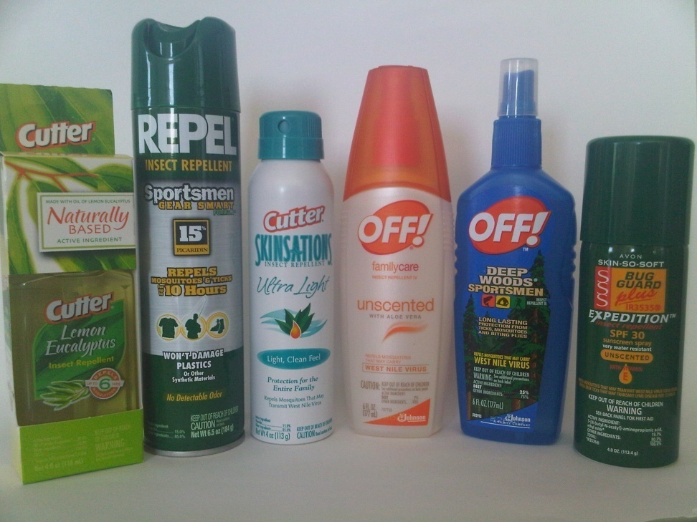
How can I protect myself?
Wear protective clothing
Wear long pants and long-sleeved shirts
Use a repellent
Be extra careful from dusk until dawn
Mosquitoes that carry EEE and
WNV are most active in the
early morning and evening
Notes:
The best way to protect yourself from getting these diseases is by preventing getting bitten in the first place. Here are some tips to help you not get bit by mosquitoes:
Wear long pants and long-sleeved shirts to lessen the amount of uncovered skin
Use a repellent (also known as “spray”) that is approved by the EPA (Environmental Protection Agency) for repelling ticks.
When using a repellent, follow the label instructions carefully. You can find the repellent that will work best for you here: http://cfpub.epa.gov/oppref/insect/
Try to minimize your time outside during early morning and early evening (this is when mosquitoes are most active)
Vocabulary:
EPA (Environmental Protection Agency) – federal agency devoted to protecting human health and the environment

Slide 12
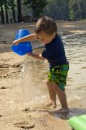
Make Your Yard Safer
Check door and window screens to make sure there are no tears in them
Dispose of old tires, cans, bottles and other containers left outside that hold water
Drain water from gutters, flower pots, pet bowls and wading pools
Notes:
To protect yourself at home, check your doors and window screens to be sure there aren’t any tears or holes in them.
If you don’t have man-made containers around your home, the risk of being bitten decreases.
Removing un-needed containers from around the home, or placing them so they will not hold water, is one way to reduce the number of mosquitoes. Throw-away old tires, cans, bottles or other containers left outside that might collect water and serve as a mosquito breeding ground.
If containers must be there, like bird baths or pet bowls, empty the water out of them once each week so that mosquito larvae in them won’t have time to complete their life cycle.

Slide 13
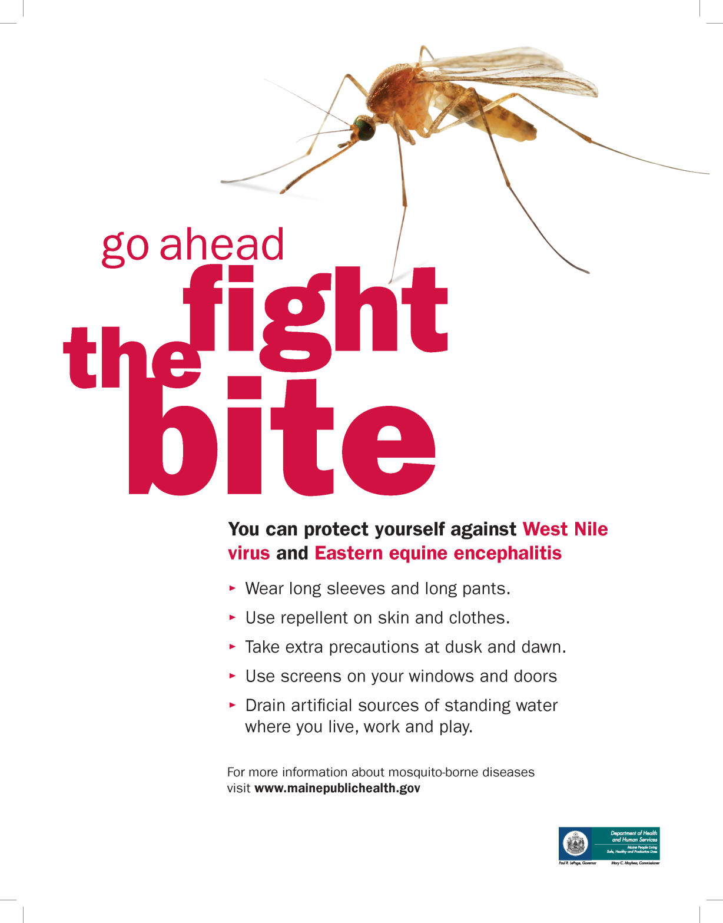
Notes:
(Hand out mosquito materials and activity books if possible.)

Slide 14
For More Information
Maine CDC disease reporting and consultation line: 1-800-821-5821 Disease.reporting@maine.gov
Maine CDC Vector-Borne Disease Website: www.maine.gov/dhhs/mecdc/infectious-disease/epi/vector-borne/index.shtml
Maine Medical Center Research Institute – Vector-borne Disease Lab: 207-662-7142
Notes:
Please let us know if you have questions.

