Slide 1
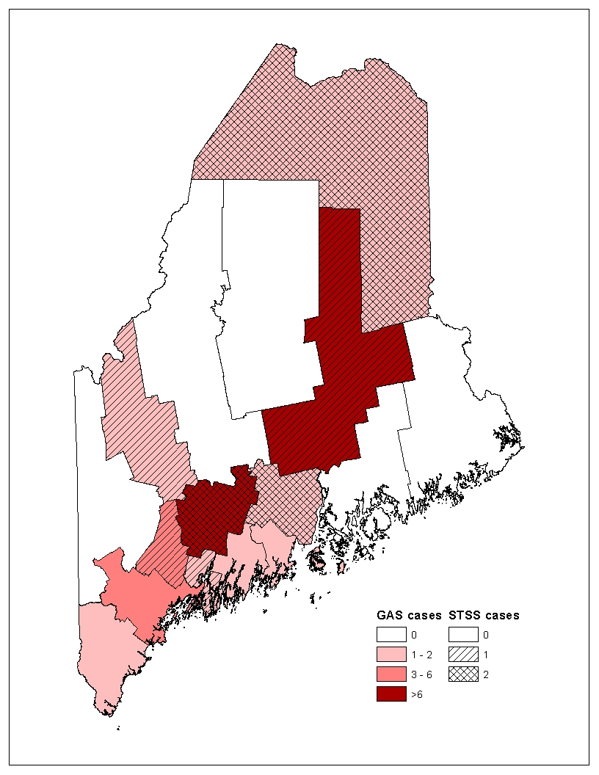
Invasive Group A Strep Infections Associated With Bath Salts Injection
Patty Carson, BA, SM (ASCP)^{1,2} , Sara Robinson, MPH¹, Stephen Sears, MD, MPH¹
¹Maine Center for Disease Control and Prevention; ² University of Southern Maine
BACKGROUND
RESULTS
Streptococcus pyogenes, or Group A Strep (GAS), are common bacteria in the throat and on the skin. These bacteria can cause Strep throat or noninvasive skin infections such as impetigo and cellulitis, and can cause invasive disease such as bloodstream infections and necrotizing fasciitis. Invasive disease can be fatal.
Streptococcal toxic shock syndrome (STSS) can be associated with invasive or noninvasive GAS infection. STSS can be diagnosed when a patient has GAS infection, as well as hypotension and at least two other clinical findings consistent with more serious organ involvement such as renal impairment, coagulopathy, liver damage indicators, and tissue necrosis.
In late 2012, four cases of invasive GAS were reported to the Maine Center for Disease Control and Prevention (MECDC). The cases were from Penobscot and Aroostook counties. These four patients had prior history of illicit intravenous drug use (IDU) and were found to have injected “bath salts” in the days preceding infection.
New designer drugs which are synthesized cathinone, a central nervous system stimulant, have emerged in recent years and are being marketed as bath salts. As drugs of abuse, these preparations can be ingested orally, inhaled, or smoked; greater health risks are associated with snorting or injecting them.
The four case patients were hospitalized. Blood cultures were obtained on all, and skin or soft tissue cultures were done on patients with cellulitis or abscess.
All four had the common risk factor of injection drug use and specifically, injection of bath salts. All admitted to this practice in the week prior to onset of infection.
None of the four had history of recent surgery, hospital stay, or other invasive procedure.
One of the four presented with abscess and necrotizing fasciitis; this patient required surgery and subsequent debridement to control the infection and prevent the need for amputation.
Three of the cases had cellulitis.
Three of the patients were known to be positive for Hepatitis C.
All patients were treated successfully with antibiotics and discharged.
MECDC released a statewide health advisory on December 6, 2012 to assist with case finding in other geographic locales. The State Epidemiologist spoke with media outlets in order to inform the public. Targeted interventions included distributing educational materials to needle exchange programs and providing an in-service to employees of a needle exchange program. Clinical providers and substance abuse counselors received risk reduction messages via MECDC and Office of Substance Abuse.
Invasive GAS and STSS cases by county – Maine, 2012*
*Cases can be counted as both STSS and GAS
CONCLUSIONS
The use of bath salts, and especially injection of these potent drugs, is relatively new to this region. This cluster may represent only a small portion of actual cases in the community. Transmission of GAS among the IDU population may be more extensive than is known, due to the generally unclean practices of drug injection, the associated secrecy, and reluctance to disclose illness.
The cases were not closely linked by residence, but drug distribution is known to occur extensively between the counties of residence.
Partnership with mental health and substance abuse programs and detailed investigations and epidemiologic studies will help us understand different risk factors for infection and prevent further harm.
Group A beta hemolytic Streptococcus
METHODS
MORE INFORMATION
MECDC investigated all reported cases of invasive GAS and STSS using a case definition as reference and standardized case report form for data collection.
Field epidemiologists (FE) obtained and reviewed medical records on the four case patients.
Data on patient clinical history, underlying illnesses, and risk factors for infection was collected.
Patient interviews were completed by FE; hospitalized patients were interviewed in person, and outpatients were interviewed by telephone.
Maine CDC: http://www.maine.gov/dhhs/mecdc/infectious-disease/epi/airborne/group-a.shtml
Federal CDC: http://www.cdc.gov/ncidod/dbmd/diseaseinfo
/groupastreptococcal_g.htm
National Institute on Drug Abuse: www.drugabuse.gov
ACKNOWLEDGEMENT
The authors thank Vickie Rea, RN, MPH of Maine Center for Disease Control and Prevention and the University of Southern Maine.

