Slide 1
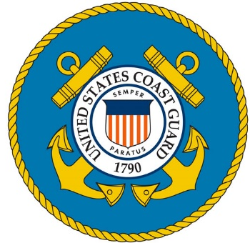
SUNKEN VESSEL ‘NO EXCUSE’ INTERAGENCY REMOVAL
March 2021 - Seabrook Harbor, NH
Ryan Hanson, MST1
US Coast Guard
Chris Wood
NHDES Spill Response

Slide 2
Overnight March 4
Combination of high winds/waves and lack of maintenance
44-foot fiberglass hull fishing vessel with gantry and winch
Notes:
The owner reported having to pump the vessel out periodically due to small leaks. The owner had recently lost use of his dinghy and could not tend to the vessel.

Slide 3
March 5
Diesel sheen observed
NHDES hired US Ecology to deploy containment boom
RP hired Tow Boat US to plug fuel vents
Notes:
USCG notified the National Response Center of the sunken vessel and diesel sheen
NHDES Spill Response notified NH Fish & Game and the NH Shellfish Program of the diesel release

Slide 4
March 8
Tow Boat US attempt to raise vessel was unsuccessful
Owner did not have resources to continue removal efforts
Notes:
Tow Boat US determined that the size and weight of the vessel required additional vessel-based equipment for recovery. The sandy bottom prevented proper attachment of float bags beneath the hull. Deck-mounted commercial fishing equipment and gravel ballast in the hull put total weight estimates between 30 and 35 tons.

Slide 5
Channel Restriction
Broadcast Notice to Mariners
Limited Access to Fishing Co-Op
Clam flats closed

Slide 6
The Plan
Raise / stabilize vessel
Dewater / Remove oil
Transport to ramp / pier
Crane to trailer for impound
Notes:
Wait for break in windy weather before attempting to raise vessel

Slide 7
Day 1 - March 16
Notes:
Morning of the first day. Contractors on scene for diving and connecting float bags to raise the vessel.

Slide 8
Notes:
Local citizen flying drone on scene provided pictures throughout the operation. At one point the drone operator reported sheen helping us to mitigate/contain very quickly. The vessel was floated as close as possible to Harborside Park for safe/secure pumping of fuel and water.

Slide 9
Notes:
Difficulty floating the vessel pushed fuel removal efforts to Day 2 due to the approaching low tide and safety concerns during night operations

Slide 10
Day 2 - March 17
Vac truck positioned at Harborside Park
500 gallons oily water collected, approx. half oil
Project passed to NHDES for transport, salvage, and impounding
Notes:
Morning of the second day. Tide is low and vessel is secured to the barge and stable for dewatering and oil removal.

Slide 11
Notes:
Steel gantry, winch, and other accessories were cut and removed from the deck and cabin roof to lighten the vessel for floating

Slide 12
Pumped dry, the vessel floated unassisted as the tide came in
Determined the vessel could be trailed – no crane needed

Slide 13
Notes:
The vessel was pushed ~550 feet South to Seabrook public boat ramp for trailering out of the water

Slide 14
Notes:
The vessel was loaded onto a hydraulic lift trailer to remove from the water

Slide 15
Notes:
The vessel was towed to a storage lot at the Hampton State Pier, 1 mile North

Slide 16
Notes:
No Excuse was set on stands at the Hampton State Pier for storage until final disposition is determined. NHDES holds the vessel until costs associated with booming and recovery have been reimbursed by the owner. If the owner relinquishes the vessel to NHDES, or payment is not made within legal timeframe, then the vessel is auctioned or disposed of.

Slide 17
Questions?
Hampton Harbor from Harborside Park, Seabrook, NH

