Slide 1
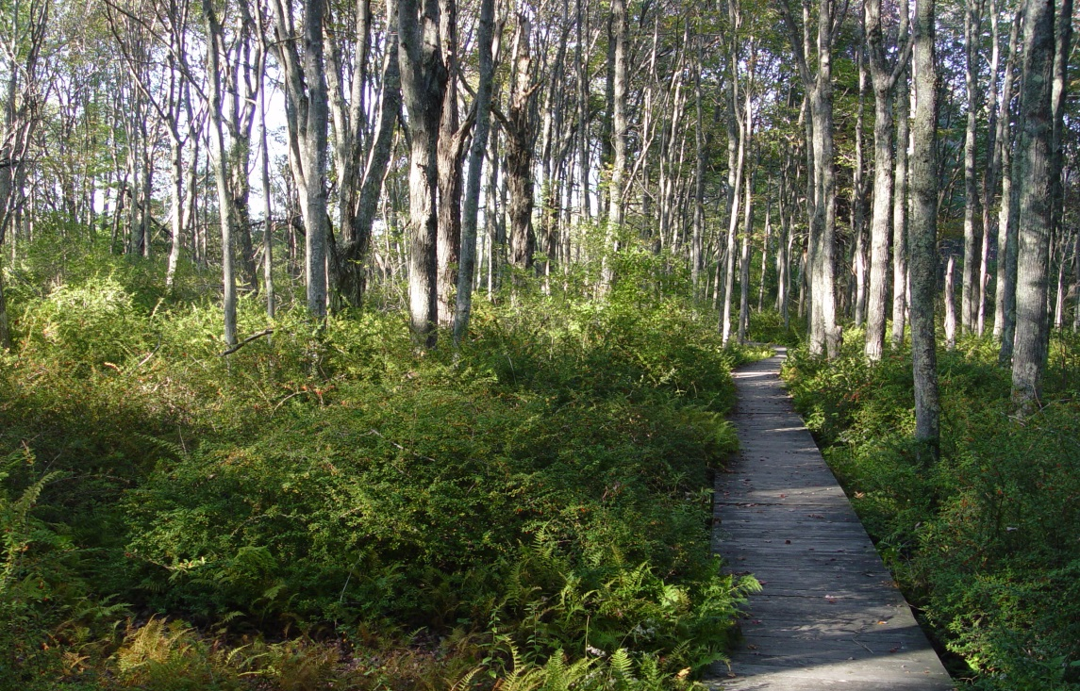
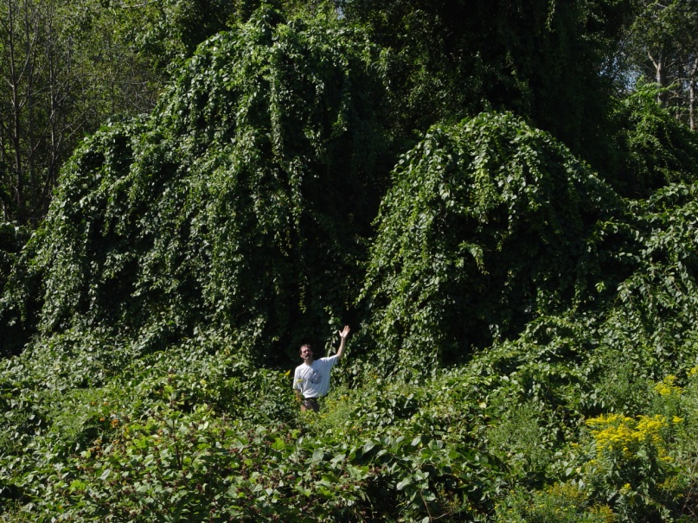
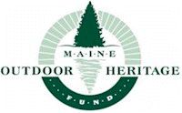
How to identify and control common invasive plants of Maine
Nancy Olmstead, Invasive Plant Biologist
Maine Natural Areas Program
Ag Trade Show - BPC/Coop. Ext. workshop January 8, 2015
Notes:
On the left, Japanese barberry
On the right, Asiatic bittersweet

Slide 2
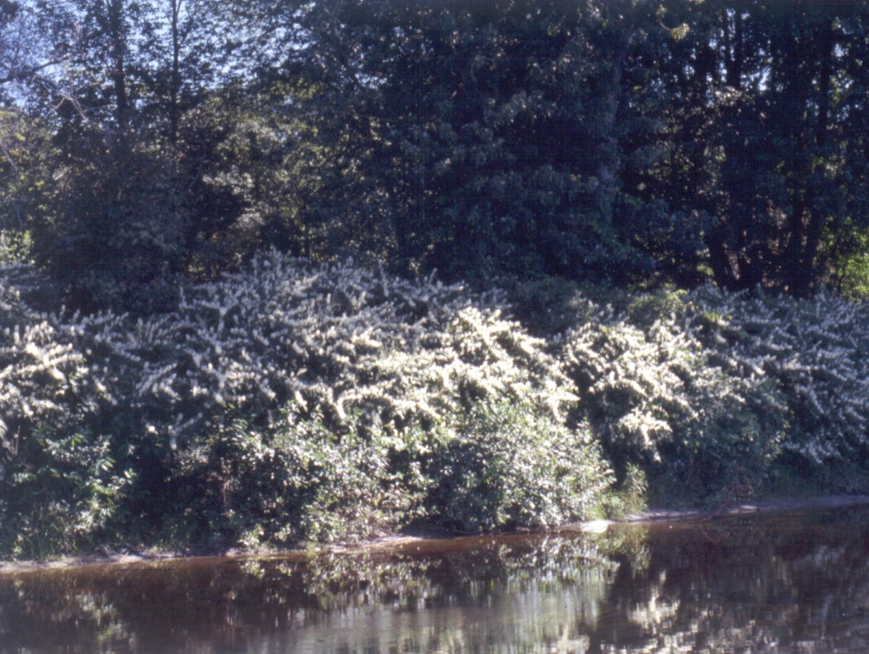
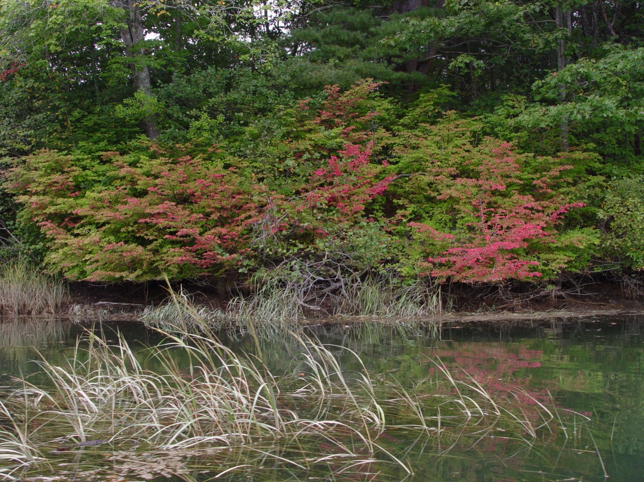
What is an invasive species?
An alien or non-native species whose introduction does or is likely to cause economic or environmental harm or harm to human health. (ME Dept. of Ag, 2011)
Japanese knotweed (aka bamboo) and burning bush (aka winged euonymus)
Notes:
Maine Statute definition for invasive species
Many non-natives are not invasive. Many weeds are not invasive.

Slide 3
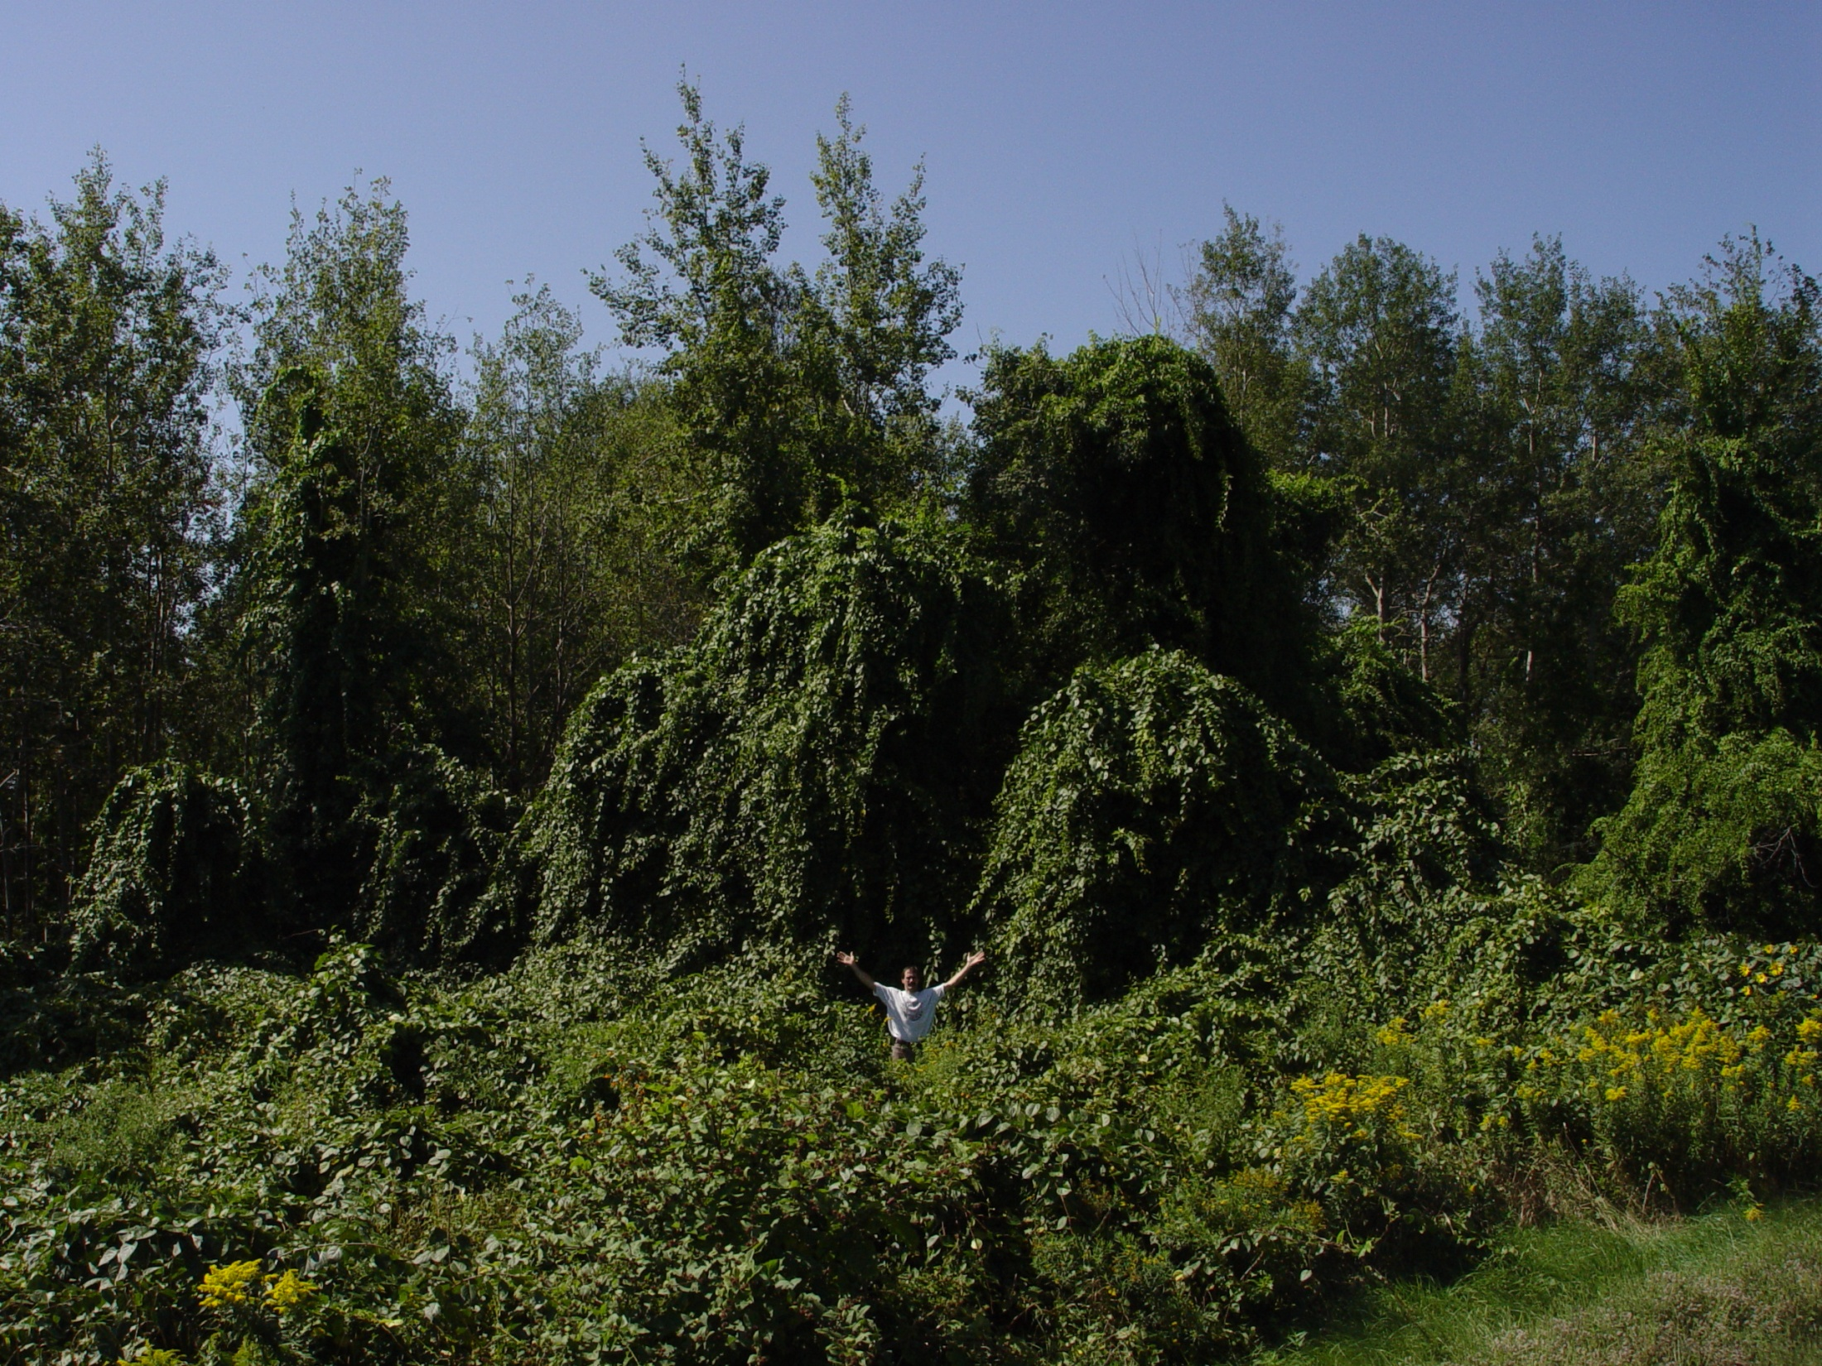
What harm do invasive plants do?
Primary ecological harm is to out-compete or impair native species, overrun habitats
Notes:
Can cause habitats to change in structure or function, so that they no longer meet the needs of native species. E.g., dense thickets of shrubs like honeysuckles can cause decreased survival of native tree seedlings.

Slide 4
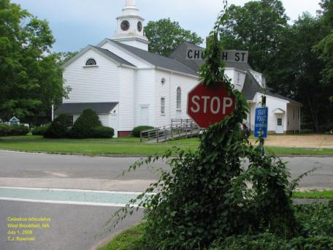
Values and resources at risk
Health of native species and the environment (e.g., biological diversity)
Human & animal health & safety
Recreation & aesthetic resources
Forest crop production
Commercial agriculture
Property values
Infrastructure

Slide 5
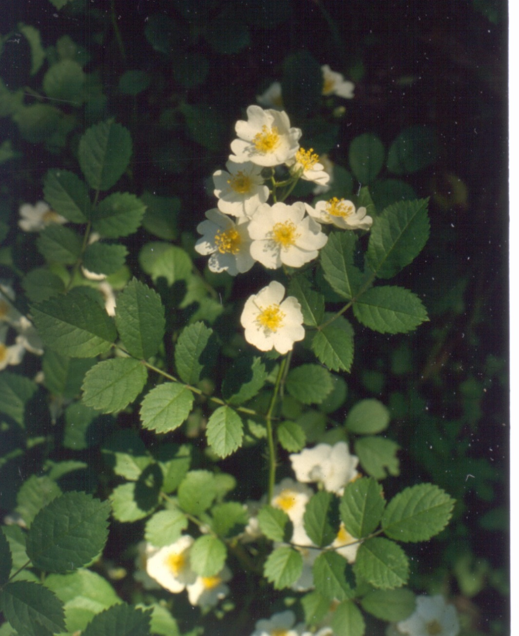
Learning to identify plants
Just like all skills, plant ID requires practice.
Seeing pictures and descriptions is only the first step.
To learn these plants, seek them out in the field and check your ID.
Notes:
Have a friend or family member help you learn these!

Slide 6
General control principles
Manual/mechanical control
Disturb the soil as little as possible
Properly dispose of plant parts: some plants can sprout from fragments
If possible, remove before seed set; check later in season and remove any re-growth
Be patient, it will probably take multiple years
Some large infestations are not possible to control with manual/mechanical work alone; multiple methods can be a good approach
Re-plant with natives
Notes:
If there is a seed bank, you will have to keep at it until it is exhausted – can take years!!

Slide 7
General control principles
Herbicide control
Avoid native plants, can use timing to help
Use the lowest concentration that will do the job
Remember it takes several days to see results
Choose the right time of year and conditions
You may need additives – read label
The Label Is The Law
Be patient, it may take multiple years
Re-plant with natives
Today I’m discussing UPLAND (dry site) applications. Near wetlands or waterbodies, additional rules and considerations apply!
Notes:
4. Timing – eg, if you can apply in the late fall when other plants have already lost leaves; AVOID spring sap flow for almost all treatment types.
Conditions – most herbicides are designed to work on HEALTHY plants, so won’t be as effective in drought or other stressful conditions.
7. If there is a seed bank, you will have to keep at it until it is exhausted – can take years!! Herbicide does not kill seeds.

Slide 8
General control principles
Herbicide control
3 main kinds of treatments:
Foliar spray
Basal bark
Cut-stem or cut-stump
mostly mention 2 active ingredients :
glyphosate
triclopyr
Notes:
Foliar spray: uses less herbicide, a very dilute mix (~2-5%), usually with a surfactant, can inflict collateral damage unless you are careful, or apply on the shoulder season – when invasive plants have leaves and other plants do not!
Basal bark: uses concentrated herbicide, applied to bottom ~12-18” of DRY stem, all the way around. Not during spring sap flow. For stems <6” diameter. Need penetrating oil.
Cut-stem or cut-stump: apply concentrated herbicide to cut stem surface, mostly at the cambium (the growing cells in outer ring of the stump, just inside the bark. Must be done quickly after cutting. Not during spring sap flow.
Glyphosate – sold as Round-Up and other names systematic, non-selective, works by inhibiting a plant amino acid enzyme (and may inhibit other plant enzymes) so all plants are affected
not soil-active (meaning it doesn’t affect other plants once it gets down into the roots
Triclopyr – sold as Garlon and other names
systematic, “selective” for broad-leaf plants (does not work on grasses or conifers)
growth inhibitor, soil-active for 30-90 days at least, so can affect other plants in the area even once it’s in the soil.

Slide 9
ID and control of 10 common, terrestrial, invasive plants
Notes:
These are the ones I judge that you will come across most often – subjective based on my own experience, mostly in the southern part of the state.
Please raise your hand if:
-You are already using manual controls or pesticides to control invasive plants
-You have a good sense of what invasive plants look like and you see them if they are there

Slide 10
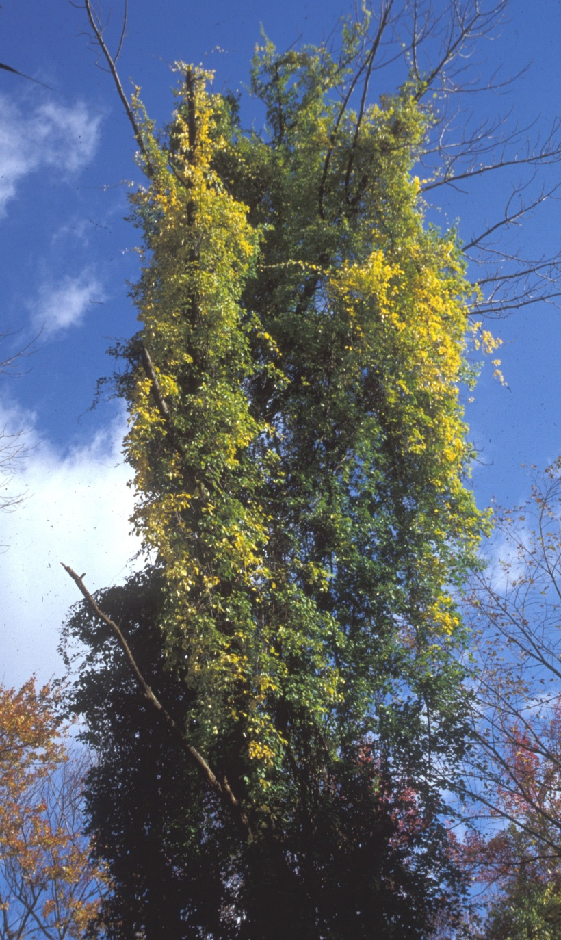
Asiatic bittersweet
(Celastrus orbiculatus)
Woody vine that climbs other plants
Can strangle or weigh down a mature tree
Favors open areas but will survive under forest canopy
Notes:
Leaves turn yellow in the fall
Weight can make trees more vulnerable in ice storms, high wind events

Slide 11
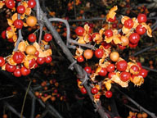
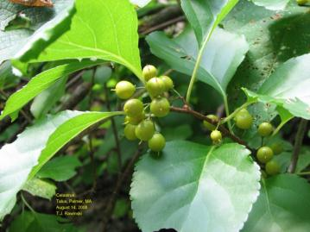
Asiatic bittersweet
(Celastrus orbiculatus)
Red fall fruits with yellow covers
Dense clusters of fruit all along the vine in the axils (where the leaf meets the stem)
Leaves alternate, round to elliptical
Leaves turn yellow in fall
??
Notes:
We have a native species of bittersweet but it’s rare and unlikely to be confused with Asiatic; flowers/fruits only at the ends of the twigs, rather than in the axils.
How many of you recognize this species?

Slide 12
Asiatic bittersweet control
Manual
Cut vines at knee height, leave them in trees so you don’t damage the tree
For sprouts and low growth, pull, pull, pull or mow, mow, mow, 2x/month or as needed
Repeat as long as it keeps resprouting, may take years
Herbicide
For large vines, cut-stem treatment with concentrated (25%) triclopyr, leave vines in trees; growing season after spring sap flow
For sprouts and low growth, foliar spray with 2% triclopyr anytime during active growing season
Notes:
Manual
Don’t bother trying to pull vines out of trees – you’ll just cause damage
Herbicide
Glyphosate (Round-Up) not as effective on bittersweet; triclopyr = active ingredient in Garlon
Can also do a basal-bark application on stems <1” diameter (20% triclopyr ester formulation with penetrating oil); year-round but must have access to dry 18” bottom of stem.
Careful with triclopyr near valuable plants b/c it stays active in soil for a while, so neighboring plants may be affected thru roots – glyphosate can be used in those situations, e.g., in a cut stump application

Slide 13
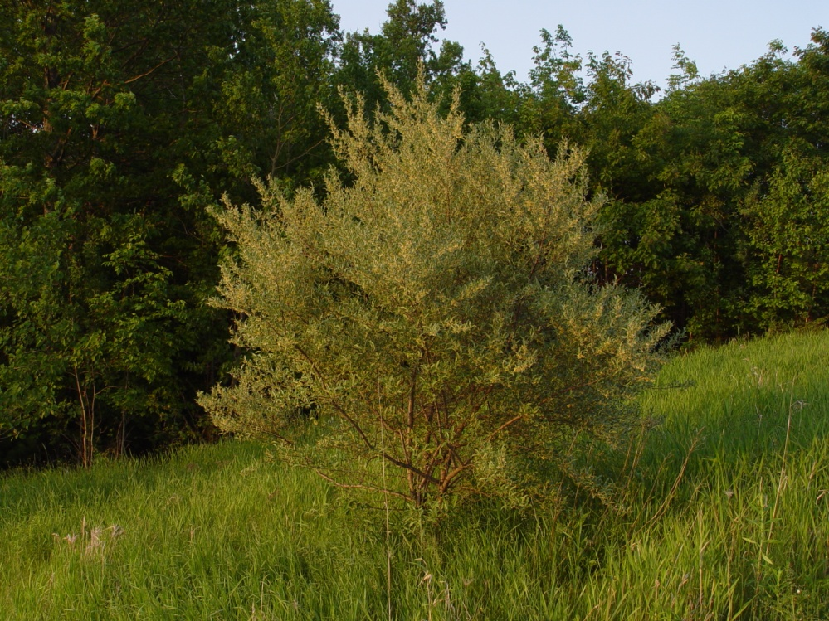
Autumn olive
Eleagnus umbellata
Woody shrub can grow to ~15’ tall
Found in open areas and forest edges
Alternate leaves with tiny brown and/or silver scales
Leaf edges are smooth
Notes:
N-fixer so has competitive advantage in nutrient-poor soils
Single shrub can produce 80 lbs of fruit/year

Slide 14
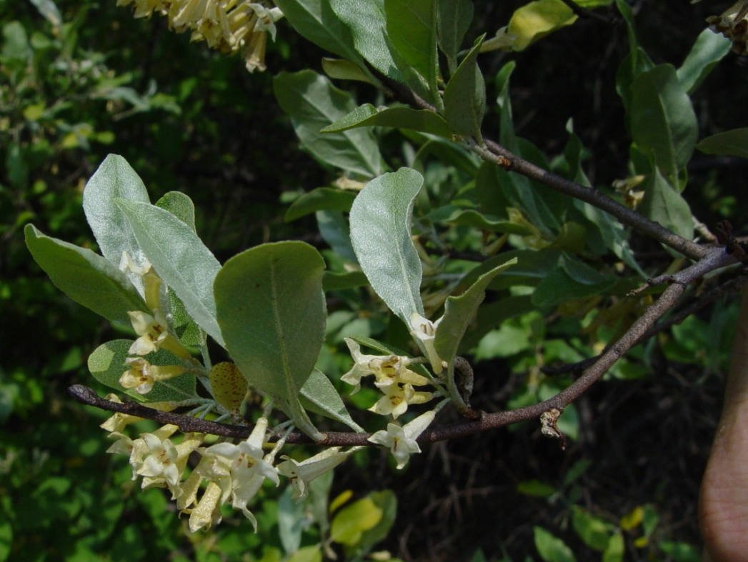
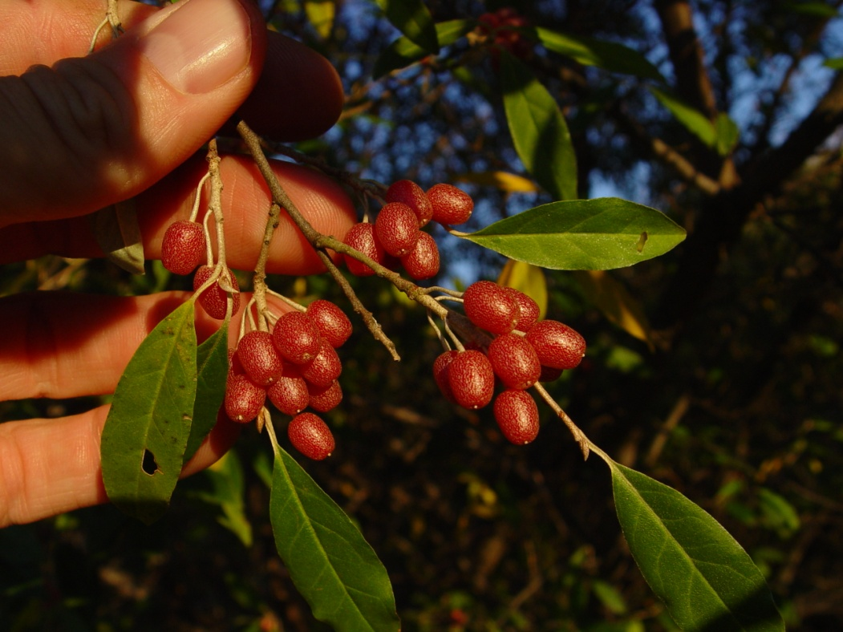
Autumn olive
Eleagnus umbellata
Tiny scales also found on twigs
Clusters of tubular, white-yellow flowers
Fruits start out brown, mature to deep orange-red
Russian olive is a sister species, much less common, very similar

Slide 15
Autumn olive control
Manual (smaller plants)
Pull/dig small plants when soil is damp
Only effective with small plants/early in an invasion
Mowing/cutting stimulates sprouting so would have to be done repeatedly or in combination with herbicide
Herbicide (larger plants)
Basal-bark treatment with 20% triclopyr, ester formulation, with penetrating oil; year-round but must have access to dry, bottom 18”
Cut-stem treatment with 20% triclopyr; growing season after spring sap flow
Notes:
Herbicide
Glyphosate not as effective with this species
Can do foliar application with 2-3% triclopyr ester (eg Garlon 4 Ultra), do in spring once leafed out; glyphosate not as effective
Careful with triclopyr near valuable plants b/c it stays active in soil so neighboring plants may be affected thru roots – glyphosate can be used in those situations, e.g., in a cut stump application.
Remember that cut-stem treatments should be done IMMEDIATELY after cutting to be effective

Slide 16
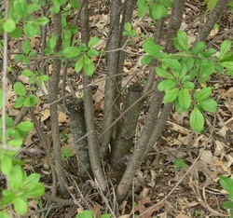
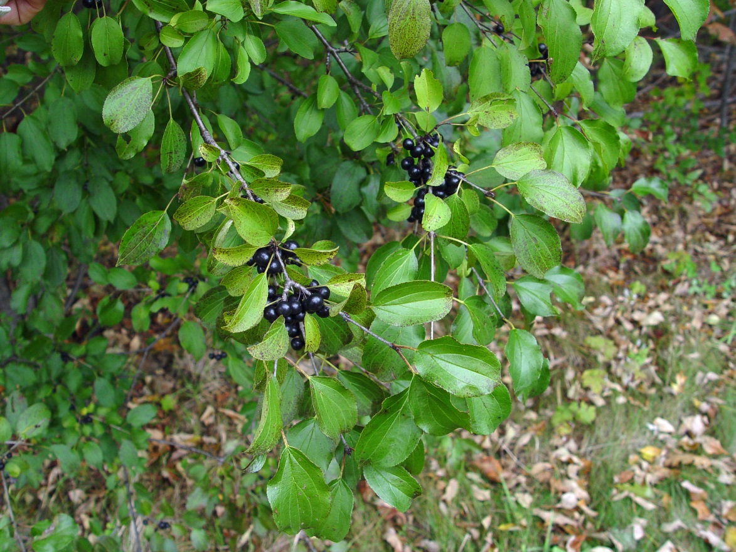
Common buckthorn
(Rhamnus cathartica)
Upright shrub or small tree (to 25’)
Does fine in full shade
~1/4 in. “thorns” at the end of twigs – easy to miss, not like rose or raspberry thorns
Bark of larger buckthorns has scaly appearance similar to black cherry

Slide 17
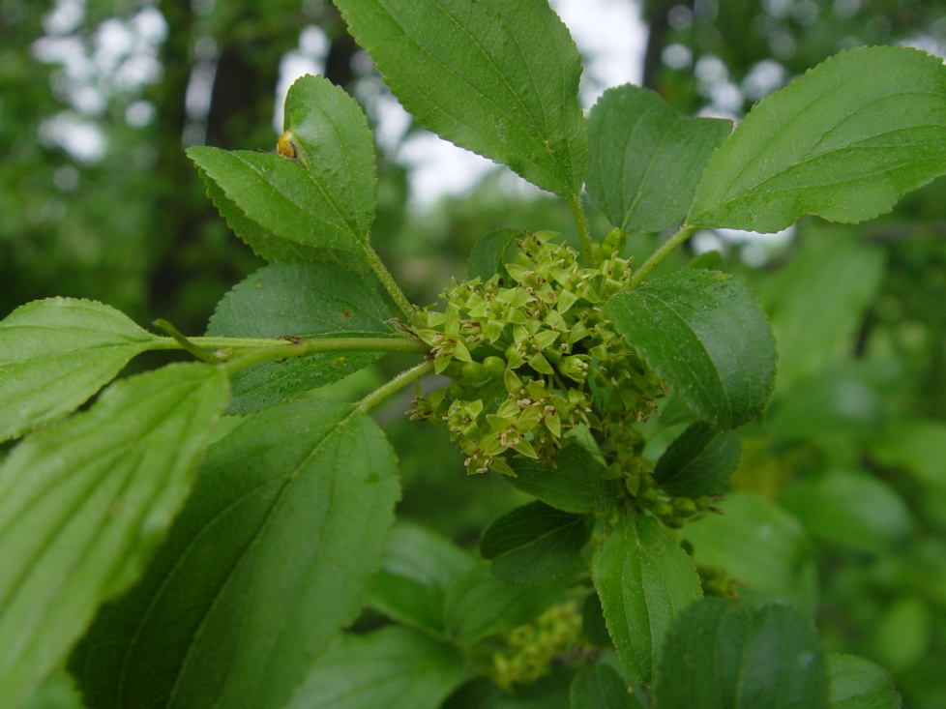
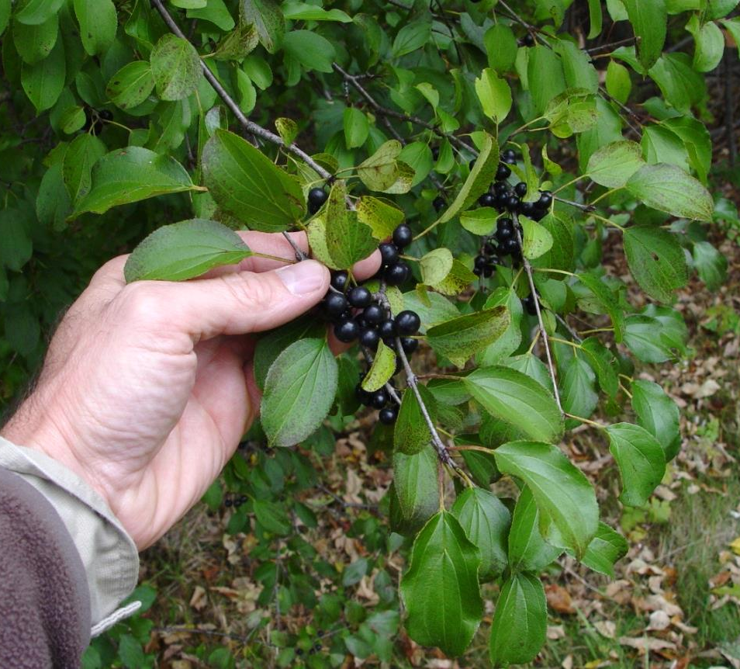
Common buckthorn
(Rhamnus cathartica)
Opposite to subopposite to alternate leaves
Leaves egg-shaped with pointed tips
Toothed leaf edges
Clusters of little green flowers
Fruits mature to black color
??
Notes:
How many of you recognize this species? Major forest threat

Slide 18
Common buckthorn control
Manual
Pull/dig small plants when soil is damp
Only effective with small plants/early in an invasion
Mowing/cutting stimulates sprouting so would have to be done repeatedly or in combination with herbicide
Herbicide
Basal-bark treatment with 20% triclopyr ester formulation, with penetrating oil; year-round but must have access to dry, bottom 18”
Cut-stem treatment with 20% triclopyr ester; growing season after spring sap flow
Notes:
Herbicide
Some authors say that glyphosate not as effective with this species; it is at least somewhat effective and could be used instead eg in cut-stump treatment
Can do foliar application with 2-3% triclopyr ester, with adjuvant (eg Garlon 4 Ultra), may be more effective in spring – per Ron Lemin; glyphosate not as effective
Careful with triclopyr near valuable plants b/c it stays active in soil (at least 30-90 days) so neighboring plants may be affected thru roots – glyphosate can be used in those situations, e.g., in a cut stump application.
Remember that cut-stem treatments should be done IMMEDIATELY after cutting to be effective

Slide 19
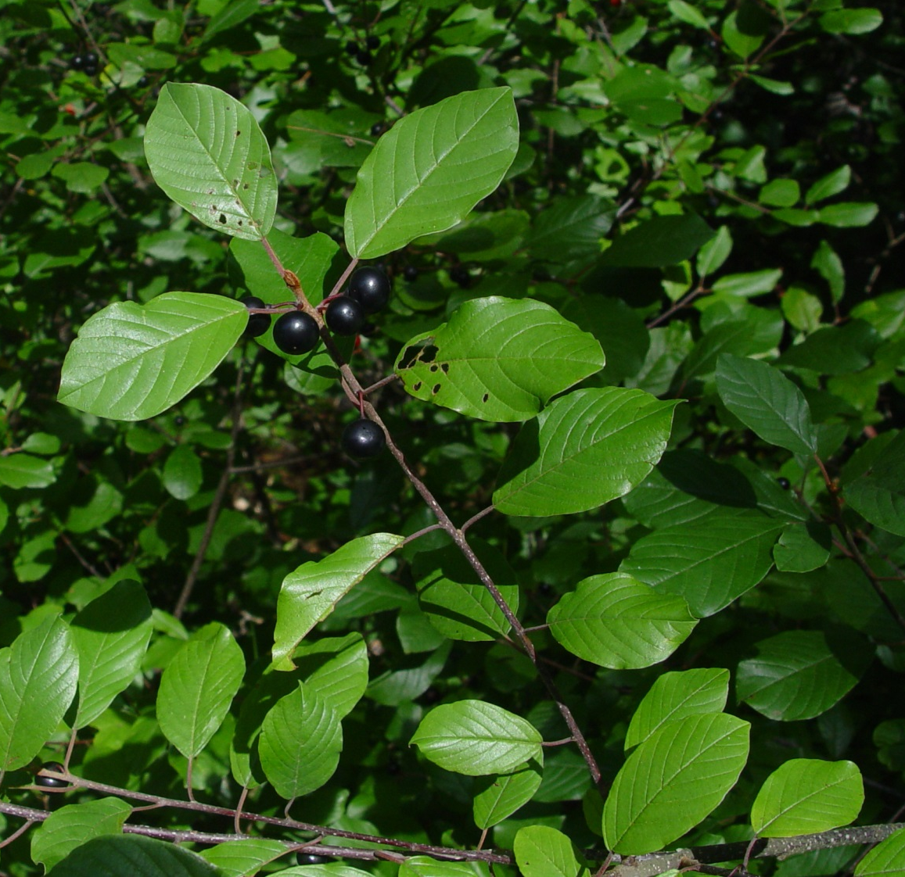
Glossy false buckthorn (Frangula alnus)
Shrub or small tree (to 20’)
Can grow in uplands or wetlands, in shade or sun
Twigs/bark with small, white, horizontal marks
Alternate leaves
Smooth leaf edges
Leaf veins mostly parallel to each other
Notes:
Emodin is a metabolic by-product that has been found to have a negative effect on amphibian breeding success in the midwest

Slide 20
Glossy false buckthorn (Frangula alnus)
Leaves egg-shaped with pointed tips, widest above the middle
Leaves can be glossy or not
Inconspicuous white flowers
Fruits are first green, then red, mature to purple-black
??
Notes:
Emodin is a metabolic by-product that has been found to have a negative effect on amphibian breeding success in the midwest
How many recognize this species? Major forest and wetland threat

Slide 21
Glossy buckthorn control
Manual
Pull/dig small plants when soil is damp
Only effective with small plants/early in an invasion/in looser soils
Mowing/cutting stimulates sprouting so would have to be done repeatedly or in combination with herbicide
Girdle with ~2” tall cut completely around stem (remove bark)
Herbicide
For stems <4-6” in diameter, basal-bark treatment with 20% triclopyr ester formulation, with penetrating oil; year-round but must have access to dry, bottom 18”
Cut-stem treatment with 20% triclopyr ester; growing season after spring sap flow
Notes:
THIS IS A HARD ONE – IF YOU HAVE THIS SPECIES, GET IT EARLY!!
Manual
5-second Flame torch reportedly kills saplings <4.5cm in diameter (<1.75”)
When girdling, can also apply concentrated triclopyr ester to cambium to aid effectiveness of girdle
Herbicide
Some authors say that glyphosate not as effective with this species; it is at least somewhat effective and could be used instead
Can do foliar application with 2% triclopyr ester with adjuvant/surfactant (eg Garlon 4 Ultra) (may be more effective in spring, per Ron Lemin), or glyphosate.
Careful with triclopyr near valuable plants b/c it stays active in soil so neighboring plants may be affected thru roots – glyphosate can be used in those situations, e.g., in a cut stump application.
Remember that cut-stem treatments should be done IMMEDIATELY after cutting to be effective

Slide 22
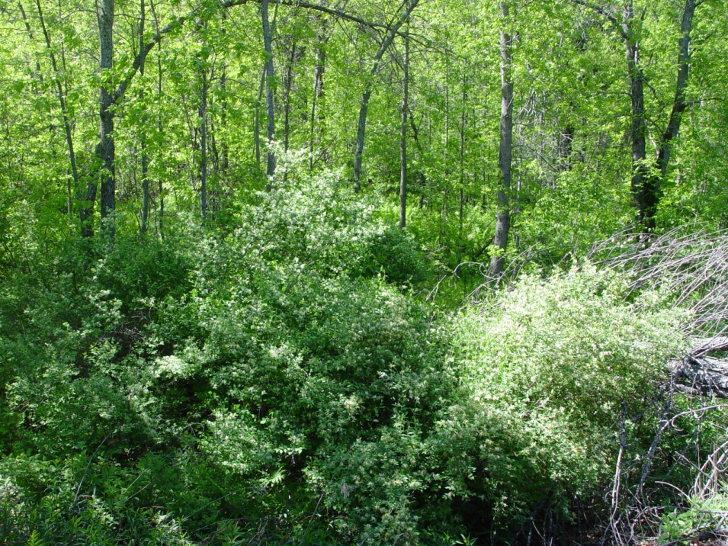
Honeysuckle shrubs
Lonicera morrowii, L. tatarica
Arching shrubs of open to shaded areas
Older shrubs can reach 10’ tall and 10’ wide
Bark on larger trucks peels in strips
Hollow stem pith distinguishes invasive spp. from our one native species
Notes:
We do have a native honeysuckle, but it’s less robust, not hairy on the leaves, flowers are radially symmetrical, pith solid-white

Slide 23
Honeysuckle shrubs
Lonicera morrowii, L. tatarica
Leaves longer than wide, smooth edges
Leaves usually hairy, at least on underside
Flowers in pairs usually yellow, occasional shrubs with pink flowers
Fruit mature to juicy red berries
Notes:
We do have a native honeysuckle, but it’s less robust, not hairy on the leaves, flowers are radially symmetrical, pith solid-white

Slide 24
Shrubby honeysuckle control
Manual
Pull/dig small plants when soil is damp
Only effective with small plants/early in an invasion/in looser soils
Mowing/cutting stimulates sprouting so would have to be done repeatedly or in combination with herbicide
Herbicide
Cut-stem treatment with 25% glyphosate or triclopyr; late in growing season
For smaller, smooth-trunked ones, basal bark spray with 12% triclopyr ester with oil; anytime except spring sap flow
Foliar spray with 2% glyphosate, add surfactant if not included; do in fall to avoid natives and maximize effectiveness
Notes:
Herbicide
Remember that cut-stem treatments should be done IMMEDIATELY after cutting to be effective
Basal bark treatment not as good on large honeysuckles b/c of flaky, shaggy bark on mature shrubs

Slide 25
Japanese barberry
Berberis thunbergii
Arching shrub of forests and edges
Grows well in shade
Can grow to 5’ tall and just as wide
Can tolerate damp soil
Densely thorny twigs (“barbs”)
Notes:
Early leaf-out
50% germination rate
Dispersed by mammals and songbirds
Mice like the barberry thickets, and ticks are found there in higher densities than in the surrounding, uninfested forest, leading to more TICKS!!!

Slide 26
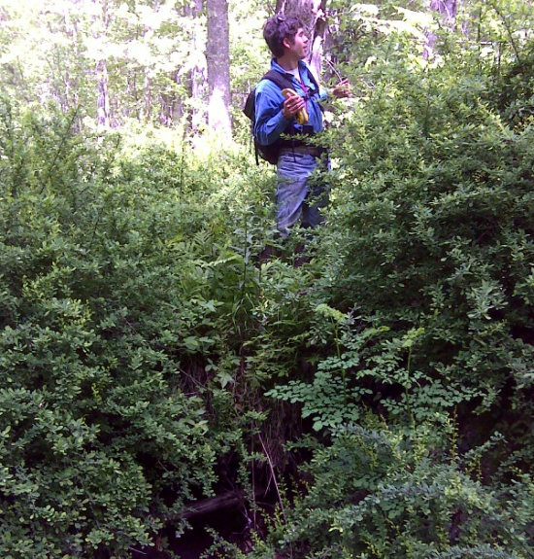
Japanese barberry
Berberis thunbergii
Small, alternate leaves
Small, oblong, bright red fruits hang below the twigs
Notes:
Early leaf-out
50% germination rate
Dispersed by mammals and songbirds
Mice like the barberry thickets, and ticks are found there in higher densities than in the surrounding, uninfested forest, leading to more TICKS!!!

Slide 27
Japanese barberry control
Manual
Pull/dig small-medium plants when soil is damp (cut as much of root as possible)
Mowing/cutting stimulates sprouting so would have to be done repeatedly or in combination with herbicide or torch
Propane torch! in combination with follow-up treatment. See UConn Coop Ext. website FMI
Herbicide
Cut-stem treatment with 25% glyphosate or triclopyr; late in season
Foliar spray with 2% glyphosate, add surfactant if not included; after leaf out but before fruiting – can do early since it leafs out early
Notes:
Manual
This one you can kill fairly effectively by pulling/digging/cutting roots
Uconn Coop Ext has also pioneered the use of propane torch as part of a combination treatment – google FMI
Herbicide
Basal bark can also work, use 25% triclopyr in oil – But note that most barberry has a multi-trunked stem, hard to access, so this may cause soil contamination via overspray

Slide 28
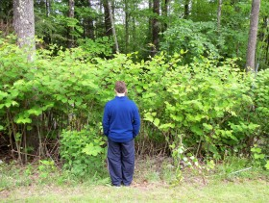
Japanese knotweed
(Fallopia japonica)
Technically an “herb” but has tough stems
Thrives in open areas, also in floodplain forests and in partial shade
Can tolerate wet soil
Grows in dense clumps connected by rhizomes

Slide 29
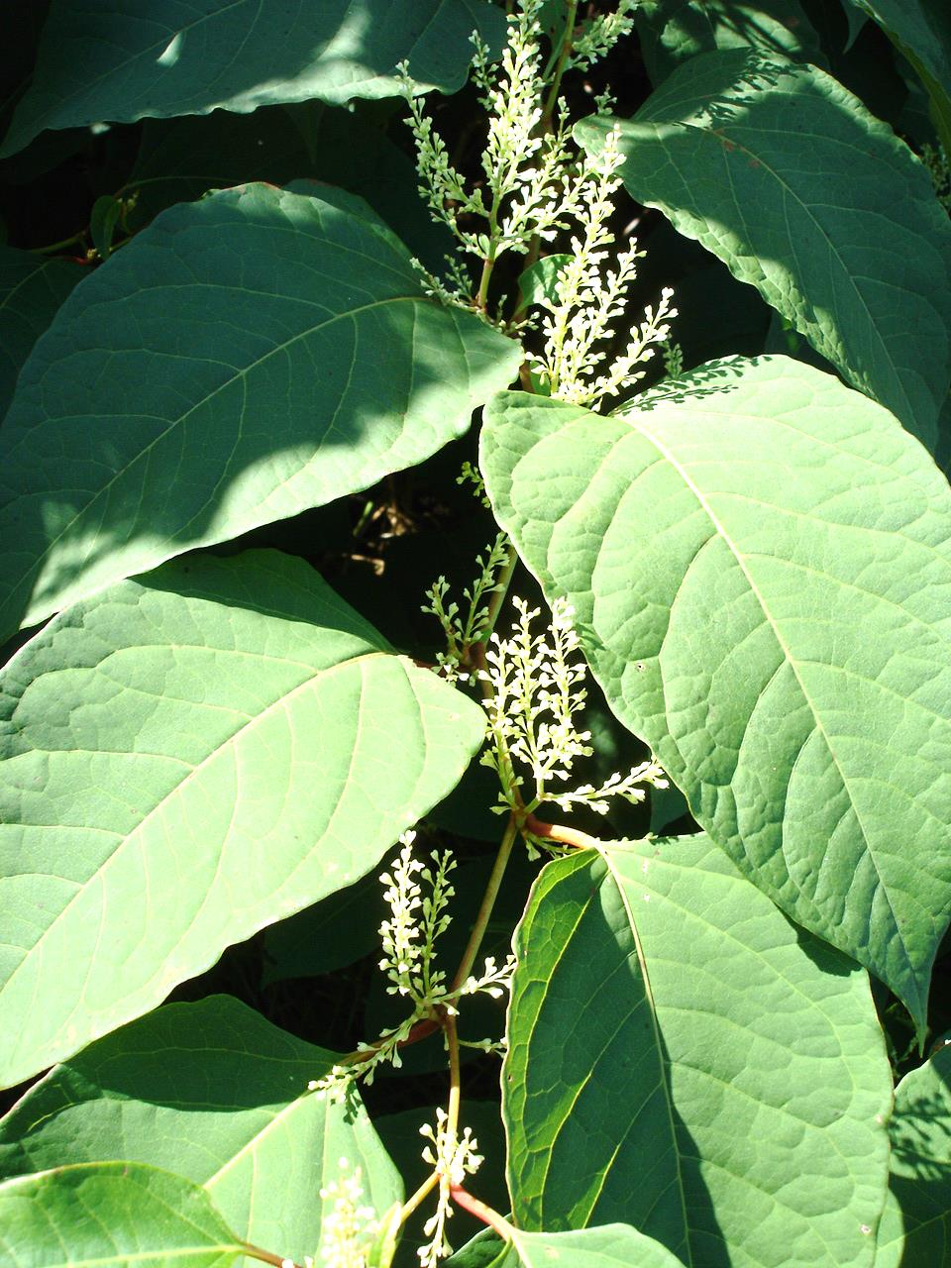
Japanese knotweed
(Fallopia japonica)
White flowers are rarely fertile
Mostly spreads by fragments – can sprout from any node ☹
Leaves alternate
Leaves wider than long, with smooth edges

Slide 30
Japanese knotweed control
Manual
Pull/dig not recommended except for isolated patches of <5 stems; must repeat
Cutting is only effective if done repeatedly (monthly for years) on small patches, or in combination with herbicide
Disposal: cuttings can sprout from any node; should be landfilled in bags or burned once dry, NEVER compost!!
Herbicide
Combo with cutting: a)after cutting to ground twice in one growing season, allow to grow waist-high, foliar spray with 2% glyphosate or triclopyr b) Cut stem between lowest nodes, spray immediately with 25% glyphosate
Remember that if you can’t spray the top, herbicide will not kill it
X Mowing* X
Notes:
Another VERY DIFFICULT plant – if you see a patch, get on it immediately!!
This plant has huge underground rhizomes so it may take YEARS to kill a large/old patch
Manual
ANY FRAGMENT can root, so you have to be VERY CAREFUL with pulled/cut material
Use extreme caution if mowing – all fragments can sprout!
Herbicide
Can do foliar spray alone but less kill and more chance of re-sprout
Imazapyr has also been used but it is significantly more expensive and is long-lasting in the soil (>1yr), so it’s not good for sites where there are mixtures with native species

Slide 31
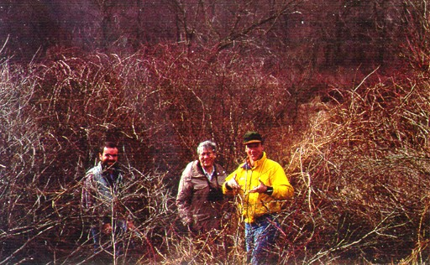
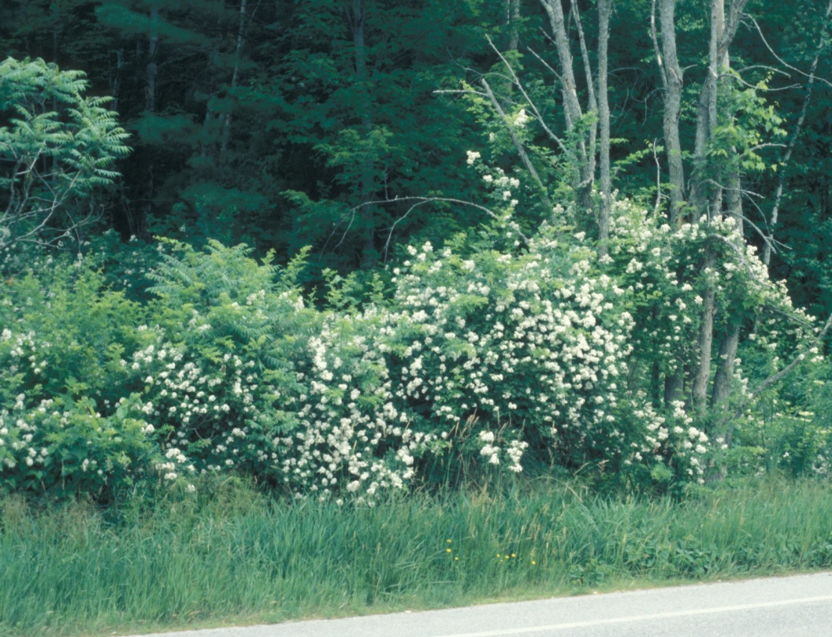
Multiflora rose
Rosa multiflora
Arching shrub
Grows in open areas to partial shade
Typical, rose-like thorns along twigs
Can even start to climb/sprawl on trees and shrubs

Slide 32
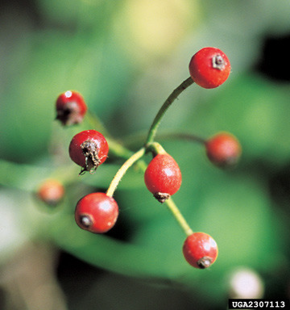
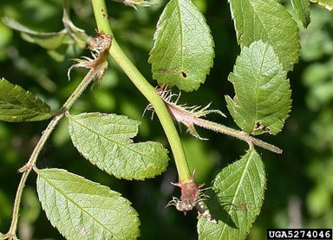
Multiflora rose
Rosa multiflora
Opposite, compound leaves
Leaf base has fringed petiole where it meets the stem – distinguishes it from all native roses
Many small, white flowers clustered at or near the twig tips
Small, red, rose “hips”

Slide 33
Multiflora rose control
Manual
Cut/pull/dig small-medium plants when soil is damp (get as much of root as possible)
Not effective by itself for larger infestations or large plants
Repeated mowing can suppress large population but will not likely kill it
Herbicide
Foliar spray with 2% glyphosate or triclopyr, using surfactant; after leaf out but before fruiting
Cut-stem treatment is difficult due to thorny canes, but will respond to 25% glyphosate or triclopyr
Combo method: Cut/mow to ground early in season, then foliar spray re-sprouts with 2% glyphosate or triclopyr
Notes:
Manual
People talk about using bulldozers to get rid of this stuff!
Herbicide
Multiflora responds pretty well to foliar spray

Slide 34
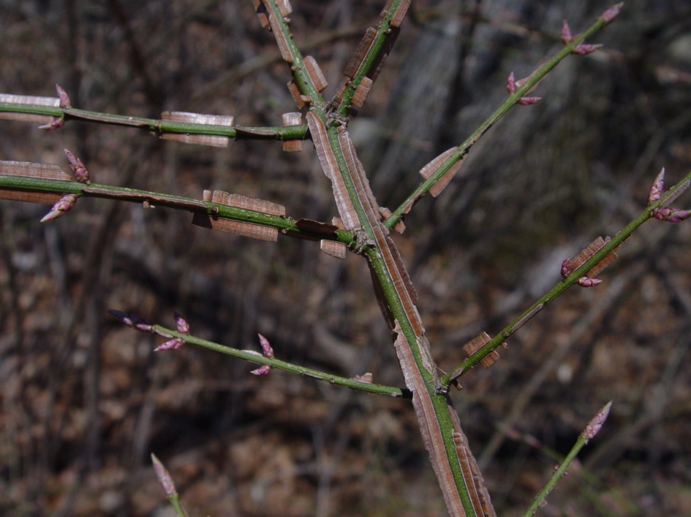
Winged euonymous aka burning bush
Euonymous alatus
Branching shrub can grow to over 10’ tall
Tolerates sun and full shade
Moist to wet soils
Corky “wings” on larger twigs

Slide 35
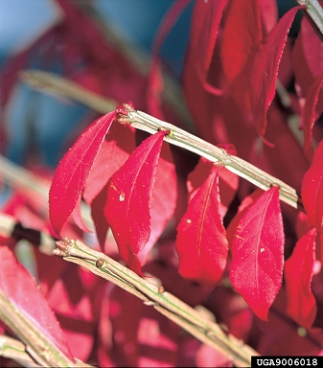
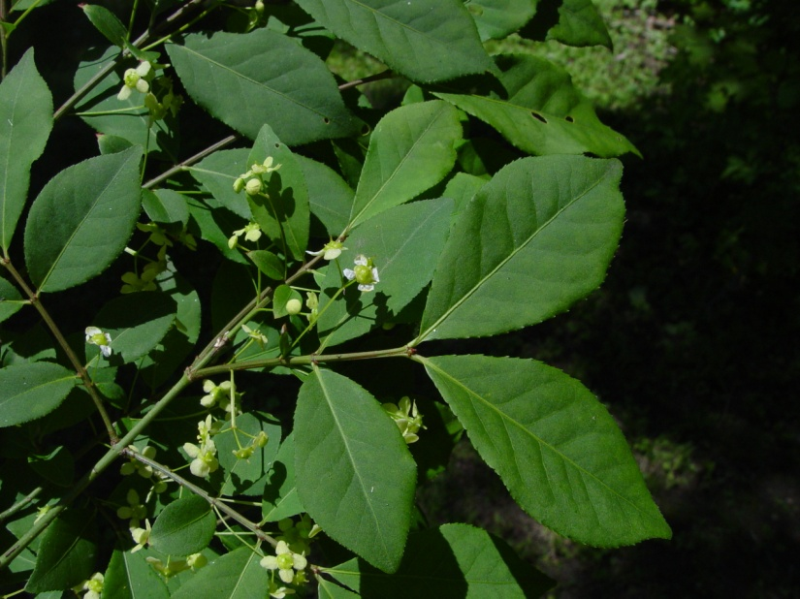
Winged euonymous aka burning bush
Euonymous alatus
Opposite leaves
Leaves taper at both ends
Foliage turns bright red in fall
Small, inconspicuous flowers
Purple capsule splits open - red fruit

Slide 36
Winged euonymus/burning bush control
Manual
Cut/pull/dig small-medium plants when soil is damp (get as much of root as possible)
For large plants, use weed wrench, then monitor and cut re-growth
Herbicide
Foliar spray with 2% glyphosate, using surfactant; after leaf out but before fruiting
Cut-stem treatment for shrubs too large for foliar spray; 25% glyphosate or triclopyr
Basal bark treatment using 25% triclopyr in oil; growing season after spring sap flow

Slide 37
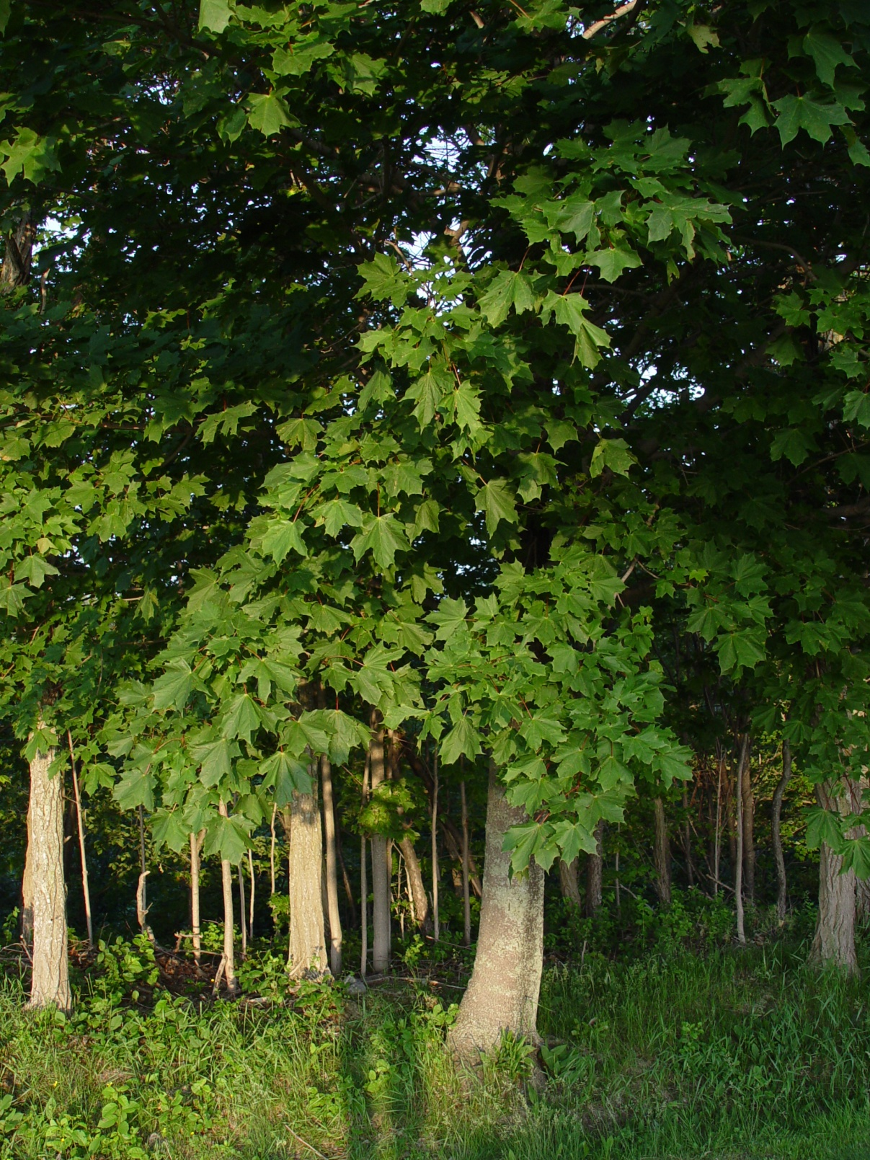
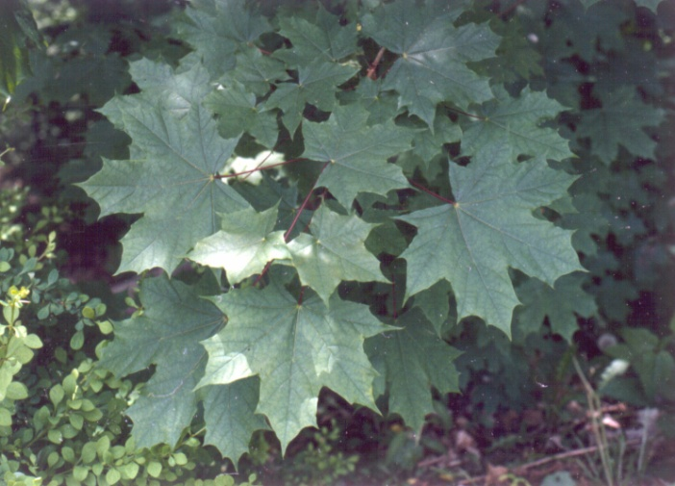
Norway maple
Acer platanoides
Canopy tree
Leaves opposite
Leaves slightly different shape than native maples
Broken leaf stem has white, milky sap, unlike native maples

Slide 38
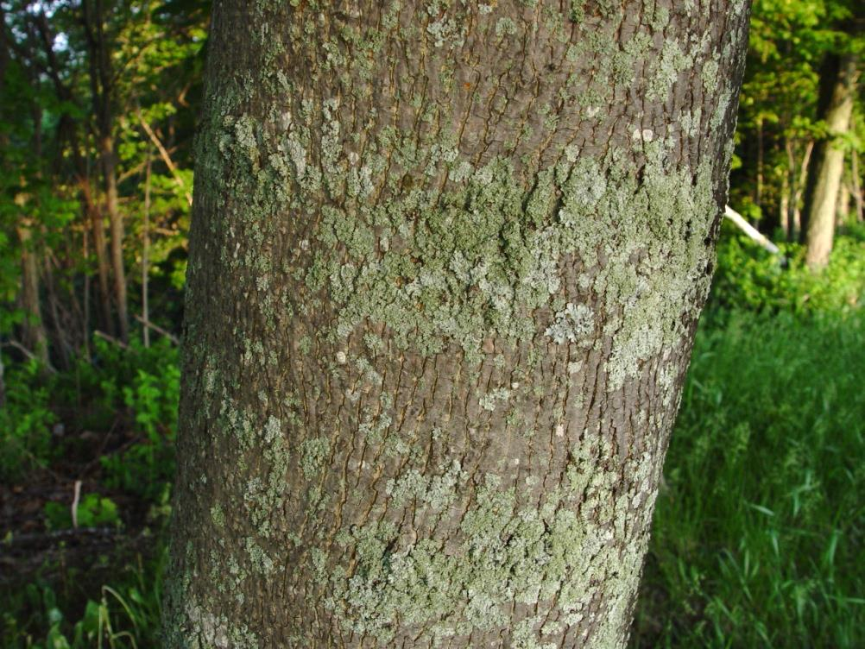
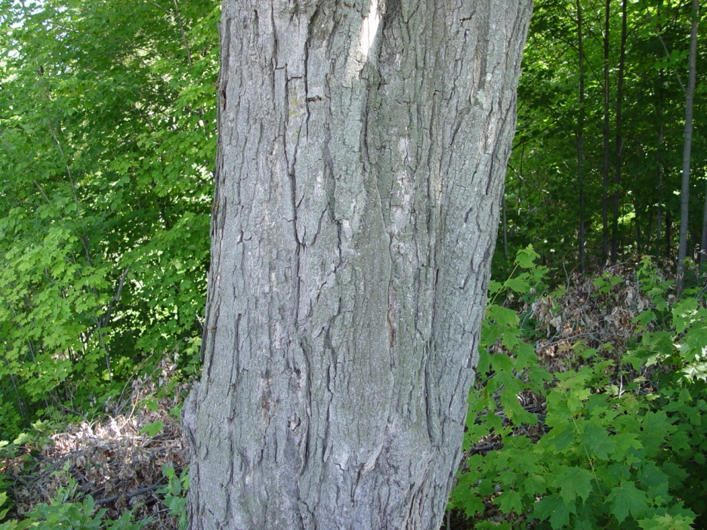
Norway maple
Acer platanoides
Bark less shaggy than native maples, more regular ridges
Fruits typical maple samaras, but with very wide angle
Saplings tolerate dense shade
Norway maple bark
Sugar maple bark

Slide 39
Norway maple control
Manual
Cut/pull/dig saplings when soil is damp (get as much of root as possible)
Cut larger trees anytime; monitor and cut (or foliar spray) re-sprouts
Girdle larger trees and apply 25-40% triclopyr amine to the cambium
Herbicide
For re-sprouts after cutting, foliar spray with 2% glyphosate, using surfactant
For small trees (<6” diameter) with thin bark, basal bark treatment using 20% triclopyr ester in oil; growing season after spring sap flow
Cut-stump treatment with 25% glyphosate

Slide 40
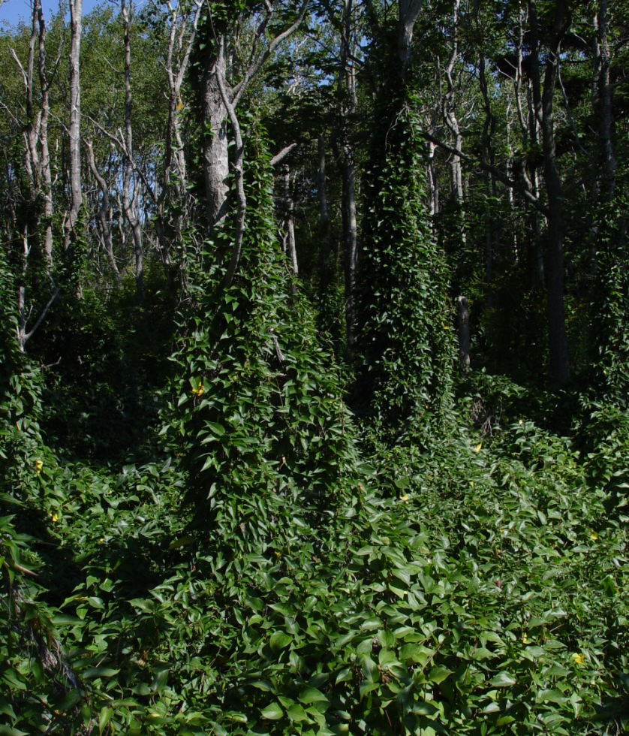
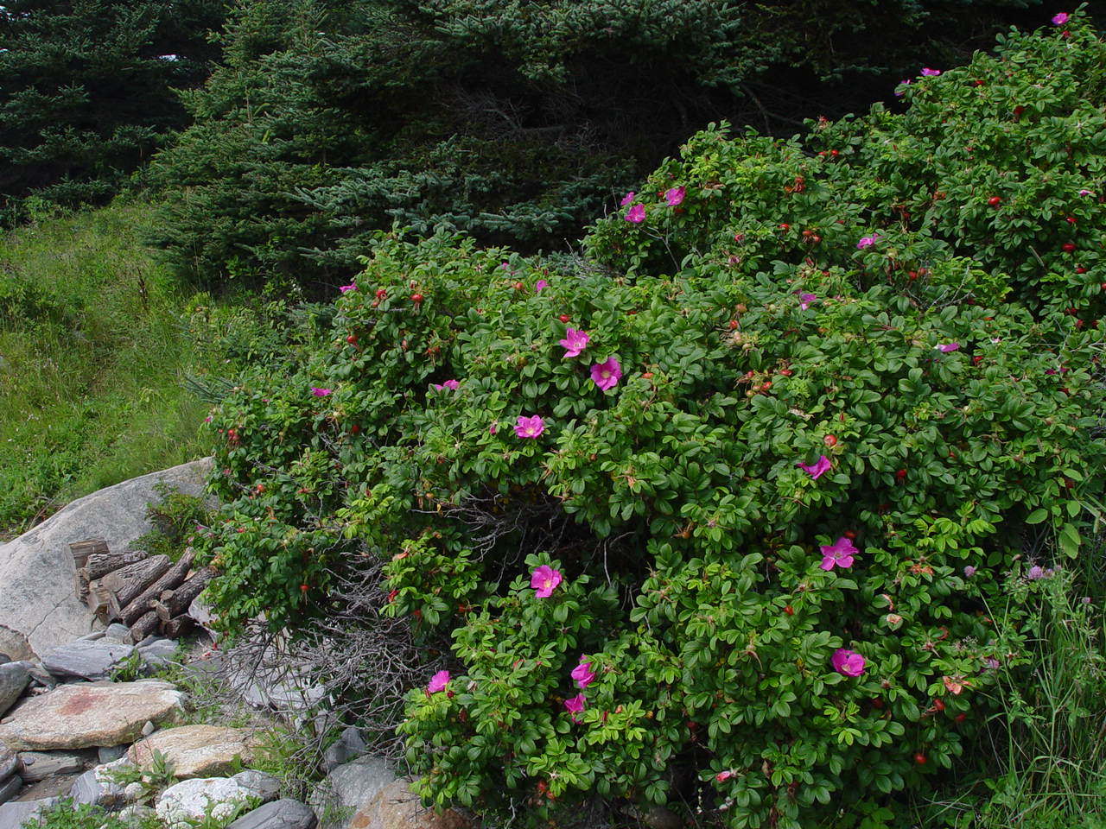
Other terrestrial invasive plants
Black swallowwort
Rugosa rose
Notes:
Rugosa rose is mostly a problem in coastal areas
Thorny shrub
Popular planting
Not native and very invasive in sandy areas
Black swallowwort is an herbaceous vine – dies back to ground in winter
Found mostly in open areas
Climbs and over-tops all kinds of vegetation
Small (<1’’ flowers), star-shaped
Milkweed-like pods disperse seeds in early fall

Slide 41
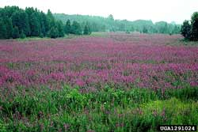
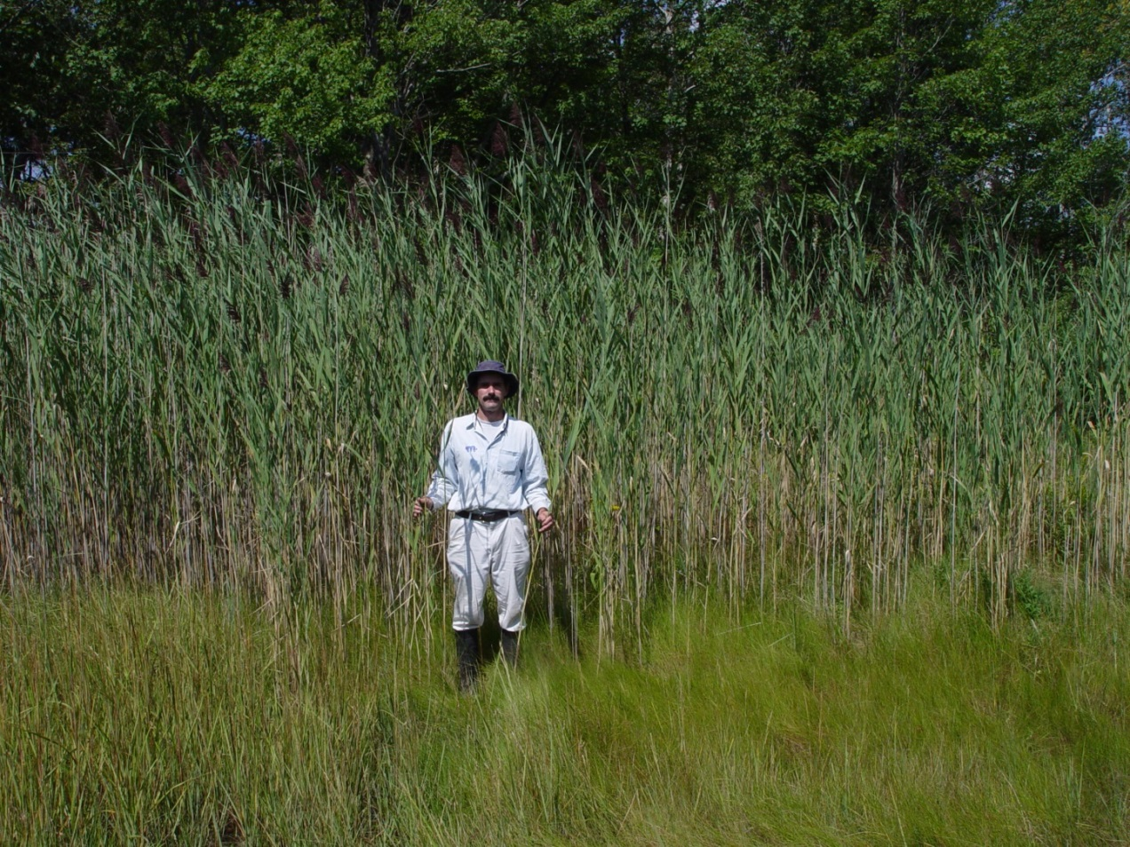
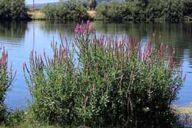
Common wetland invasive plants
These require additional permits/exemptions/variances to treat. Please consult the BPC, DEP, and/or town CEO for more info.
Purple loosestrife and common reed (aka Phragmites)

Slide 42
Species to crush (new/not yet widespread) and habitats where they are found
Upland forests and forest edges
Garlic mustard
Japanese stiltgrass*
Disturbed areas, fields
Black swallowwort
Porcelainberry
Japanese honeysuckle
Mile-a-minute weed*
Tree-of-heaven
Kudzu*
Wetlands
Perennial pepperweed
Ornamental jewelweed
Yellow iris
*Not known from Maine
Notes:
Ones with stars are known in Maine; these are the ones I think we have a chance of keeping at bay, really preventing from becoming widespread
Species we should attack with a lot of effort now (or “attack” with vigilant patrolling in places where they do not yet exist) while they are still small in extent and more easily contained.

Slide 43
A new online mapping tool for invasive species - iMapInvasives
Map locations of invasive plants using your smartphone or on your computer
See distribution data statewide
Keep track of control efforts
Free user accounts
Easy to use
www.imapinvasives.org/meimi or search for Maine iMapInvasives

Slide 44
Websites for ID
Websites for Control
GoBotany
About My Woods, What’s in My Woods section
Michigan Dept. of Natural Resources – “Invasive Species Best Control Practices”
US Forest Service PDF “A Management Guide for Invasive Plants in Southern Forests”
Acknowledgements and references
These plus
Amanda Devine,
Ron Lemin, Nancy Sferra

Slide 45
QUESTIONS?
Nancy Olmstead
Maine Natural Areas Program
Nancy.olmstead@maine.gov
287-8046

Slide 46
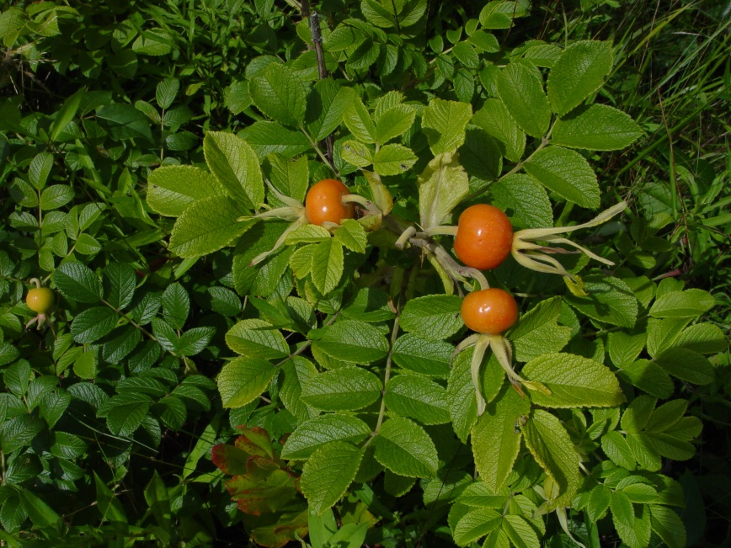
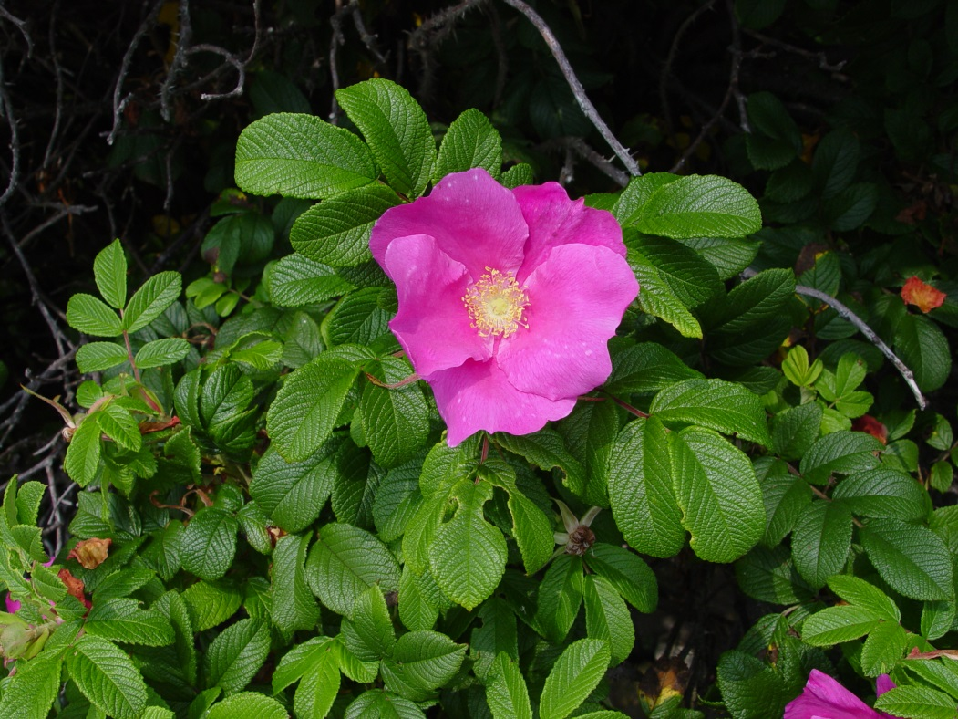
Rugosa rose aka salt-spray rose
Rosa rugosa

Slide 47
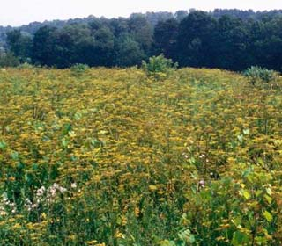
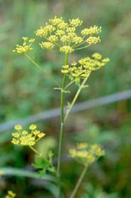
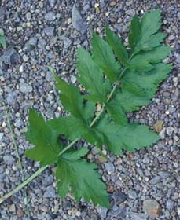
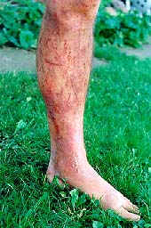
Wild parsnip
Pastinaca sativa
Biennial; photo-toxic

Slide 48
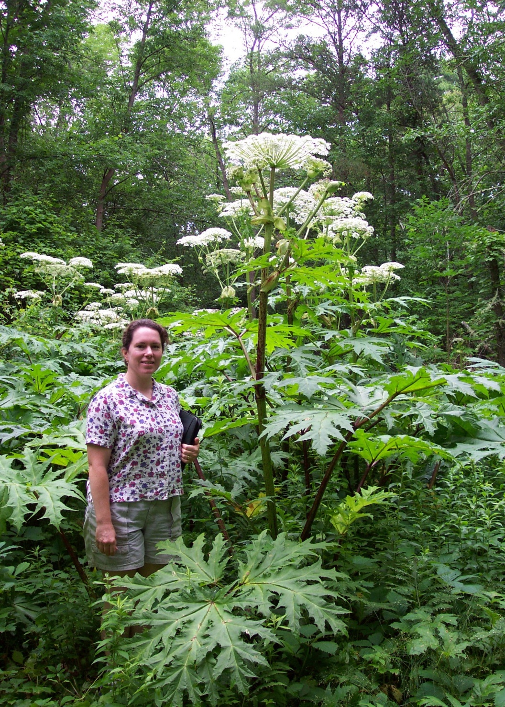
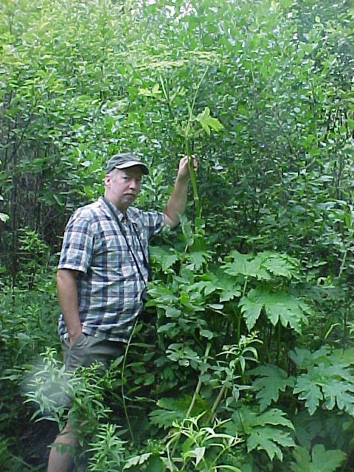
Giant Hogweed
(Heracleum mantagazzianum)
Cow Parsnip
(Heracleum maximum)
Notes:
Both strong photo-toxins

Slide 49
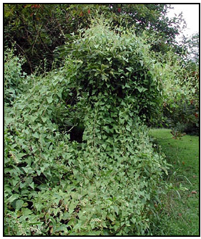
Mile-a-minute weed (Persicaria perfoliata)
Porcelain berry (Ampelopsis brevipedunculata)

Slide 50
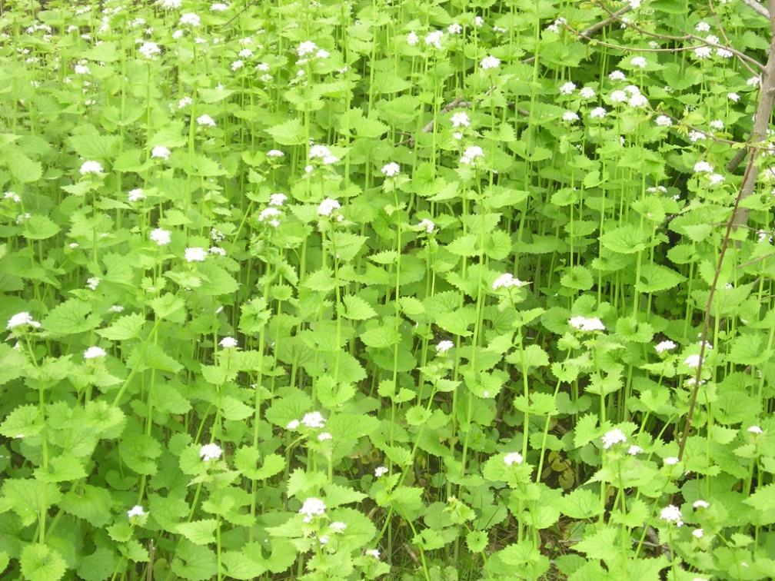
Garlic mustard
Alliaria petiolata
Biennial – careful monitoring needed
Notes:
Example of where monitoring important. Seeds cast in June buy lie dormant for 18-20 months then emerge and form basal rosettes – a stalk and flowers grow the second year. And seeds viable for 4-7 years. So even after you pull it a year later it may be back full force. Also reproduces exclusively by seed, seeds easily moved along trails and waterways by people and animals (monitoring again).
Pesto anyone?

Slide 51
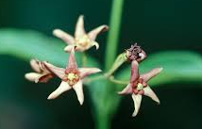
Black swallowwort & pale swallowwort
Cynanchum louiseae & C. rossicum
Notes:
Herbaceous vine
Primarily wind dispersed, toxic to wildlife and livestock, allelopathic
Common and aggressive in immediate coastal areas, prefers full sun

Slide 52
Perennial or tall pepperweed
Lepidium latifolium
Notes:
Threat to salt marshes
Annual herb
Coastal New England (NH and MA), found on riverbanks, floodplains, coastal wetlands, and marshes and will grow in hay meadows, rangelands and along roadsides
Several detections in Maine in the past 2 years – latest was just this summer
Infestation – Photo: Sarah Janson, Parker River National Wildlife Refuge, Newburyport, MA, US FWS, DOI

Slide 53
Ornamental jewelweed, Himalayan balsam
Impatiens glandulifera
Notes:
Grows in wet areas, can form dense stands that crowd out native vegetation Can be a very tall plant, up to 2m

